Slide 1


Lecture 19 Determinants formulas and cofactors
Formula for det(A)
Cofactor formula
Tridiagonal Matrices
$$n!terms$$
Attribution-NonCommercial-ShareAlike 4.0 International (CC BY-NC-SA 4.0)

Slide 2


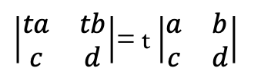

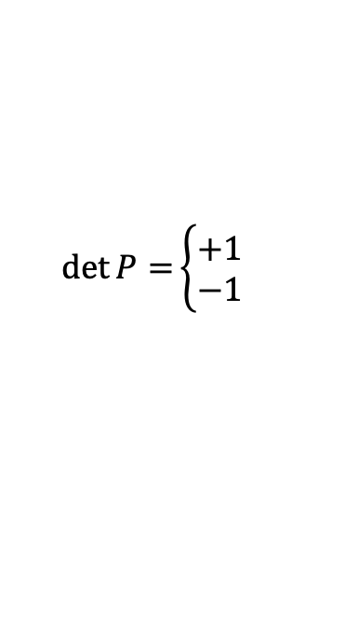

Properties of det(A)
P-01
$$\left|\begin{matrix}1 & 0 \\ 0 & 1\end{matrix}\right|=1$$
$$\det{I=}\left|I\right|=1$$
P-02
$$Exchange rows = reverse sign of the determinant$$
$$\det{P=}\left\{\begin{aligned}+1 \\ −1\end{aligned}\right.$$
Even
$$\left|\begin{matrix}0 & 1 \\ 1 & 0\end{matrix}\right|=−1$$
odd
P-03
det(A) is linear in each each row separately
A)
$\left|\begin{matrix}ta & tb \\ c & d\end{matrix}\right|$= t $\left|\begin{matrix}a & b \\ c & d\end{matrix}\right|$
B)
$\left|\begin{matrix}a+a′ & b+b′ \\ c & d\end{matrix}\right|$= $\left|\begin{matrix}a & b \\ c & d\end{matrix}\right|$+ $\left|\begin{matrix}a′ & b′ \\ c & d\end{matrix}\right|$

Slide 3
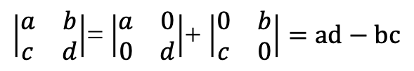

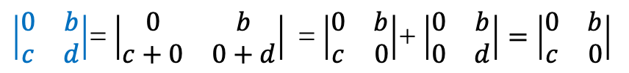
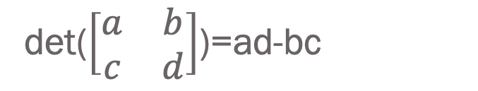
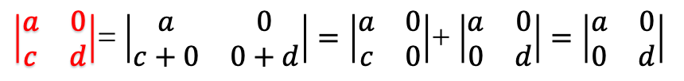
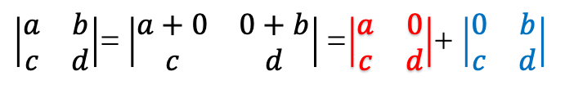

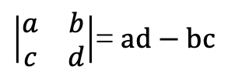
det($\left[\begin{matrix}a & b \\ c & d\end{matrix}\right]$)=ad-bc
$$1)\left|\begin{matrix}1 & 0 \\ 0 & 1\end{matrix}\right|=1$$
$$2)\left|\begin{matrix}0 & 1 \\ 1 & 0\end{matrix}\right|=−1$$
$\left|\begin{matrix}a & b \\ c & d\end{matrix}\right|$= $\left|\begin{matrix}a+0 & 0+b \\ c & d\end{matrix}\right|$ =$\left|\begin{matrix}a & 0 \\ c & d\end{matrix}\right|$+ $\left|\begin{matrix}0 & b \\ c & d\end{matrix}\right|$
$\left|\begin{matrix}a & 0 \\ c & d\end{matrix}\right|$= $\left|\begin{matrix}a & 0 \\ c+0 & 0+d\end{matrix}\right|=\left|\begin{matrix}a & 0 \\ c & 0\end{matrix}\right|$+ $\left|\begin{matrix}a & 0 \\ 0 & d\end{matrix}\right|=\left|\begin{matrix}a & 0 \\ 0 & d\end{matrix}\right|$
$\left|\begin{matrix}0 & b \\ c & d\end{matrix}\right|$= $\left|\begin{matrix}0 & b \\ c+0 & 0+d\end{matrix}\right|$ = $\left|\begin{matrix}0 & b \\ c & 0\end{matrix}\right|$+ $\left|\begin{matrix}0 & b \\ 0 & d\end{matrix}\right|=\left|\begin{matrix}0 & b \\ c & 0\end{matrix}\right|$
$\left|\begin{matrix}a & b \\ c & d\end{matrix}\right|$= $\left|\begin{matrix}a & 0 \\ 0 & d\end{matrix}\right|$+ $\left|\begin{matrix}0 & b \\ c & 0\end{matrix}\right|=ad−bc$
$\left|\begin{matrix}a & b \\ c & d\end{matrix}\right|$= $ad−bc$
QED

Slide 4
det($\left[\begin{matrix}a & b \\ c & d\end{matrix}\right]$)=ad-bc
$$1)\left|\begin{matrix}1 & 0 \\ 0 & 1\end{matrix}\right|=1$$
$$2)\left|\begin{matrix}0 & 1 \\ 1 & 0\end{matrix}\right|=−1$$
$\left|\begin{matrix}a & b \\ c & d\end{matrix}\right|$= $\left|\begin{matrix}a+0 & 0+b \\ c & d\end{matrix}\right|$ =$\left|\begin{matrix}a & 0 \\ c & d\end{matrix}\right|$+ $\left|\begin{matrix}0 & b \\ c & d\end{matrix}\right|$
$\left|\begin{matrix}a & 0 \\ c & d\end{matrix}\right|$= $\left|\begin{matrix}a & 0 \\ c+0 & 0+d\end{matrix}\right|=\left|\begin{matrix}a & 0 \\ c & 0\end{matrix}\right|$+ $\left|\begin{matrix}a & 0 \\ 0 & d\end{matrix}\right|=\left|\begin{matrix}a & 0 \\ 0 & d\end{matrix}\right|$
$\left|\begin{matrix}0 & b \\ c & d\end{matrix}\right|$= $\left|\begin{matrix}0 & b \\ c+0 & 0+d\end{matrix}\right|$ = $\left|\begin{matrix}0 & b \\ c & 0\end{matrix}\right|$+ $\left|\begin{matrix}0 & b \\ 0 & d\end{matrix}\right|=\left|\begin{matrix}0 & b \\ c & 0\end{matrix}\right|$
$\left|\begin{matrix}a & b \\ c & d\end{matrix}\right|$= $\left|\begin{matrix}a & 0 \\ 0 & d\end{matrix}\right|$+ $\left|\begin{matrix}0 & b \\ c & 0\end{matrix}\right|=ad−bc$
$\left|\begin{matrix}a & b \\ c & d\end{matrix}\right|$= $ad−bc$
QED

Slide 5

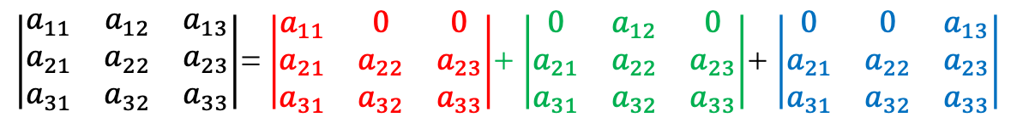
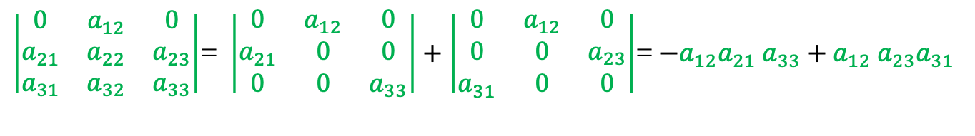

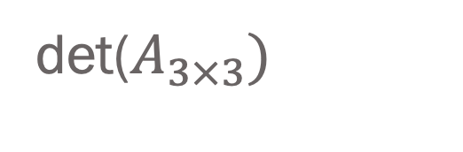



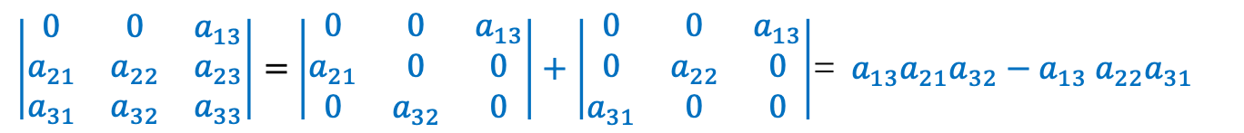
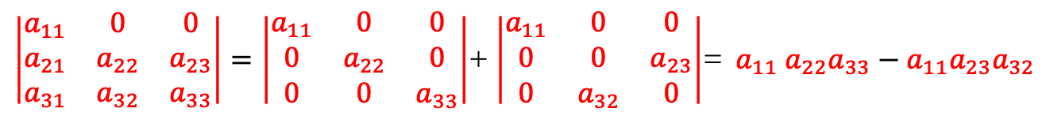

det($A_{3×3})$
$\left|\begin{matrix}a_{11} & a_{12} & a_{13} \\ a_{21} & a_{22} & a_{23} \\ a_{31} & a_{32} & a_{33}\end{matrix}\right|$= $\left|\begin{matrix}a_{11} & 0 & 0 \\ a_{21} & a_{22} & a_{23} \\ a_{31} & a_{32} & a_{33}\end{matrix}\right|$+ $\left|\begin{matrix}0 & a_{12} & 0 \\ a_{21} & a_{22} & a_{23} \\ a_{31} & a_{32} & a_{33}\end{matrix}\right|$+ $\left|\begin{matrix}0 & 0 & a_{13} \\ a_{21} & a_{22} & a_{23} \\ a_{31} & a_{32} & a_{33}\end{matrix}\right|$
$\left|\begin{matrix}a_{11} & 0 & 0 \\ a_{21} & a_{22} & a_{23} \\ a_{31} & a_{32} & a_{33}\end{matrix}\right|=\left|\begin{matrix}a_{11} & 0 & 0 \\ 0 & a_{22} & 0 \\ 0 & 0 & a_{33}\end{matrix}\right|$+ $\left|\begin{matrix}a_{11} & 0 & 0 \\ 0 & 0 & a_{23} \\ 0 & a_{32} & 0\end{matrix}\right|$= ${ a}_{11}$ $a_{22}a_{33}−a_{11}a_{23}a_{32}$
$a_{11}$ $a_{22}a_{33}$
$$a_{11}a_{23}a_{32}$$
$\left|\begin{matrix}0 & a_{12} & 0 \\ a_{21} & a_{22} & a_{23} \\ a_{31} & a_{32} & a_{33}\end{matrix}\right|$= $\left|\begin{matrix}0 & a_{12} & 0 \\ a_{21} & 0 & 0 \\ 0 & 0 & a_{33}\end{matrix}\right|+\left|\begin{matrix}0 & a_{12} & 0 \\ 0 & 0 & a_{23} \\ a_{31} & 0 & 0\end{matrix}\right|$= $−a_{12}a_{21}$ $a_{33}+a_{12} a_{23}a_{31}$
$a_{12}a_{21}$ $a_{33}$
$a_{12}$ $a_{23}a_{31}$
$\left|\begin{matrix}0 & 0 & a_{13} \\ a_{21} & a_{22} & a_{23} \\ a_{31} & a_{32} & a_{33}\end{matrix}\right|=$ $\left|\begin{matrix}0 & 0 & a_{13} \\ a_{21} & 0 & 0 \\ 0 & a_{32} & 0\end{matrix}\right|+\left|\begin{matrix}0 & 0 & a_{13} \\ 0 & a_{22} & 0 \\ a_{31} & 0 & 0\end{matrix}\right|$= $a_{13}a_{21}a_{32}−a_{13} a_{22}a_{31}$
$$a_{13}a_{21}a_{32}$$
$a_{13}$ $a_{22}a_{31}$

Slide 6
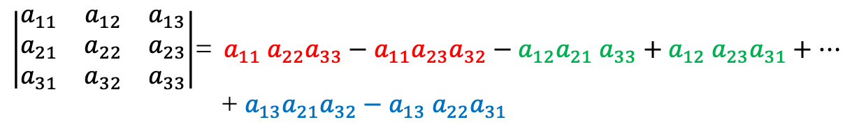
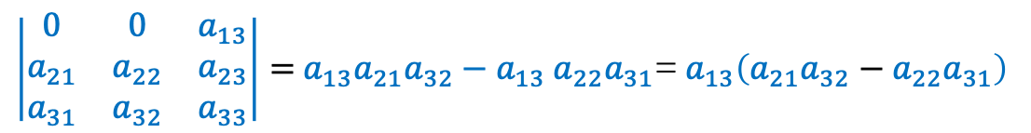
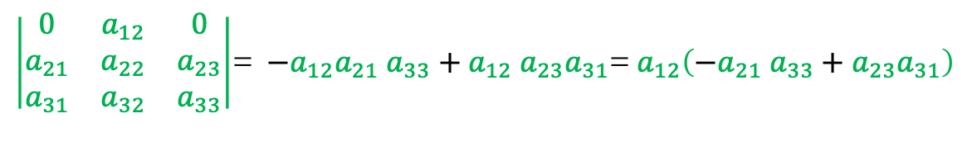
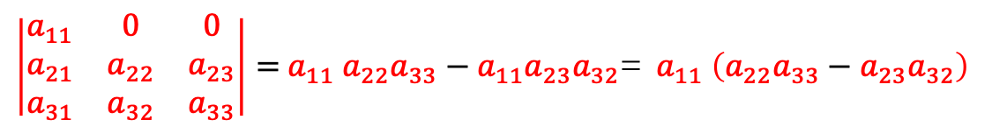
det($A_{3×3})$
$\left|\begin{matrix}a_{11} & a_{12} & a_{13} \\ a_{21} & a_{22} & a_{23} \\ a_{31} & a_{32} & a_{33}\end{matrix}\right|$= $\left|\begin{matrix}a_{11} & 0 & 0 \\ a_{21} & a_{22} & a_{23} \\ a_{31} & a_{32} & a_{33}\end{matrix}\right|$+ $\left|\begin{matrix}0 & a_{12} & 0 \\ a_{21} & a_{22} & a_{23} \\ a_{31} & a_{32} & a_{33}\end{matrix}\right|$+ $\left|\begin{matrix}0 & 0 & a_{13} \\ a_{21} & a_{22} & a_{23} \\ a_{31} & a_{32} & a_{33}\end{matrix}\right|$
$\left|\begin{matrix}a_{11} & 0 & 0 \\ a_{21} & a_{22} & a_{23} \\ a_{31} & a_{32} & a_{33}\end{matrix}\right|={ a}_{11}$ $a_{22}a_{33}−a_{11}a_{23}a_{32}$= ${ a}_{11}$ $\left(a_{22}a_{33}−a_{23}a_{32}\right)$
$\left|\begin{matrix}0 & a_{12} & 0 \\ a_{21} & a_{22} & a_{23} \\ a_{31} & a_{32} & a_{33}\end{matrix}\right|$= $−a_{12}a_{21}$ $a_{33}+a_{12} a_{23}a_{31}$= $a_{12}\left(−a_{21} a_{33}+a_{23}a_{31}\right)$
$\left|\begin{matrix}0 & 0 & a_{13} \\ a_{21} & a_{22} & a_{23} \\ a_{31} & a_{32} & a_{33}\end{matrix}\right|=$ $a_{13}a_{21}a_{32}−a_{13} a_{22}a_{31}$= $a_{13}\left(a_{21}a_{32}−a_{22}a_{31}\right)$
$\left|\begin{matrix}a_{11} & a_{12} & a_{13} \\ a_{21} & a_{22} & a_{23} \\ a_{31} & a_{32} & a_{33}\end{matrix}\right|$= ${ a}_{11}$ $a_{22}a_{33}−a_{11}a_{23}a_{32}−a_{12}a_{21} a_{33}+a_{12} a_{23}a_{31}+…$
+ $a_{13}a_{21}a_{32}−a_{13} a_{22}a_{31}$

Slide 7
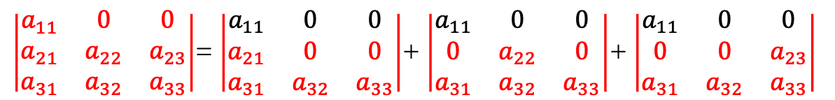
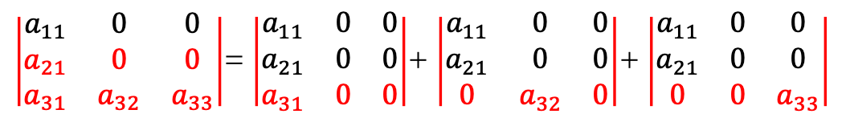
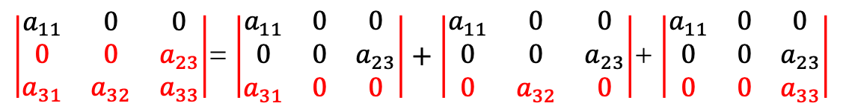
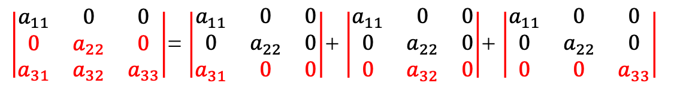
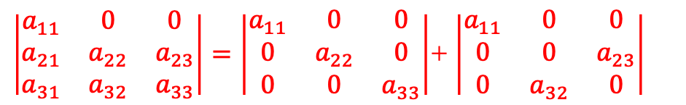
det($A_{3×3})$
$\left|\begin{matrix}a_{11} & 0 & 0 \\ a_{21} & a_{22} & a_{23} \\ a_{31} & a_{32} & a_{33}\end{matrix}\right|$= $\left|\begin{matrix}a_{11} & 0 & 0 \\ a_{21} & 0 & 0 \\ a_{31} & a_{32} & a_{33}\end{matrix}\right|$+ $\left|\begin{matrix}a_{11} & 0 & 0 \\ 0 & a_{22} & 0 \\ a_{31} & a_{32} & a_{33}\end{matrix}\right|$+ $\left|\begin{matrix}a_{11} & 0 & 0 \\ 0 & 0 & a_{23} \\ a_{31} & a_{32} & a_{33}\end{matrix}\right|$
$\left|\begin{matrix}a_{11} & 0 & 0 \\ a_{21} & 0 & 0 \\ a_{31} & a_{32} & a_{33}\end{matrix}\right|$= $\left|\begin{matrix}a_{11} & 0 & 0 \\ a_{21} & 0 & 0 \\ a_{31} & 0 & 0\end{matrix}\right|$+ $\left|\begin{matrix}a_{11} & 0 & 0 \\ a_{21} & 0 & 0 \\ 0 & a_{32} & 0\end{matrix}\right|$+ $\left|\begin{matrix}a_{11} & 0 & 0 \\ a_{21} & 0 & 0 \\ 0 & 0 & a_{33}\end{matrix}\right|$
$\left|\begin{matrix}a_{11} & 0 & 0 \\ 0 & a_{22} & 0 \\ a_{31} & a_{32} & a_{33}\end{matrix}\right|$= $\left|\begin{matrix}a_{11} & 0 & 0 \\ 0 & a_{22} & 0 \\ a_{31} & 0 & 0\end{matrix}\right|$+ $\left|\begin{matrix}a_{11} & 0 & 0 \\ 0 & a_{22} & 0 \\ 0 & a_{32} & 0\end{matrix}\right|$+ $\left|\begin{matrix}a_{11} & 0 & 0 \\ 0 & a_{22} & 0 \\ 0 & 0 & a_{33}\end{matrix}\right|$
$\left|\begin{matrix}a_{11} & 0 & 0 \\ 0 & 0 & a_{23} \\ a_{31} & a_{32} & a_{33}\end{matrix}\right|$= $\left|\begin{matrix}a_{11} & 0 & 0 \\ 0 & 0 & a_{23} \\ a_{31} & 0 & 0\end{matrix}\right|+\left|\begin{matrix}a_{11} & 0 & 0 \\ 0 & 0 & a_{23} \\ 0 & a_{32} & 0\end{matrix}\right|$+ $\left|\begin{matrix}a_{11} & 0 & 0 \\ 0 & 0 & a_{23} \\ 0 & 0 & a_{33}\end{matrix}\right|$
$\left|\begin{matrix}a_{11} & 0 & 0 \\ a_{21} & a_{22} & a_{23} \\ a_{31} & a_{32} & a_{33}\end{matrix}\right|=\left|\begin{matrix}a_{11} & 0 & 0 \\ 0 & a_{22} & 0 \\ 0 & 0 & a_{33}\end{matrix}\right|$+ $\left|\begin{matrix}a_{11} & 0 & 0 \\ 0 & 0 & a_{23} \\ 0 & a_{32} & 0\end{matrix}\right|$

Slide 8
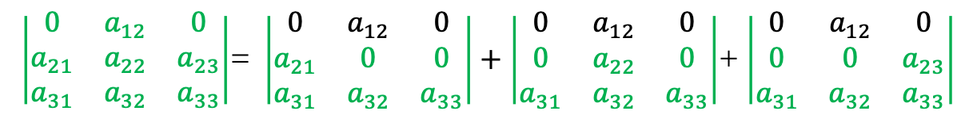
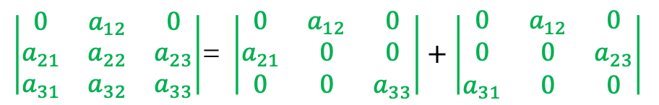
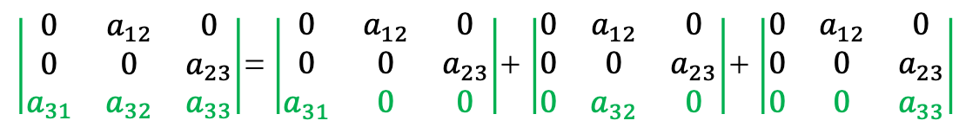
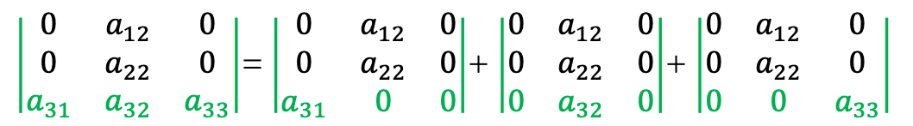
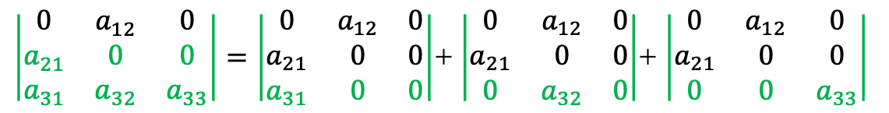
det($A_{3×3})$
$\left|\begin{matrix}0 & a_{12} & 0 \\ a_{21} & a_{22} & a_{23} \\ a_{31} & a_{32} & a_{33}\end{matrix}\right|$= $\left|\begin{matrix}0 & a_{12} & 0 \\ a_{21} & 0 & 0 \\ a_{31} & a_{32} & a_{33}\end{matrix}\right|+\left|\begin{matrix}0 & a_{12} & 0 \\ 0 & a_{22} & 0 \\ a_{31} & a_{32} & a_{33}\end{matrix}\right|$+ $\left|\begin{matrix}0 & a_{12} & 0 \\ 0 & 0 & a_{23} \\ a_{31} & a_{32} & a_{33}\end{matrix}\right|$
$\left|\begin{matrix}0 & a_{12} & 0 \\ a_{21} & 0 & 0 \\ a_{31} & a_{32} & a_{33}\end{matrix}\right|=\left|\begin{matrix}0 & a_{12} & 0 \\ a_{21} & 0 & 0 \\ a_{31} & 0 & 0\end{matrix}\right|$+ $\left|\begin{matrix}0 & a_{12} & 0 \\ a_{21} & 0 & 0 \\ 0 & a_{32} & 0\end{matrix}\right|$+ $\left|\begin{matrix}0 & a_{12} & 0 \\ a_{21} & 0 & 0 \\ 0 & 0 & a_{33}\end{matrix}\right|$
$\left|\begin{matrix}0 & a_{12} & 0 \\ 0 & a_{22} & 0 \\ a_{31} & a_{32} & a_{33}\end{matrix}\right|$= $\left|\begin{matrix}0 & a_{12} & 0 \\ 0 & a_{22} & 0 \\ a_{31} & 0 & 0\end{matrix}\right|$+ $\left|\begin{matrix}0 & a_{12} & 0 \\ 0 & a_{22} & 0 \\ 0 & a_{32} & 0\end{matrix}\right|$+ $\left|\begin{matrix}0 & a_{12} & 0 \\ 0 & a_{22} & 0 \\ 0 & 0 & a_{33}\end{matrix}\right|$
$\left|\begin{matrix}0 & a_{12} & 0 \\ 0 & 0 & a_{23} \\ a_{31} & a_{32} & a_{33}\end{matrix}\right|$= $\left|\begin{matrix}0 & a_{12} & 0 \\ 0 & 0 & a_{23} \\ a_{31} & 0 & 0\end{matrix}\right|$+ $\left|\begin{matrix}0 & a_{12} & 0 \\ 0 & 0 & a_{23} \\ 0 & a_{32} & 0\end{matrix}\right|$+ $\left|\begin{matrix}0 & a_{12} & 0 \\ 0 & 0 & a_{23} \\ 0 & 0 & a_{33}\end{matrix}\right|$
$\left|\begin{matrix}0 & a_{12} & 0 \\ a_{21} & a_{22} & a_{23} \\ a_{31} & a_{32} & a_{33}\end{matrix}\right|$= $\left|\begin{matrix}0 & a_{12} & 0 \\ a_{21} & 0 & 0 \\ 0 & 0 & a_{33}\end{matrix}\right|+\left|\begin{matrix}0 & a_{12} & 0 \\ 0 & 0 & a_{23} \\ a_{31} & 0 & 0\end{matrix}\right|$

Slide 9
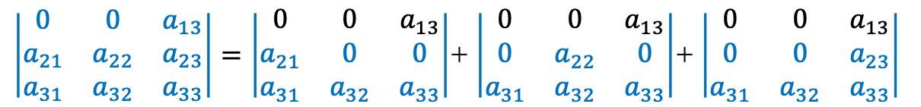
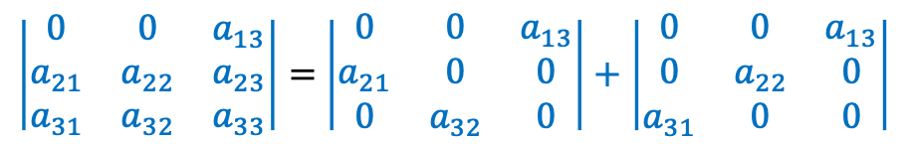
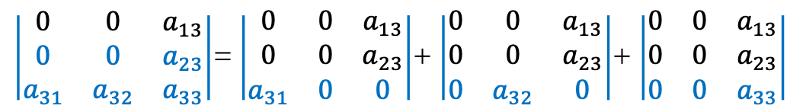
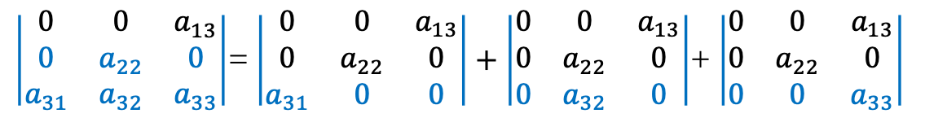
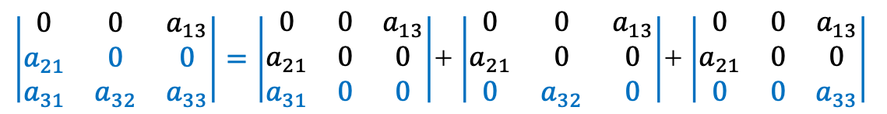
det($A_{3×3})$
$\left|\begin{matrix}0 & 0 & a_{13} \\ a_{21} & a_{22} & a_{23} \\ a_{31} & a_{32} & a_{33}\end{matrix}\right|=\left|\begin{matrix}0 & 0 & a_{13} \\ a_{21} & 0 & 0 \\ a_{31} & a_{32} & a_{33}\end{matrix}\right|$+ $\left|\begin{matrix}0 & 0 & a_{13} \\ 0 & a_{22} & 0 \\ a_{31} & a_{32} & a_{33}\end{matrix}\right|$+ $\left|\begin{matrix}0 & 0 & a_{13} \\ 0 & 0 & a_{23} \\ a_{31} & a_{32} & a_{33}\end{matrix}\right|$
$\left|\begin{matrix}0 & 0 & a_{13} \\ a_{21} & 0 & 0 \\ a_{31} & a_{32} & a_{33}\end{matrix}\right|=\left|\begin{matrix}0 & 0 & a_{13} \\ a_{21} & 0 & 0 \\ a_{31} & 0 & 0\end{matrix}\right|$+ $\left|\begin{matrix}0 & 0 & a_{13} \\ a_{21} & 0 & 0 \\ 0 & a_{32} & 0\end{matrix}\right|$+ $\left|\begin{matrix}0 & 0 & a_{13} \\ a_{21} & 0 & 0 \\ 0 & 0 & a_{33}\end{matrix}\right|$
$\left|\begin{matrix}0 & 0 & a_{13} \\ 0 & a_{22} & 0 \\ a_{31} & a_{32} & a_{33}\end{matrix}\right|$= $\left|\begin{matrix}0 & 0 & a_{13} \\ 0 & a_{22} & 0 \\ a_{31} & 0 & 0\end{matrix}\right|+\left|\begin{matrix}0 & 0 & a_{13} \\ 0 & a_{22} & 0 \\ 0 & a_{32} & 0\end{matrix}\right|$+ $\left|\begin{matrix}0 & 0 & a_{13} \\ 0 & a_{22} & 0 \\ 0 & 0 & a_{33}\end{matrix}\right|$
$\left|\begin{matrix}0 & 0 & a_{13} \\ 0 & 0 & a_{23} \\ a_{31} & a_{32} & a_{33}\end{matrix}\right|$= $\left|\begin{matrix}0 & 0 & a_{13} \\ 0 & 0 & a_{23} \\ a_{31} & 0 & 0\end{matrix}\right|$+ $\left|\begin{matrix}0 & 0 & a_{13} \\ 0 & 0 & a_{23} \\ 0 & a_{32} & 0\end{matrix}\right|$+ $\left|\begin{matrix}0 & 0 & a_{13} \\ 0 & 0 & a_{23} \\ 0 & 0 & a_{33}\end{matrix}\right|$
$\left|\begin{matrix}0 & 0 & a_{13} \\ a_{21} & a_{22} & a_{23} \\ a_{31} & a_{32} & a_{33}\end{matrix}\right|=$ $\left|\begin{matrix}0 & 0 & a_{13} \\ a_{21} & 0 & 0 \\ 0 & a_{32} & 0\end{matrix}\right|+\left|\begin{matrix}0 & 0 & a_{13} \\ 0 & a_{22} & 0 \\ a_{31} & 0 & 0\end{matrix}\right|$

Slide 10
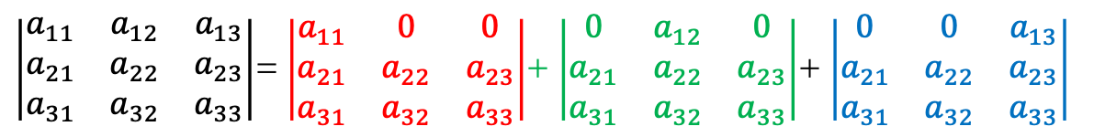
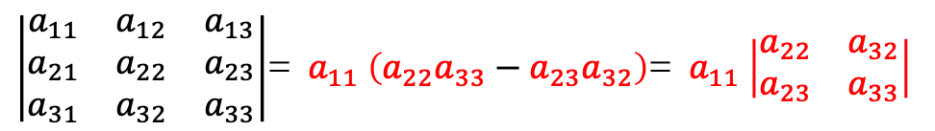
det($A_{3×3})$
3! = 6 terms
$\left|\begin{matrix}a_{11} & a_{12} & a_{13} \\ a_{21} & a_{22} & a_{23} \\ a_{31} & a_{32} & a_{33}\end{matrix}\right|$= $\left|\begin{matrix}a_{11} & 0 & 0 \\ a_{21} & a_{22} & a_{23} \\ a_{31} & a_{32} & a_{33}\end{matrix}\right|$+ $\left|\begin{matrix}0 & a_{12} & 0 \\ a_{21} & a_{22} & a_{23} \\ a_{31} & a_{32} & a_{33}\end{matrix}\right|$+ $\left|\begin{matrix}0 & 0 & a_{13} \\ a_{21} & a_{22} & a_{23} \\ a_{31} & a_{32} & a_{33}\end{matrix}\right|$
$\left|\begin{matrix}a_{11} & a_{12} & a_{13} \\ a_{21} & a_{22} & a_{23} \\ a_{31} & a_{32} & a_{33}\end{matrix}\right|$= ${ a}_{11}$ $\left(a_{22}a_{33}−a_{23}a_{32}\right)$= ${ a}_{11}$ $\left|\begin{matrix}a_{22} & a_{32} \\ a_{23} & a_{33}\end{matrix}\right|$

Slide 11
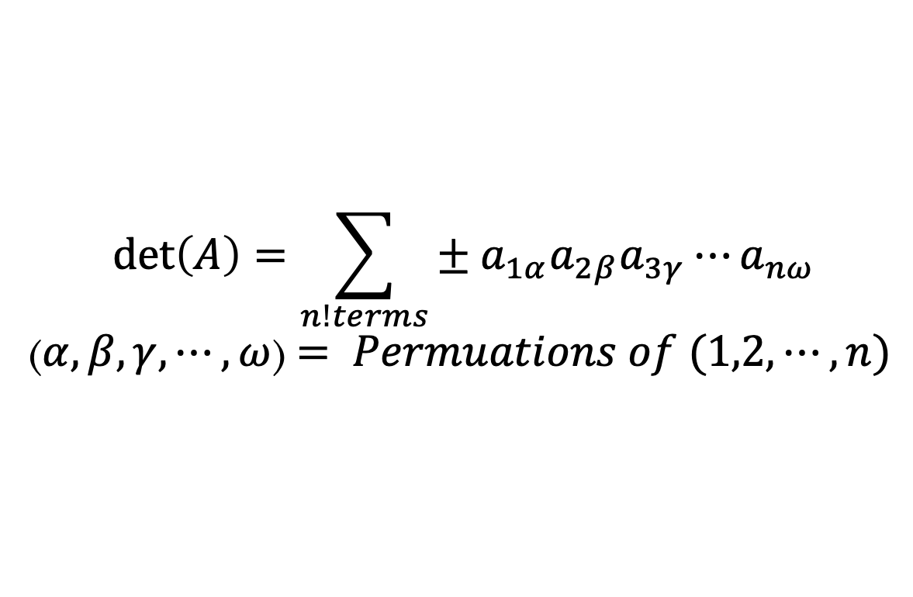


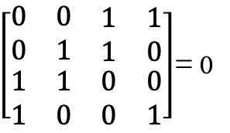
Big Formula
$$\det\left(A\right)=\sum_{n!terms}{{± a}_{1α}a_{2β}a_{3γ}⋯a_{nω}}$$
($α,β,γ,⋯,ω$) $= Permuations of (1,2, ⋯,n)$
Example:
$\left[\begin{matrix}0 & 0 & \begin{matrix}1 & 1\end{matrix} \\ 0 & 1 & \begin{matrix}1 & 0\end{matrix} \\ \begin{matrix}1 \\ 1\end{matrix} & \begin{matrix}1 \\ 0\end{matrix} & \begin{matrix}\begin{matrix}0 & 0\end{matrix} \\ \begin{matrix}0 & 1\end{matrix}\end{matrix}\end{matrix}\right]$= 0
$$\left(4,3,2,1\right)→ +1$$
$$\left(3,2,1,4\right)→−1$$
Notes:
Mejorar esta diapositiva

Slide 12
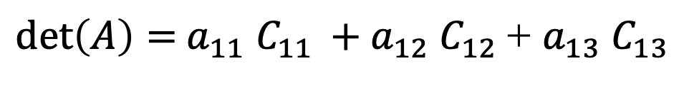
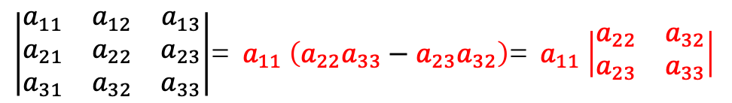
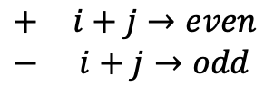

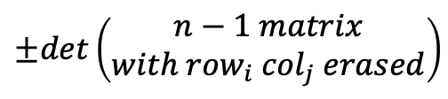

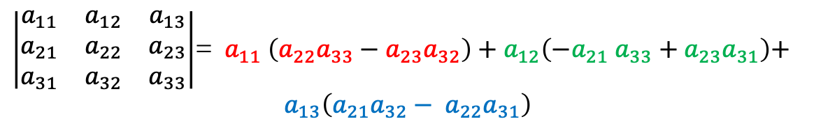
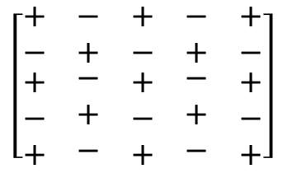
Cofactor Formula
$\left|\begin{matrix}a_{11} & a_{12} & a_{13} \\ a_{21} & a_{22} & a_{23} \\ a_{31} & a_{32} & a_{33}\end{matrix}\right|$= ${ a}_{11}$ $a_{22}a_{33}−a_{11}a_{23}a_{32}−a_{12}a_{21} a_{33}+a_{12} a_{23}a_{31}+…$
+ $a_{13}a_{21}a_{32}−a_{13} a_{22}a_{31}$
$$\left[\begin{matrix}+ & − & \begin{matrix}+ & − & +\end{matrix} \\ − & + & \begin{matrix}− & + & −\end{matrix} \\ \begin{matrix}+ \\ − \\ +\end{matrix} & \begin{matrix}− \\ + \\ −\end{matrix} & \begin{matrix}\begin{matrix}+ \\ − \\ +\end{matrix} & \begin{matrix}− \\ + \\ −\end{matrix} & \begin{matrix}+ \\ − \\ +\end{matrix}\end{matrix}\end{matrix}\right]$$
$\left|\begin{matrix}a_{11} & a_{12} & a_{13} \\ a_{21} & a_{22} & a_{23} \\ a_{31} & a_{32} & a_{33}\end{matrix}\right|$= ${ a}_{11}$ $\left(a_{22}a_{33}−a_{23}a_{32}\right)$= ${ a}_{11}$ $\left|\begin{matrix}a_{22} & a_{32} \\ a_{23} & a_{33}\end{matrix}\right|$
$\left|\begin{matrix}a_{11} & a_{12} & a_{13} \\ a_{21} & a_{22} & a_{23} \\ a_{31} & a_{32} & a_{33}\end{matrix}\right|$= ${ a}_{11}$ $\left(a_{22}a_{33}−a_{23}a_{32}\right)+a_{12}\left(−a_{21} a_{33}+a_{23}a_{31}\right)$+
$$a_{13}\left(a_{21}a_{32}− a_{22}a_{31}\right)$$
$C_{ij}$ = Cofactor of $a_{ij}$
$$±det\left(\begin{matrix}n−1 matrix \\ with {row}_{i}{ col}_{j} erased\end{matrix}\right)$$
$$\begin{matrix}+ & i+j→even \\ − & i+j→odd\end{matrix}$$
$\det\left(A\right)=$ $a_{11}$ $C_{11 }+a_{12} C_{12 }$+ $a_{13}$ $C_{13 }$

Slide 13
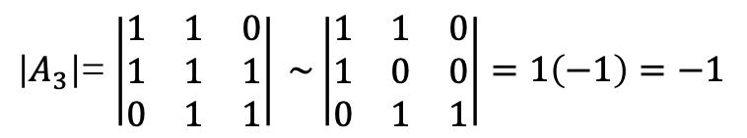



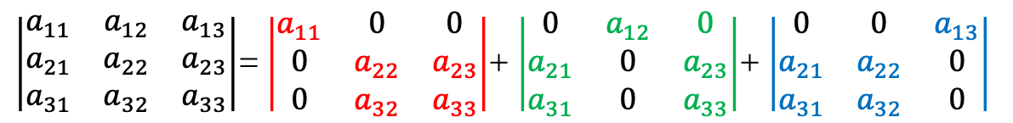

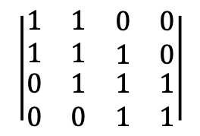
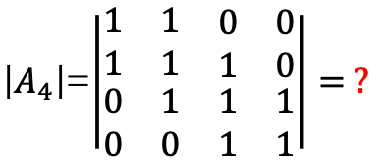
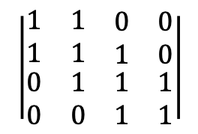
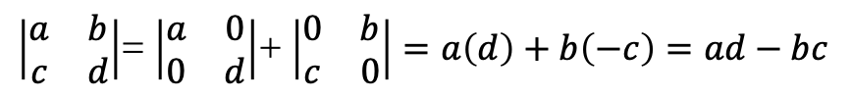

Cofactor Formula
$\det\left(A\right)=$ $a_{11}$ $C_{11 }+a_{12} C_{12 }$+ $a_{13}$ $C_{13 }$
$\left|\begin{matrix}a_{11} & a_{12} & a_{13} \\ a_{21} & a_{22} & a_{23} \\ a_{31} & a_{32} & a_{33}\end{matrix}\right|$= $\left|\begin{matrix}a_{11} & 0 & 0 \\ 0 & a_{22} & a_{23} \\ 0 & a_{32} & a_{33}\end{matrix}\right|$+ $\left|\begin{matrix}0 & a_{12} & 0 \\ a_{21} & 0 & a_{23} \\ a_{31} & 0 & a_{33}\end{matrix}\right|$+ $\left|\begin{matrix}0 & 0 & a_{13} \\ a_{21} & a_{22} & 0 \\ a_{31} & a_{32} & 0\end{matrix}\right|$
Examples:
$\left|\begin{matrix}a & b \\ c & d\end{matrix}\right|$= $\left|\begin{matrix}a & 0 \\ 0 & d\end{matrix}\right|$+ $\left|\begin{matrix}0 & b \\ c & 0\end{matrix}\right|=a\left(d\right)+b\left(−c\right)=ad−bc$
$\left|A_{4}\right|$=$\left|\begin{matrix}1 & 1 & \begin{matrix}0 & 0\end{matrix} \\ 1 & 1 & \begin{matrix}1 & 0\end{matrix} \\ \begin{matrix}0 \\ 0\end{matrix} & \begin{matrix}1 \\ 0\end{matrix} & \begin{matrix}\begin{matrix}1 & 1\end{matrix} \\ \begin{matrix}1 & 1\end{matrix}\end{matrix}\end{matrix}\right|= ?$
$\left|A_{4}\right|$=1 $\left|A_{3}\right|−1\left|A_{2}\right|$
$\left|A_{n}\right|$= $\left|A_{n−1}\right|−\left|A_{n−2}\right|$
$\left|A_{1}\right|$=$\left|1\right|=1$
$$\left|\begin{matrix}1 & 1 & \begin{matrix}0 & 0\end{matrix} \\ 1 & 1 & \begin{matrix}1 & 0\end{matrix} \\ \begin{matrix}0 \\ 0\end{matrix} & \begin{matrix}1 \\ 0\end{matrix} & \begin{matrix}\begin{matrix}1 & 1\end{matrix} \\ \begin{matrix}1 & 1\end{matrix}\end{matrix}\end{matrix}\right|$$
$$\left|\begin{matrix}1 & 1 & \begin{matrix}0 & 0\end{matrix} \\ 1 & 1 & \begin{matrix}1 & 0\end{matrix} \\ \begin{matrix}0 \\ 0\end{matrix} & \begin{matrix}1 \\ 0\end{matrix} & \begin{matrix}\begin{matrix}1 & 1\end{matrix} \\ \begin{matrix}1 & 1\end{matrix}\end{matrix}\end{matrix}\right|$$
$\left|A_{2}\right|$= $\left|\begin{matrix}1 & 1 \\ 1 & 1\end{matrix}\right| =0$
$\left|A_{3}\right|$= $\left|\begin{matrix}1 & 1 & 0 \\ 1 & 1 & 1 \\ 0 & 1 & 1\end{matrix}\right| \sim \left|\begin{matrix}1 & 1 & 0 \\ 1 & 0 & 0 \\ 0 & 1 & 1\end{matrix}\right|=1\left(−1\right)=−1$

Slide 14

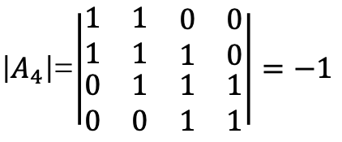

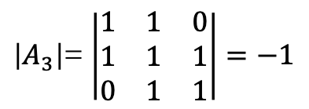





Tridiagonal Matrices
$\left|A_{n}\right|$= $\left|A_{n−1}\right|−\left|A_{n−2}\right|$
$$\left[\begin{matrix}b_{1} & c_{1} & \begin{matrix} & & \end{matrix} \\ a_{2} & b_{2} & \begin{matrix}c_{2} & & \end{matrix} \\ \begin{matrix} \\ \\ \end{matrix} & \begin{matrix}a_{3} \\ \\ \end{matrix} & \begin{matrix}\begin{matrix}b_{3} \\ ⋱ \\ \end{matrix} & \begin{matrix}⋱ \\ ⋱ \\ a_{n}\end{matrix} & \begin{matrix} \\ c_{n−1} \\ b_{n}\end{matrix}\end{matrix}\end{matrix}\right]\left[\begin{matrix}x_{1} \\ x_{2} \\ \begin{matrix}x_{3} \\ ⋮ \\ x_{n}\end{matrix}\end{matrix}\right]=\left[\begin{matrix}d_{1} \\ d_{2} \\ \begin{matrix}d_{3} \\ ⋮ \\ d_{n}\end{matrix}\end{matrix}\right]$$
$\left|A_{1}\right|$=$\left|1\right|=1$
$\left|A_{2}\right|$= $\left|\begin{matrix}1 & 1 \\ 1 & 1\end{matrix}\right| =0$
Algunos de los problemas físicos que se plantean así son la Ecuación de Poisson, la ecuación de calor, la ecuación de onda o la interpolación por splines.
$\left|A_{3}\right|$= $\left|\begin{matrix}1 & 1 & 0 \\ 1 & 1 & 1 \\ 0 & 1 & 1\end{matrix}\right|=−1$
Algoritmo para matrices tridiagonales.(s.f.). En Wikipedia.
Retrieve in 21/05/2020 from
https://es.wikipedia.org/wiki/Algoritmo_para_matrices_tridiagonales
$\left|A_{4}\right|$=$\left|\begin{matrix}1 & 1 & \begin{matrix}0 & 0\end{matrix} \\ 1 & 1 & \begin{matrix}1 & 0\end{matrix} \\ \begin{matrix}0 \\ 0\end{matrix} & \begin{matrix}1 \\ 0\end{matrix} & \begin{matrix}\begin{matrix}1 & 1\end{matrix} \\ \begin{matrix}1 & 1\end{matrix}\end{matrix}\end{matrix}\right|=−1$
$$\left|A_{5}\right|=0$$
$$\left|A_{6}\right|=1$$
$$\left|A_{7}\right|=1$$
Notes:
Algoritmo para matrices tridiagonales.(s.f.). En Wikipedia.
Recuperado el 21/05/2020 de
https://es.wikipedia.org/wiki/Algoritmo_para_matrices_tridiagonales

Slide 15
Credits
Ariel Guerrero
Lic. Electrónica
ariel.guerrero@uc.edu.py
(+595) 981-425 040
Hernandarias – Paraguay
@2020
Attribution-NonCommercial-ShareAlike 4.0 International (CC BY-NC-SA 4.0)
GitHub
https://github.com/aegiloru/linearAlgebra
Lec 19 –MIT 18.06
https://www.youtube.com/watch?v=23LLB9mNJvc
MIT 18.06
https://ocw.mit.edu/courses/mathematics/18-06-linear-algebra-spring-2010/
Prof. Gilbert Strang
http://www-math.mit.edu/~gs/

