Slide 1

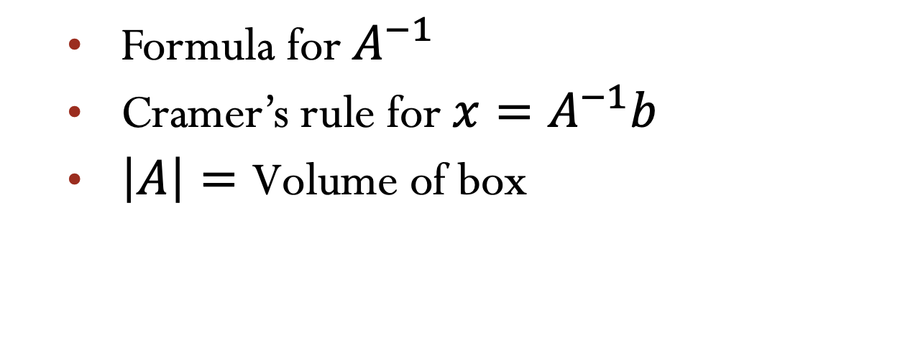
Lecture 20 Cramer’s rule, Inverse Matrix, and volume
Formula for $A^{−1}$
Cramer’s rule for $x=A^{−1}b$
$\left|A\right|=\text{Volume} \text{of} \text{box}$
Attribution-NonCommercial-ShareAlike 4.0 International (CC BY-NC-SA 4.0)

Slide 2



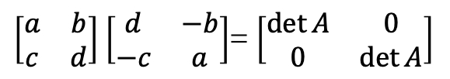
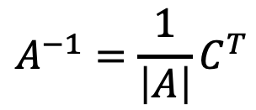
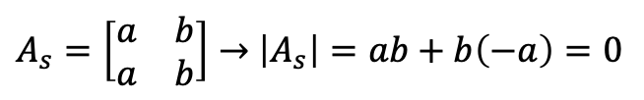
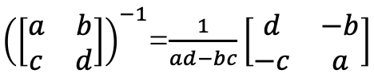
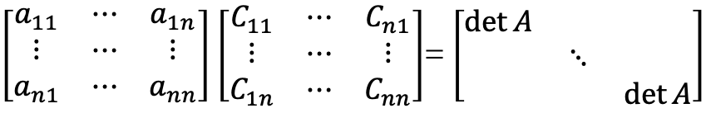
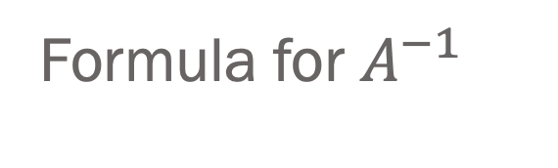

Cofactor Formula
$\det\left(A\right)=$ $a_{i1}$ $C_{i1 }+a_{i2} C_{i2 }$+…+ $a_{in}$ $C_{in }$
$\left|\begin{matrix}a_{11} & a_{12} & a_{13} \\ a_{21} & a_{22} & a_{23} \\ a_{31} & a_{32} & a_{33}\end{matrix}\right|$= $\left|\begin{matrix}a_{11} & 0 & 0 \\ 0 & a_{22} & a_{23} \\ 0 & a_{32} & a_{33}\end{matrix}\right|$+ $\left|\begin{matrix}0 & a_{12} & 0 \\ a_{21} & 0 & a_{23} \\ a_{31} & 0 & a_{33}\end{matrix}\right|$+ $\left|\begin{matrix}0 & 0 & a_{13} \\ a_{21} & a_{22} & 0 \\ a_{31} & a_{32} & 0\end{matrix}\right|$
Formula for $A^{−1}$
${\left(\left[\begin{matrix}a & b \\ c & d\end{matrix}\right]\right)}^{−1}$=$\frac{1}{ad−bc}\left[\begin{matrix}d & −b \\ −c & a\end{matrix}\right]$
$$A^{−1}=\frac{1}{\left|A\right|}C^{T}$$
Products of $n−1$ entries
Products of $n$ entries
Check
$AC^{T}$= $\left|A\right|$I
$\left[\begin{matrix}a_{11} & ⋯ & a_{1n} \\ ⋮ & ⋯ & ⋮ \\ a_{n1} & ⋯ & a_{nn}\end{matrix}\right]$ $\left[\begin{matrix}C_{11} & ⋯ & C_{n1} \\ ⋮ & ⋯ & ⋮ \\ C_{1n} & ⋯ & C_{nn}\end{matrix}\right]$= $\left[\begin{matrix}\det{A} & & \\ & ⋱ & \\ & & \det{A}\end{matrix}\right]$
$A_{s}=\left[\begin{matrix}a & b \\ a & b\end{matrix}\right]→$ $\left|A_{s}\right|=ab+b\left(−a\right)=0$
$\left[\begin{matrix}a & b \\ c & d\end{matrix}\right]$ $\left[\begin{matrix}d & −b \\ −c & a\end{matrix}\right]$= $\left[\begin{matrix}\det{A} & 0 \\ 0 & \det{A}\end{matrix}\right]$

Slide 3

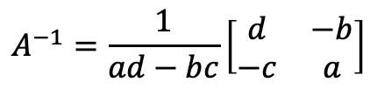

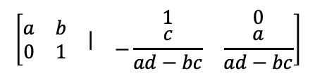
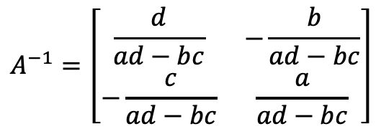

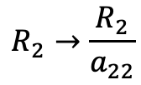
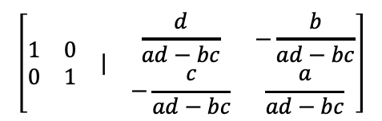

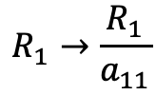
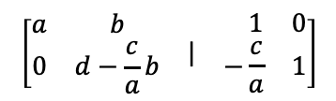
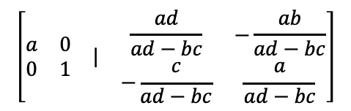
${\left(\left[\begin{matrix}a & b \\ c & d\end{matrix}\right]\right)}^{−1}$= $?$
$$\left[\begin{matrix}\begin{matrix}a & b \\ c & d\end{matrix} & | & \begin{matrix}1 & 0 \\ 0 & 1\end{matrix}\end{matrix}\right]$$
Step
Row operations
Aumented Matrix
$$A^{−1}=\left[\begin{matrix}\frac{d}{ad−bc} & −\frac{b}{ad−bc} \\ −\frac{c}{ad−bc} & \frac{a}{ad−bc}\end{matrix}\right]$$
$$R_{2}→R_{2}−\frac{c}{a}R_{1}$$
$$\left[\begin{matrix}\begin{matrix}a & b \\ 0 & d−\frac{c}{a}b\end{matrix} & | & \begin{matrix} 1 & 0 \\ −\frac{c}{a} & 1\end{matrix}\end{matrix}\right]$$
1.
2.
$$R_{2}→\frac{R_{2}}{a_{22}}$$
$$\left[\begin{matrix}\begin{matrix}a & b \\ 0 & 1\end{matrix} & | & \begin{matrix} 1 & 0 \\ −\frac{c}{ad−bc} & \frac{a}{ad−bc}\end{matrix}\end{matrix}\right]$$
$$A^{−1}=\frac{1}{ad−bc}\left[\begin{matrix}d & −b \\ −c & a\end{matrix}\right]$$
$$\left[\begin{matrix}\begin{matrix}a & 0 \\ 0 & 1\end{matrix} & | & \begin{matrix}\frac{ad}{ad−bc} & −\frac{ab}{ad−bc} \\ −\frac{c}{ad−bc} & \frac{a}{ad−bc}\end{matrix}\end{matrix}\right]$$
3.
$$R_{1}→R_{1}−bR_{1}$$
$$\left[\begin{matrix}\begin{matrix}1 & 0 \\ 0 & 1\end{matrix} & | & \begin{matrix}\frac{d}{ad−bc} & −\frac{b}{ad−bc} \\ −\frac{c}{ad−bc} & \frac{a}{ad−bc}\end{matrix}\end{matrix}\right]$$
4.
$$R_{1}→\frac{R_{1}}{a_{11}}$$

Slide 4
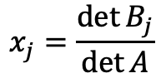
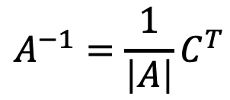
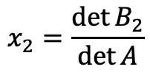


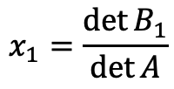
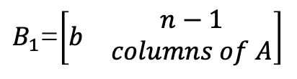

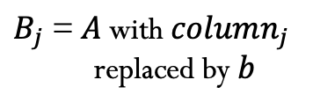
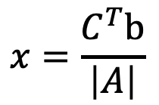
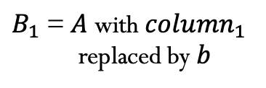
Cramer’s Rule
$$A^{−1}=\frac{1}{\left|A\right|}C^{T}$$
$$Ax=b$$
$$x=A^{−1}b$$
$C^{T}b$=$C_{11}b_{1}+C_{21}b_{2}+…$
$$x=\frac{C^{T}b}{\left|A\right|}$$
$$x_{1}=\frac{\det{B_{1}}}{\det{A}}$$
$$x_{2}=\frac{\det{B_{2}}}{\det{A}}$$
$$x_{j}=\frac{\det{B_{j}}}{\det{A}}$$
$B_{1}$= $A$ with ${column}_{1}$
replaced by $b$
$B_{j}$= $A$ with ${column}_{j}$
replaced by $b$
$B_{1}$=$\left[\begin{matrix}b & \begin{aligned}n−1 \\ columns of A\end{aligned}\end{matrix}\right]$

Slide 5









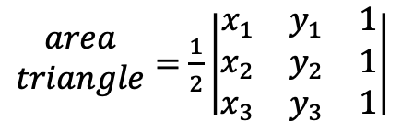









|𝐴|="Volumen of box"
$$A_{3×3}=\left[\begin{matrix}a_{11} & a_{12} & a_{13} \\ a_{21} & a_{22} & a_{23} \\ a_{31} & a_{32} & a_{33}\end{matrix}\right]$$
$$A=Q →Orthogonal Matrix$$
$${(a}_{31},a_{32},a_{33})$$
$$A=I →\left|A\right|=1$$
$$Q^{T}Q=I$$
$$\left|Q^{T}\right|\left|Q\right|=1$$
$${\left(\left|Q\right|\right)}^{2}=1$$
(0,0,0)
$${(a}_{11},a_{12},a_{13})$$
Unit Square
Unit Square rotated
P01, P02, P03.A, P03.B
I
$$±$$
t
$\left|\begin{matrix}a+a^{′} & b+b^{′} \\ c & d\end{matrix}\right|=\left|\begin{matrix}a & b \\ c & d\end{matrix}\right|$+ $\left|\begin{matrix}a^{′} & b^{′} \\ c & d\end{matrix}\right|$
$$(a+c,b+d)$$
$$\begin{matrix}area \\ parallelogram\end{matrix}=\left|\begin{matrix}a & b \\ c & d\end{matrix}\right|=ad−bc$$
$\begin{matrix}area \\ triangle\end{matrix}=$ $\frac{ad−bc}{2}$
$$(c,d)$$
(0,0)
$$(a,b)$$
$${(x}_{3},y_{3})$$
$\begin{matrix}area \\ triangle\end{matrix}=$ $\frac{1}{2}\left|\begin{matrix}x_{1} & y_{1} & 1 \\ x_{2} & y_{2} & 1 \\ x_{3} & y_{3} & 1\end{matrix}\right|$
$${(x}_{2},y_{2})$$
$${(x}_{1},y_{1})$$

Slide 6
|𝐴|="Volume of box"

Slide 7
Credits
Ariel Guerrero
Lic. Electrónica
ariel.guerrero@uc.edu.py
(+595) 981-425 040
Hernandarias – Paraguay
@2020
Attribution-NonCommercial-ShareAlike 4.0 International (CC BY-NC-SA 4.0)
GitHub
https://github.com/aegiloru/linearAlgebra
Lec 20 –MIT 18.06
https://www.youtube.com/watch?v=QNpj-gOXW9M
MIT 18.06
https://ocw.mit.edu/courses/mathematics/18-06-linear-algebra-spring-2010/
Prof. Gilbert Strang
http://www-math.mit.edu/~gs/

Slide 8

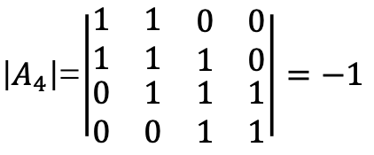

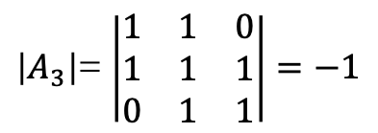
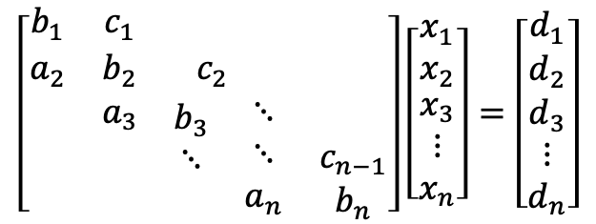




Tridiagonal Matrices
$\left|A_{n}\right|$= $\left|A_{n−1}\right|−\left|A_{n−2}\right|$
$$\left[\begin{matrix}b_{1} & c_{1} & \begin{matrix} & & \end{matrix} \\ a_{2} & b_{2} & \begin{matrix}c_{2} & & \end{matrix} \\ \begin{matrix} \\ \\ \end{matrix} & \begin{matrix}a_{3} \\ \\ \end{matrix} & \begin{matrix}\begin{matrix}b_{3} \\ ⋱ \\ \end{matrix} & \begin{matrix}⋱ \\ ⋱ \\ a_{n}\end{matrix} & \begin{matrix} \\ c_{n−1} \\ b_{n}\end{matrix}\end{matrix}\end{matrix}\right]\left[\begin{matrix}x_{1} \\ x_{2} \\ \begin{matrix}x_{3} \\ ⋮ \\ x_{n}\end{matrix}\end{matrix}\right]=\left[\begin{matrix}d_{1} \\ d_{2} \\ \begin{matrix}d_{3} \\ ⋮ \\ d_{n}\end{matrix}\end{matrix}\right]$$
$\left|A_{1}\right|$=$\left|1\right|=1$
$\left|A_{2}\right|$= $\left|\begin{matrix}1 & 1 \\ 1 & 1\end{matrix}\right| =0$
Algunos de los problemas físicos que se plantean así son la Ecuación de Poisson, la ecuación de calor, la ecuación de onda o la interpolación por splines.
$\left|A_{3}\right|$= $\left|\begin{matrix}1 & 1 & 0 \\ 1 & 1 & 1 \\ 0 & 1 & 1\end{matrix}\right|=−1$
Algoritmo para matrices tridiagonales.(s.f.). En Wikipedia.
Retrieve in 21/05/2020 from
https://es.wikipedia.org/wiki/Algoritmo_para_matrices_tridiagonales
$\left|A_{4}\right|$=$\left|\begin{matrix}1 & 1 & \begin{matrix}0 & 0\end{matrix} \\ 1 & 1 & \begin{matrix}1 & 0\end{matrix} \\ \begin{matrix}0 \\ 0\end{matrix} & \begin{matrix}1 \\ 0\end{matrix} & \begin{matrix}\begin{matrix}1 & 1\end{matrix} \\ \begin{matrix}1 & 1\end{matrix}\end{matrix}\end{matrix}\right|=−1$
$$\left|A_{5}\right|=0$$
$$\left|A_{6}\right|=1$$
$$\left|A_{7}\right|=1$$
Notes:
Algoritmo para matrices tridiagonales.(s.f.). En Wikipedia.
Recuperado el 21/05/2020 de
https://es.wikipedia.org/wiki/Algoritmo_para_matrices_tridiagonales

