Slide 1

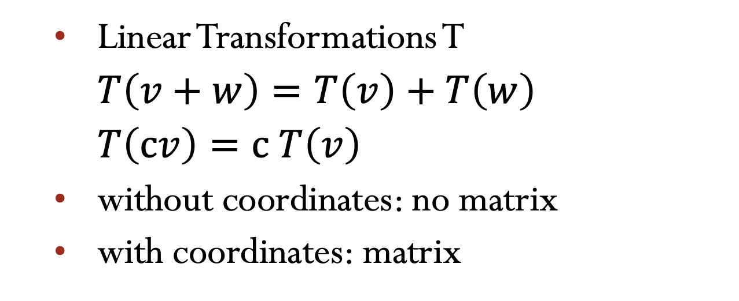
Lecture 30 Linear Transformations and their matrices
Linear Transformations T
$T\left(v+w\right)=T\left(v\right)+T\left(w\right)$
$T\left(cv\right)=c T\left(v\right)$
without coordinates: no matrix
with coordinates: matrix
Attribution-NonCommercial-ShareAlike 4.0 International (CC BY-NC-SA 4.0)

Slide 2








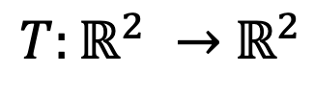










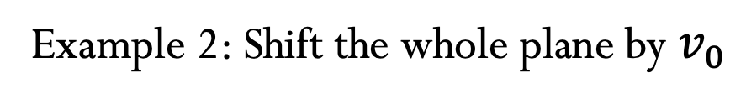

Linear Transformations T
$$T\left(cv+dw\right)=c T\left(v\right)+d T\left(w\right)$$
Example 1: Projection
$T:ℝ^{2} →$ $ℝ^{2}$
$$a$$
$$a$$
$$w$$
$$v$$
$$w$$
$$v$$
$$T(v)$$
$$T(v)$$
$$T(w)$$
$$T(w)$$
$$v_{0}$$
Example 2: Shift the whole plane by $v_{0}$
$$v_{0}$$
$$2v$$
$T\left(2v\right)$ $≠2 T\left(v\right)$
$$v$$
$$T(v)$$
$$T(2v)$$
The transformation is not linear!
$$T\left(0\right)=0$$

Slide 3



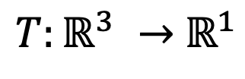



Linear Transformations T
Example 3: The length of a vector
$T\left(v\right)$ $=$ $\left\|v\right\|$
$T:ℝ^{3} →$ $ℝ^{1}$
$T\left(2v\right)$ $=2 T\left(v\right)$
$T\left(−2v\right)$ $≠−2 T\left(v\right)$
The transformation is not linear!
Example 4: Rotation by 45º
$$T(v)$$
$$v$$
$$v$$
45º

Slide 4




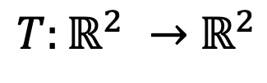
Linear Transformations T
Example 3: The length of a vector
$T\left(v\right)$ $=$ $\left\|v\right\|$
$T:ℝ^{3} →$ $ℝ^{1}$
$T\left(2v\right)$ $=2 T\left(v\right)$
$T\left(−2v\right)$ $≠−2 T\left(v\right)$
The transformation is not linear!
Example 4: Rotation by 45º
$T:ℝ^{2} →$ $ℝ^{2}$
$$T(v)$$
$$v$$
$$A=\left[\begin{matrix}\cos{45} & −\sin{45} \\ \sin{45} & \cos{45}\end{matrix}\right]$$
$$v$$
45º

Slide 5
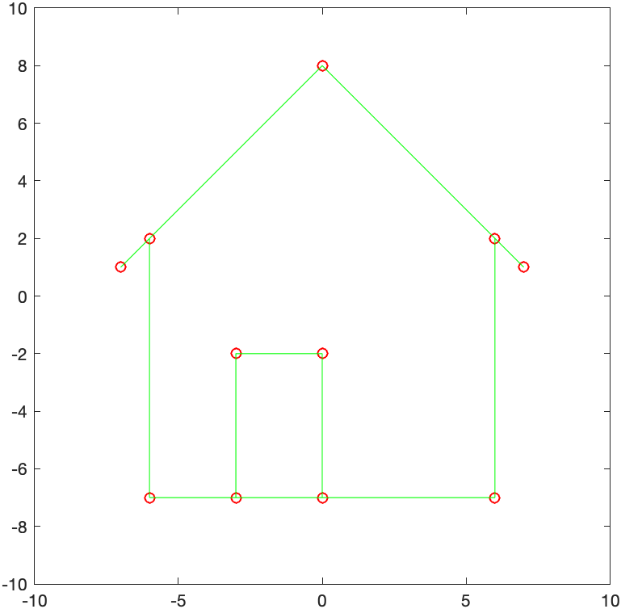
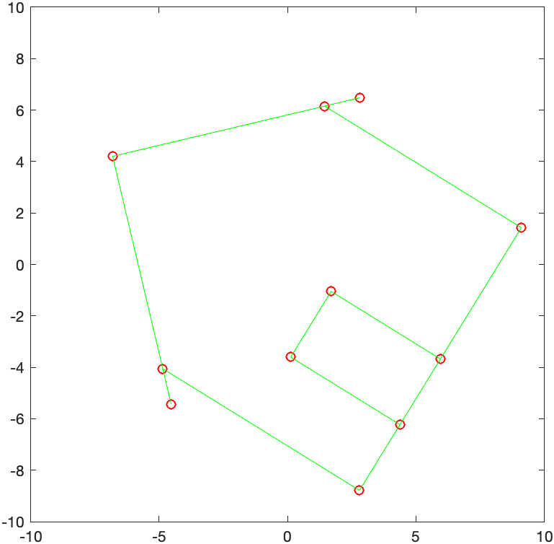
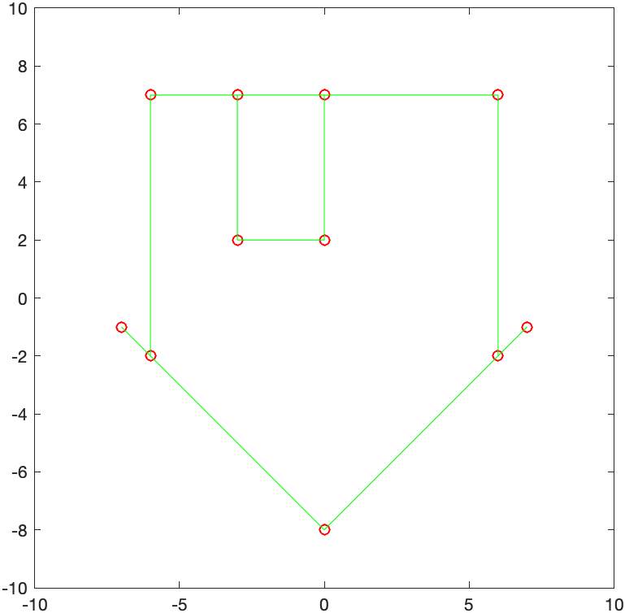

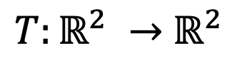




Linear Transformations T
Example 5: Linear Transformation of the plane
$T:ℝ^{2} →$ $ℝ^{2}$
$$H=\left[\begin{matrix}−6 & −6 & \begin{matrix}7 & 0 & \begin{matrix}7 & 6 & \begin{matrix}+6 & −3 & \begin{matrix}−3 & +0 & \begin{matrix}+0 & −6\end{matrix}\end{matrix}\end{matrix}\end{matrix}\end{matrix} \\ −7 & +2 & \begin{matrix}1 & 8 & \begin{matrix}1 & 2 & \begin{matrix}−7 & −7 & \begin{matrix}−2 & −2 & \begin{matrix}−7 & −7\end{matrix}\end{matrix}\end{matrix}\end{matrix}\end{matrix}\end{matrix}\right]$$
$T\left(v\right)$ $=Av$
$$A\left(v+w\right)=Av+Aw$$
$$A=\left[\begin{matrix}\cos{45} & −\sin{45} \\ \sin{45} & \cos{45}\end{matrix}\right]$$
$$A=\left[\begin{matrix}1 & 0 \\ 0 & −1\end{matrix}\right]$$
$$A\left(cv\right)=c Av$$

Slide 6


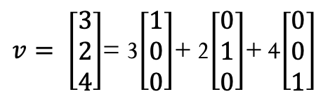





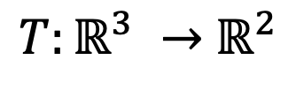








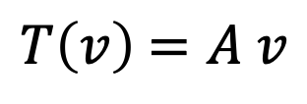


Linear Transformations T
Start
$T:ℝ^{3} →$ $ℝ^{2}$
$T\left(v\right)$ $=A v$
input
output
output
input
$$ℝ^{2}$$
$$ℝ^{3}$$
$$A_{2x3}$$
Information needed to know $T(v)$ for all inputs.
$$v_{1}$$
$$v_{2}$$
$$v_{n}$$
${For any input basis v}_{1}$, $v_{2},…,v_{n}$
$$⋯$$
$$T\left(v_{1}\right)$$
$$T\left(v_{2}\right)$$
$$T\left(v_{n}\right)$$
$T(v)=$ ${c_{1}T(v}_{1})$ + $c_{2} {T(v}_{2})+…+c_{n}{T(v}_{n})$
$v=$ ${c_{1}v}_{1}$ + $c_{2} v_{2}+…+c_{n}v_{n}$
Coordinates comes from a basis.
$v= \left[\begin{matrix}3 \\ 2 \\ 4\end{matrix}\right]$= 3$\left[\begin{matrix}1 \\ 0 \\ 0\end{matrix}\right]$+ 2$\left[\begin{matrix}0 \\ 1 \\ 0\end{matrix}\right]$+ 4$\left[\begin{matrix}0 \\ 0 \\ 1\end{matrix}\right]$
$$e_{1}$$
$$e_{2}$$
$$e_{3}$$

Slide 7













Linear Transformations T
Construct a matrix A that represents a linear transformation T
1. Choose a basis for the input space ${\{v}_{1}$, $v_{2},…,v_{n}$} in $ℝ^{n}$
$T:ℝ^{n} →$ $ℝ^{m}$
2. Choose a basis for the output space ${\{w}_{1}$, $w_{2},…,w_{n}$} in $ℝ^{m}$
Want a matrix A
Projection
$v=$ ${c_{1}v}_{1}$ + $c_{2} v_{2}$
${(c}_{1}$, $c_{2})$
$v_{2}$= $w_{2}$
$$↓$$
$$a$$
$T(v)=$ ${c_{1}T(v}_{1})$
${(c}_{1}$, $0)$
$v_{1}$= $w_{1}$
$\left[\begin{matrix}1 & 0 \\ 0 & 0\end{matrix}\right]$ $\left[\begin{matrix}c_{1} \\ c_{2}\end{matrix}\right]$= $\left[\begin{matrix}c_{1} \\ 0\end{matrix}\right]$
Output
Coordinates
$$A= ?$$
$$A$$
Input
Coordinates
The eigenvector basis leads to a diagonal matrix $Λ$

Slide 8
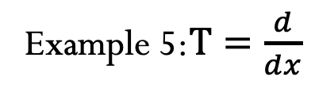
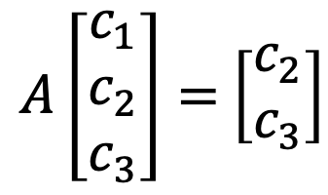
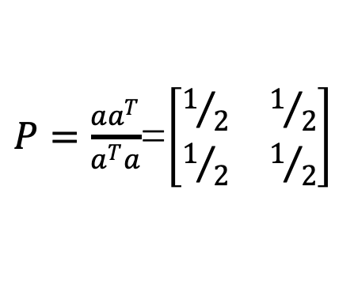





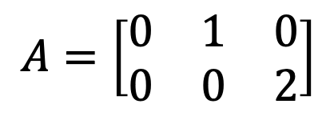



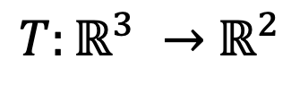
Linear Transformations T
Project onto 45º line use standard basis $v_{1}$= $w_{1}$=$\left[\begin{matrix}1 \\ 0\end{matrix}\right]$ and $v_{2}$= $w_{2}$=$\left[\begin{matrix}0 \\ 1\end{matrix}\right]$.
$P=\frac{aa^{T}}{a^{T}a}$=$\left[\begin{matrix}1/2 & 1/2 \\ 1/2 & 1/2\end{matrix}\right]$
$v_{1}$, $v_{2},…,v_{n}$
Rule to find A
Given bases
$w_{1}$, $w_{2},…,w_{n}$
1rst. Column of A
$T(v_{1})=$ ${a_{11}w}_{1}$ +${a_{21}w}_{2}+…+{a_{m1}w}_{m}$
2nd. Column of A
$T(v_{2})=$ ${a_{12}w}_{1}$ +${a_{22}w}_{2}+…+{a_{m2}w}_{m}$
Example 5:$T=\frac{d}{ⅆx}$
Input:
$$c_{1}+c_{2}x+c_{3}x^{2}$$
Basis:
1$,x,x^{2}$
Output:
$$c_{2}+{2 c}_{3}x$$
Basis:
1$,x$
$A\left[\begin{matrix}c_{1} \\ c_{2} \\ c_{3}\end{matrix}\right]=$ $\left[\begin{matrix}c_{2} \\ c_{3}\end{matrix}\right]$
$$A=\left[\begin{matrix}0 & 1 & 0 \\ 0 & 0 & 2\end{matrix}\right]$$
$T:ℝ^{3} →$ $ℝ^{2}$

Slide 10
Credits
Ariel Guerrero
Lic. Electrónica
ariel.guerrero@uc.edu.py
(+595) 981-425 040
Hernandarias – Paraguay
@2020
Attribution-NonCommercial-ShareAlike 4.0 International (CC BY-NC-SA 4.0)
GitHub
https://github.com/aegiloru/linearAlgebra
Lec 30 –MIT 18.06
https://www.youtube.com/watch?time_continue=7&v=Ts3o2I8_Mxc
MIT 18.06
https://ocw.mit.edu/courses/mathematics/18-06-linear-algebra-spring-2010/
Prof. Gilbert Strang
http://www-math.mit.edu/~gs/

