Slide 1



Lecture 22 Diagonalization and Powers of A
Diagonalizing a matrix
Powers of A
$$S^{−1}AS=Λ$$
$u_{k+1}=$ A $u_{k}$
Attribution-NonCommercial-ShareAlike 4.0 International (CC BY-NC-SA 4.0)

Slide 2




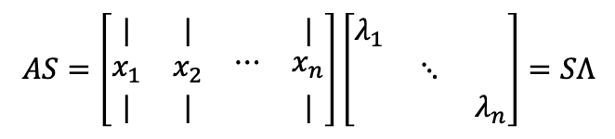


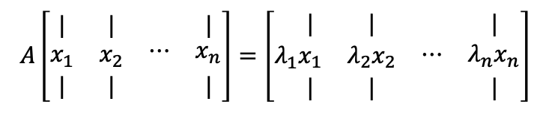



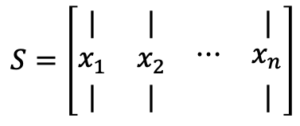
Diagonalizing a Matrix
$$Ax=λx$$
$$\left[A−λI\right]$$
singular
Suppose n indep. eigenvectors of A
Put them in columns of $S$
$$AS= ?$$
$$λ_{1}{→x}_{1}$$
$$A\left[\begin{matrix}| & | & \begin{matrix} & |\end{matrix} \\ x_{1} & x_{2} & \begin{matrix}⋯ & x_{n}\end{matrix} \\ | & | & \begin{matrix} & |\end{matrix}\end{matrix}\right]=\left[λ_{1}\begin{matrix}| & | & \begin{matrix} & |\end{matrix} \\ x_{1} & λ_{2}x_{2} & \begin{matrix}⋯ & λ_{n}x_{n}\end{matrix} \\ | & | & \begin{matrix} & |\end{matrix}\end{matrix}\right]$$
$$λ_{2}{→x}_{2}$$
$$⋮$$
$$λ_{n}{→x}_{n}$$
$$AS=\left[\begin{matrix}| & | & \begin{matrix} & |\end{matrix} \\ x_{1} & x_{2} & \begin{matrix}⋯ & x_{n}\end{matrix} \\ | & | & \begin{matrix} & |\end{matrix}\end{matrix}\right]\left[\begin{matrix}λ_{1} & & \\ & ⋱ & \\ & & λ_{n}\end{matrix}\right]=SΛ$$
$$S=\left[\begin{matrix}| & | & \begin{matrix} & |\end{matrix} \\ x_{1} & x_{2} & \begin{matrix}⋯ & x_{n}\end{matrix} \\ | & | & \begin{matrix} & |\end{matrix}\end{matrix}\right]$$
$$AS=SΛ$$

Slide 3

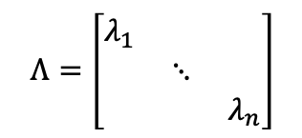

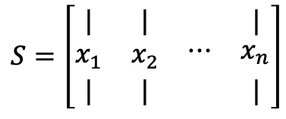

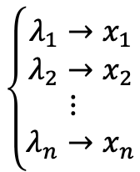

Diagonalizing a Matrix
$$\left\{\begin{aligned}λ_{1}{→x}_{1} \\ λ_{2}{→x}_{2} \\ \begin{matrix}⋮ \\ λ_{n}{→x}_{n}\end{matrix}\end{aligned}\right.$$
$$A$$
$$AS=SΛ$$
$$S^{−1}AS=Λ$$
$$S=\left[\begin{matrix}| & | & \begin{matrix} & |\end{matrix} \\ x_{1} & x_{2} & \begin{matrix}⋯ & x_{n}\end{matrix} \\ | & | & \begin{matrix} & |\end{matrix}\end{matrix}\right]$$
$$A=SΛS^{−1}$$
Eigenvector Matrix
$$Λ=\left[\begin{matrix}λ_{1} & & \\ & ⋱ & \\ & & λ_{n}\end{matrix}\right]$$
Diagonal Eigenvalues Matrix

Slide 4
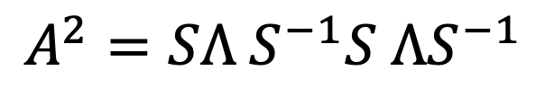

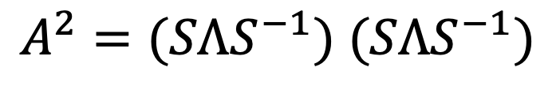



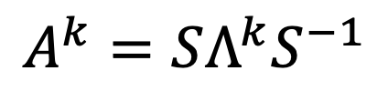


Powers of A
$$AS=SΛ$$
$$S^{−1}AS=Λ$$
$$A=SΛS^{−1}$$
If $Ax=λx$, then $A^{2}x=λAx=λ^{2}x$
$$A=SΛS^{−1}$$
$A^{2}=(SΛS^{−1})$ $(SΛS^{−1})$
$$A^{k}=SΛ^{k}S^{−1}$$
$$A^{2}=SΛ{ S}^{−1}S ΛS^{−1}$$
$$A^{2}=SΛ^{2}S^{−1}$$

Slide 5





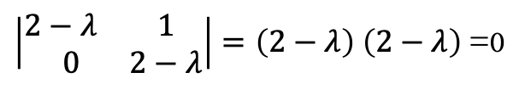



Powers of A
$A$ is sure to have n independent Eigenvectors and be diagonalizable
If all the $λ$’s are diferent (Not repeated $λ$’s).
Repeated Eigenvalues // may or may not haven independent Eigenvectors.
$$A=\left[\begin{matrix}2 & 1 \\ 0 & 2\end{matrix}\right]$$
$$det\left(A−λI\right)=0$$
$\left|\begin{matrix}2−λ & 1 \\ 0 & 2−λ\end{matrix}\right|=\left(2−λ\right)$ $\left(2−λ\right)$=0
$$λ_{1}=2$$
$$λ_{2}=2$$
$$\left[\begin{matrix}0 & 1 \\ 0 & 0\end{matrix}\right]x=0$$
No second indep. $x_{2}$
$$x_{1}=\left[\begin{matrix}1 \\ 0\end{matrix}\right]$$

Slide 6







Powers of A
$u_{k+1}=$ A $u_{k}$
Start with a vector $u_{0}$
$u_{1}=$ A $u_{0}$
$u_{2}=$ $A^{2}$ $u_{0}$
$u_{k}=$ $A^{k}$ $u_{0}$
To really solve write:
$u_{0}$= $c_{1}x_{1}+c_{2}x_{2}+…+c_{n}x_{n}=Sc$
$u_{100}=$ $A^{100}$ $u_{0}=c_{1}{λ_{1}}^{100} x_{1}+…+c_{n}{λ_{n}}^{100} x_{n}$
$u_{100}=$ $Λ^{100}Sc$

Slide 7


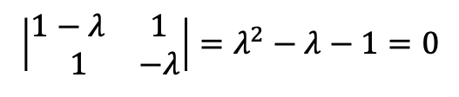

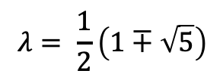








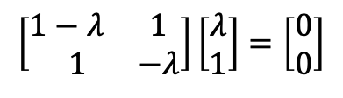
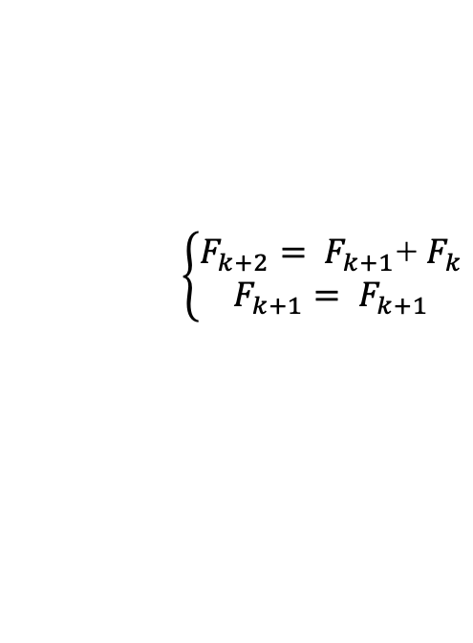




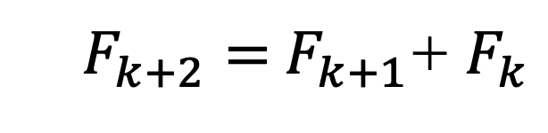



$F_{k+2}=$ $F_{k+1}$+ $F_{k}$
Powers of A
Find the Fibonacci number $F_{100}$
0,1,1,2,3,5,8,13,…,$F_{100}$
$$u_{100}=A^{100}u_{0}$$
$$\left\{\begin{aligned}F_{k+2}= F_{k+1}\text{+ }F_{k} \\ F_{k+1}= F_{k+1}\end{aligned}\right.$$
$$det\left(A−λI\right)=0$$
$$\left[\begin{matrix}F_{k+2} \\ F_{k+1}\end{matrix}\right]=\left[\begin{matrix}1 & 1 \\ 1 & 0\end{matrix}\right]\left[\begin{matrix}F_{k+1} \\ F_{k}\end{matrix}\right]$$
A=$\left[\begin{matrix}1 & 1 \\ 1 & 0\end{matrix}\right]$
$$u_{k+1}$$
A
$$u_{k}$$
$$u_{0}=\left[\begin{matrix}1 \\ 0\end{matrix}\right]$$
$$u_{1}=\left[\begin{matrix}1 \\ 1\end{matrix}\right]$$
$$u_{2}=\left[\begin{matrix}2 \\ 1\end{matrix}\right]$$
$$u_{3}=\left[\begin{matrix}3 \\ 2\end{matrix}\right]$$
$$⋯$$
$$u_{100}=\left[\begin{matrix}F_{101} \\ F_{100}\end{matrix}\right]$$
$$\left|\begin{matrix}1−λ & 1 \\ 1 & −λ\end{matrix}\right|=λ^{2}−λ−1=0$$
$$\left[\begin{matrix}1−λ & 1 \\ 1 & −λ\end{matrix}\right]\left[\begin{matrix}λ \\ 1\end{matrix}\right]=\left[\begin{matrix}0 \\ 0\end{matrix}\right]$$
$$λ= \frac{1}{2}\left(1∓\sqrt{5}\right)$$
$$x_{1}=\left[\begin{matrix}λ_{1} \\ 1\end{matrix}\right]$$
$$λ_{1}≈1.618$$
$$x_{2}=\left[\begin{matrix}λ_{2} \\ 1\end{matrix}\right]$$
$$λ_{2}≈−0.618$$

Slide 8




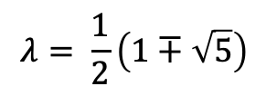

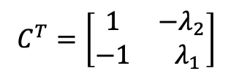
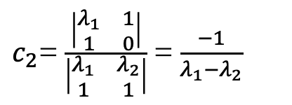


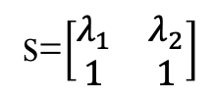

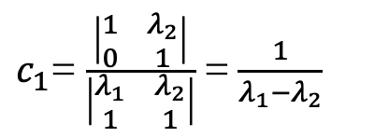

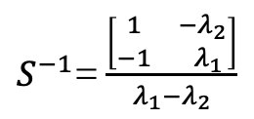




Powers of A
$$u_{100}=\left[\begin{matrix}F_{101} \\ F_{100}\end{matrix}\right]$$
$u_{k}=$ $A^{k}$ $u_{0}$
$$u_{100}=A^{100}u_{0}$$
Find the Fibonacci number $F_{100}$
0,1,1,2,3,5,8,13,…,$F_{100}$
S=$\left[\begin{matrix}λ_{1} & λ_{2} \\ 1 & 1\end{matrix}\right]$
$u_{0}=$S$c$
A=$\left[\begin{matrix}1 & 1 \\ 1 & 0\end{matrix}\right]$
$\left[\begin{matrix}λ_{1} & λ_{2} \\ 1 & 1\end{matrix}\right]$ $\left[\begin{matrix}c_{1} \\ c_{2}\end{matrix}\right]$= $\left[\begin{matrix}1 \\ 0\end{matrix}\right]$
$S^{−1}$= $\frac{C^{T}}{\left|S\right|}$
$$u_{0}=\left[\begin{matrix}1 \\ 0\end{matrix}\right]$$
$c_{1}$= $\frac{\left|\begin{matrix}1 & λ_{2} \\ 0 & 1\end{matrix}\right|}{\left|\begin{matrix}λ_{1} & λ_{2} \\ 1 & 1\end{matrix}\right|}$ =$\frac{1}{λ_{1}−λ_{2}}$
$$C=\left[\begin{matrix}1 & −1 \\ {−λ}_{2} & λ_{1}\end{matrix}\right]$$
$$λ= \frac{1}{2}\left(1∓\sqrt{5}\right)$$
$c_{2}$= $\frac{\left|\begin{matrix}λ_{1} & 1 \\ 1 & 0\end{matrix}\right|}{\left|\begin{matrix}λ_{1} & λ_{2} \\ 1 & 1\end{matrix}\right|}$ =$\frac{−1}{λ_{1}−λ_{2}}$
$$C^{T}=\left[\begin{matrix}1 & {−λ}_{2} \\ −1 & λ_{1}\end{matrix}\right]$$
$$λ_{1}≈1.618$$
$$x_{1}=\left[\begin{matrix}λ_{1} \\ 1\end{matrix}\right]$$
$S^{−1}$= $\frac{\left[\begin{matrix}1 & {−λ}_{2} \\ −1 & λ_{1}\end{matrix}\right]}{λ_{1}−λ_{2}}$
$$λ_{2}≈−0.618$$
$$x_{2}=\left[\begin{matrix}λ_{2} \\ 1\end{matrix}\right]$$

Slide 9
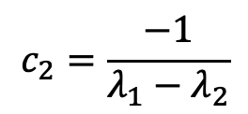

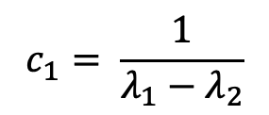

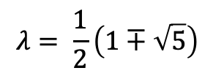




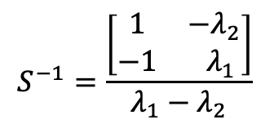
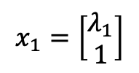
Powers of A
$$u_{100}=\left[\begin{matrix}F_{101} \\ F_{100}\end{matrix}\right]$$
$u_{k}=$ $A^{k}$ $u_{0}$
$$u_{100}=A^{100}u_{0}$$
Find the Fibonacci number $F_{100}$
0,1,1,2,3,5,8,13,…,$F_{100}$
$$A=\left[\begin{matrix}1 & 1 \\ 1 & 0\end{matrix}\right]$$
$$S=\left[\begin{matrix}λ_{1} & λ_{2} \\ 1 & 1\end{matrix}\right]$$
$$u_{0}=\left[\begin{matrix}1 \\ 0\end{matrix}\right]$$
$$S^{−1}=\frac{\left[\begin{matrix}1 & {−λ}_{2} \\ −1 & λ_{1}\end{matrix}\right]}{λ_{1}−λ_{2}}$$
$$λ= \frac{1}{2}\left(1∓\sqrt{5}\right)$$
$$c_{1}= \frac{1}{λ_{1}−λ_{2}}$$
$$λ_{1}≈1.618$$
$$λ_{2}≈−0.618$$
$$x_{1}=\left[\begin{matrix}λ_{1} \\ 1\end{matrix}\right]$$
$$x_{2}=\left[\begin{matrix}λ_{2} \\ 1\end{matrix}\right]$$
$$c_{2}=\frac{−1}{λ_{1}−λ_{2}}$$

Slide 10
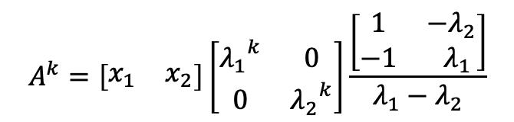
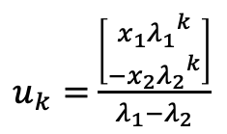

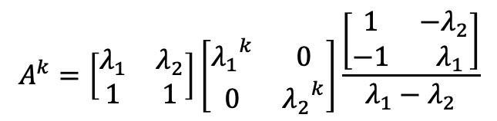
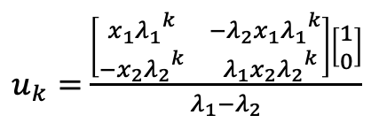


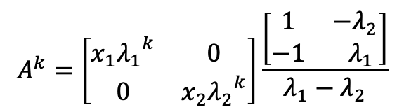

Powers of A
$$u_{100}=\left[\begin{matrix}F_{101} \\ F_{100}\end{matrix}\right]$$
$u_{k}=$ $A^{k}$ $u_{0}$
$$u_{100}=A^{100}u_{0}$$
Find the Fibonacci number $F_{100}$
$$A^{k}=SΛ^{k}S^{−1}$$
$$A^{k}=\left[\begin{matrix}λ_{1} & λ_{2} \\ 1 & 1\end{matrix}\right]\left[\begin{matrix}{λ_{1}}^{k} & 0 \\ 0 & {λ_{2}}^{k}\end{matrix}\right]\frac{\left[\begin{matrix}1 & {−λ}_{2} \\ −1 & λ_{1}\end{matrix}\right]}{λ_{1}−λ_{2}}$$
$u_{k}=$ $A^{k}$ $u_{0}$
$$A^{k}=\left[\begin{matrix}x_{1} & x_{2}\end{matrix}\right]\left[\begin{matrix}{λ_{1}}^{k} & 0 \\ 0 & {λ_{2}}^{k}\end{matrix}\right]\frac{\left[\begin{matrix}1 & {−λ}_{2} \\ −1 & λ_{1}\end{matrix}\right]}{λ_{1}−λ_{2}}$$
$u_{k}=$ $\frac{\left[\begin{matrix}{{x_{1}λ}_{1}}^{k} & {−λ}_{2}{{x_{1}λ}_{1}}^{k} \\ −{{x_{2}λ}_{2}}^{k} & λ_{1}{{x_{2}λ}_{2}}^{k}\end{matrix}\right]\left[\begin{matrix}1 \\ 0\end{matrix}\right]}{λ_{1}−λ_{2}}$
$$A^{k}=\left[\begin{matrix}{{x_{1}λ}_{1}}^{k} & 0 \\ 0 & {{x_{2}λ}_{2}}^{k}\end{matrix}\right]\frac{\left[\begin{matrix}1 & {−λ}_{2} \\ −1 & λ_{1}\end{matrix}\right]}{λ_{1}−λ_{2}}$$
$u_{k}=$ $\frac{\left[\begin{matrix}{{x_{1}λ}_{1}}^{k} \\ {{{−x}_{2}λ}_{2}}^{k}\end{matrix}\right]}{λ_{1}−λ_{2}}$
$$A^{k}=\frac{\left[\begin{matrix}{{x_{1}λ}_{1}}^{k} & {−λ}_{2}{{x_{1}λ}_{1}}^{k} \\ −{{x_{2}λ}_{2}}^{k} & λ_{1}{{x_{2}λ}_{2}}^{k}\end{matrix}\right]}{λ_{1}−λ_{2}}$$
$u_{100}=$ $\frac{{\left(λ_{1}\right)}^{100}x_{1}−{\left(λ_{2}\right)}^{100}x_{2}}{λ_{1}−λ_{2}}$

Slide 11



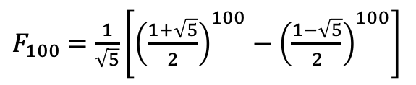


Powers of A
$$u_{100}=\left[\begin{matrix}F_{101} \\ F_{100}\end{matrix}\right]$$
$u_{k}=$ $A^{k}$ $u_{0}$
$$u_{100}=A^{100}u_{0}$$
Find the Fibonacci number $F_{100}$
$$A^{k}=SΛ^{k}S^{−1}$$
$u_{100}=$ $\frac{{\left(λ_{1}\right)}^{100}x_{1}−{\left(λ_{2}\right)}^{100}x_{2}}{λ_{1}−λ_{2}}$
$$u_{100}=\left[\begin{matrix}F_{101} \\ F_{100}\end{matrix}\right]$$
$F_{100}$ $=\frac{{\left(λ_{1}\right)}^{100}−{\left(λ_{2}\right)}^{100}}{λ_{1}−λ_{2}}$
$F_{k}=$ $\frac{{\left(λ_{1}\right)}^{k}−{\left(λ_{2}\right)}^{k}}{λ_{1}−λ_{2}}$
$F_{100}$ $=\frac{1}{\sqrt{5}}\left[{\left(\frac{1+\sqrt{5}}{2}\right)}^{100}−{\left(\frac{1−\sqrt{5}}{2}\right)}^{100}\right]$
$F_{100}≈$ 3.54 $∙{10}^{20}$

Slide 13
Credits
Ariel Guerrero
Lic. Electrónica
ariel.guerrero@uc.edu.py
(+595) 981-425 040
Hernandarias – Paraguay
@2020
Attribution-NonCommercial-ShareAlike 4.0 International (CC BY-NC-SA 4.0)
GitHub
https://github.com/aegiloru/linearAlgebra
Lec 22 –MIT 18.06
https://www.youtube.com/watch?v=13r9QY6cmjc
MIT 18.06
https://ocw.mit.edu/courses/mathematics/18-06-linear-algebra-spring-2010/
Prof. Gilbert Strang
http://www-math.mit.edu/~gs/

