Slide 1




Lecture 17 Orthogonal matrices and Gram-Schmidt
Orthogonal basis
Orthogonal matrix
Gram-Schmidt
$$q_{1},⋯,q_{n}$$
$$Q$$
$$A→Q$$
Attribution-NonCommercial-ShareAlike 4.0 International (CC BY-NC-SA 4.0)

Slide 2
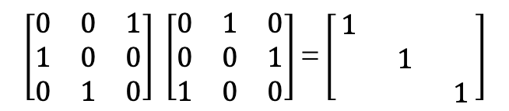
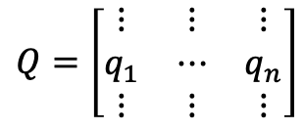
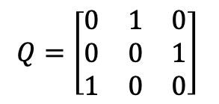
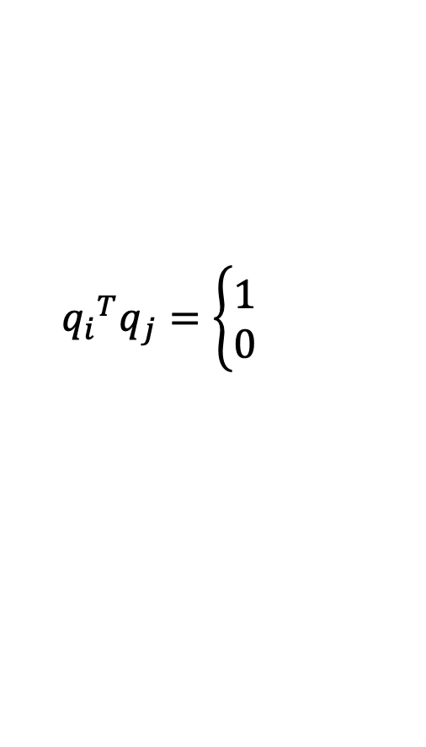

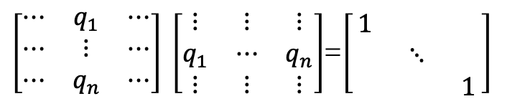

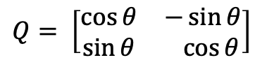
Orthonormal Vectors
$${q_{i}}^{T}q_{j}=\left\{\begin{aligned}1 \\ 0\end{aligned}\right.$$
$$Q=\left[\begin{matrix}⋮ & ⋮ & ⋮ \\ q_{1} & ⋯ & q_{n} \\ ⋮ & ⋮ & ⋮\end{matrix}\right]$$
$\left[\begin{matrix}⋯ & q_{1} & ⋯ \\ ⋯ & ⋮ & ⋯ \\ ⋯ & q_{n} & ⋯\end{matrix}\right] \left[\begin{matrix}⋮ & ⋮ & ⋮ \\ q_{1} & ⋯ & q_{n} \\ ⋮ & ⋮ & ⋮\end{matrix}\right]$=$\left[\begin{matrix}1 & & \\ & ⋱ & \\ & & 1\end{matrix}\right]$
$Q^{T}Q=I$
Orthogonal matrix
When Q is square we called Orthogonal Matrix
If Q is square $Q^{T}Q=I$ the tell us $Q^{T}=Q^{−1}$
Examples:
$$Q=\left[\begin{matrix}0 & 1 & 0 \\ 0 & 0 & 1 \\ 1 & 0 & 0\end{matrix}\right]$$
$$\left[\begin{matrix}0 & 0 & 1 \\ 1 & 0 & 0 \\ 0 & 1 & 0\end{matrix}\right] \left[\begin{matrix}0 & 1 & 0 \\ 0 & 0 & 1 \\ 1 & 0 & 0\end{matrix}\right]\text{=}\left[\begin{matrix}1 & & \\ & 1 & \\ & & 1\end{matrix}\right]$$
Permutation matrix
Unit Vectors
$$Q= \left[\begin{matrix}\cos{θ} & −\sin{θ} \\ \sin{θ} & \cos{θ}\end{matrix}\right]$$

Slide 3
Orthonormal Vectors

Slide 4





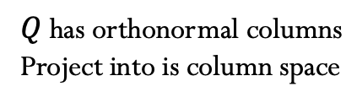


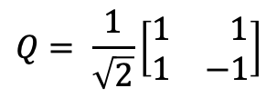


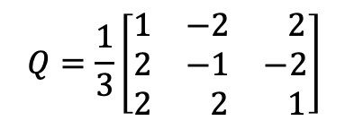

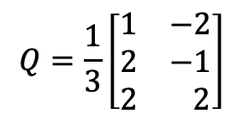



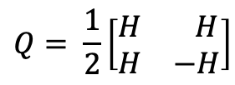


Orthogonal matrix
Examples:
$$H= \left[\begin{matrix}1 & 1 \\ 1 & −1\end{matrix}\right]$$
$$Q= \frac{1}{\sqrt{2}}\left[\begin{matrix}1 & 1 \\ 1 & −1\end{matrix}\right]$$
$$Q= \frac{1}{2}\left[\begin{matrix}H & H \\ H & −H\end{matrix}\right]$$
Hadamard matrix
$$Q=\frac{1}{3}\left[\begin{matrix}1 & −2 \\ 2 & −1 \\ 2 & 2\end{matrix}\right]$$
$$Q=\frac{1}{3}\left[\begin{matrix}1 & −2 & 2 \\ 2 & −1 & −2 \\ 2 & 2 & 1\end{matrix}\right]$$
Another exmaple
Why is it good to have orthogonal matrices?
What calculation is made easy?
$P=Q {{\left(Q^{T}Q\right)}^{−1}Q}^{T} ∴Q^{T}Q=I$ $→$
$$P=Q Q^{T}$$
$Q$ has orthonormal columns
Project into is column space
If Q is square!
$Q$^{T}= ${\left(Q Q^{T}\right)}^{T}=Q^{T^{T}} Q^{T}=Q Q^{T}$
$Q$^{T}$=Q Q^{T}$
Projection Matrix P
$Q$²=${\left(Q Q^{T}\right)}^{2}=\left(Q Q^{T}\right)$ $\left(Q Q^{T}\right)$= $Q Q^{T}$
$Q$²$=Q Q^{T}$
$$P=A {{\left(A^{T}A\right)}^{−1}A}^{T}$$
$A^{T}A$ $\hat{x}=A^{T}b$
$$→$$
$Q^{T}Q$ $\hat{x}=Q^{T}b$
$$→$$
$$\hat{x}=Q^{T}b$$
Properties of P
$P$^{T}= $P$
$$\hat{x_{i}}={q_{i}}^{T}b$$
$P$²= $P$
Lecture 15-16

Slide 5

















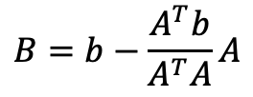

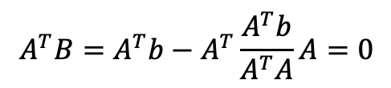
Gram-Schmidt
Independ vectors
$$→$$
Orthogonal vectors
$$→$$
Orthonormal vectors
$$a,b,c$$
$$A,B,C$$
$q_{1},q_{2}$, $q_{3}$
$$A ⊥B$$
$q_{1}$=$\frac{A}{\left\|A\right\|},q_{2}\text{=}\frac{B}{\left\|B\right\|}$, $q_{3}$=$\frac{C}{\left\|C\right\|}$
$$e=B$$
$$b$$
$$B=b−\frac{A^{T}b}{A^{T}A}A$$
$C=c−\frac{A^{T}c}{A^{T}A}A$- $−\frac{B^{T}c}{B^{T}B}B$
$$c$$
$a$=A
$$p=\frac{A^{T}b}{A^{T}b}A$$
The projection of b in the A direction
$$C ⊥A$$
* $c$ is not in the same plane
$$C ⊥B$$
Can you chek that $A ⊥B$?
$$A^{T}B=0$$
${A^{T}B=A}^{T}$ $\left(b−\frac{A^{T}b}{A^{T}A}A\right)$
$${A^{T}B=A}^{T}b−A^{T}\frac{A^{T}b}{A^{T}A}A=0$$

Slide 6
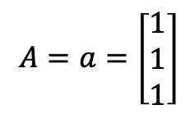
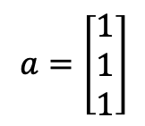
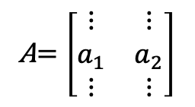

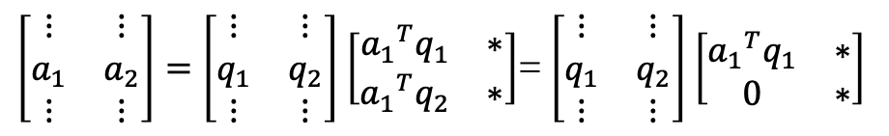
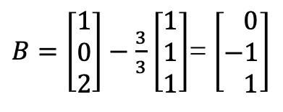

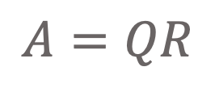
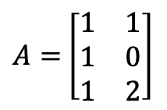




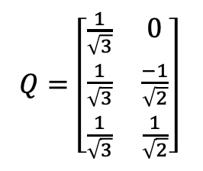
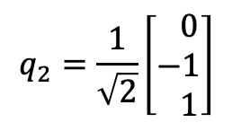
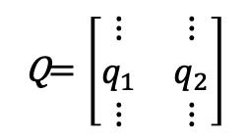
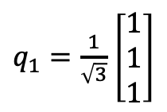
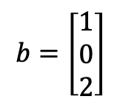
Gram-Schmidt
Example:
Independ vectors
$$→$$
Orthogonal vectors
$$→$$
Orthonormal vectors
$$a,b$$
$$A,B$$
$q_{1},q_{2}$,
$$Q=\left[\begin{matrix}q_{1} & q_{2}\end{matrix}\right]$$
$$a=\left[\begin{matrix}1 \\ 1 \\ 1\end{matrix}\right]$$
$$b=\left[\begin{matrix}1 \\ 0 \\ 2\end{matrix}\right]$$
$$A=a=\left[\begin{matrix}1 \\ 1 \\ 1\end{matrix}\right]$$
$q_{1}=\frac{1}{\sqrt{3}}$ $\left[\begin{matrix}1 \\ 1 \\ 1\end{matrix}\right]$
A$=\left[\begin{matrix}a & b\end{matrix}\right]$
$$q_{2}=\frac{1}{\sqrt{2}}\left[\begin{matrix} 0 \\ −1 \\ 1\end{matrix}\right]$$
$B=\left[\begin{matrix}1 \\ 0 \\ 2\end{matrix}\right]−\frac{3}{3}$ $\left[\begin{matrix}1 \\ 1 \\ 1\end{matrix}\right]$= $\left[\begin{matrix} 0 \\ −1 \\ 1\end{matrix}\right]$
$$\left[\begin{matrix}q_{1} & q_{2}\end{matrix}\right]$$
$$Q=\left[\begin{matrix}\frac{1}{\sqrt{3}} & 0 \\ \frac{1}{\sqrt{3}} & \frac{−1}{\sqrt{2}} \\ \frac{1}{\sqrt{3}} & \frac{1}{\sqrt{2}}\end{matrix}\right]$$
$A=$ $\left[\begin{matrix}\begin{matrix}1 \\ 1 \\ 1\end{matrix} & \begin{matrix}1 \\ 0 \\ 2\end{matrix}\end{matrix}\right]$
A$=\left[\begin{matrix}⋮ & ⋮ \\ a_{1} & a_{2} \\ ⋮ & ⋮\end{matrix}\right]$
Q$=\left[\begin{matrix}⋮ & ⋮ \\ q_{1} & q_{2} \\ ⋮ & ⋮\end{matrix}\right]$
$$A=QR$$
$\left[\begin{matrix}⋮ & ⋮ \\ a_{1} & a_{2} \\ ⋮ & ⋮\end{matrix}\right]=\left[\begin{matrix}⋮ & ⋮ \\ q_{1} & q_{2} \\ ⋮ & ⋮\end{matrix}\right]$ $\left[\begin{matrix}{a_{1}}^{T}q_{1} & ∗ \\ {a_{1}}^{T}q_{2} & ∗\end{matrix}\right]$= $\left[\begin{matrix}⋮ & ⋮ \\ q_{1} & q_{2} \\ ⋮ & ⋮\end{matrix}\right]$ $\left[\begin{matrix}{a_{1}}^{T}q_{1} & ∗ \\ 0 & ∗\end{matrix}\right]$

Slide 7
Gram-Schimidt

Slide 8
Credits
Ariel Guerrero
Lic. Electrónica
ariel.guerrero@uc.edu.py
(+595) 981-425 040
Hernandarias – Paraguay
@2020
Attribution-NonCommercial-ShareAlike 4.0 International (CC BY-NC-SA 4.0)
GitHub
https://github.com/aegiloru/linearAlgebra
Lec 17 –MIT 18.06
https://www.youtube.com/watch?time_continue=6&v=0MtwqhIwdrI
MIT 18.06
https://ocw.mit.edu/courses/mathematics/18-06-linear-algebra-spring-2010/
Prof. Gilbert Strang
http://www-math.mit.edu/~gs/

