Slide 1

Lecture 11 Matrix Spaces, Rank 1, Small world graphs
Basis of a new vector spaces
Rank one matrices
Small world graphs
Attribution-NonCommercial-ShareAlike 4.0 International (CC BY-NC-SA 4.0)

Slide 2
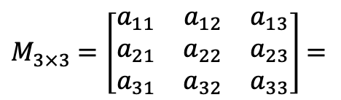

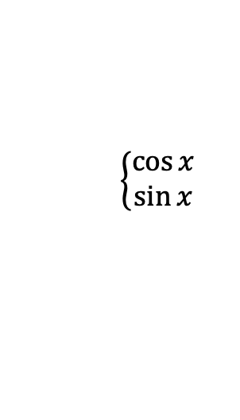

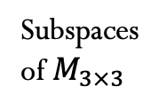

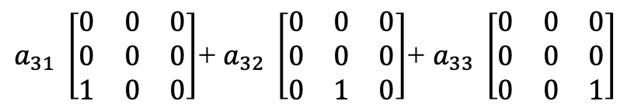

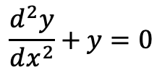
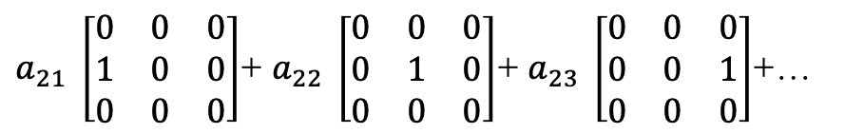


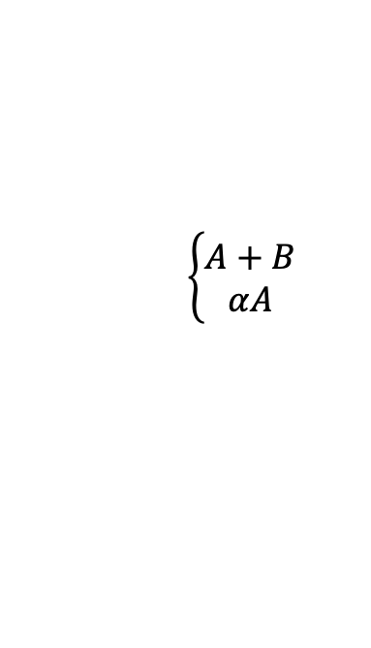
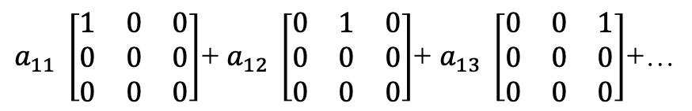


Matrix Spaces
All $M_{3×3}$
$$\left\{\begin{aligned}A+B \\ αA\end{aligned}\right.$$
U
S
D
U $∩$S = D
dim$\left(\text{U} ∩ \text{S}\right)$ = 3
Subspaces
of $M_{3×3}$
Upper
Triangular
Symmetric
matrices
Diagonal
matrices
U $∪$S = M
dim$\left(\text{U}∪\text{S}\right)$ = 9
Dim M = 9
Dim = 6
Dim = 6
Dim = 3
dim$\left(\text{S}\right)$+ dim$\left(\text{U}\right)$ = dim$\left(\text{U} ∩ \text{S}\right)+\text{dim}\left(\text{U}∪\text{S}\right)$
$M_{3×3}$ $=\left[\begin{matrix}a_{11} & a_{12} & a_{13} \\ a_{21} & a_{22} & a_{23} \\ a_{31} & a_{32} & a_{33}\end{matrix}\right]$ $=$
$a_{11} \left[\begin{matrix}1 & 0 & 0 \\ 0 & 0 & 0 \\ 0 & 0 & 0\end{matrix}\right]$+ $a_{12} \left[\begin{matrix}0 & 1 & 0 \\ 0 & 0 & 0 \\ 0 & 0 & 0\end{matrix}\right]$+ $a_{13} \left[\begin{matrix}0 & 0 & 1 \\ 0 & 0 & 0 \\ 0 & 0 & 0\end{matrix}\right]$+…
$a_{21} \left[\begin{matrix}0 & 0 & 0 \\ 1 & 0 & 0 \\ 0 & 0 & 0\end{matrix}\right]$+ $a_{22} \left[\begin{matrix}0 & 0 & 0 \\ 0 & 1 & 0 \\ 0 & 0 & 0\end{matrix}\right]$+ $a_{23} \left[\begin{matrix}0 & 0 & 0 \\ 0 & 0 & 1 \\ 0 & 0 & 0\end{matrix}\right]$+…
$a_{31} \left[\begin{matrix}0 & 0 & 0 \\ 0 & 0 & 0 \\ 1 & 0 & 0\end{matrix}\right]$+ $a_{32} \left[\begin{matrix}0 & 0 & 0 \\ 0 & 0 & 0 \\ 0 & 1 & 0\end{matrix}\right]$+ $a_{33} \left[\begin{matrix}0 & 0 & 0 \\ 0 & 0 & 0 \\ 0 & 0 & 1\end{matrix}\right]$
Function Spaces
$$\frac{d^{2}y}{{ⅆx}^{2}}+y=0$$
$$\left\{\begin{aligned}\cos{x} \\ \sin{x}\end{aligned}\right.$$
$$y=c_{1}\cos{x}+c_{2}\sin{x}$$
dim$\left(\begin{aligned}Solution \\ space\end{aligned}\right)=2$
basis

Slide 3

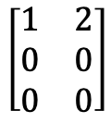



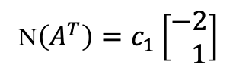

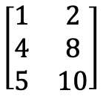
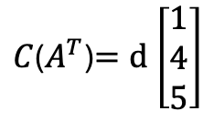




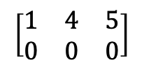


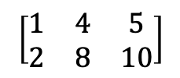

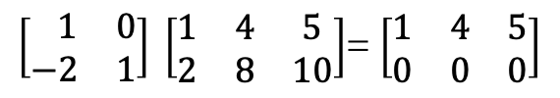

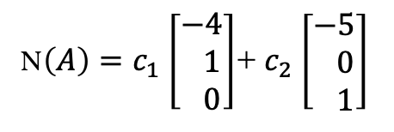




Rank One Matrices
$A=\left[\begin{matrix}1 & 4 & 5 \\ 2 & 8 & 10\end{matrix}\right]$=$\left[\begin{matrix}1 \\ 2\end{matrix}\right]\left[\begin{matrix}1 & 4 & 5\end{matrix}\right]$=$uv^{T}$
$$u=\left[\begin{matrix}1 \\ 2\end{matrix}\right]$$
$v^{T}$= $\left[\begin{matrix}1 & 4 & 5\end{matrix}\right]$
$$A_{2×3}$$
$$\left[\begin{matrix}1 & 4 & 5 \\ 2 & 8 & 10\end{matrix}\right]$$
$$\left[\begin{matrix}1 & 4 & 5 \\ 0 & 0 & 0\end{matrix}\right]$$
$$E=\left[\begin{matrix} 1 & 0 \\ −2 & 1\end{matrix}\right]$$
$$\left[\begin{matrix}1 & 2 \\ 4 & 8 \\ 5 & 10\end{matrix}\right]$$
$$→$$
$$\left[\begin{matrix}1 & 2 \\ 0 & 0 \\ 0 & 0\end{matrix}\right]$$
$$→$$
$$A$$
$$R$$
$$EA=R$$
$$ℝ^{m}$$
$$ℝ^{n}$$
$C\left(A\right)=$c $\left[\begin{matrix}1 \\ 2\end{matrix}\right]$
$\left[\begin{matrix} 1 & 0 \\ −2 & 1\end{matrix}\right] \left[\begin{matrix}1 & 4 & 5 \\ 2 & 8 & 10\end{matrix}\right]$= $\left[\begin{matrix}1 & 4 & 5 \\ 0 & 0 & 0\end{matrix}\right]$
$C$($A^{T}$)$=d$ $\left[\begin{matrix}1 \\ 4 \\ 5\end{matrix}\right]$
dim($C\left(A\right)$)=1
dim($C\text{(}A^{T}\text{)}$)=1
N$\left(A\right)=c_{1}$ $\left[\begin{matrix}−4 \\ 1 \\ 0\end{matrix}\right]$+ $c_{2}$ $\left[\begin{matrix}−5 \\ 0 \\ 1\end{matrix}\right]$
N$\left(A^{T}\right)=c_{1}\left[\begin{matrix}−2 \\ 1\end{matrix}\right]$
dim(N$\text{(}A^{T}\text{)}$)=1
dim(N$\left(A\right)$)=2

Slide 4
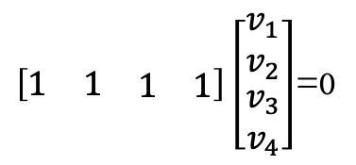



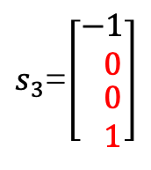




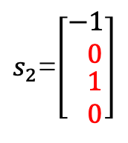


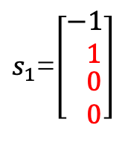



$M_{5×17}=All 5 x 17 rank 4 matrices$
$M_{5×17}$
r=4
Can break down $M_{5×17}$ in rank one matrices?
Would the rank four matrices form a subspace?
In $ℝ^{4}$
Would the rank one matrices form a subspace?
S all $v$ in $ℝ$ with $v_{1}$+ $v_{2}$+ $v_{3}$+ $v_{4}$=0
S nullspace of A
$$Av=0$$
r = rank = 1
$\left[\begin{matrix}1 & 1 & \begin{matrix}1 & 1\end{matrix}\end{matrix}\right]\left[\begin{matrix}v_{1} \\ v_{2} \\ \begin{matrix}v_{3} \\ v_{4}\end{matrix}\end{matrix}\right]$=0
C$\left(A\right)=ℝ$
Dim($N\left(A\right)$)=n-r = 3
$$\left[\begin{matrix}1 & 1 & \begin{matrix}1 & 1\end{matrix}\end{matrix}\right]$$
$N$($A^{T}$)={0}
Dim($N\left(A\right)$)+ Dim(C$\left(A^{T}\right)$)= 3+1=4=n
$s_{1}$=$\left[\begin{matrix}−1 \\ 1 \\ \begin{matrix} 0 \\ 0\end{matrix}\end{matrix}\right]$
$s_{2}$=$\left[\begin{matrix}−1 \\ 0 \\ \begin{matrix} 1 \\ 0\end{matrix}\end{matrix}\right]$
$s_{3}$=$\left[\begin{matrix}−1 \\ 0 \\ \begin{matrix} 0 \\ 1\end{matrix}\end{matrix}\right]$
Dim(C$\left(A\right)$)+ Dim(N$\left(A^{T}\right)$)= 1+0=1=m
Basis for S

Slide 5

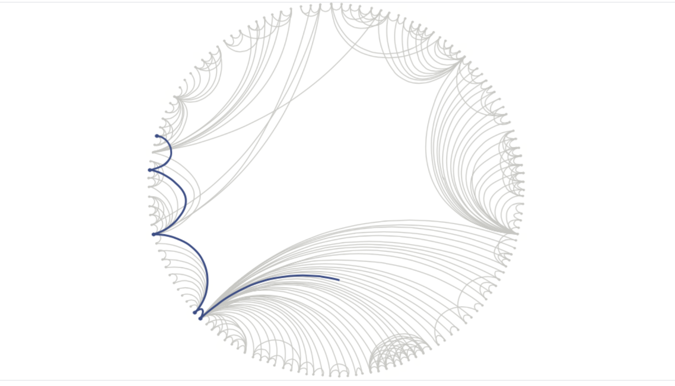
Graphs
Graphs = {nodes, edges}
Internet
Notes:
https://medium.com/basecs/a-gentle-introduction-to-graph-theory-77969829ead8
https://research.fb.com/blog/2016/02/three-and-a-half-degrees-of-separation/
https://mathinsight.org/network_introduction
Adamic L.A. (2009) World Wide Web, Graph Structure. In: Meyers R. (eds) Encyclopedia of Complexity and Systems Science. Springer, New York, NY
https://medium.com/neo4j/article-recommendation-with-personalized-pagerank-and-full-text-search-c0203dd833e8

Slide 6
Credits
Ariel Guerrero
Lic. Electrónica
ariel.guerrero@uc.edu.py
(+595) 981-425 040
Hernandarias – Paraguay
@2020
Attribution-NonCommercial-ShareAlike 4.0 International (CC BY-NC-SA 4.0)
GitHub
https://github.com/aegiloru/linearAlgebra
Lec 11 –MIT 18.06
https://www.youtube.com/watch?v=2IdtqGM6KWU
MIT 18.06
https://ocw.mit.edu/courses/mathematics/18-06-linear-algebra-spring-2010/
Prof. Gilbert Strang
http://www-math.mit.edu/~gs/
Joshi, Vaidehi. (2017). “A Gentle Introduction to graph Theory”. Medium: retrieve from
https://medium.com/basecs/a-gentle-introduction-to-graph-theory-77969829ead8
Baghat et Al. (2016). “Three and a half degrees of separation”. Facebook Research: retrieve from https://medium.com/basecs/a-gentle-introduction-to-graph-theory-77969829ead8
Nykamp DQ. (2019). “An introduction to networks”. Math Insight: retrieve from https://mathinsight.org/network_introduction
Nykamp DQ. (2019). “Article recommendation with Personalized PageRank and Full Text Search”. Medium:
retrieve from https://medium.com/neo4j/article-recommendation-with-personalized-pagerank-and-full-text-search-c0203dd833e8

