Slide 1

Lecture 03 Multiplications and Inverse Matrices
Matrix multiplications (4 ways!)
Inverse of A, Inverse of AB, Inverse of A^{T}
Gauss-Jordan / Find A⁻¹
Attribution-NonCommercial-ShareAlike 4.0 International (CC BY-NC-SA 4.0)

Slide 2
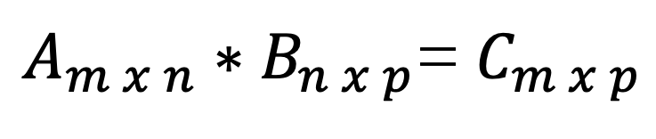
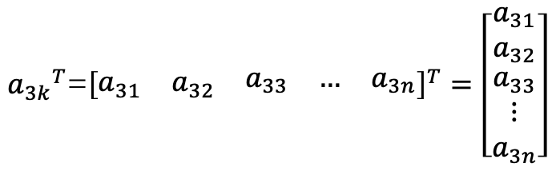
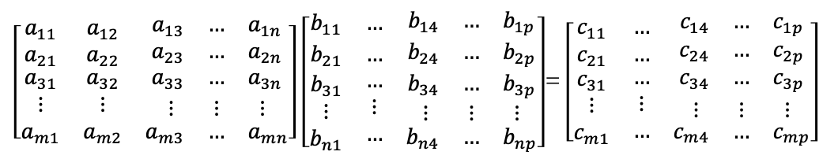

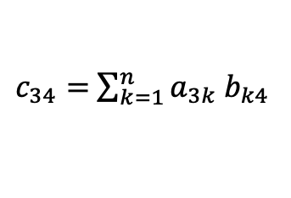

Matrix Multiplication
$A_{m x n}∗B_{n x p}$= $C_{m x p}$
CASE 1 – Row by a Column
$\left[\begin{matrix}a_{11} & a_{12} & \begin{matrix}a_{13} & … & a_{1n}\end{matrix} \\ a_{21} & a_{22} & \begin{matrix}a_{23} & … & a_{2n}\end{matrix} \\ \begin{matrix}a_{31} \\ ⋮ \\ a_{m1}\end{matrix} & \begin{matrix}a_{32} \\ ⋮ \\ a_{m2}\end{matrix} & \begin{matrix}\begin{matrix}a_{33} & … & a_{3n}\end{matrix} \\ \begin{matrix}⋮ & ⋮ & ⋮\end{matrix} \\ \begin{matrix}a_{m3} & … & a_{mn}\end{matrix}\end{matrix}\end{matrix}\right]$ $\left[\begin{matrix}b_{11} & … & \begin{matrix}b_{14} & … & b_{1p}\end{matrix} \\ b_{21} & … & \begin{matrix}b_{24} & … & b_{2p}\end{matrix} \\ \begin{matrix}b_{31} \\ ⋮ \\ b_{n1}\end{matrix} & \begin{matrix}… \\ ⋮ \\ …\end{matrix} & \begin{matrix}\begin{matrix}b_{34} & … & b_{3p}\end{matrix} \\ \begin{matrix}⋮ & ⋮ & ⋮\end{matrix} \\ \begin{matrix}b_{n4} & … & b_{np}\end{matrix}\end{matrix}\end{matrix}\right]$= $\left[\begin{matrix}c_{11} & … & \begin{matrix}c_{14} & … & c_{1p}\end{matrix} \\ c_{21} & … & \begin{matrix}c_{24} & … & c_{2p}\end{matrix} \\ \begin{matrix}c_{31} \\ ⋮ \\ c_{m1}\end{matrix} & \begin{matrix}… \\ ⋮ \\ …\end{matrix} & \begin{matrix}\begin{matrix}c_{34} & … & c_{3p}\end{matrix} \\ \begin{matrix}⋮ & ⋮ & ⋮\end{matrix} \\ \begin{matrix}c_{m4} & … & c_{mp}\end{matrix}\end{matrix}\end{matrix}\right]$
$c_{34}=$ $a_{31}$ $b_{14}+a_{32} b_{24}+…+a_{3n} b_{n4}$
$c_{34}=$ $\sum_{k=1}^{n}{a_{3k} b_{k4}}$
${a_{3k}}^{T}$=${\left[\begin{matrix}a_{31} & a_{32} & \begin{matrix}a_{33} & … & a_{3n}\end{matrix}\end{matrix}\right]}^{T}=\left[\begin{matrix}a_{31} \\ a_{32} \\ \begin{matrix}a_{33} \\ ⋮ \\ a_{3n}\end{matrix}\end{matrix}\right]$
$c_{34}={a_{3k}}^{T}$. $b_{k4}$

Slide 3
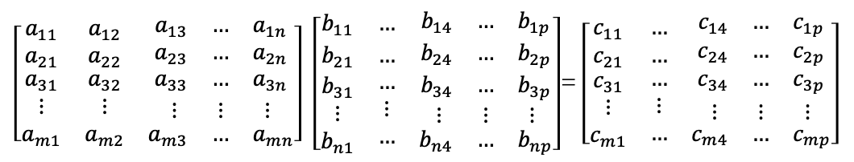
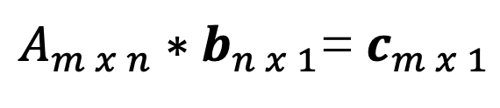
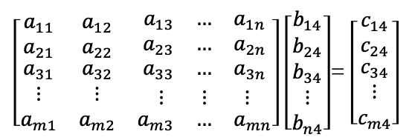
Matrix Multiplication
$A_{m x n}∗B_{n x p}$= $C_{m x p}$
CASE 2 –by Column
$\left[\begin{matrix}a_{11} & a_{12} & \begin{matrix}a_{13} & … & a_{1n}\end{matrix} \\ a_{21} & a_{22} & \begin{matrix}a_{23} & … & a_{2n}\end{matrix} \\ \begin{matrix}a_{31} \\ ⋮ \\ a_{m1}\end{matrix} & \begin{matrix}a_{32} \\ ⋮ \\ a_{m2}\end{matrix} & \begin{matrix}\begin{matrix}a_{33} & … & a_{3n}\end{matrix} \\ \begin{matrix}⋮ & ⋮ & ⋮\end{matrix} \\ \begin{matrix}a_{m3} & … & a_{mn}\end{matrix}\end{matrix}\end{matrix}\right]$ $\left[\begin{matrix}b_{11} & … & \begin{matrix}b_{14} & … & b_{1p}\end{matrix} \\ b_{21} & … & \begin{matrix}b_{24} & … & b_{2p}\end{matrix} \\ \begin{matrix}b_{31} \\ ⋮ \\ b_{n1}\end{matrix} & \begin{matrix}… \\ ⋮ \\ …\end{matrix} & \begin{matrix}\begin{matrix}b_{34} & … & b_{3p}\end{matrix} \\ \begin{matrix}⋮ & ⋮ & ⋮\end{matrix} \\ \begin{matrix}b_{n4} & … & b_{np}\end{matrix}\end{matrix}\end{matrix}\right]$= $\left[\begin{matrix}c_{11} & … & \begin{matrix}c_{14} & … & c_{1p}\end{matrix} \\ c_{21} & … & \begin{matrix}c_{24} & … & c_{2p}\end{matrix} \\ \begin{matrix}c_{31} \\ ⋮ \\ c_{m1}\end{matrix} & \begin{matrix}… \\ ⋮ \\ …\end{matrix} & \begin{matrix}\begin{matrix}c_{34} & … & c_{3p}\end{matrix} \\ \begin{matrix}⋮ & ⋮ & ⋮\end{matrix} \\ \begin{matrix}c_{m4} & … & c_{mp}\end{matrix}\end{matrix}\end{matrix}\right]$
Columns of C are combinations
Of columns of A
$\left[\begin{matrix}a_{11} & a_{12} & \begin{matrix}a_{13} & … & a_{1n}\end{matrix} \\ a_{21} & a_{22} & \begin{matrix}a_{23} & … & a_{2n}\end{matrix} \\ \begin{matrix}a_{31} \\ ⋮ \\ a_{m1}\end{matrix} & \begin{matrix}a_{32} \\ ⋮ \\ a_{m2}\end{matrix} & \begin{matrix}\begin{matrix}a_{33} & … & a_{3n}\end{matrix} \\ \begin{matrix}⋮ & ⋮ & ⋮\end{matrix} \\ \begin{matrix}a_{m3} & … & a_{mn}\end{matrix}\end{matrix}\end{matrix}\right]$ $\left[\begin{matrix}b_{14} \\ b_{24} \\ \begin{matrix}b_{34} \\ ⋮ \\ b_{n4}\end{matrix}\end{matrix}\right]$= $\left[\begin{matrix}c_{14} \\ c_{24} \\ \begin{matrix}c_{34} \\ ⋮ \\ c_{m4}\end{matrix}\end{matrix}\right]$
$A_{m x n}∗b_{n x 1}$= $c_{m x 1}$

Slide 4
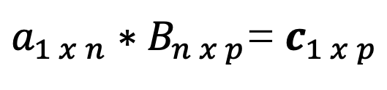
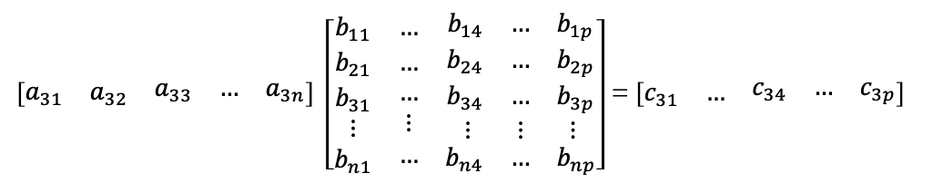
Matrix Multiplication
$A_{m x n}∗B_{n x p}$= $C_{m x p}$
CASE 3 –by Row
$\left[\begin{matrix}a_{11} & a_{12} & \begin{matrix}a_{13} & … & a_{1n}\end{matrix} \\ a_{21} & a_{22} & \begin{matrix}a_{23} & … & a_{2n}\end{matrix} \\ \begin{matrix}a_{31} \\ ⋮ \\ a_{m1}\end{matrix} & \begin{matrix}a_{32} \\ ⋮ \\ a_{m2}\end{matrix} & \begin{matrix}\begin{matrix}a_{33} & … & a_{3n}\end{matrix} \\ \begin{matrix}⋮ & ⋮ & ⋮\end{matrix} \\ \begin{matrix}a_{m3} & … & a_{mn}\end{matrix}\end{matrix}\end{matrix}\right]$ $\left[\begin{matrix}b_{11} & … & \begin{matrix}b_{14} & … & b_{1p}\end{matrix} \\ b_{21} & … & \begin{matrix}b_{24} & … & b_{2p}\end{matrix} \\ \begin{matrix}b_{31} \\ ⋮ \\ b_{n1}\end{matrix} & \begin{matrix}… \\ ⋮ \\ …\end{matrix} & \begin{matrix}\begin{matrix}b_{34} & … & b_{3p}\end{matrix} \\ \begin{matrix}⋮ & ⋮ & ⋮\end{matrix} \\ \begin{matrix}b_{n4} & … & b_{np}\end{matrix}\end{matrix}\end{matrix}\right]$= $\left[\begin{matrix}c_{11} & … & \begin{matrix}c_{14} & … & c_{1p}\end{matrix} \\ c_{21} & … & \begin{matrix}c_{24} & … & c_{2p}\end{matrix} \\ \begin{matrix}c_{31} \\ ⋮ \\ c_{m1}\end{matrix} & \begin{matrix}… \\ ⋮ \\ …\end{matrix} & \begin{matrix}\begin{matrix}c_{34} & … & c_{3p}\end{matrix} \\ \begin{matrix}⋮ & ⋮ & ⋮\end{matrix} \\ \begin{matrix}c_{m4} & … & c_{mp}\end{matrix}\end{matrix}\end{matrix}\right]$
$\left[\begin{matrix}a_{31} & a_{32} & \begin{matrix}a_{33} & … & a_{3n}\end{matrix}\end{matrix}\right] \left[\begin{matrix}b_{11} & … & \begin{matrix}b_{14} & … & b_{1p}\end{matrix} \\ b_{21} & … & \begin{matrix}b_{24} & … & b_{2p}\end{matrix} \\ \begin{matrix}b_{31} \\ ⋮ \\ b_{n1}\end{matrix} & \begin{matrix}… \\ ⋮ \\ …\end{matrix} & \begin{matrix}\begin{matrix}b_{34} & … & b_{3p}\end{matrix} \\ \begin{matrix}⋮ & ⋮ & ⋮\end{matrix} \\ \begin{matrix}b_{n4} & … & b_{np}\end{matrix}\end{matrix}\end{matrix}\right]$= $\left[\begin{matrix}c_{31} & … & \begin{matrix}c_{34} & … & c_{3p}\end{matrix}\end{matrix}\right]$
$a_{1 x n}∗B_{n x p}$= $c_{1 x p}$
Rows of C are combinations
of Rows of B

Slide 5
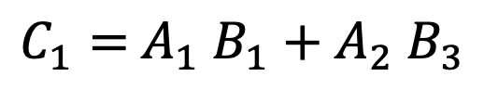
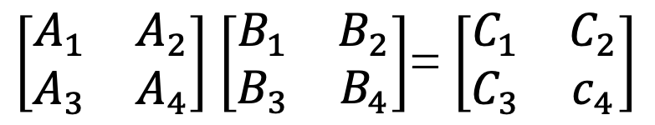
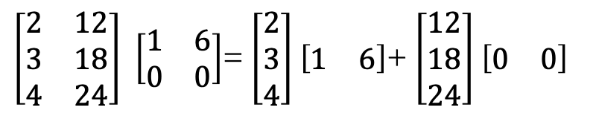


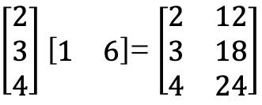
Matrix Multiplication
$A_{m x n}∗B_{n x p}$= $C_{m x p}$
(Cols of A)x(Rows of B)
$$m x 1$$
$$1 x p$$
$\left[\begin{matrix}2 \\ 3 \\ 4\end{matrix}\right]$ $\left[\begin{matrix}1 & 6\end{matrix}\right]$= $\left[\begin{matrix}2 & 12 \\ 3 & 18 \\ 4 & 24\end{matrix}\right]$
CASE 4 – Sum of(Cols of A)x(Rows of B)
$\left[\begin{matrix}2 & 12 \\ 3 & 18 \\ 4 & 24\end{matrix}\right]$ $\left[\begin{matrix}1 & 6 \\ 0 & 0\end{matrix}\right]$= $\left[\begin{matrix}2 \\ 3 \\ 4\end{matrix}\right]$ $\left[\begin{matrix}1 & 6\end{matrix}\right]$+ $\left[\begin{matrix}12 \\ 18 \\ 24\end{matrix}\right]$ $\left[\begin{matrix}0 & 0\end{matrix}\right]$
$\left[\begin{matrix}A_{1} & A_{2} \\ A_{3} & A_{4}\end{matrix}\right]$ $\left[\begin{matrix}B_{1} & B_{2} \\ B_{3} & B_{4}\end{matrix}\right]$= $\left[\begin{matrix}C_{1} & C_{2} \\ C_{3} & c_{4}\end{matrix}\right]$
Block Multiplication
$C_{1}=$ $A_{1}$ $B_{1}+A_{2} B_{3}$

Slide 6

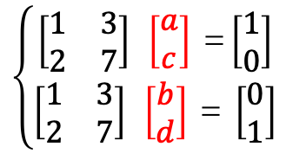






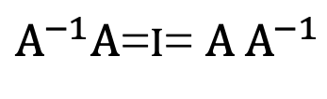
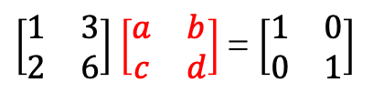
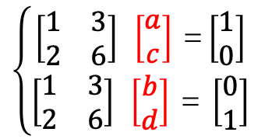



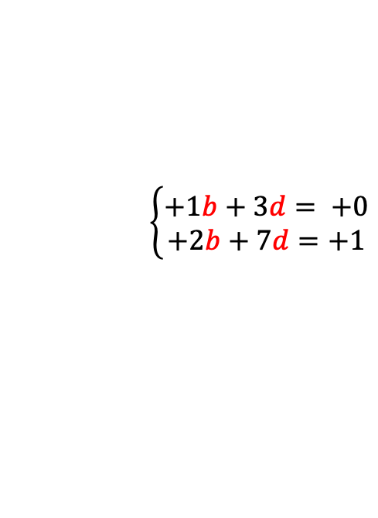



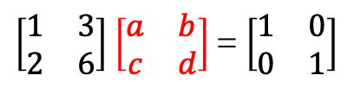
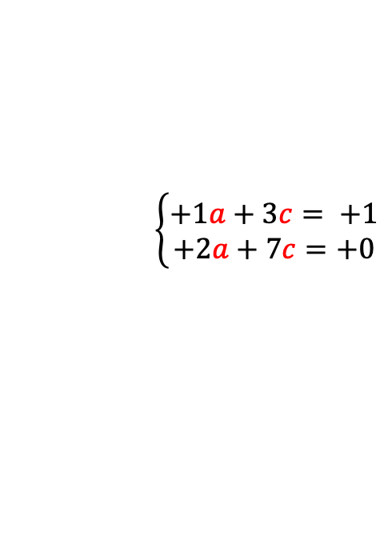

INVERSES (Square Matrix)
$A^{−1}A$=I= $A A^{−1}$
If $A^{−1}$ exist!
${∄A}^{−1}$, Then A is singular and not invertible
${∃A}^{−1}$, Then A is invertiible and not singular
A=$\left[\begin{matrix}1 & 3 \\ 2 & 6\end{matrix}\right]$
$\left[\begin{matrix}1 & 3 \\ 2 & 6\end{matrix}\right]$ $\left[\begin{matrix}a & b \\ c & d\end{matrix}\right]$= $\left[\begin{matrix}1 & 0 \\ 0 & 1\end{matrix}\right]$
A=$\left[\begin{matrix}1 & 3 \\ 2 & 7\end{matrix}\right]$
$\left[\begin{matrix}1 & 3 \\ 2 & 6\end{matrix}\right]$ $\left[\begin{matrix}a & b \\ c & d\end{matrix}\right]$= $\left[\begin{matrix}1 & 0 \\ 0 & 1\end{matrix}\right]$
$$A$$
$$A^{−1}$$
I
$A∗\left[?\right]$= I
$$A$$
$$A^{−1}$$
I
A x column_{j} of A⁻¹ = column_{j} of I
$$\left\{\begin{aligned}\left[\begin{matrix}1 & 3 \\ 2 & 6\end{matrix}\right] \left[\begin{matrix}a \\ c\end{matrix}\right] \text{=}\left[\begin{matrix}1 \\ 0\end{matrix}\right] \\ \left[\begin{matrix}1 & 3 \\ 2 & 6\end{matrix}\right] \left[\begin{matrix}b \\ d\end{matrix}\right] \text{= }\left[\begin{matrix}0 \\ 1\end{matrix}\right]\end{aligned}\right.$$
$$\left\{\begin{aligned}\left[\begin{matrix}1 & 3 \\ 2 & 7\end{matrix}\right] \left[\begin{matrix}a \\ c\end{matrix}\right] \text{=}\left[\begin{matrix}1 \\ 0\end{matrix}\right] \\ \left[\begin{matrix}1 & 3 \\ 2 & 7\end{matrix}\right] \left[\begin{matrix}b \\ d\end{matrix}\right] \text{= }\left[\begin{matrix}0 \\ 1\end{matrix}\right]\end{aligned}\right.$$
Find a vector $x≠0$ with Ax=0
$$\left\{\begin{aligned}+1a+3c= +1 \\ +2a+7c=+0\end{aligned}\right.$$
Test of invertibilty
Ax=$\left[\begin{matrix}1 & 3 \\ 2 & 6\end{matrix}\right]\left[\begin{matrix}x \\ y\end{matrix}\right]$= $\left[\begin{matrix}0 \\ 0\end{matrix}\right]$
$$\left\{\begin{aligned}+1b+3d= +0 \\ +2b+7d=+1\end{aligned}\right.$$
$\left[\begin{matrix}x \\ y\end{matrix}\right]$= $\left[\begin{matrix}+3 \\ −1\end{matrix}\right]$
$\left[\begin{matrix}1 & 3 \\ 2 & 6\end{matrix}\right]\left[\begin{matrix}+3 \\ −1\end{matrix}\right]$= $\left[\begin{matrix}0 \\ 0\end{matrix}\right]$

Slide 7




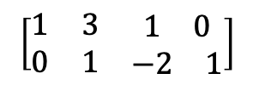

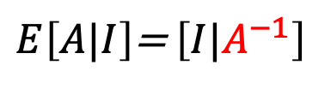





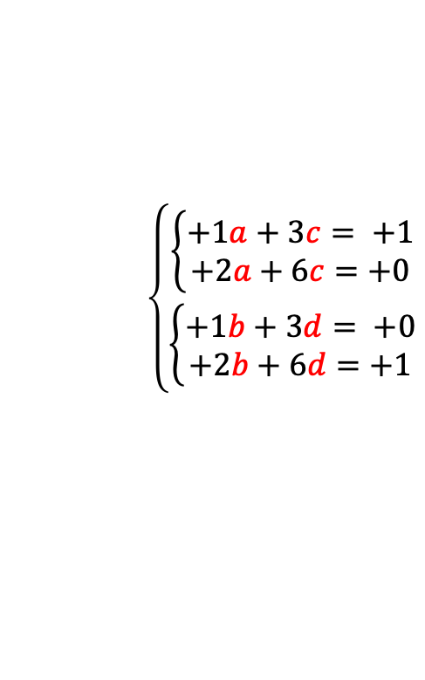
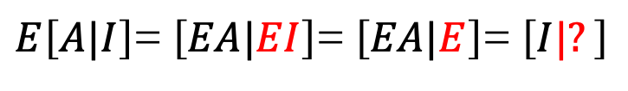





INVERSES (Square Matrix)
$A^{−1}A$=I= $A A^{−1}$
If $A^{−1}$ exist!
GAUSS-JORDAN
$$\left\{\begin{aligned}\left\{\begin{aligned}+1a+3c= +1 \\ +2a+6c=+0\end{aligned}\right. \\ \left\{\begin{aligned}+1b+3d= +0 \\ +2b+6d=+1\end{aligned}\right.\end{aligned}\right.$$
A=$\left[\begin{matrix}1 & 3 \\ 2 & 7\end{matrix}\right]$
Solve 2 equations at once
$E_{21}$=$\left[\begin{matrix}+1 & +0 \\ −2 & +0\end{matrix}\right]$
$E_{12}$=$\left[\begin{matrix}+1 & −3 \\ +0 & +1\end{matrix}\right]$
$$\left[\begin{matrix}1 & 3 & \begin{matrix}1 & 0\end{matrix} \\ 2 & 7 & \begin{matrix}0 & 1\end{matrix}\end{matrix}\right]$$
$$\left[\begin{matrix}1 & 3 & \begin{matrix}1 & 0\end{matrix} \\ 0 & 1 & \begin{matrix}−2 & 1\end{matrix}\end{matrix}\right]$$
$$→$$
$$\left[\begin{matrix}1 & 0 & \begin{matrix}7 & −3\end{matrix} \\ 0 & 1 & \begin{matrix}−2 & 1\end{matrix}\end{matrix}\right]$$
$$→$$
$$A$$
$$I$$
$$I$$
$$A^{−1}$$
Step 1
Substract (2*Row₁) from Row₂
Step 2
Substract (3*Row₂) from Row₁
$${{E=E}_{21}E}_{12}$$
$E\left[A|I\right]$= $\left[EA|EI\right]$= $\left[EA|E\right]$= $\left[I|?\right]$
$$∴EA=I tell us E=A^{−1}$$
$E\left[A|I\right]$= $\left[I|A^{−1}\right]$

Slide 8
Credits
Ariel Guerrero
Lic. Electrónica
ariel.guerrero@uc.edu.py
(+595) 981-425 040
Hernandarias – Paraguay
@2020
Attribution-NonCommercial-ShareAlike 4.0 International (CC BY-NC-SA 4.0)
GitHub
https://github.com/aegiloru/linearAlgebra
Lec 03 –MIT 18.06
https://www.youtube.com/watch?v=FX4C-JpTFgY
MIT 18.06
https://ocw.mit.edu/courses/mathematics/18-06-linear-algebra-spring-2010/
Prof. Gilbert Strang
http://www-math.mit.edu/~gs/

