Slide 1

Lecture 04 Factorization into A=LU
Inverse of AB
Inverse of A^{T}
Product of eliminations matrices:
A=LU (no row echanges!)
Attribution-NonCommercial-ShareAlike 4.0 International (CC BY-NC-SA 4.0)

Slide 2











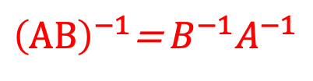

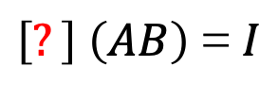


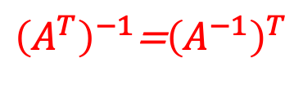
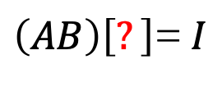

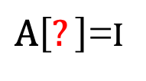

INVERSES (Square Matrix)
If $A^{−1}$ exist!
$A^{−1}A$=I= $A A^{−1}$
INVERSE OF AB
INVERSE OF A^{T}
The transpose of an invertible matrix is also invertible, and its inverse is the transpose of the inverse of the original matrix
${\left(AB\right)}^{−1}$= $B^{−1}A^{−1}$
${\left(A^{T}\right)}^{−1}$=${\left(A^{−1}\right)}^{T}$
$\left(AB\right)\left[?\right]$= $I$
$A\left[?\right]$=I
${\left(AA^{−1}\right)}^{T}$= ${\left(I\right)}^{T}$
$\left(AB\right)\left(B^{−1}A^{−1}\right)$= $…$
${\left(A^{−1}\right)}^{T}$ $A^{T}$=I
A$\left(I\right)A^{−1}$= $…$
This is ${\left(A^{T}\right)}^{−1}$. Inverse of $A^{T}$
A$A^{−1}$=I
$\left[?\right]$ $\left(AB\right)$= $I$
A=$\left[\begin{matrix}1 & 3 \\ 2 & 7\end{matrix}\right]$
$\left(B^{−1}A^{−1}\right)\left(AB\right)$= $…$
$A^{T}$=$\left[\begin{matrix}1 & 2 \\ 3 & 7\end{matrix}\right]$
${\left(A^{T}\right)}^{−1}$=$\left[\begin{matrix}+7 & −2 \\ −3 & +1\end{matrix}\right]$
$B^{−1}\left(I\right)$B= $…$
$B^{−1}$B= $I$
$A^{−1}$=$\left[\begin{matrix}+7 & −3 \\ −2 & +1\end{matrix}\right]$
${\left(A^{−1}\right)}^{T}$=$\left[\begin{matrix}+7 & −2 \\ −3 & +1\end{matrix}\right]$
Gauss - Jordán

Slide 3









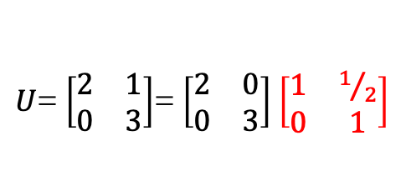

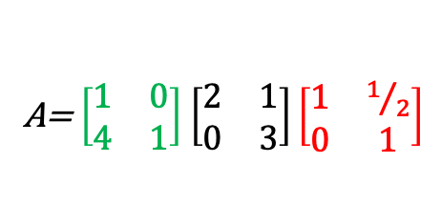




ELIMINATION (Fatorization A=LU)
How is A related to U?
A=$\left[\begin{matrix}2 & 1 \\ 8 & 7\end{matrix}\right]$
No row exchanges !
(2,1)
$A$= LU
$\left[\begin{matrix}2 & 1 \\ 8 & 7\end{matrix}\right]$ $→\left[\begin{matrix}2 & 1 \\ 0 & 3\end{matrix}\right]$
A= $\left[\begin{matrix}1 & 0 \\ 4 & 1\end{matrix}\right]$ $\left[\begin{matrix}2 & 1 \\ 0 & 3\end{matrix}\right]$
$\left[\begin{matrix}+1 & +0 \\ −4 & +1\end{matrix}\right] \left[\begin{matrix}2 & 1 \\ 8 & 7\end{matrix}\right]$ $=\left[\begin{matrix}2 & 1 \\ 0 & 3\end{matrix}\right]$
$A$= LDU
$$E_{21}A=U$$
$U$= $\left[\begin{matrix}2 & 1 \\ 0 & 3\end{matrix}\right]$
$U$= D${ U}_{new}$
${{E_{21}}^{−1}E}_{21}A$= ${E_{21}}^{−1}$U
$U$= $\left[\begin{matrix}2 & 1 \\ 0 & 3\end{matrix}\right]$= $\left[\begin{matrix}2 & 0 \\ 0 & 3\end{matrix}\right]$ $\left[\begin{matrix}1 & 1/2 \\ 0 & 1\end{matrix}\right]$
$A$= ${E_{21}}^{−1}$U
L = ${E_{21}}^{−1}$
A= $\left[\begin{matrix}1 & 0 \\ 4 & 1\end{matrix}\right]$ $\left[\begin{matrix}2 & 1 \\ 0 & 3\end{matrix}\right]\left[\begin{matrix}1 & 1/2 \\ 0 & 1\end{matrix}\right]$
L= $\left[\begin{matrix}1 & 0 \\ 4 & 1\end{matrix}\right]$
U … Upper Triangular Matrix
L … Lower Triangular Matrix
D … Diagonal Matrix
$A$= LU = L D${ U}_{new}$

Slide 4














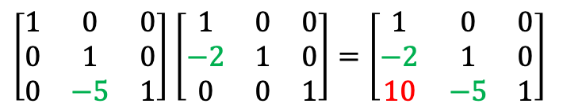


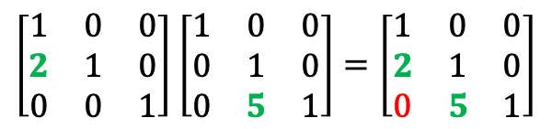

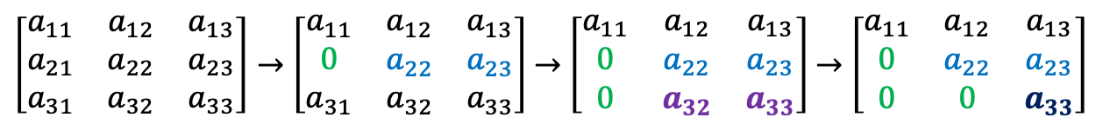


ELIMINATION (Fatorization A=LU)
How is A related to U?
No row exchanges !
(2,1)
(3,1)
(3,2)
$\left[\begin{matrix}a_{11} & a_{12} & a_{13} \\ a_{21} & a_{22} & a_{23} \\ a_{31} & a_{32} & a_{33}\end{matrix}\right]→$ $\left[\begin{matrix}a_{11} & a_{12} & a_{13} \\ 0 & a_{22} & a_{23} \\ a_{31} & a_{32} & a_{33}\end{matrix}\right]$ $→$ $\left[\begin{matrix}a_{11} & a_{12} & a_{13} \\ 0 & a_{22} & a_{23} \\ 0 & a_{32} & a_{33}\end{matrix}\right]$ $→$ $\left[\begin{matrix}a_{11} & a_{12} & a_{13} \\ 0 & a_{22} & a_{23} \\ 0 & 0 & a_{33}\end{matrix}\right]$
$$A$$
U
$$E_{21}A$$
$$→$$
$$E_{31} \left(E_{21}A\right)$$
$$→$$
$$E_{32} \left({E_{31}E}_{21}A\right)$$
$$→$$
$E_{32}{E_{31}E}_{21}A$=U
$E_{32}{E_{31}E}_{21}A$=U
$$E_{32}$$
$$E_{21}$$
$$E$$
$\left[\begin{matrix}1 & 0 & 0 \\ 0 & 1 & 0 \\ 0 & −5 & 1\end{matrix}\right]$ $\left[\begin{matrix}1 & 0 & 0 \\ −2 & 1 & 0 \\ 0 & 0 & 1\end{matrix}\right]=\left[\begin{matrix}1 & 0 & 0 \\ −2 & 1 & 0 \\ 10 & −5 & 1\end{matrix}\right]$
$A$=${{{{{E_{21}}^{−1}E}_{31}}^{−1}E}_{32}}^{−1}$U
$L$=${{{{{E_{21}}^{−1}E}_{31}}^{−1}E}_{32}}^{−1}$
$L$=${{{E_{21}}^{−1}E}_{32}}^{−1}$
$A$=$L$ U
$\left[\begin{matrix}1 & 0 & 0 \\ 2 & 1 & 0 \\ 0 & 0 & 1\end{matrix}\right]$ $\left[\begin{matrix}1 & 0 & 0 \\ 0 & 1 & 0 \\ 0 & 5 & 1\end{matrix}\right]=\left[\begin{matrix}1 & 0 & 0 \\ 2 & 1 & 0 \\ 0 & 5 & 1\end{matrix}\right]$
If no row exchages
Multiplers go directily into L
$${E_{21}}^{−1}$$
$${E_{32}}^{−1}$$
$$L$$

Slide 5
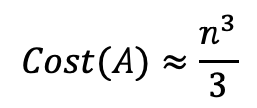
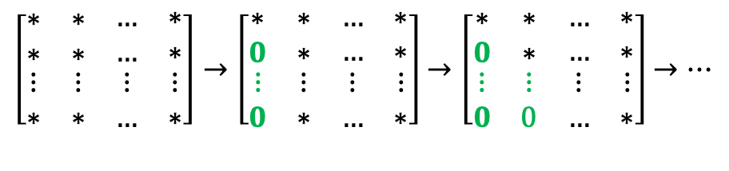
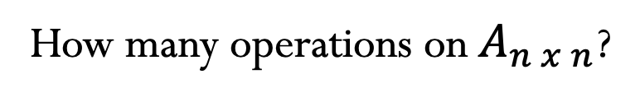

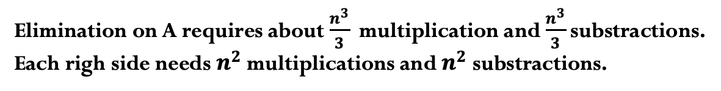

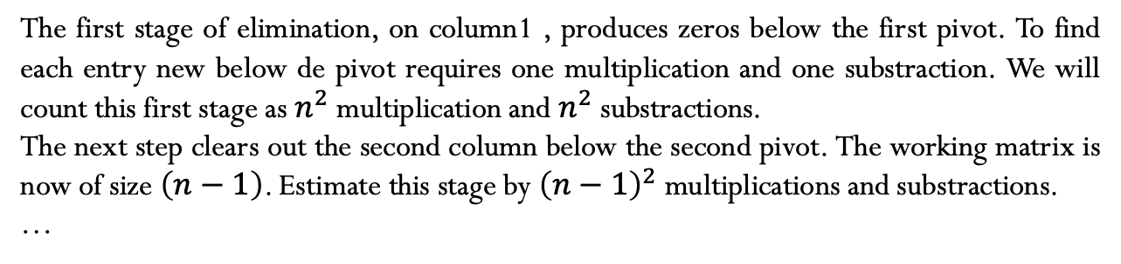


ELIMINATION
How many operations on $A_{n x n}$?
Operations = multiply + substract
Elimination on A requires about $\frac{n^{3}}{3}$ multiplication and $\frac{n^{3}}{3}$substractions.
Each righ side needs $n^{2}$multiplications and $n^{2}$substractions.
$$n^{2}$$
$${\left(n−1\right)}^{2}$$
$$…$$
$\left[\begin{matrix}∗ & ∗ & \begin{matrix}… & ∗\end{matrix} \\ ∗ & ∗ & \begin{matrix}… & ∗\end{matrix} \\ \begin{matrix}⋮ \\ ∗\end{matrix} & \begin{matrix}⋮ \\ ∗\end{matrix} & \begin{matrix}\begin{matrix}⋮ \\ …\end{matrix} & \begin{matrix}⋮ \\ ∗\end{matrix}\end{matrix}\end{matrix}\right]→\left[\begin{matrix}∗ & ∗ & \begin{matrix}… & ∗\end{matrix} \\ 0 & ∗ & \begin{matrix}… & ∗\end{matrix} \\ \begin{matrix}⋮ \\ 0\end{matrix} & \begin{matrix}⋮ \\ ∗\end{matrix} & \begin{matrix}\begin{matrix}⋮ \\ …\end{matrix} & \begin{matrix}⋮ \\ ∗\end{matrix}\end{matrix}\end{matrix}\right]$ $→\left[\begin{matrix}∗ & ∗ & \begin{matrix}… & ∗\end{matrix} \\ 0 & ∗ & \begin{matrix}… & ∗\end{matrix} \\ \begin{matrix}⋮ \\ 0\end{matrix} & \begin{matrix}⋮ \\ 0\end{matrix} & \begin{matrix}\begin{matrix}⋮ \\ …\end{matrix} & \begin{matrix}⋮ \\ ∗\end{matrix}\end{matrix}\end{matrix}\right]$ $→…$
n, n², n³, n!
n= 100?
The first stage of elimination, on column1 , produces zeros below the first pivot. To find each entry new below de pivot requires one multiplication and one substraction. We will count this first stage as $n^{2}$ multiplication and $n^{2}$ substractions.
The next step clears out the second column below the second pivot. The working matrix is now of size $\left(n−1\right)$. Estimate this stage by ${\left(n−1\right)}^{2}$ multiplications and substractions.
…
$Cost(A)≈n^{2}$+ ${\left(n−1\right)}^{2}$+ ${\left(n−2\right)}^{2}+…+3^{2}+2^{2}+1^{2}$
$$Cost(A)≈\frac{n^{3}}{3}$$
$$Cost\left(b\right)≈n^{2}$$

Slide 6
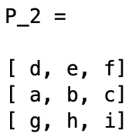
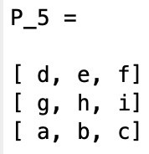
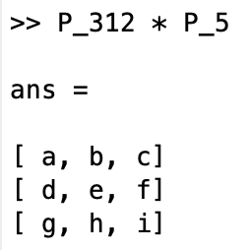

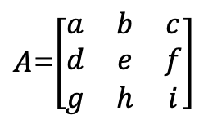

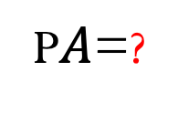
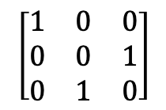

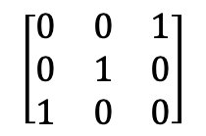


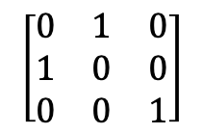



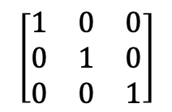
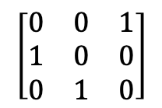
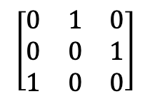
$A$=$\left[\begin{matrix}a & b & c \\ d & e & f \\ g & h & i\end{matrix}\right]$
PERMUTATIONS
P$A$=?
We need to do row exchanges if a zero shows up in the pivot position.
List all the three by three permutation matrices.
$n$= 3 $→06 P^{′}s This is 3!$
I
$P_{12}$
$$P_{13}$$
$P_{23}$
$${P_{23}P}_{12}$$
$${P_{12}P}_{23}$$
$$\left[\begin{matrix}1 & 0 & 0 \\ 0 & 1 & 0 \\ 0 & 0 & 1\end{matrix}\right]$$
$$\left[\begin{matrix}0 & 1 & 0 \\ 1 & 0 & 0 \\ 0 & 0 & 1\end{matrix}\right]$$
$$\left[\begin{matrix}0 & 0 & 1 \\ 0 & 1 & 0 \\ 1 & 0 & 0\end{matrix}\right]$$
$$\left[\begin{matrix}1 & 0 & 0 \\ 0 & 0 & 1 \\ 0 & 1 & 0\end{matrix}\right]$$
$$\left[\begin{matrix}0 & 1 & 0 \\ 0 & 0 & 1 \\ 1 & 0 & 0\end{matrix}\right]$$
$$\left[\begin{matrix}0 & 0 & 1 \\ 1 & 0 & 0 \\ 0 & 1 & 0\end{matrix}\right]$$
A permutation matrix P has the rows of the identity I in any order.
$P^{T}$=$P^{−1}$
$n$= 4 $→24 P^{′}s This is 4!$
Notes:
Corregir esta diapositiva

Slide 7
Credits
Ariel Guerrero
Lic. Electrónica
ariel.guerrero@uc.edu.py
(+595) 981-425 040
Hernandarias – Paraguay
@2020
Attribution-NonCommercial-ShareAlike 4.0 International (CC BY-NC-SA 4.0)
GitHub
https://github.com/aegiloru/linearAlgebra
Lec 04 –MIT 18.06
https://www.youtube.com/watch?v=MsIvs_6vC38
MIT 18.06
https://ocw.mit.edu/courses/mathematics/18-06-linear-algebra-spring-2010/
Prof. Gilbert Strang
http://www-math.mit.edu/~gs/

