Slide 1


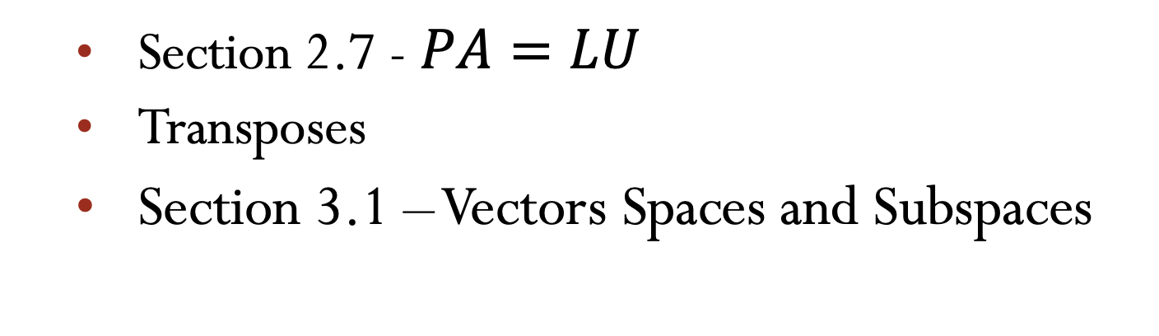
Lecture 05 Transposes, Permutations, Spaces $ℝ^{n}$
Section 2.7 - $PA=LU$
Transposes
Section 3.1 – Vectors Spaces and Subspaces
Attribution-NonCommercial-ShareAlike 4.0 International (CC BY-NC-SA 4.0)

Slide 2
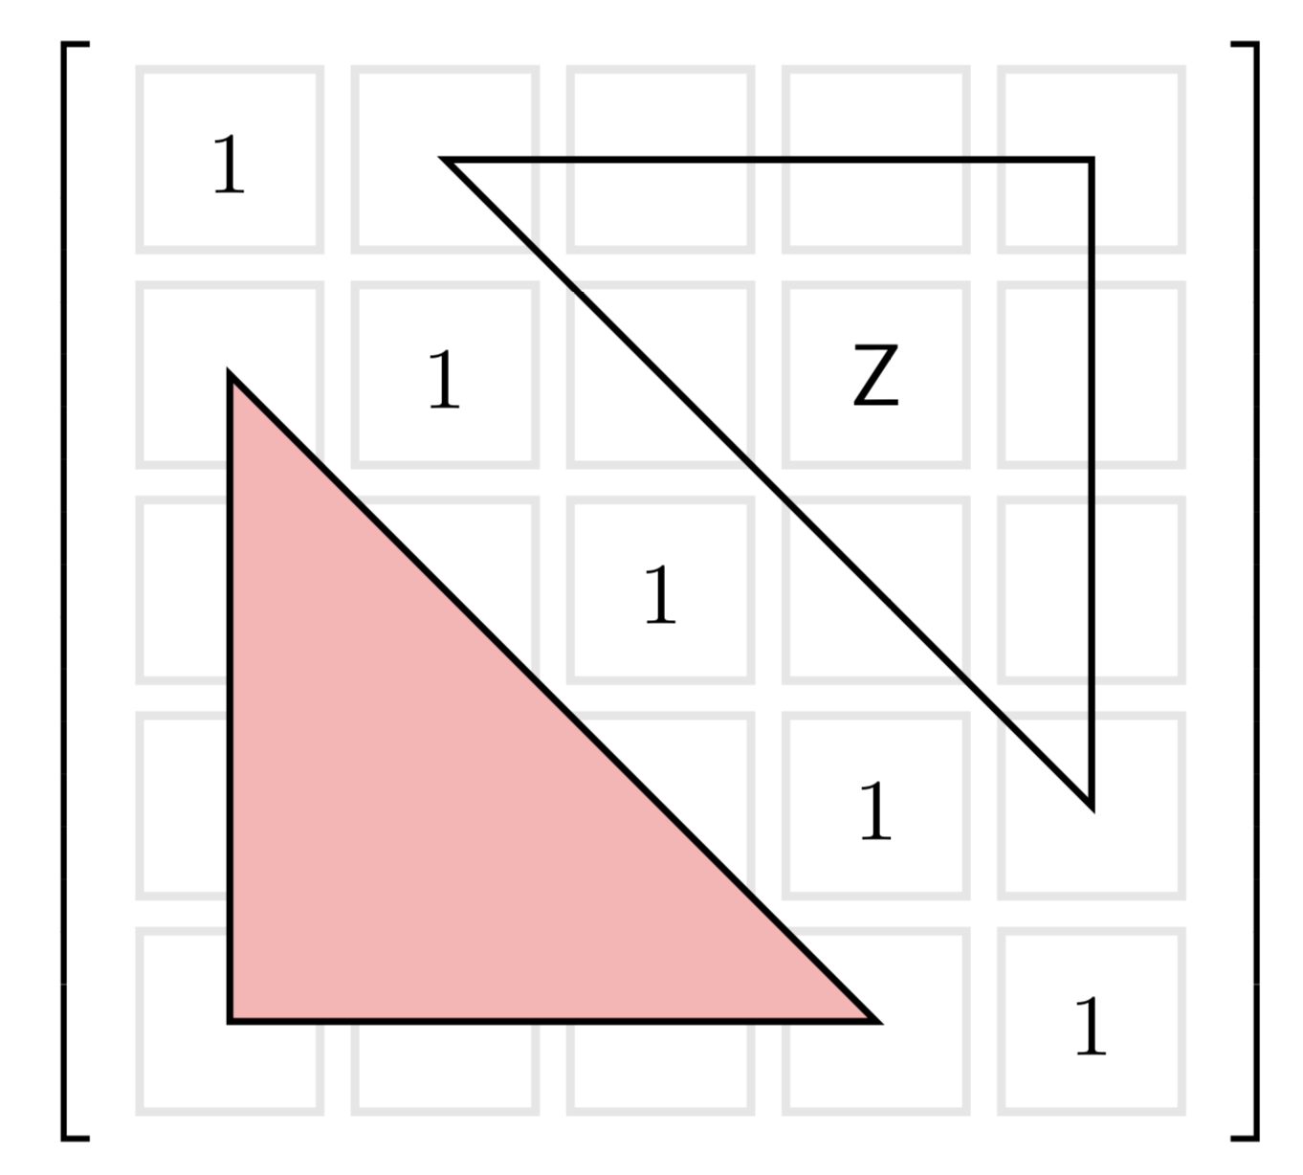
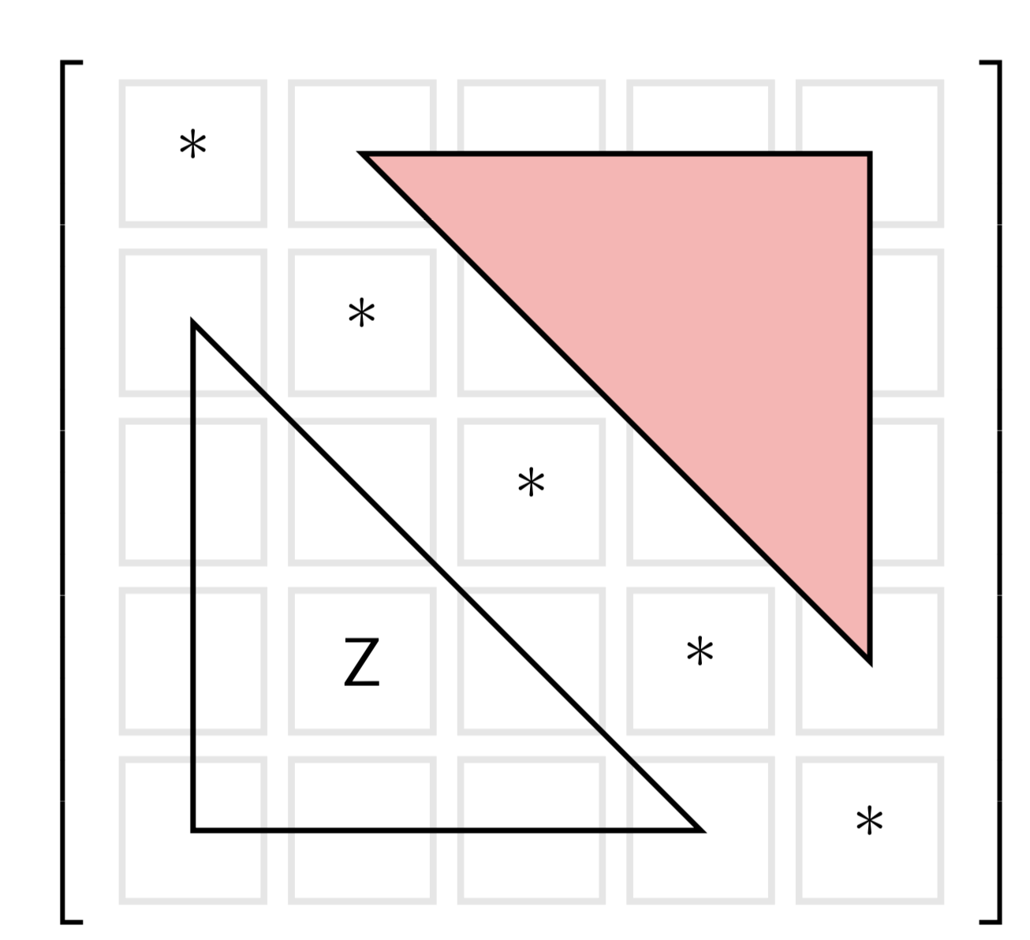
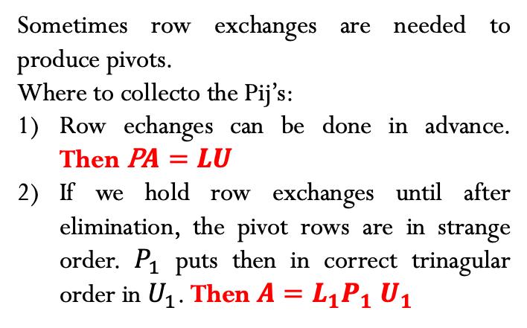
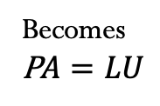




PERMUTATIONS
The PA=LU Factorizations with row exchange
If A is invertible then a permutation P will reorder its rows for P$A=LU$
Sometimes row exchanges are needed to produce pivots.
Where to collecto the Pij’s:
Row echanges can be done in advance. Then P$A=LU$
If we hold row exchanges until after elimination, the pivot rows are in strange order. $P_{1}$ puts then in correct trinagular order in $U_{1}$. Then $A=L_{1}P_{1}$ $U_{1}$
$$A=LU$$
Becomes
P$A=LU$
L=Lower
U=Upper
P is the identity matrix I with rorder rows
$n!=n\left(n−1\right)$ $\left(n−2\right)⋯\left(3\right)$ $\left(2\right)$ $\left(1\right)$
$P^{−1}$=$P^{T}$
$P^{T}P$=I
Counts all $n$x$n$ permutations.

Slide 3
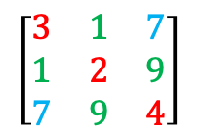






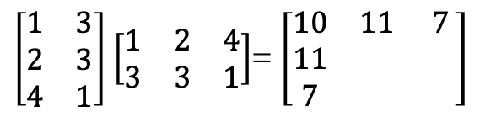
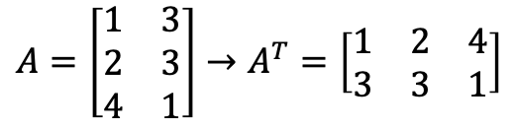


Transposes
The transpose puts rows of A into the columns of $A^{T}$. Then${\left(A^{T}\right)}_{ij}=A_{ji}$
$$A=\left[\begin{matrix}1 & 3 \\ 2 & 3 \\ 4 & 1\end{matrix}\right]→A^{T}=\left[\begin{matrix}1 & 2 & 4 \\ 3 & 3 & 1\end{matrix}\right]$$
$$3 x 2$$
$$2 x 3$$
$\left[\begin{matrix}3 & 1 & 7 \\ 1 & 2 & 9 \\ 7 & 9 & 4\end{matrix}\right]$
Symetric Matrices
$A^{T}$=A
$R^{T}R$ is always symetrics.
Why? Take the transpose!
$\left[\begin{matrix}1 & 3 \\ 2 & 3 \\ 4 & 1\end{matrix}\right]$ $\left[\begin{matrix}1 & 2 & 4 \\ 3 & 3 & 1\end{matrix}\right]$= $\left[\begin{matrix}10 & 11 & 7 \\ 11 & & \\ 7 & & \end{matrix}\right]$
${\left(R^{T}R\right)}^{T}=R^{T}$ ${\left(R^{T}\right)}^{T}=R^{T}$R
$$3 x 2$$
$$2 x 3$$
$$3 x 3$$

Slide 4
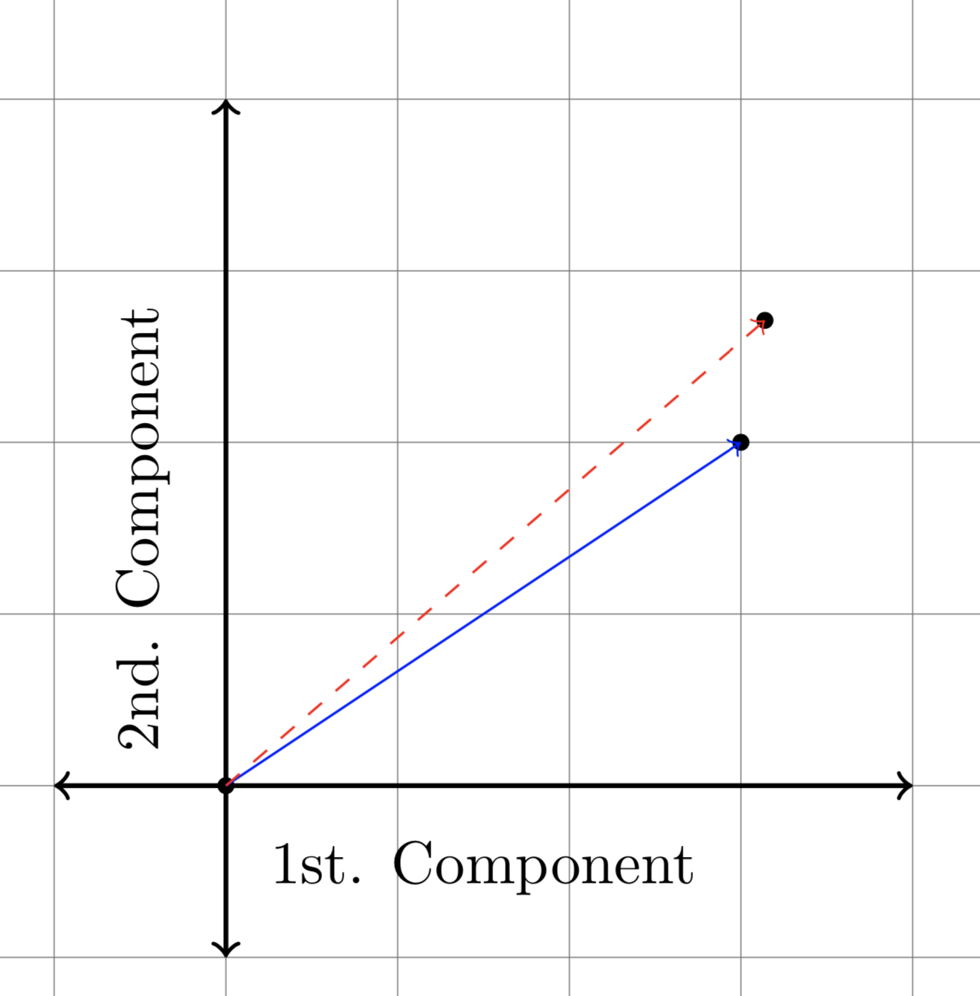
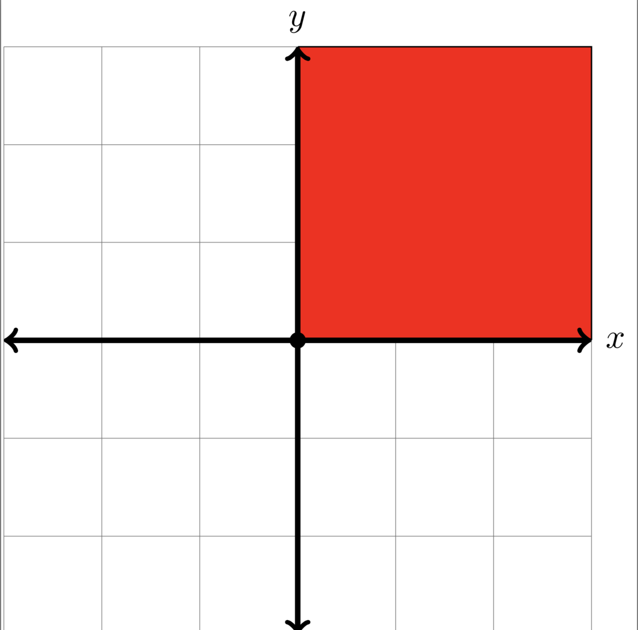
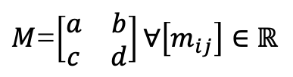
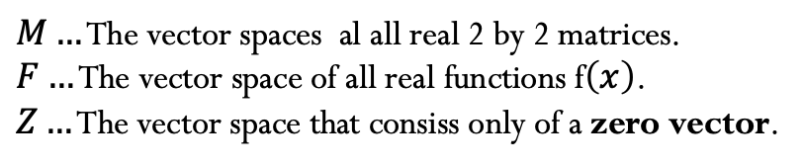
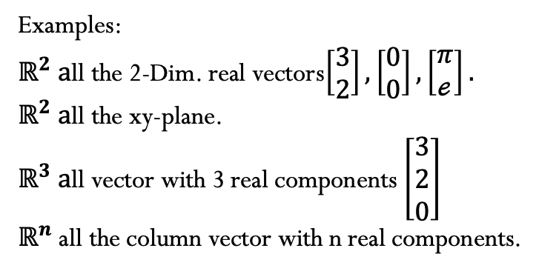

Vector Spaces
The space $ℝ^{n}$consist all of columns vectors $v$ with n components.
A real vector space is a set de “vector” together wiith rules for vector adition and for multiplication
By real numbers. (8 conditions – Problem set 3.1)
Examples:
$ℝ^{2} a$ll the 2-Dim. real vectors$\left[\begin{matrix}3 \\ 2\end{matrix}\right],\left[\begin{matrix}0 \\ 0\end{matrix}\right],\left[\begin{matrix}π \\ ℯ\end{matrix}\right].$
$ℝ^{2} a$ll the xy-plane.
$ℝ^{3} a$ll vector with 3 real components $\left[\begin{matrix}3 \\ 2 \\ 0\end{matrix}\right]$
$ℝ^{n}$ all the column vector with n real components.
$M…$ The vector spaces al all real 2 by 2 matrices.
$F…$ The vector space of all real functions f$\left(x\right)$.
$Z…$ The vector space that consiss only of a zero vector.
$M$=$\left[\begin{matrix}a & b \\ c & d\end{matrix}\right]∀\left[m_{ij}\right]∈ℝ$
$$P_{n}=a_{0}+a_{1}x+…+a_{n}x^{n}$$
Not a vector Space!

Slide 5
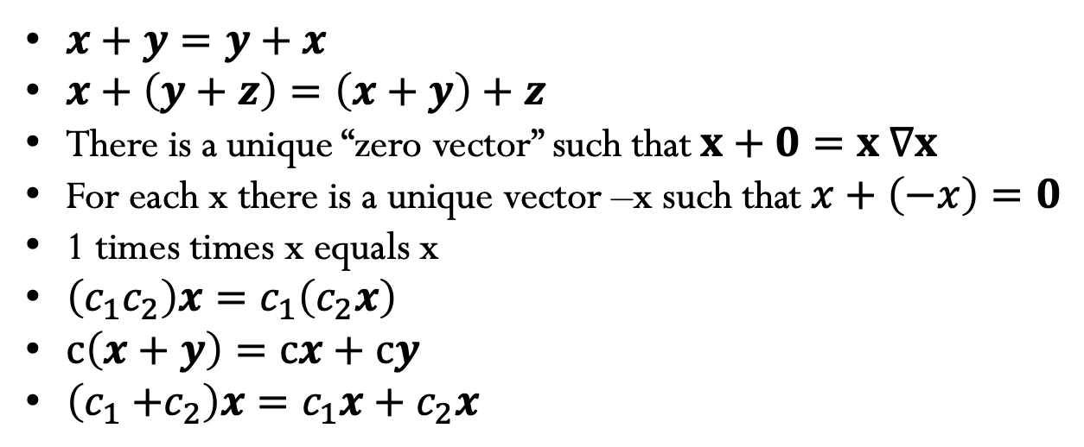
Vector Spaces
A real vector space is a set de “vector” together wiith rules for vector adition and for multiplication
By real numbers. (8 conditions – Problem set 3.1)
$x+y=y+x$
$x+\left(y+z\right)=\left(x+y\right)+z$
There is a unique “zero vector” such that $x+0=x ∇x$
For each x there is a unique vector –x such that $x+$ $\left(−x\right)=0$
1 times times x equals x
$\left(c_{1}c_{2}\right)x=c_{1}\left(c_{2}x\right)$
$c\left(x+y\right)=cx+cy$
$\left(c_{1}{+c}_{2}\right)x=c_{1}x+c_{2}x$

Slide 6
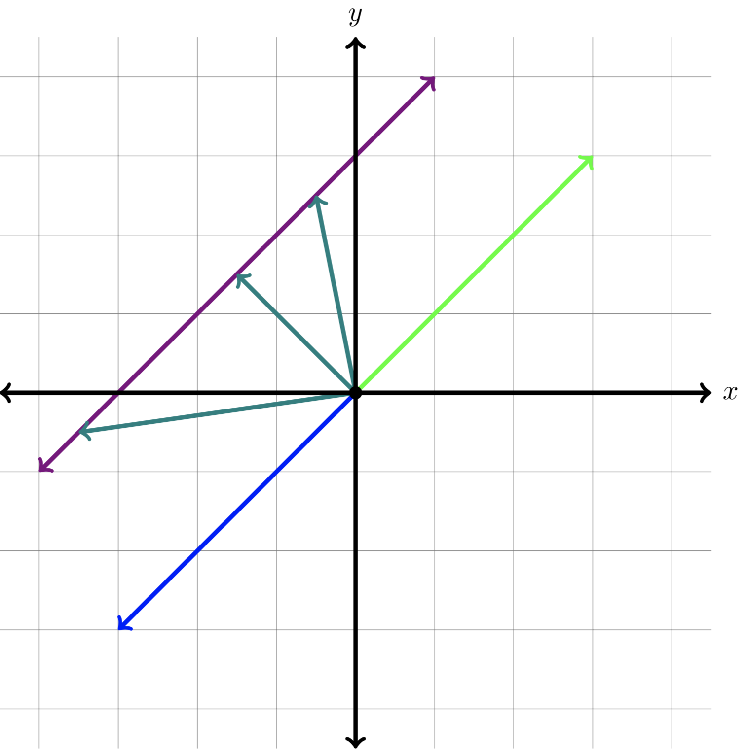

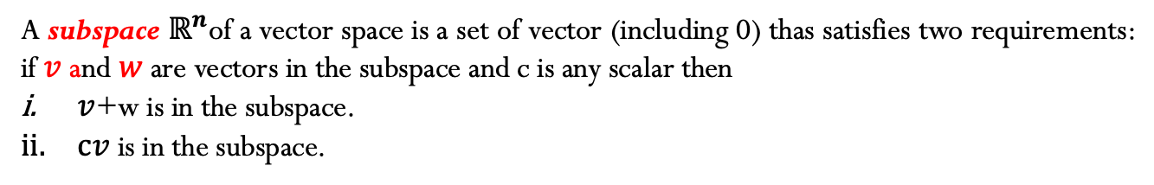
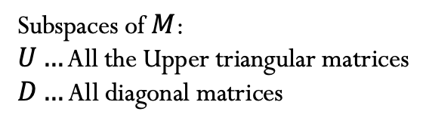
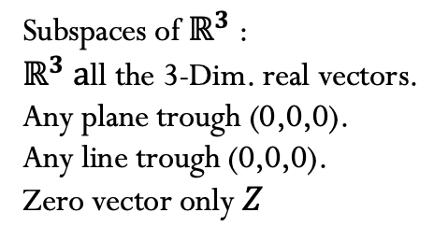
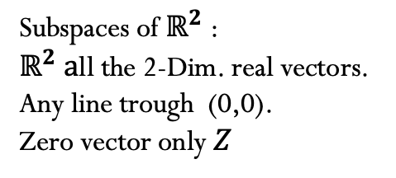

Vector Spaces
A subspace $ℝ^{n}$of a vector space is a set of vector (including 0) thas satisfies two requirements: if $v$ and $w$ are vectors in the subspace and c is any scalar then
$v$+w is in the subspace.
$cv$ is in the subspace.
Subspaces of $ℝ^{2}$:
$ℝ^{2} a$ll the 2-Dim. real vectors.
Any line trough (0,0).
Zero vector only $Z$
Subspaces of $ℝ^{3}$:
$ℝ^{3} a$ll the 3-Dim. real vectors.
Any plane trough (0,0,0).
Any line trough (0,0,0).
Zero vector only $Z$
Subspaces of$M$:
$U…$ All the Upper triangular matrices
$D…$ All diagonal matrices
$U$=$\left[\begin{matrix}a & b \\ 0 & d\end{matrix}\right]$
$D$=$\left[\begin{matrix}a & 0 \\ 0 & d\end{matrix}\right]$

Slide 7
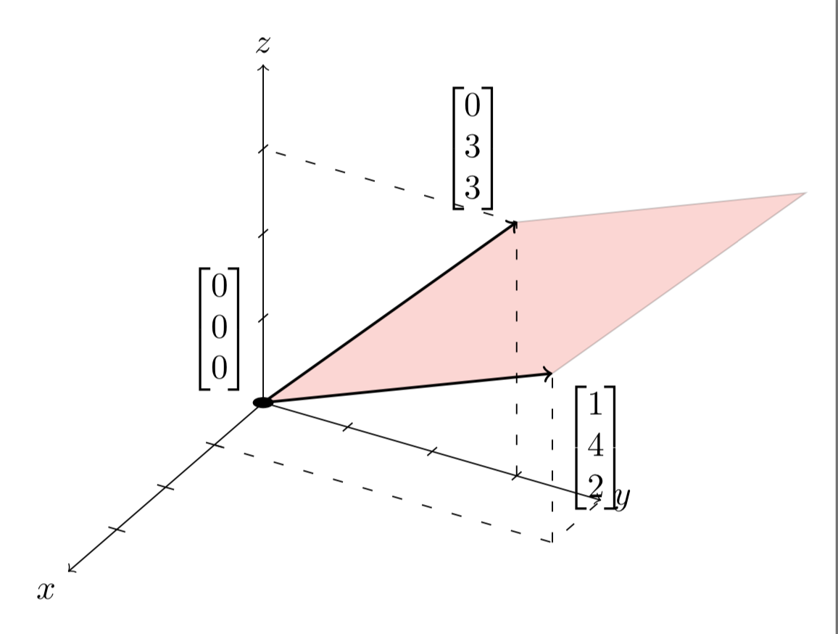
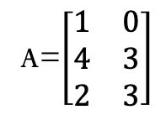
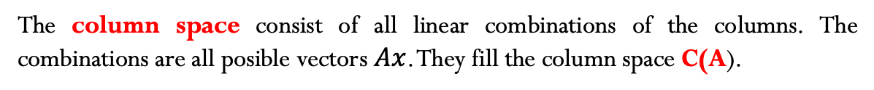
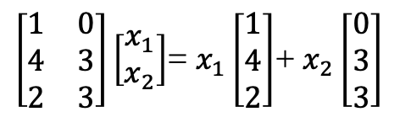


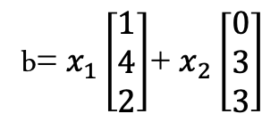
The column space of A
The column space consist of all linear combinations of the columns. The combinations are all posible vectors $Ax$. They fill the column space C(A).
$$A_{m x n}$$
The column space of A is a subspace of $ℝ^{m}$.Then column space is “spanned” by the columns.
The system $Ax=b$ is solvable if and only if $b$ is in the column space of $A$
$\left[\begin{matrix}1 & 0 \\ 4 & 3 \\ 2 & 3\end{matrix}\right]\left[\begin{matrix}x_{1} \\ x_{2}\end{matrix}\right]$= $x_{1}\left[\begin{matrix}1 \\ 4 \\ 2\end{matrix}\right]$+ $x_{2}\left[\begin{matrix}0 \\ 3 \\ 3\end{matrix}\right]$
A=$\left[\begin{matrix}1 & 0 \\ 4 & 3 \\ 2 & 3\end{matrix}\right]$
b= $x_{1}\left[\begin{matrix}1 \\ 4 \\ 2\end{matrix}\right]$+ $x_{2}\left[\begin{matrix}0 \\ 3 \\ 3\end{matrix}\right]$
Plane = C(A)= all vectors $Ax$

Slide 8
Credits
Ariel Guerrero
Lic. Electrónica
ariel.guerrero@uc.edu.py
(+595) 981-425 040
Hernandarias – Paraguay
@2020
Attribution-NonCommercial-ShareAlike 4.0 International (CC BY-NC-SA 4.0)
GitHub
https://github.com/aegiloru/linearAlgebra
Lec 05 –MIT 18.06
https://www.youtube.com/watch?v=JibVXBElKL0
MIT 18.06
https://ocw.mit.edu/courses/mathematics/18-06-linear-algebra-spring-2010/
Prof. Gilbert Strang
http://www-math.mit.edu/~gs/

