Slide 1

Lecture 16 Projections matrices and Least Squares
Projection Matrix
Least Squares and best straight line
Attribution-NonCommercial-ShareAlike 4.0 International (CC BY-NC-SA 4.0)

Slide 2

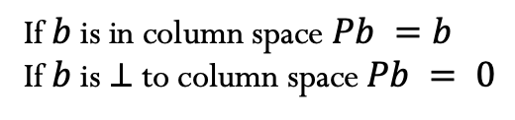









Projection Matrix
$$C(A)$$
$$P=A {{\left(A^{T}A\right)}^{−1}A}^{T}$$
If $b$ is in column space $Pb =b$
If $b$ is $⊥$ to column space $Pb = 0$
$$p=Pb$$
$$p$$
$$b$$
$$p+e=b$$
$$e$$
$$e=\left(I−P\right)b$$
Project onto $⊥$ space
$$N(AT)$$

Slide 3




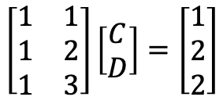





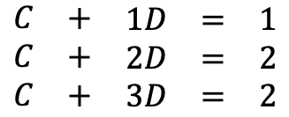






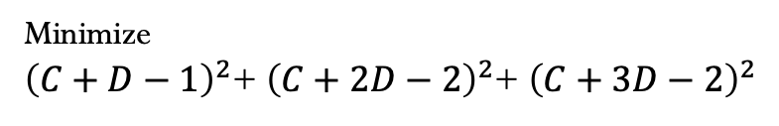
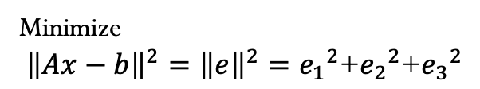












Least Squares
$Ax=b$
Minimize
${\left\|Ax−b\right\|}^{2}={\left\|e\right\|}^{2}={e_{1}}^{2}\text{+}{e_{2}}^{2}\text{+}{e_{3}}^{2}$
$$\begin{matrix}C & + & \begin{matrix}1D & = & 1\end{matrix} \\ C & + & \begin{matrix}2D & = & 2\end{matrix} \\ C & + & \begin{matrix}3D & = & 2\end{matrix}\end{matrix}$$
$$\left[\begin{matrix}1 & 1 \\ 1 & 2 \\ 1 & 3\end{matrix}\right]\left[\begin{matrix}C \\ D\end{matrix}\right]=\left[\begin{matrix}1 \\ 2 \\ 2\end{matrix}\right]$$
Minimize
${\left(C+D−1\right)}^{2}$+ ${\left(C+2D−2\right)}^{2}$+ ${\left(C+3D−2\right)}^{2}$
$$b$$
$$C(A)$$
3
$$\left[\begin{matrix}1 & 1 \\ 1 & 2 \\ 1 & 3\end{matrix}\right]$$
$$p_{3}$$
$$b=C+Dt$$
$$b_{2}$$
$$e_{3}$$
$$p$$
2
$$×$$
$$×$$
$$b=\left[\begin{matrix}1 \\ 2 \\ 2\end{matrix}\right]$$
$$b$$
$$e_{2}$$
$$b_{3}$$
$$p_{2}$$
$$p_{1}$$
$$e$$
$$e_{1}$$
$$×$$
$$b_{i}$$
1
$$×$$
$$p_{i}$$
$$b_{1}$$
$$e_{i}$$
$$t$$
$$N(AT)$$
1
2
3

Slide 4

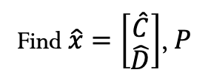








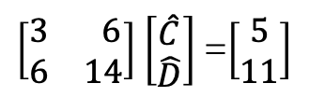

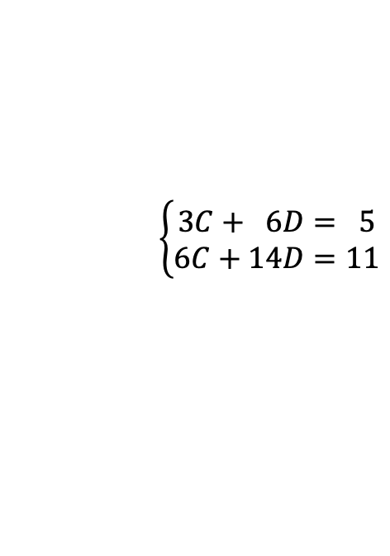



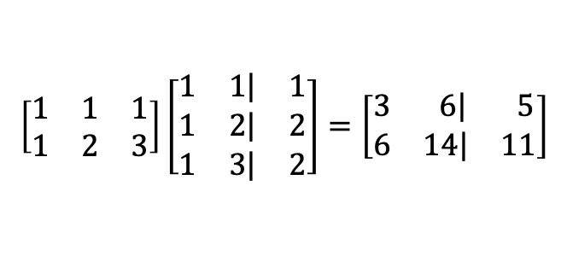



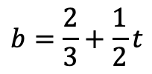




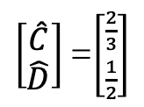


Least Squares
$Ax=b$
Minimize
${\left\|Ax−b\right\|}^{2}={\left\|e\right\|}^{2}={e_{1}}^{2}\text{+}{e_{2}}^{2}\text{+}{e_{3}}^{2}$
$$\begin{matrix}C & + & \begin{matrix}1D & = & 1\end{matrix} \\ C & + & \begin{matrix}2D & = & 2\end{matrix} \\ C & + & \begin{matrix}3D & = & 2\end{matrix}\end{matrix}$$
$$\left[\begin{matrix}1 & 1 \\ 1 & 2 \\ 1 & 3\end{matrix}\right]\left[\begin{matrix}C \\ D\end{matrix}\right]=\left[\begin{matrix}1 \\ 2 \\ 2\end{matrix}\right]$$
Minimize
${\left(C+D−1\right)}^{2}$+ ${\left(C+2D−2\right)}^{2}$+ ${\left(C+3D−2\right)}^{2}$
$$b$$
Find $\hat{x}=\left[\begin{matrix}\hat{C} \\ \hat{D}\end{matrix}\right]$, $P$
3
$$p_{3}$$
$$b=C+Dt$$
$A^{T}A$ $\hat{x}=A^{T}b$
$$b_{2}$$
$$e_{3}$$
$$\left[\begin{matrix}1 & 1 & 1 \\ 1 & 2 & 3\end{matrix}\right]\left[\begin{matrix}1 & \left.1\right| & 1 \\ 1 & \left.2\right| & 2 \\ 1 & \left.3\right| & 2\end{matrix}\right]=\left[\begin{matrix}3 & \left. 6\right| & 5 \\ 6 & \left.14\right| & 11\end{matrix}\right]$$
2
$$×$$
$$×$$
$$e_{2}$$
$$b_{3}$$
$$p_{2}$$
$$p_{1}$$
$\left[\begin{matrix}3 & 6 \\ 6 & 14\end{matrix}\right]$ $\left[\begin{matrix}\hat{C} \\ \hat{D}\end{matrix}\right]$ =$\left[\begin{matrix}5 \\ 11\end{matrix}\right]$
$$\left\{\begin{aligned}3C+ 6D= 5 \\ 6C+14D=11\end{aligned}\right.$$
$$e_{1}$$
$$×$$
$$b_{i}$$
1
$$×$$
$$p_{i}$$
$$b_{1}$$
$$e_{i}$$
$\left[\begin{matrix}\hat{C} \\ \hat{D}\end{matrix}\right]$ =$\left[\begin{matrix}\frac{2}{3} \\ \frac{1}{2}\end{matrix}\right]$
$$2D=1$$
$$D=\frac{1}{2}$$
$$t$$
$$3C+ 6D= 5$$
1
2
3
$$b=\frac{2}{3}+\frac{1}{2}t$$
$$3C+ 3= 5$$
$$C=\frac{2}{3}$$

Slide 6
Credits
Ariel Guerrero
Lic. Electrónica
ariel.guerrero@uc.edu.py
(+595) 981-425 040
Hernandarias – Paraguay
@2020
Attribution-NonCommercial-ShareAlike 4.0 International (CC BY-NC-SA 4.0)
GitHub
https://github.com/aegiloru/linearAlgebra
Lec 16 –MIT 18.06
https://www.youtube.com/watch?time_continue=2&v=osh80YCg_GM
MIT 18.06
https://ocw.mit.edu/courses/mathematics/18-06-linear-algebra-spring-2010/
Prof. Gilbert Strang
http://www-math.mit.edu/~gs/

