Slide 1

Lecture 09 Independence, Basis and Dimension
Linear Independence
Spanning a space
Basis
Dimension
Attribution-NonCommercial-ShareAlike 4.0 International (CC BY-NC-SA 4.0)

Slide 2
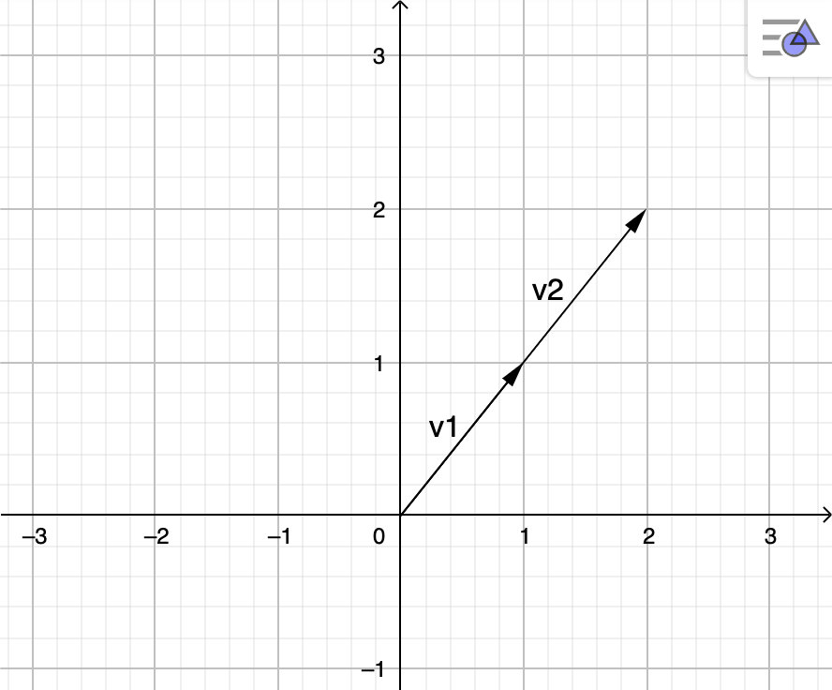
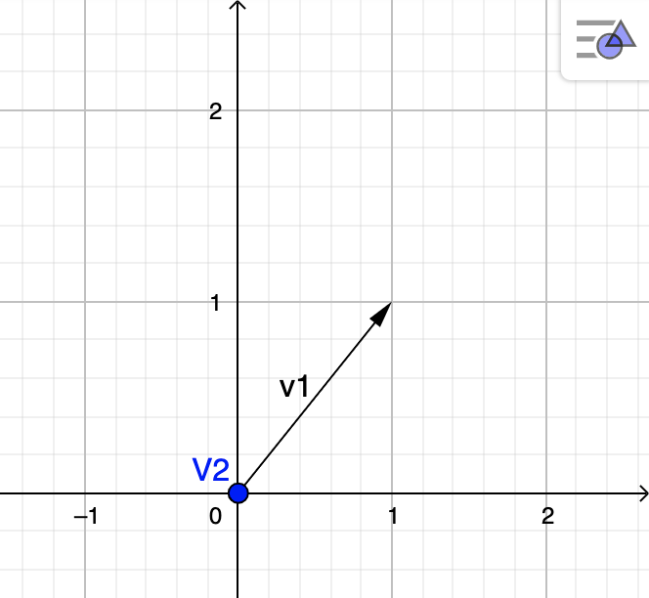
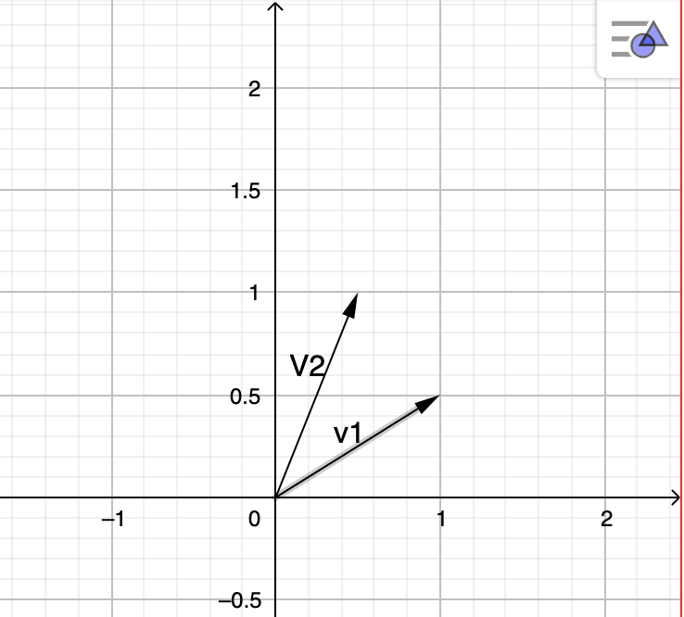



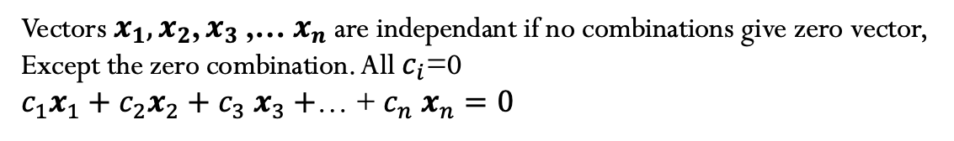
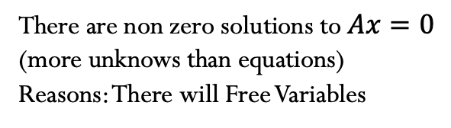

S$upose A_{m×n} wiht m≤n$
There are non zero solutions to $Ax=0$
(more unknows than equations)
Reasons: There will Free Variables
Independence
Vectors $x_{1},x_{2}$, $x_{3}$,… $x_{n}$are independant if no combinations give zero vector,
Except the zero combination. All $c_{i}$=0
${c_{1}x}_{1}+{c_{2}x}_{2}+$ $c_{3} x_{3}+$… + $c_{n} x_{n}=0$
$$\vec{v_{2}}=2\vec{v_{1}}$$
$2\vec{v_{1}}$- $\vec{v_{1}}=0$
$0\vec{v_{1}}$- $6\vec{v_{1}}=0$
Notes:
Graficos realizados en geogebra, cambiar a tickz

Slide 3
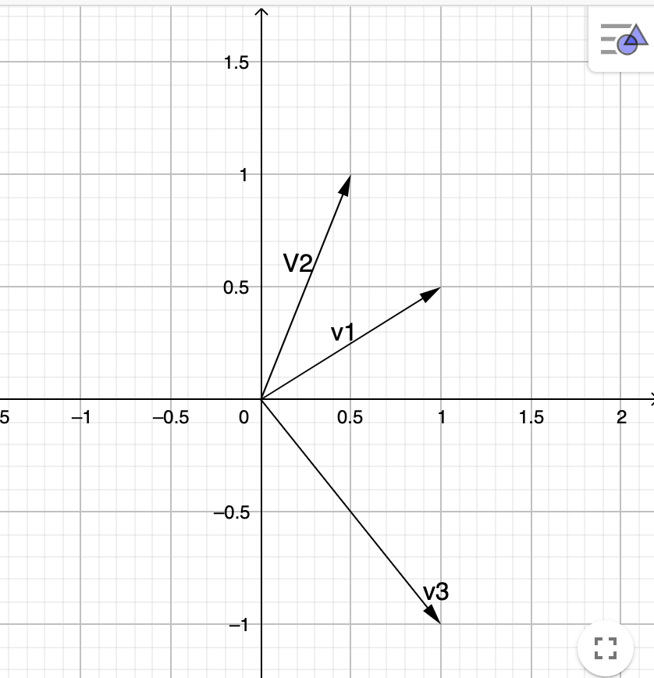



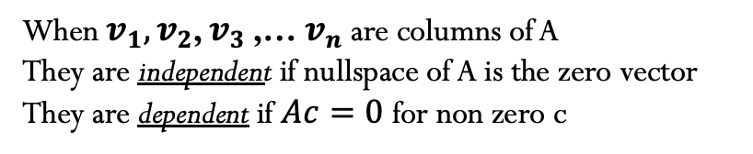

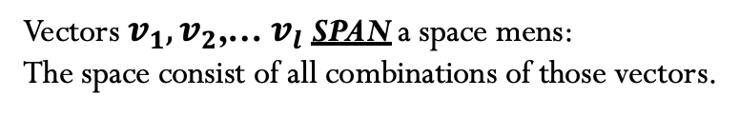


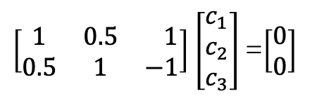






Independence
When $v_{1},v_{2}$, $v_{3}$,… $v_{n}$are columns of A
They are independent if nullspace of A is the zero vector
They are dependent if $Ac=0$ for non zero c
rank = n
No free variables
$$N\left(A\right)=\left\{0\right\}$$
rank $<$ n
Yes free variables
$$\vec{v_{1}}$$
$$\vec{v_{2}}$$
$$\vec{v_{3}}$$
$\left[\begin{matrix}1 & 0.5 & 1 \\ 0.5 & 1 & −1\end{matrix}\right]$ $\left[\begin{matrix}c_{1} \\ c_{2} \\ c_{3}\end{matrix}\right]$ =$\left[\begin{matrix}0 \\ 0\end{matrix}\right]$
$$Ac=0$$
Vectors that Span a subspace
Vectors $v_{1},v_{2}$,… $v_{l}$SPAN a space mens:
The space consist of all combinations of those vectors.
Examples:
1) $v_{1}=\left[\begin{matrix}1 \\ 0\end{matrix}\right],v_{2}=\left[\begin{matrix}0 \\ 1\end{matrix}\right]$
3) $w_{1}=\left[\begin{matrix}1 \\ 1\end{matrix}\right]$, $w_{2}=\left[\begin{matrix}−1 \\ −1\end{matrix}\right]$
Span the full space $ℝ^{2}$
2) $v_{1}=\left[\begin{matrix}1 \\ 0\end{matrix}\right],v_{2}=\left[\begin{matrix}0 \\ 1\end{matrix}\right],v_{3}=\left[\begin{matrix}4 \\ 7\end{matrix}\right]$
Span a line in $ℝ^{2}$
Span $ℝ^{2}$
Notes:
Graficos realizados en geogebra, cambiar a tickz

Slide 4
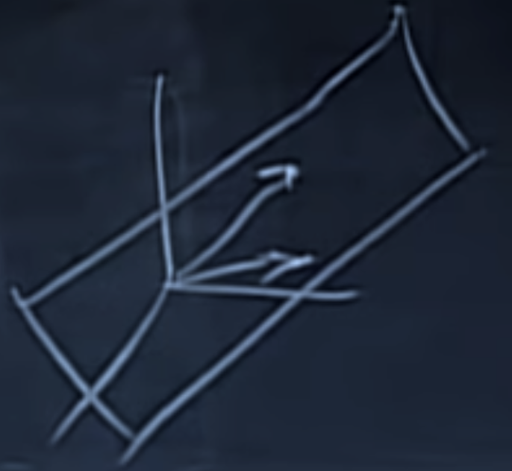
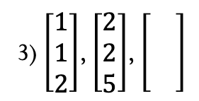
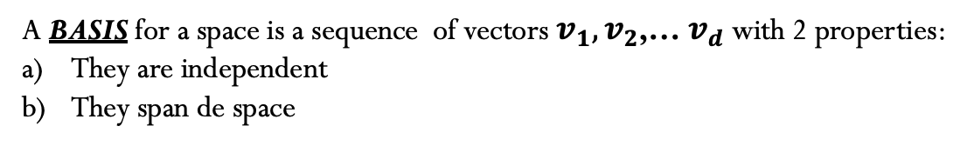

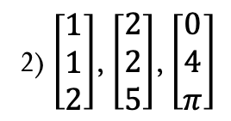
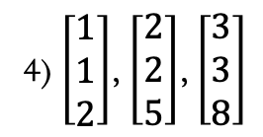
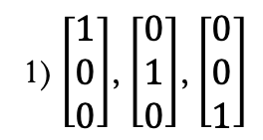
A basis for a vector space
A BASIS for a space is a sequence of vectors $v_{1},v_{2}$,… $v_{d}$with 2 properties:
They are independent
They span de space
Examples in $ℝ^{3}$:
1) $\left[\begin{matrix}1 \\ 0 \\ 0\end{matrix}\right]$, $\left[\begin{matrix}0 \\ 1 \\ 0\end{matrix}\right]$, $\left[\begin{matrix}0 \\ 0 \\ 1\end{matrix}\right]$
2) $\left[\begin{matrix}1 \\ 1 \\ 2\end{matrix}\right]$, $\left[\begin{matrix}2 \\ 2 \\ 5\end{matrix}\right]$, $\left[\begin{matrix}0 \\ 4 \\ π\end{matrix}\right]$
$ℝ^{n}$ n vectors give a BASIS if the nxn matrix with those columns are invertible.
3) $\left[\begin{matrix}1 \\ 1 \\ 2\end{matrix}\right]$, $\left[\begin{matrix}2 \\ 2 \\ 5\end{matrix}\right]$,
4) $\left[\begin{matrix}1 \\ 1 \\ 2\end{matrix}\right]$, $\left[\begin{matrix}2 \\ 2 \\ 5\end{matrix}\right]$, $\left[\begin{matrix}3 \\ 3 \\ 8\end{matrix}\right]$
The matrix is not invertible
Because it’s got two equals rows
Notes:
Graficos realizados en geogebra, cambiar a tickz

Slide 5


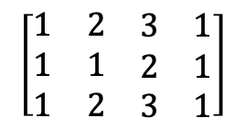

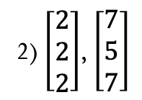
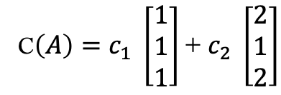
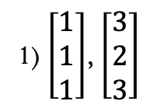
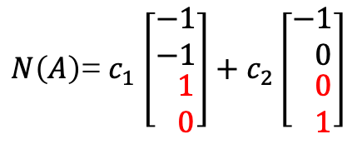




Dimension for a vector space
Given a space: every BASIS for the space has the same numbers of vectors.
Examples:
Space is $C\left(A\right)$
$r=$Rank of A =# pivost columns= 2 =Dimension of $C\left(A\right)$
$$\left[\begin{matrix}1 & 2 & \begin{matrix}3 & 1\end{matrix} \\ 1 & 1 & \begin{matrix}2 & 1\end{matrix} \\ 1 & 2 & \begin{matrix}3 & 1\end{matrix}\end{matrix}\right]$$
Dim $C(A)=r$
Anoher basis for $C(A$) ?
C$\left(A\right)=c_{1} \left[\begin{matrix}1 \\ 1 \\ 1\end{matrix}\right]\text{+} c_{2} \left[\begin{matrix}2 \\ 1 \\ 2\end{matrix}\right]$
1) $\left[\begin{matrix}1 \\ 1 \\ 1\end{matrix}\right]$, $\left[\begin{matrix}3 \\ 2 \\ 3\end{matrix}\right]$
2) $\left[\begin{matrix}2 \\ 2 \\ 2\end{matrix}\right]$, $\left[\begin{matrix}7 \\ 5 \\ 7\end{matrix}\right]$
$$→$$
$$→$$
Space is N$\left(A\right)$
$N\left(A\right)$= $c_{1}$ $\left[\begin{matrix}−1 \\ −1 \\ \begin{matrix} 1 \\ 0\end{matrix}\end{matrix}\right]+c_{2}\left[\begin{matrix}−1 \\ 0 \\ \begin{matrix} 0 \\ 1\end{matrix}\end{matrix}\right]$
Dim N$\left(A\right)=\#free variables=n−r$
Notes:
Graficos realizados en geogebra, cambiar a tickz

Slide 6
Credits
Ariel Guerrero
Lic. Electrónica
ariel.guerrero@uc.edu.py
(+595) 981-425 040
Hernandarias – Paraguay
@2020
Attribution-NonCommercial-ShareAlike 4.0 International (CC BY-NC-SA 4.0)
GitHub
https://github.com/aegiloru/linearAlgebra
Lec 09 –MIT 18.06
https://www.youtube.com/watch?v=yjBerM5jWsc
MIT 18.06
https://ocw.mit.edu/courses/mathematics/18-06-linear-algebra-spring-2010/
Prof. Gilbert Strang
http://www-math.mit.edu/~gs/

