Slide 1

Lecture 01 The geometry of Linear Equations
n linear equations, n unknows
Row picture,
Column picture
Matrix form
Matrix multiplications
Attribution-NonCommercial-ShareAlike 4.0 International (CC BY-NC-SA 4.0)

Slide 2
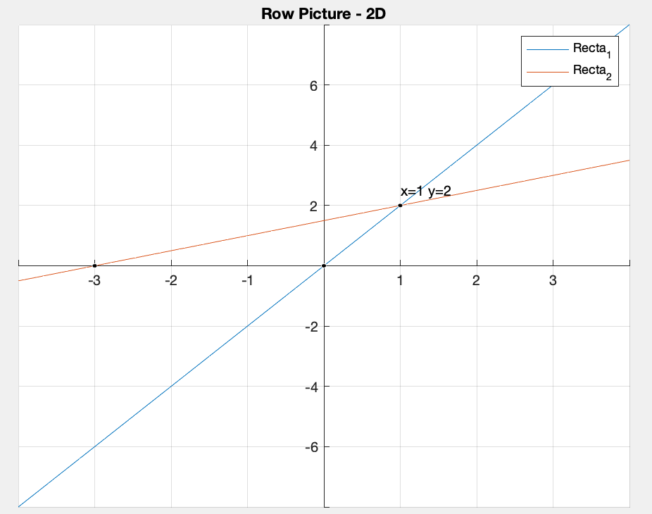
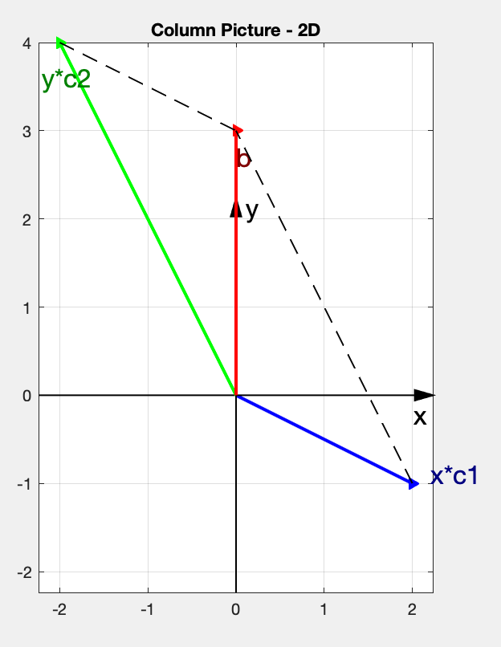
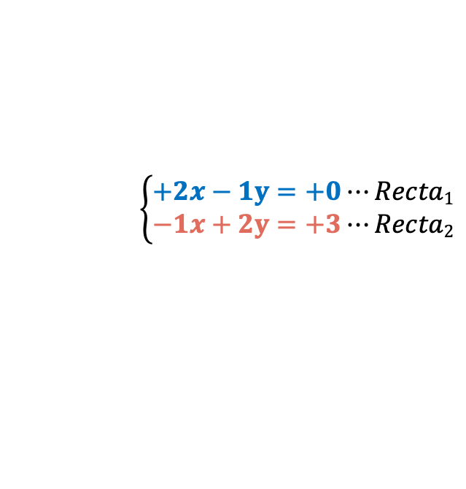

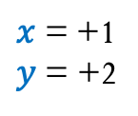
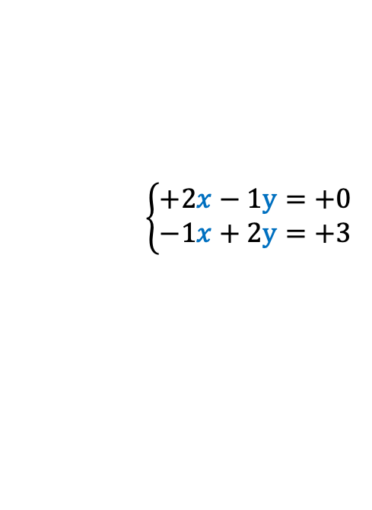



2 Equations, 2 Unknowns
Ax=b
$$\left\{\begin{aligned}+2x−1y=+0 \\ −1x+2y=+3 \end{aligned}\right.$$
$$\left[\begin{matrix}+2 & −1 \\ −1 & +2\end{matrix}\right]\left[\begin{matrix}x \\ y\end{matrix}\right]=\left[\begin{matrix}+0 \\ +3\end{matrix}\right]$$
A=$\left[\begin{matrix}+2 & −1 \\ −1 & +2\end{matrix}\right]$
b=$\left[\begin{matrix}+0 \\ +3\end{matrix}\right]$
ROW PICTURE
x | y
0 | 0
1 | 2
x | y
-3 | 0
1 | 2
COLUMN PICTURE
$$\left\{\begin{aligned}+2x−1y=+0⋯Recta1 \\ −1x+2y=+3⋯Recta2 \end{aligned}\right.$$
$x$= +1
$y$ = +2
$x\left[\begin{matrix}+2 \\ −1\end{matrix}\right]+y\left[\begin{matrix}−1 \\ +2\end{matrix}\right]$= $\left[\begin{matrix}+0 \\ +3\end{matrix}\right]$

Slide 3
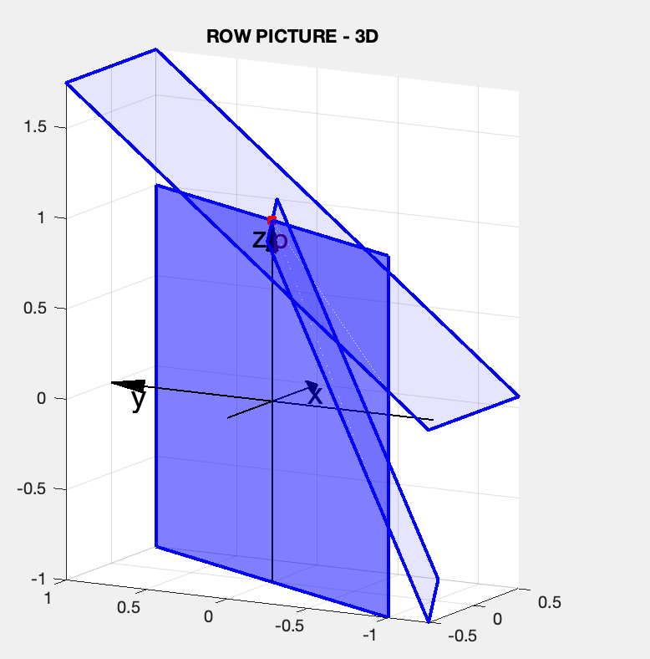
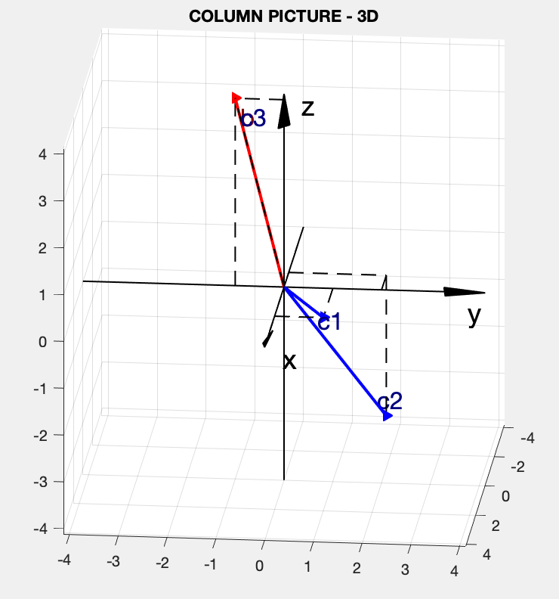
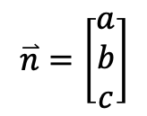
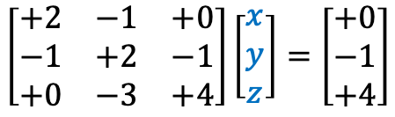

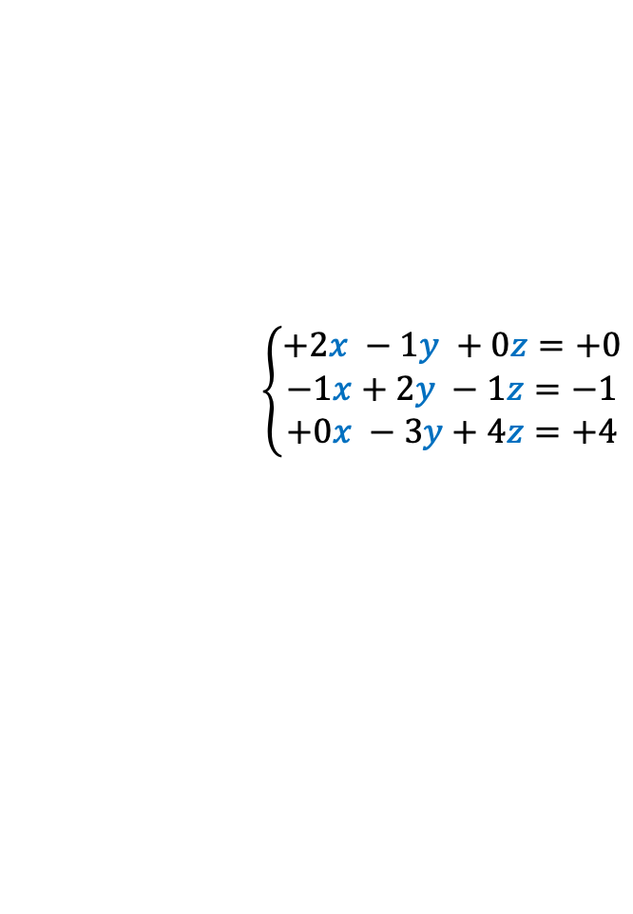
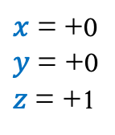
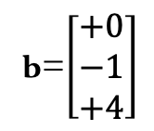
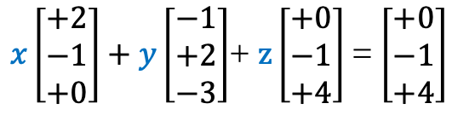
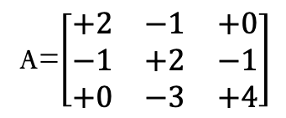
3 Equations, 3 Unknowns
Ax=b
$$\left\{\begin{matrix}+2x −1y +0z=+0 \\ −1x+2y −1z=−1 \\ +0x −3y+4z=+4\end{matrix}\right.$$
$$\left[\begin{matrix}+2 & −1 & +0 \\ −1 & +2 & −1 \\ +0 & −3 & +4\end{matrix}\right]\left[\begin{matrix}x \\ y \\ z\end{matrix}\right]=\left[\begin{matrix}+0 \\ −1 \\ +4\end{matrix}\right]$$
A=$\left[\begin{matrix}+2 & −1 & +0 \\ −1 & +2 & −1 \\ +0 & −3 & +4\end{matrix}\right]$
b=$\left[\begin{matrix}+0 \\ −1 \\ +4\end{matrix}\right]$
ROW PICTURE
COLUMN PICTURE
$$\overset{⃑}{n}=\left[\begin{matrix}a \\ b \\ c\end{matrix}\right]$$
$x\left[\begin{matrix}+2 \\ −1 \\ +0\end{matrix}\right]+y\left[\begin{matrix}−1 \\ +2 \\ −3\end{matrix}\right]$+ $z\left[\begin{matrix}+0 \\ −1 \\ +4\end{matrix}\right]$= $\left[\begin{matrix}+0 \\ −1 \\ +4\end{matrix}\right]$
$x$= +0
$y$ = +0
$z$ = +1
$$π_{i}:ax+by +cz=d$$

Slide 4
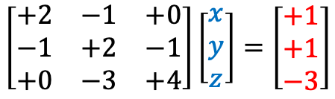
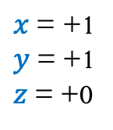
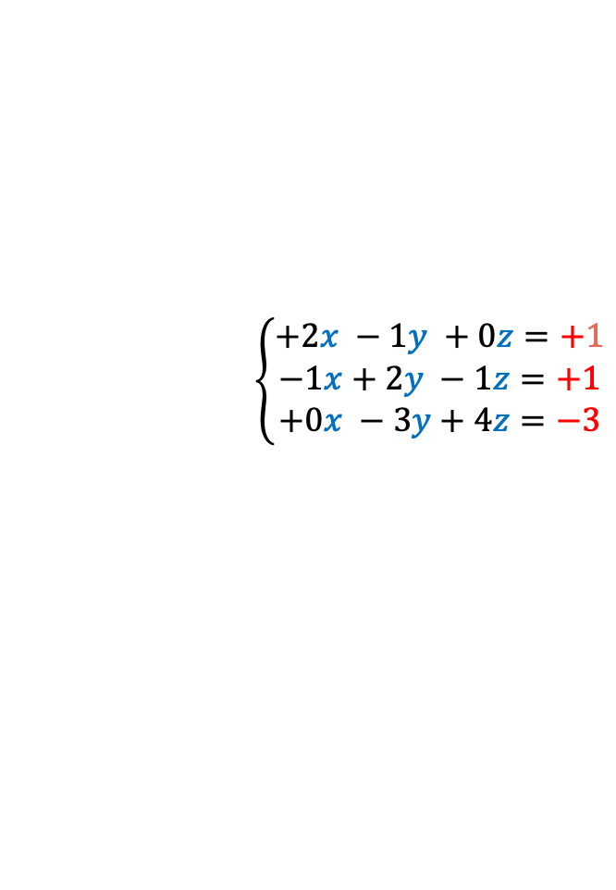
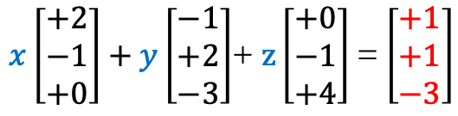
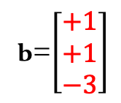
3 Equations, 3 Unknowns
Ax=b
$$\left\{\begin{matrix}+2x −1y +0z=+1 \\ −1x+2y −1z=+1 \\ +0x −3y+4z=−3\end{matrix}\right.$$
$$\left[\begin{matrix}+2 & −1 & +0 \\ −1 & +2 & −1 \\ +0 & −3 & +4\end{matrix}\right]\left[\begin{matrix}x \\ y \\ z\end{matrix}\right]=\left[\begin{matrix}+1 \\ +1 \\ −3\end{matrix}\right]$$
A=$\left[\begin{matrix}+2 & −1 & +0 \\ −1 & +2 & −1 \\ +0 & −3 & +4\end{matrix}\right]$
b=$\left[\begin{matrix}+1 \\ +1 \\ −3\end{matrix}\right]$
ROW PICTURE ?
Can I solve Ax=b for every b?
Do the linear combs of the columns fill 3-D Space?
For This A, answer is Yes
COLUMN PICTURE ?
$x\left[\begin{matrix}+2 \\ −1 \\ +0\end{matrix}\right]+y\left[\begin{matrix}−1 \\ +2 \\ −3\end{matrix}\right]$+ $z\left[\begin{matrix}+0 \\ −1 \\ +4\end{matrix}\right]$= $\left[\begin{matrix}+1 \\ +1 \\ −3\end{matrix}\right]$
$x$= +1
$y$ = +1
$z$ = +0

Slide 5
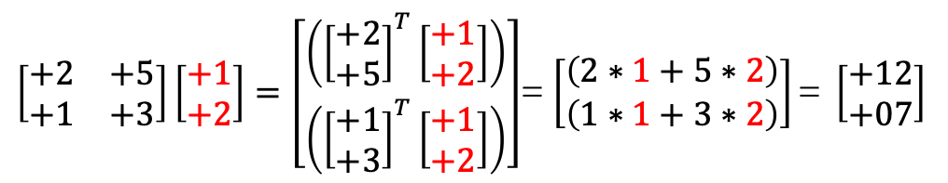
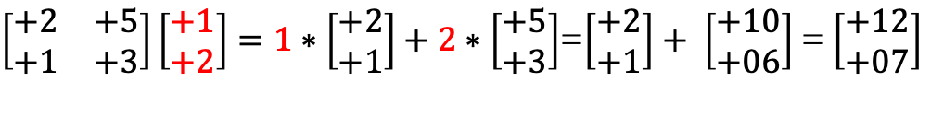
Matrix Mutliplications
Ax=b
$\left[\begin{matrix}+2 & +5 \\ +1 & +3\end{matrix}\right]\left[\begin{matrix}+1 \\ +2\end{matrix}\right]=1∗\left[\begin{matrix}+2 \\ +1\end{matrix}\right]+2∗\left[\begin{matrix}+5 \\ +3\end{matrix}\right]$=$\left[\begin{matrix}+2 \\ +1\end{matrix}\right]+ \left[\begin{matrix}+10 \\ +06\end{matrix}\right]$ = $\left[\begin{matrix}+12 \\ +07\end{matrix}\right]$
$\left[\begin{matrix}+2 & +5 \\ +1 & +3\end{matrix}\right]\left[\begin{matrix}+1 \\ +2\end{matrix}\right]=\left[\begin{matrix}\left({\left[\begin{matrix}+2 \\ +5\end{matrix}\right]}^{T}\left[\begin{matrix}+1 \\ +2\end{matrix}\right]\right) \\ \left({\left[\begin{matrix}+1 \\ +3\end{matrix}\right]}^{T}\left[\begin{matrix}+1 \\ +2\end{matrix}\right]\right)\end{matrix}\right]$= $\left[\begin{matrix}\left(2∗1+5∗2\right) \\ \left(1∗1+3∗2\right)\end{matrix}\right]\text{= }\left[\begin{matrix}+12 \\ +07\end{matrix}\right]$

Slide 6
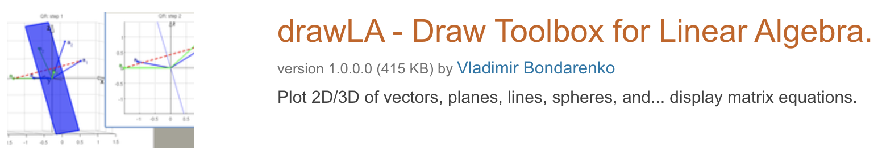
Credits
Ariel Guerrero
Lic. Electrónica
ariel.guerrero@uc.edu.py
(+595) 981-425 040
Hernandarias – Paraguay
@2020
Attribution-NonCommercial-ShareAlike 4.0 International (CC BY-NC-SA 4.0)
GitHub
https://github.com/aegiloru/linearAlgebra
Lec 01 –MIT 18.06
https://www.youtube.com/watch?v=ZK3O402wf1c
MIT 18.06
https://ocw.mit.edu/courses/mathematics/18-06-linear-algebra-spring-2010/
Prof. Gilbert Strang
http://www-math.mit.edu/~gs/
DrawLA
https://la.mathworks.com/matlabcentral/fileexchange/23608-drawla-draw-toolbox-for-linear-algebra

