Slide 1

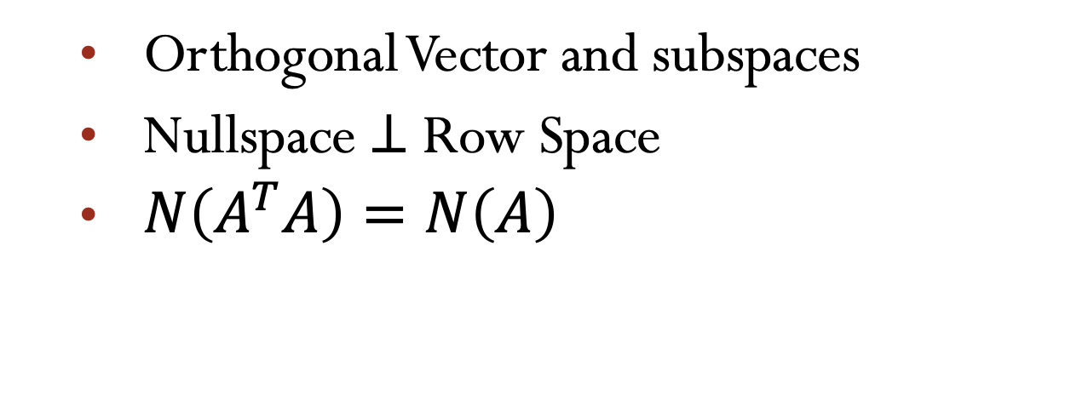
Lecture 14 Orthogonal Vectors and subspaces
Orthogonal Vector and subspaces
Nullspace $⊥$ Row Space
$N\left(A^{T}A\right)=N\left(A\right)$
Attribution-NonCommercial-ShareAlike 4.0 International (CC BY-NC-SA 4.0)

Slide 2
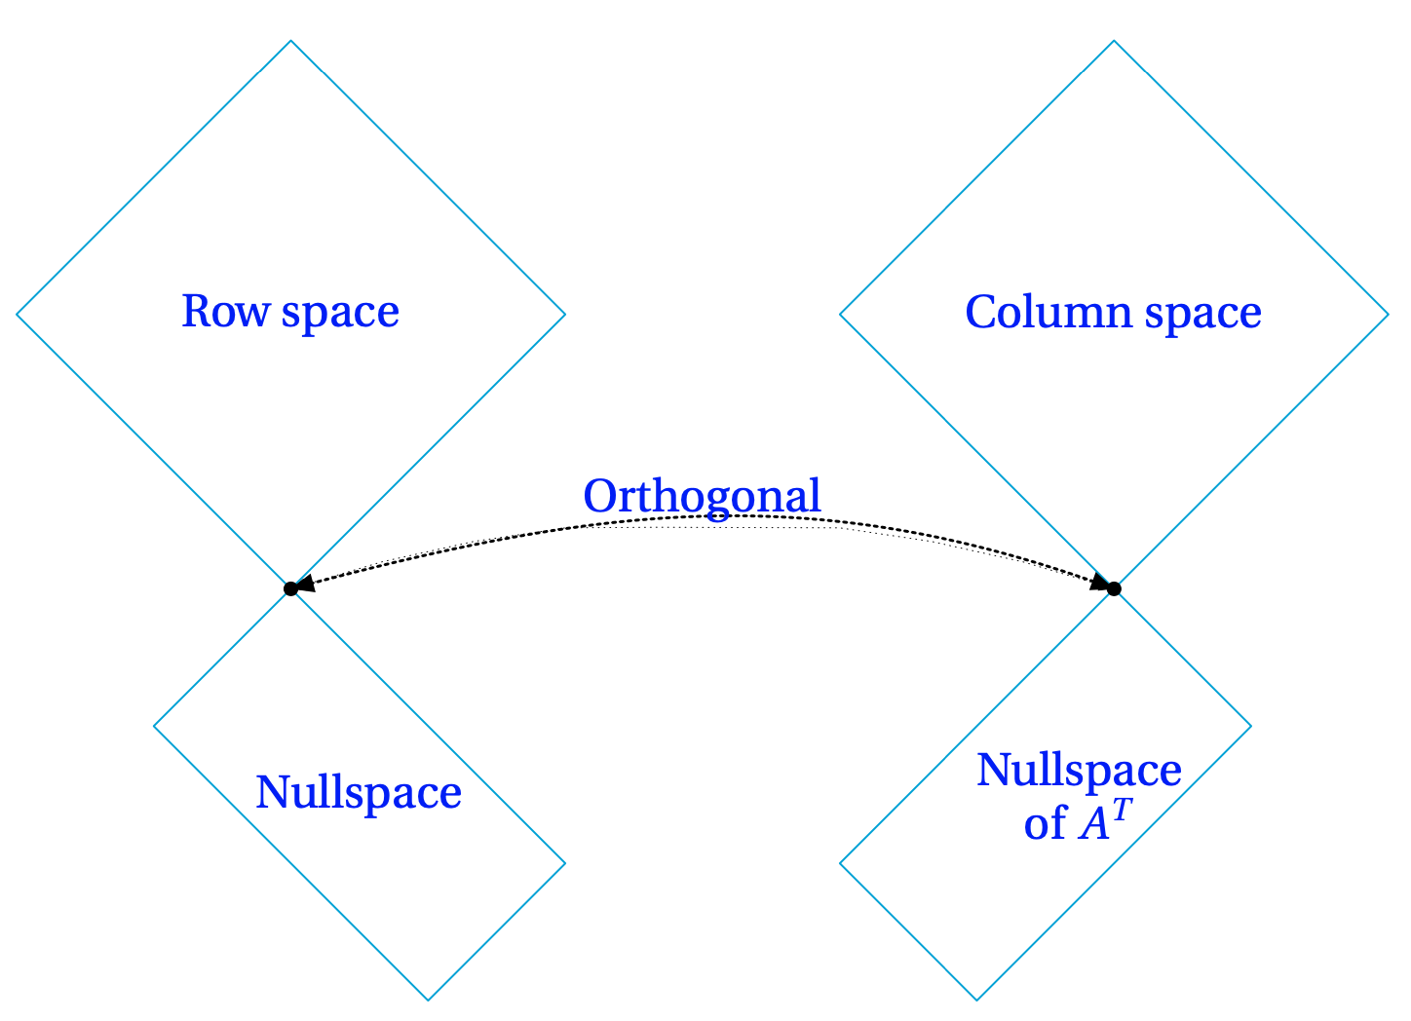
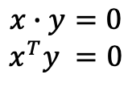

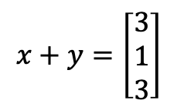


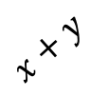


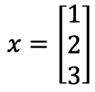











Orthogonal Subspaces
Orthogonal Vectors
$$x+y$$
$$y$$
$$x∙y=0$$
$$x^{T}y =0$$
r
r
$$x$$
$b^{2}$+ $c^{2}=a^{2}$
Pythagoras
${\left\|x\right\|}^{2}$+ ${\left\|y\right\|}^{2}={\left\|x+y\right\|}^{2}$
$x^{T}x$ +${ y}^{T}y={\left(x+y\right)}^{T}\left(x+y\right)$
$$ℝ^{n}$$
$$ℝ^{m}$$
n-r
m-r
$x^{T}x$ +${ y}^{T}y=x^{T}x\text{ +}{ x}^{T}y+y^{T}x\text{ +}{ y}^{T}y$
$$0={ x}^{T}y+{ y}^{T}y$$
$$0={ 2 x}^{T}y$$
$$0={ x}^{T}y$$
Example:
${\left\|x\right\|}^{2}$+ ${\left\|y\right\|}^{2}={\left\|x+y\right\|}^{2}$
$$x=\left[\begin{matrix}1 \\ 2 \\ 3\end{matrix}\right]$$
$$y=\left[\begin{matrix} 2 \\ −1 \\ 0\end{matrix}\right]$$
$$x+y=\left[\begin{matrix}3 \\ 1 \\ 3\end{matrix}\right]$$
Subspace S is orthogonal to subspace T
Means: Evey vector in S is orthgonal
To every vector in T
$${\left\|x\right\|}^{2}=14$$
$${\left\|y\right\|}^{2}=9$$
${\left\|x+y\right\|}^{2}$=19

Slide 3
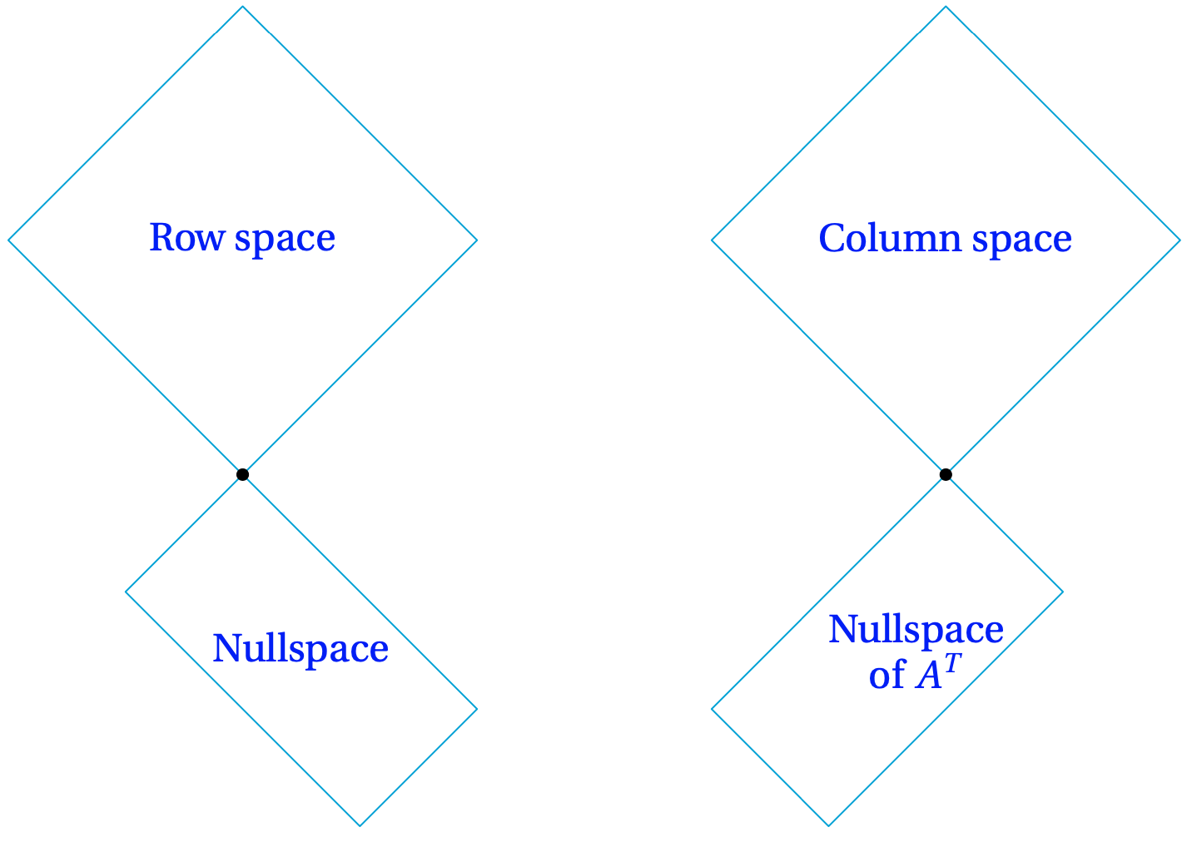
Orthogonal Vector and Subspaces

Slide 4

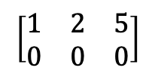
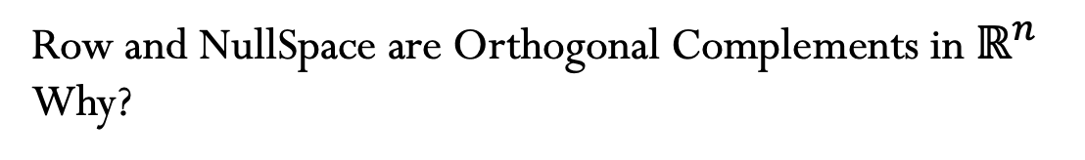

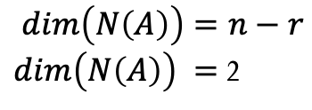




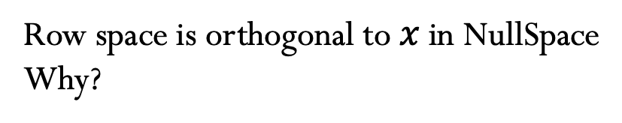
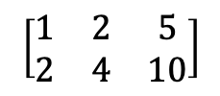





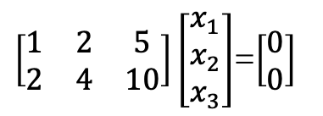


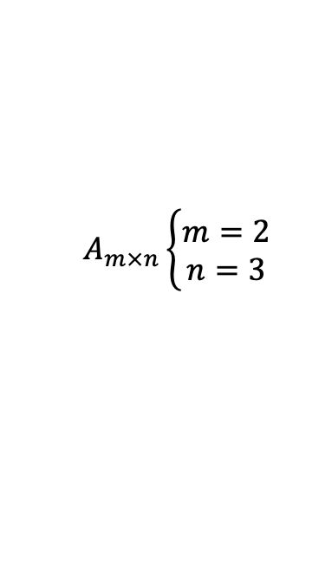
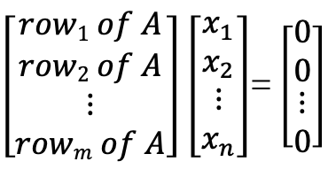


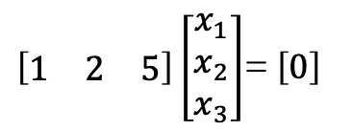

Nullspace ⊥ Row Space
Row space is orthogonal to $x$ in NullSpace
Why?
$$Ax=0$$
$\left[\begin{matrix}row1 of A \\ row2 of A \\ \begin{matrix}⋮ \\ rowm of A\end{matrix}\end{matrix}\right]$ $\left[\begin{matrix}x_{1} \\ x_{2} \\ \begin{matrix}⋮ \\ x_{n}\end{matrix}\end{matrix}\right]$= $\left[\begin{matrix}0 \\ 0 \\ \begin{matrix}⋮ \\ 0\end{matrix}\end{matrix}\right]$
$$→$$
$${\left(row1 of A\right)}^{T}∙x=0$$
$$→$$
$${\left(row2 of A\right)}^{T}∙x=0$$
$$⋮$$
$$⋮$$
$$\left(rowi of A\right) ⊥x$$
$$→$$
$${\left(rowm of A\right)}^{T}∙x=0$$
$${\left(c1 row1+c2 row2+…+cm rowm\right)}^{T}∙x=0$$
$$C\left(A^{T}\right)⊥N\left(A\right)$$
Example:
$\left[\begin{matrix}1 & 2 & 5\end{matrix}\right]\left[\begin{matrix}x_{1} \\ x_{2} \\ x_{3}\end{matrix}\right]$= $\left[0\right]$
$\left[\begin{matrix}1 & 2 & 5 \\ 2 & 4 & 10\end{matrix}\right]\left[\begin{matrix}x_{1} \\ x_{2} \\ x_{3}\end{matrix}\right]$=$\left[\begin{matrix}0 \\ 0\end{matrix}\right]$
$$\left[\begin{matrix}1 & 2 & 5 \\ 2 & 4 & 10\end{matrix}\right]$$
$$→$$
$$\left[\begin{matrix}1 & 2 & 5 \\ 0 & 0 & 0\end{matrix}\right]$$
$$\left[\begin{matrix}1 & 2 & 5\end{matrix}\right]$$
$$A_{m×n}\left\{\begin{aligned}m=2 \\ n=3\end{aligned}\right.$$
$$dim\left(N\left(A\right)\right)=n−r$$
$dim\left(N\left(A\right)\right) =$ 2
$$r=1$$
$$r=1$$
$dim\left(N\left(A\right)\right) =$ 2
Row and NullSpace are Orthogonal Complements in $ℝ^{n}$
Why?
Nullspace contains all vectors $⊥$ to row space

Slide 5



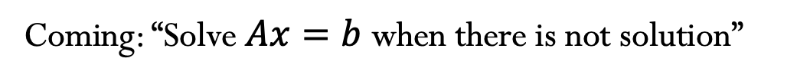



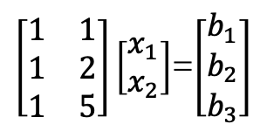
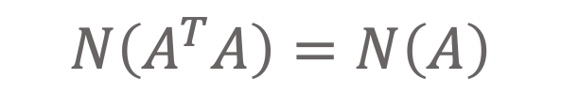






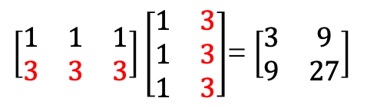

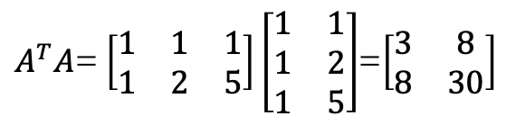


$$N\left(A^{T}A\right)=N\left(A\right)$$
Coming: “Solve $Ax=b$ when there is not solution”
$$A^{T}A$$
$A^{T}A$is symmetric
$$A_{m×n}$$
$$→$$
$${A_{n×m}}^{T}$$
$${\left(A^{T}A\right)}^{T}=A^{T}A^{T^{T}}=A^{T}A$$
$$\begin{matrix}n×m & m×n & \begin{matrix}= & n×n\end{matrix}\end{matrix}$$
$Ax=b$ when there is not solution
$$m>n$$
$$→$$
$$3>2$$
$$A^{T}Ax=A^{T}b$$
$A^{T}A$ $\hat{x}=A^{T}b$
$\left[\begin{matrix}1 & 1 \\ 1 & 2 \\ 1 & 5\end{matrix}\right]\left[\begin{matrix}x_{1} \\ x_{2}\end{matrix}\right]$=$\left[\begin{matrix}b_{1} \\ b_{2} \\ b_{3}\end{matrix}\right]$
$A^{T}A$= $\left[\begin{matrix}1 & 1 & 1 \\ 1 & 2 & 5\end{matrix}\right]\left[\begin{matrix}1 & 1 \\ 1 & 2 \\ 1 & 5\end{matrix}\right]$=$\left[\begin{matrix}3 & 8 \\ 8 & 30\end{matrix}\right]$
$$→$$
$$N\left(A^{T}A\right)=N\left(A\right)$$
$\left[\begin{matrix}1 & 1 & 1 \\ 3 & 3 & 3\end{matrix}\right]\left[\begin{matrix}1 & 3 \\ 1 & 3 \\ 1 & 3\end{matrix}\right]$= $\left[\begin{matrix}3 & 9 \\ 9 & 27\end{matrix}\right]$
Rank of $A^{T}A =\text{Rank} \text{of} A$
$A^{T}A$Is invertible exactly if $A$ has independent columns.

Slide 6
Credits
Ariel Guerrero
Lic. Electrónica
ariel.guerrero@uc.edu.py
(+595) 981-425 040
Hernandarias – Paraguay
@2020
Attribution-NonCommercial-ShareAlike 4.0 International (CC BY-NC-SA 4.0)
GitHub
https://github.com/aegiloru/linearAlgebra
Lec 14 –MIT 18.06
https://www.youtube.com/watch?time_continue=3&v=YzZUIYRCE38
MIT 18.06
https://ocw.mit.edu/courses/mathematics/18-06-linear-algebra-spring-2010/
Prof. Gilbert Strang
http://www-math.mit.edu/~gs/

