Slide 1

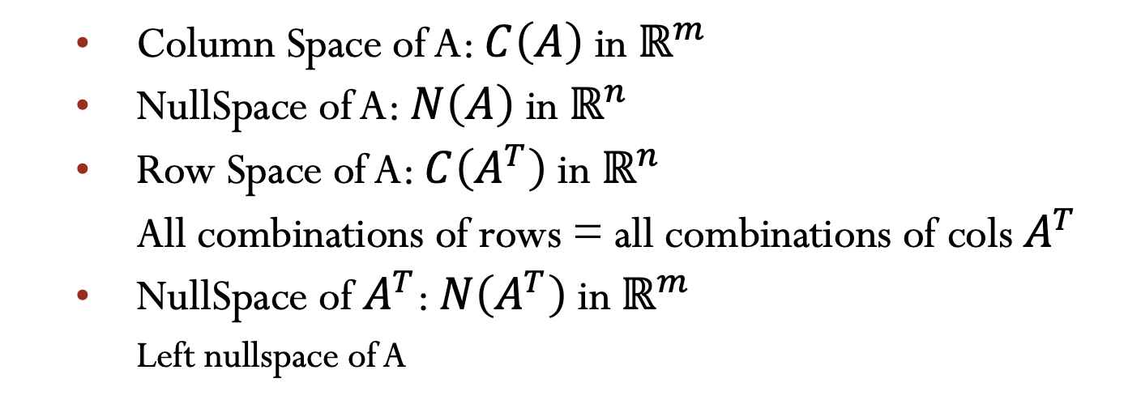

Lecture 10 The four fundamental subspaces
Column Space of A: $C\left(A\right)$ in $ℝ^{m}$
NullSpace of A: $N\left(A\right)$ in $ℝ^{n}$
Row Space of A: $C\left(A^{T}\right)$ in $ℝ^{n}$
All combinations of rows = all combinations of cols $A^{T}$
NullSpace of $A^{T}$: $N\left(A^{T}\right)$ in $ℝ^{m}$
Left nullspace of A
$$A_{m×n}$$
Attribution-NonCommercial-ShareAlike 4.0 International (CC BY-NC-SA 4.0)

Slide 2
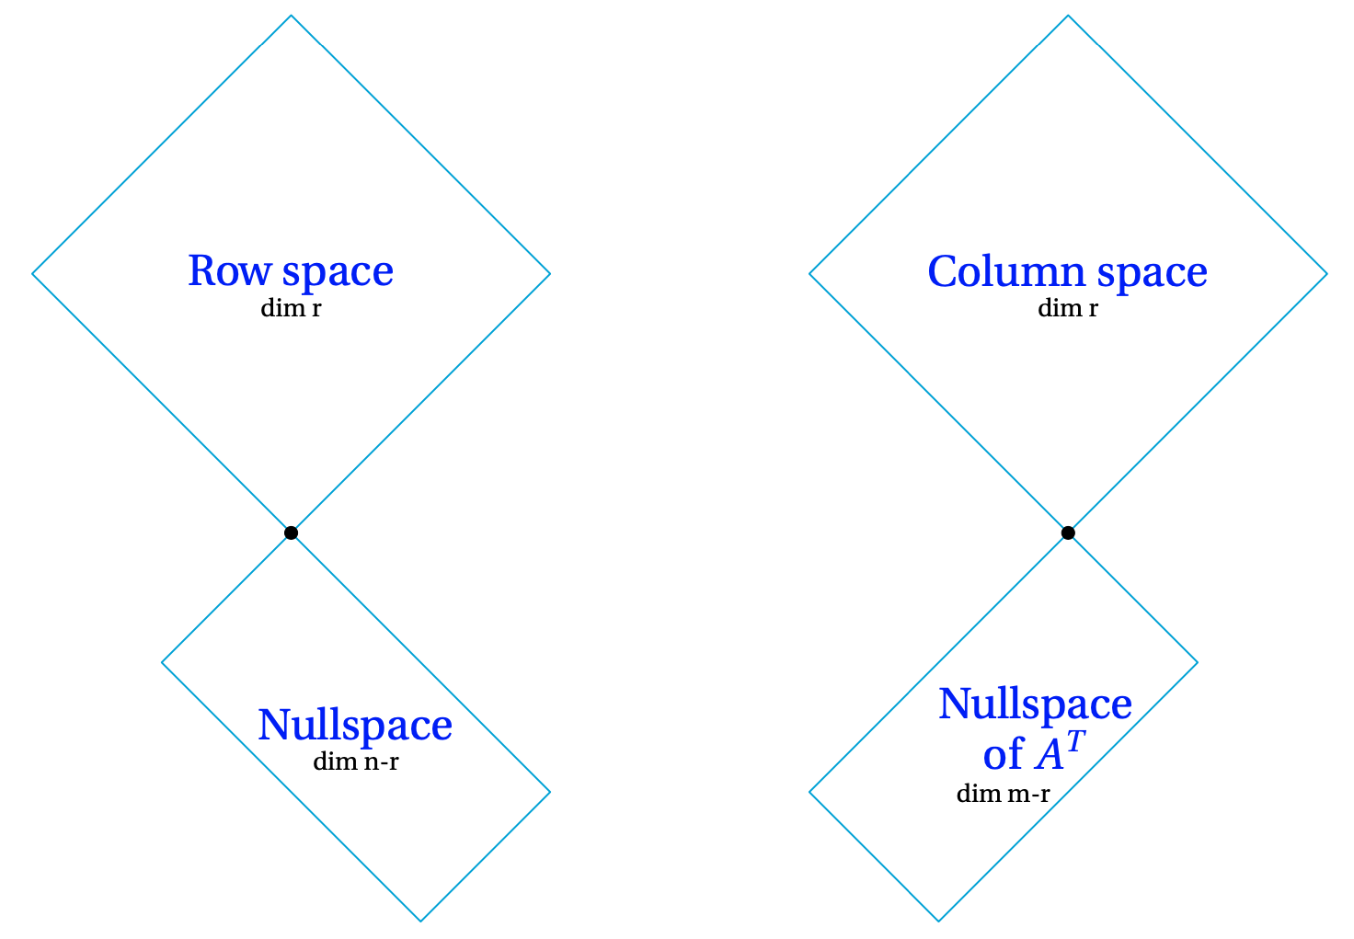


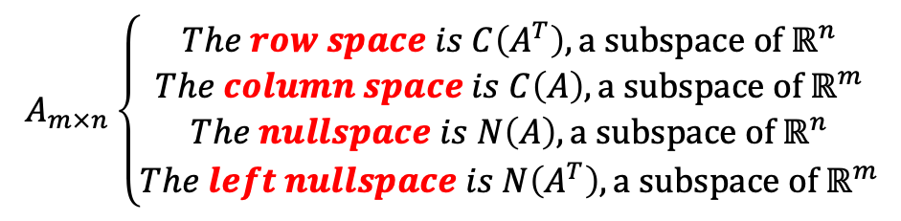






The Dimension of 4 Subspaces
$$A_{m×n}\left\{\begin{aligned}The row space is C\left(A^{T}\right), \text{a} \text{subspace} \text{of} ℝ^{n} \\ The column space is C\left(A\right), \text{a} \text{subspace} \text{of} ℝ^{m} \\ \begin{matrix}The nullspace is N\left(A\right), \text{a} \text{subspace} \text{of} ℝ^{n} \\ The left nullspace is N\left(A^{T}\right), \text{a} \text{subspace} \text{of} ℝ^{m}\end{matrix}\end{aligned}\right.$$
$$C\left(A^{T}\right)$$
$$C\left(A\right)$$
$A^{T}$y
Basis ?
Dimension ?
$$ℝ^{n}$$
$$ℝ^{m}$$
$$N\left(A\right)$$
$$N\left(A^{T}\right)$$
$A^{T}$y=0

Slide 3

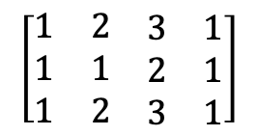




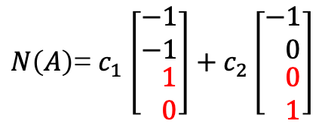

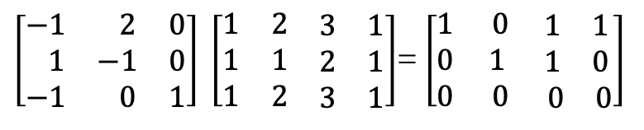

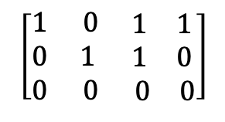



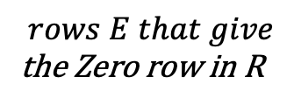

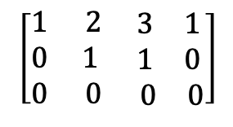
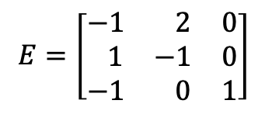




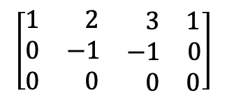
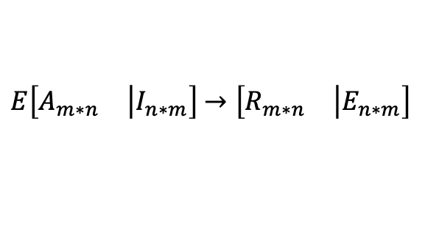
The fundamental theorem of linear algebra
Part 1
The column space and row space both have dimension r.
The nullspaces have dimension n-r and m-r.
$$C\left(A\right)$$
$$N\left(A\right)$$
$$C\left(A^{T}\right)$$
$$N\left(A^{T}\right)$$
Basis?
Dim.?
$$pivot cols. A$$
Special solutions
$$r pivots rows R$$
$$rows E that give$$
the Zero row in R
$$r$$
$$m−r$$
$$r$$
$$n−r$$
$$\left[\begin{matrix}1 & 2 & \begin{matrix}3 & 1\end{matrix} \\ 1 & 1 & \begin{matrix}2 & 1\end{matrix} \\ 1 & 2 & \begin{matrix}3 & 1\end{matrix}\end{matrix}\right]$$
$$\left[\begin{matrix}1 & 2 & \begin{matrix} 3 & 1\end{matrix} \\ 0 & −1 & \begin{matrix}−1 & 0\end{matrix} \\ 0 & 0 & \begin{matrix} 0 & 0\end{matrix}\end{matrix}\right]$$
$$\left[\begin{matrix}1 & 2 & \begin{matrix}3 & 1\end{matrix} \\ 0 & 1 & \begin{matrix}1 & 0\end{matrix} \\ 0 & 0 & \begin{matrix} 0 & 0\end{matrix}\end{matrix}\right]$$
$$\left[\begin{matrix}1 & 0 & \begin{matrix}1 & 1\end{matrix} \\ 0 & 1 & \begin{matrix}1 & 0\end{matrix} \\ 0 & 0 & \begin{matrix} 0 & 0\end{matrix}\end{matrix}\right]$$
$$→$$
$$→$$
$$→$$
$$C\left(A\right)≠C\left(R\right)$$
Gauss-Jordan
$E\left[\begin{matrix}A_{m∗n} & \left|I_{n∗m}\right.\end{matrix}\right]$ $→\left[\begin{matrix}R_{m∗n} & \left|E_{n∗m}\right.\end{matrix}\right]$
-$F$
C$\left(A\right)=c_{1} \left[\begin{matrix}1 \\ 1 \\ 1\end{matrix}\right]\text{+} c_{2} \left[\begin{matrix}2 \\ 1 \\ 2\end{matrix}\right]$
$\left[\begin{matrix}−1 & 2 & 0 \\ 1 & −1 & 0 \\ −1 & 0 & 1\end{matrix}\right] \left[\begin{matrix}1 & 2 & \begin{matrix}3 & 1\end{matrix} \\ 1 & 1 & \begin{matrix}2 & 1\end{matrix} \\ 1 & 2 & \begin{matrix}3 & 1\end{matrix}\end{matrix}\right]$= $\left[\begin{matrix}1 & 0 & \begin{matrix}1 & 1\end{matrix} \\ 0 & 1 & \begin{matrix}1 & 0\end{matrix} \\ 0 & 0 & \begin{matrix} 0 & 0\end{matrix}\end{matrix}\right]$
Lecture 09
$N\left(A\right)$= $c_{1}$ $\left[\begin{matrix}−1 \\ −1 \\ \begin{matrix} 1 \\ 0\end{matrix}\end{matrix}\right]+c_{2}\left[\begin{matrix}−1 \\ 0 \\ \begin{matrix} 0 \\ 1\end{matrix}\end{matrix}\right]$
$$E=\left[\begin{matrix}−1 & 2 & 0 \\ 1 & −1 & 0 \\ −1 & 0 & 1\end{matrix}\right]$$
$$EA=R$$
Combs of rows that give the zero row

Slide 4

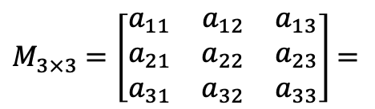
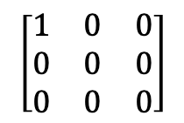





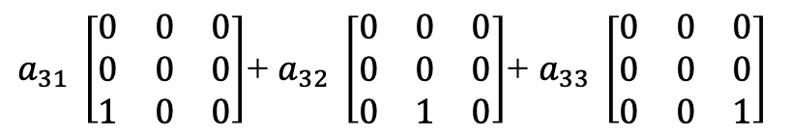
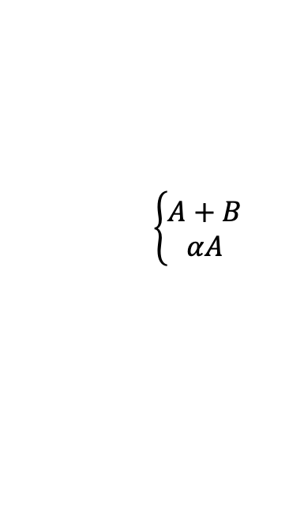



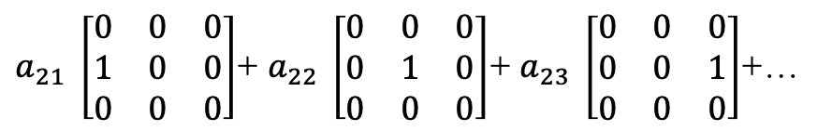




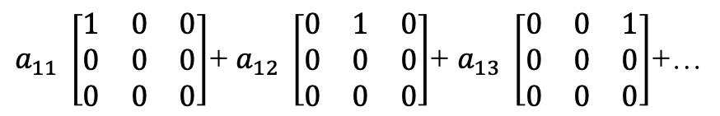
Left Nullspace of A: $N\left(A^{T}\right)$
$$A^{T}y=0$$
$$y^{T}A=0^{T}$$
$$A^{T}$$
y
Z
$${\left(A^{T}y\right)}^{T}={\left(0\right)}^{T}$$
$$A$$
=
$$→$$
$$y^{T}$$
=
$$0^{T}$$
$$\left\{\begin{aligned}A+B \\ αA\end{aligned}\right.$$
Matrix Spaces
All $M_{3×3}$
Upper
Triangular
Symmetric
matrices
Diagonal
matrices
$$\left[\begin{matrix}1 & 0 & 0 \\ 0 & 0 & 0 \\ 0 & 0 & 0\end{matrix}\right]$$
$$\left[\begin{matrix}1 & 0 & 0 \\ 0 & 3 & 0 \\ 0 & 0 & 0\end{matrix}\right]$$
$$\left[\begin{matrix}0 & 0 & 0 \\ 0 & 0 & 0 \\ 0 & 0 & 7\end{matrix}\right]$$
Subspaces
of $M_{3×3}$
Dim = 3
Dim M = 9
Dim = ?
Dim = ?
$M_{3×3}$ $=\left[\begin{matrix}a_{11} & a_{12} & a_{13} \\ a_{21} & a_{22} & a_{23} \\ a_{31} & a_{32} & a_{33}\end{matrix}\right]$ $=$
$a_{11} \left[\begin{matrix}1 & 0 & 0 \\ 0 & 0 & 0 \\ 0 & 0 & 0\end{matrix}\right]$+ $a_{12} \left[\begin{matrix}0 & 1 & 0 \\ 0 & 0 & 0 \\ 0 & 0 & 0\end{matrix}\right]$+ $a_{13} \left[\begin{matrix}0 & 0 & 1 \\ 0 & 0 & 0 \\ 0 & 0 & 0\end{matrix}\right]$+…
$a_{21} \left[\begin{matrix}0 & 0 & 0 \\ 1 & 0 & 0 \\ 0 & 0 & 0\end{matrix}\right]$+ $a_{22} \left[\begin{matrix}0 & 0 & 0 \\ 0 & 1 & 0 \\ 0 & 0 & 0\end{matrix}\right]$+ $a_{23} \left[\begin{matrix}0 & 0 & 0 \\ 0 & 0 & 1 \\ 0 & 0 & 0\end{matrix}\right]$+…
$a_{31} \left[\begin{matrix}0 & 0 & 0 \\ 0 & 0 & 0 \\ 1 & 0 & 0\end{matrix}\right]$+ $a_{32} \left[\begin{matrix}0 & 0 & 0 \\ 0 & 0 & 0 \\ 0 & 1 & 0\end{matrix}\right]$+ $a_{33} \left[\begin{matrix}0 & 0 & 0 \\ 0 & 0 & 0 \\ 0 & 0 & 1\end{matrix}\right]$

Slide 5
Credits
Ariel Guerrero
Lic. Electrónica
ariel.guerrero@uc.edu.py
(+595) 981-425 040
Hernandarias – Paraguay
@2020
Attribution-NonCommercial-ShareAlike 4.0 International (CC BY-NC-SA 4.0)
GitHub
https://github.com/aegiloru/linearAlgebra
Lec 10 –MIT 18.06
https://www.youtube.com/watch?v=nHlE7EgJFds
MIT 18.06
https://ocw.mit.edu/courses/mathematics/18-06-linear-algebra-spring-2010/
Prof. Gilbert Strang
http://www-math.mit.edu/~gs/

