Slide 1
Penalty video analysis
Evidence-first Vision II pipeline
33/39
35/39
Four 2018 World Cup shoot-outs · 39 penalty events
contact candidates
outcome fusion
Review draft · replace member names before recording
IND5003 Vision II | 01

Slide 2
Assignment outputs
Nine requested event outputs
Four camera-view intervals
Feature value + source evidence + explicit unknown
No numeric 90% threshold in the course brief
run-up / foot / steps / keeper movement / dive direction / dive height / ball trajectory / final ball position / goal-no-goal
behind kicker · 45° right · slow-motion kicker close-up · slow-motion behind goalkeeper
IND5003 Vision II | 02

Slide 3
Data and event definition
39
4
835
penalty events
matches
keeper boxes
Colombia–England 10 · Croatia–Denmark 10
Spain–Russia 9 · Russia–Croatia 10
Different views stay in one event partition
24-row and core packages update existing events; they do not add independent penalties
IND5003 Vision II | 03

Slide 4
From video to evidence table
Source
video
Event
slice
Pose +
ball
Temporal
identity
Geometry +
phase
Evidence
table
Every output keeps a frame/time basis and provenance. Unsupported measurements abstain instead of becoming guesses.
IND5003 Vision II | 04

Slide 5
Labels, splits and validation
Event-level partitions prevent views and frames from leaking across splits
Human review covers foot, contact, movement, direction, height and outcome fields
Eight-event frozen held-out check exists for the primary pipeline
Newest ball/keeper detector arms were evaluated on exposed development groups
development ≠ independent test
Keep the denominator and evidence status visible.
IND5003 Vision II | 05

Slide 6
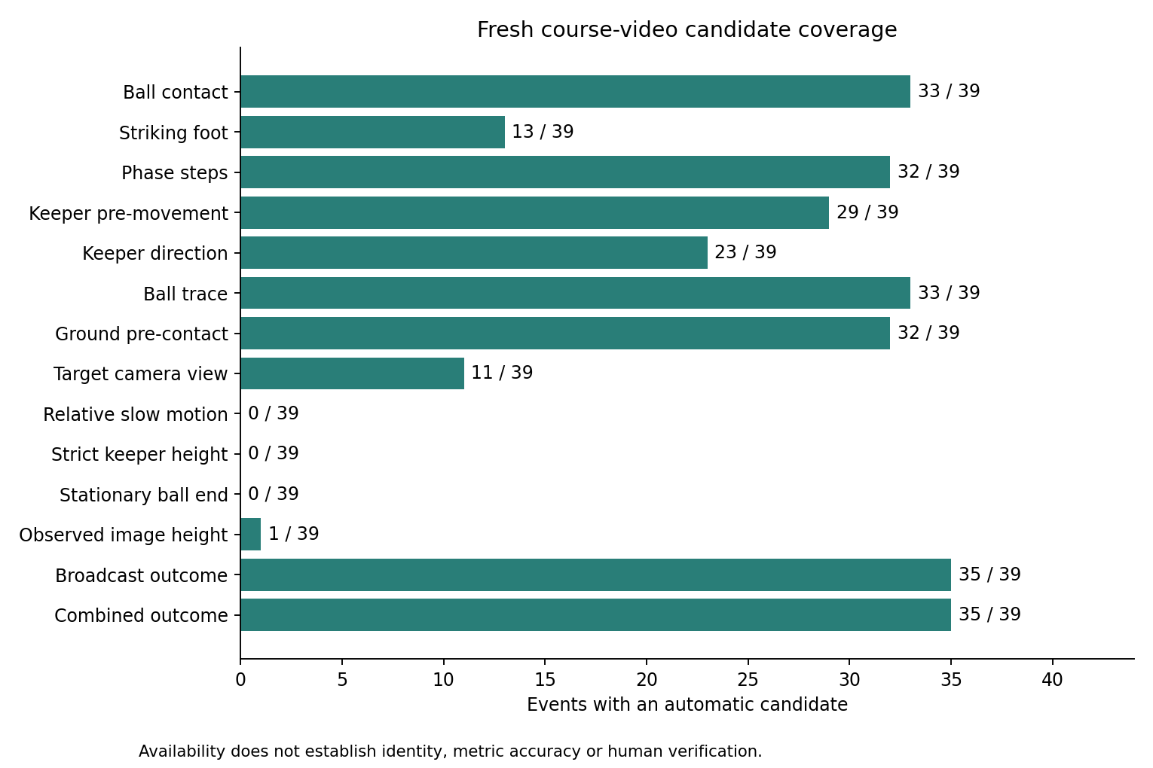
Exploratory coverage
29/39
33/39
pre-kick movement
ball trajectory
0/39
0/39
strict height
strict endpoint
Coverage is not the same as accuracy.
IND5003 Vision II | 06

Slide 7
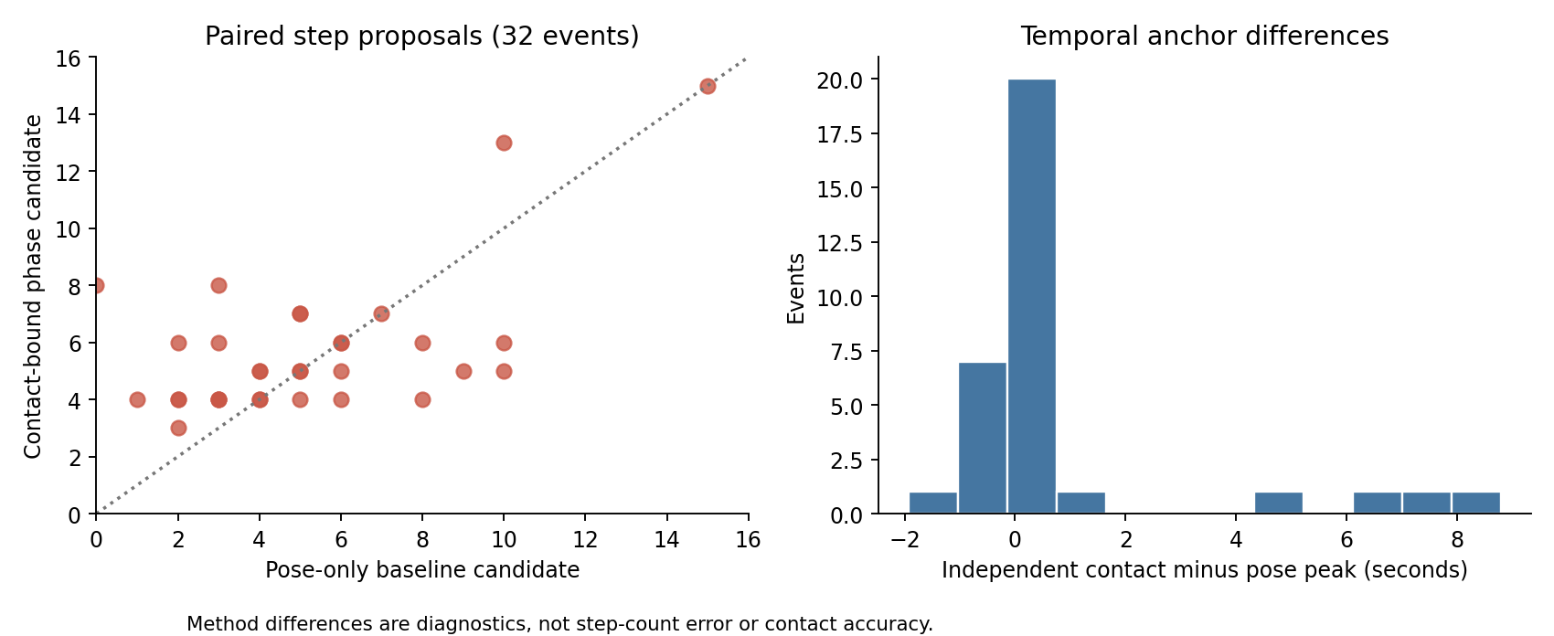
RQ1 · What can broadcast views show?
Temporal and pose evidence supports some contact and approach measurements
Sparse ground projections are not a complete top-down trajectory
Camera cuts and occlusion define the observable boundary
IND5003 Vision II | 07

Slide 8
RQ2 · Foot, steps and augmentation
Foot evidence: about 13–14/39
Step candidates: 32/39, but validation is development-only
Ball augmentation: 65/91 → 62/91 core; 61/88 → 58/88 Arsenal
Keeper photometric arm regressed on the external development group
Neither new arm replaced the selected baseline
Model change must beat the frozen comparison, not just produce more boxes.
IND5003 Vision II | 08

Slide 9
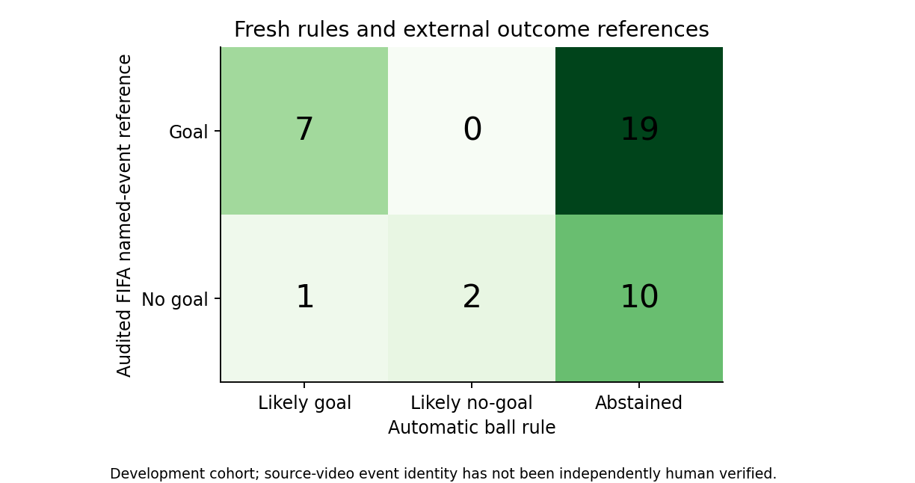
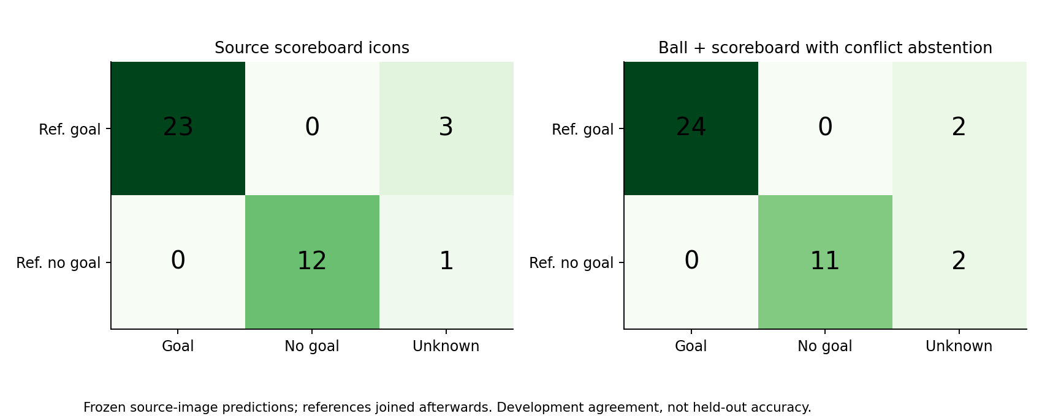
RQ3 · Ball path and outcome
33/39 ball-track candidates · 35/39 outcome-fusion candidates
IND5003 Vision II | 09

Slide 10
Failure boundaries
Strict dive height: 0/39
Strict event-final ball position: 0/39
Provisional view: 17/39 image-plane height candidates
Provisional view: 27/39 last-visible ball observations
Provisional values are not accuracy and do not overwrite strict columns
unknown
is a valid result when the source evidence is insufficient
IND5003 Vision II | 10

Slide 11
Generalisation and reproducibility
8/8
3/8
53
held-out primary runs
held-out foot strict
final focused tests
Dell RTX 2060 portable package runs without human answers
Runtime proves execution, not prediction accuracy
Raw videos and weights stay outside the public repository
Reports, manifests and hashes document what can be reproduced
IND5003 Vision II | 11

Slide 12
Conclusion and limitations
The contribution is a reproducible, evidence-first pipeline with abstention
Strongest coverage: contact, ball-track candidates, pre-kick movement and outcome fusion
Main gaps: height, terminal ball position, full top-down path and camera playback
Next data: endpoint boxes/timestamps, complete dive views and camera playback labels
Finish the narrated video, report review and SharePoint package before submission
Thank you
IND5003 Vision II | 12

