Slide 1
Chapter 3 Indexing and Retrieval ----Dictionary and Tolerant Retrieval
Dr. Dai Yu

Slide 2
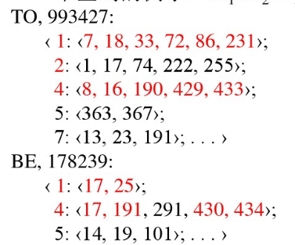
Inverted Index
Index with position->each record in the posting list is a docID
Index without position->each record in the posting list contains docID and the position
an example: to₁ be₂ or₃ not₄ to₅ be₆

Slide 3
Inverted Index
Index with position can support phrase query nd proximity query
The problem is
How to insure the efficiency
What to do when mismatch happens
exactly match some times may not work

Slide 4
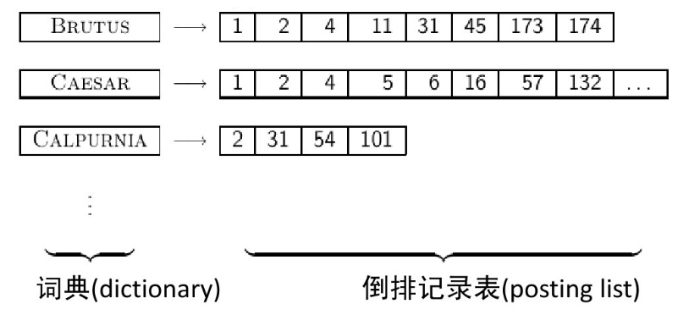
Inverted Index

Slide 5
Dictionary
Term vacabulary is a list of terms
Dictionary is a data structure which is used to store terms
for each term, we should store frequency, pointers pointed to the posting list
store with a fixed length array, each term occuy x+4+4 bytes
how to find the term in the list? compare one by one?
When we want to find something? Which data structure will be needed?
Tree
Hash

Slide 6
Hash for Index
Hash
A hash function should be established to turn a term into a integer
avoid collision
the speed will be faster than tree since the time complexity is O(1)
Disadvantage
Cannot deal with variation
Not support pre-fix
If the term list is usually updated, then it needs to re-construct hash table

Slide 7
Tree for Index
can support pre-fix
The simpliest tree structure: binary tree
time complexity is a little lower: O(logn)
needs balanced tree but to balance usually cost more
B-tree can be used

Slide 8
Wildcard Query
mon*, find the document contains the term with the prefix mon
If we use B-tree to be as the data structure, how to do?
If we use AVL tree to be as the data structure, how to do?
*mon, find the document contains the term ends up with mon
reverse the terms in the term list, based on them to construct a new tree
m*nchen， how to do?
intersection of m* and *nchen
permuterm index

Slide 9
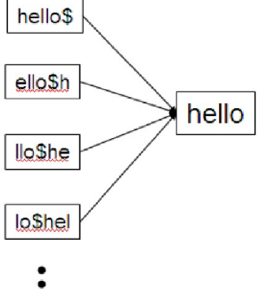
Permuterm Index
Basic idea
rotate each wildcard query, in order to make the term ends up with “*”, and then put the result into the term list that is to add a new term in the tree
$ is a special character

Slide 10
Permuterm Index
Query
x is to query x$
x* is to query x*$
*x is to query x$*
*x* is to query x*
x*y is to query y$x*
example, hel*o is to query o$hel*
When use permuterm index to find
rotate the term
find in B-tree
searching space enlarged

Slide 11
Spelling Error
To
Check the document to be indexed
Check the query of the user
Methods
Isolated word
check the spelling error of a word
Constex-sensitive
check with the consideration of the words in the context
form the sky or from the sky

Slide 12
Spelling Error
Isolated word
check whether the word is a spelling error. How to do
a list of term
compute the distance between the term and the word
return the term with the minimum distance
Edit distance
is the number of basic operations to turn the s1 to s2
basic operation: delete, insertion, replace
dog-do:1
cat-cart:1
cat-act:2

Slide 13
Spelling Error
Context-sensitive
hit-based
for each terms to be queried, return the “correct” term with the closet distance
flew form munich:flea->flew, from->form, munch->munich
Compose & search
flea from munich
flew from munich
flew form munch
the correct one has the highest hit ratio
if flew has 7 candidates, form has 20 candidate and munich has 3 candidates, how is about the combination?
Why not search in the historical log but not the documents?

Slide 14
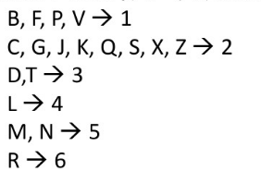
Soundex
soundex is to find the word with similar pronounciation
How to do?
Keep the first letter
Turn A\E\I\O\U\H\W\Y to 0
Turn the same charater to one.
Delete 0 in the result string

Slide 15
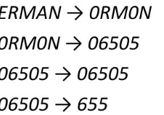
Soundex
HearMan
Keep H
Return H655
Hermann

