Slide 1
Chapter 3 Indexing and Retrieval ----Construct Index
Dr. Dai Yu

Slide 2
Background
Since software run on the hardware, we need to understand some features of the hardware to help us design the software
Accessing to the memory is much faster than the disk
I/O is based on block and the size of block ranges from 8k to 256k

Slide 3
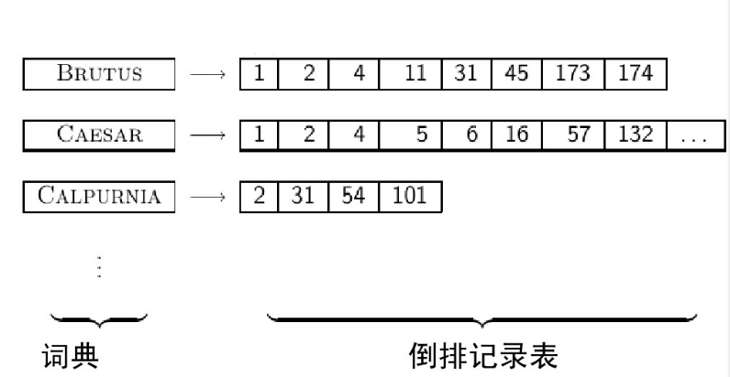
How to construct Inverted index?

Slide 4
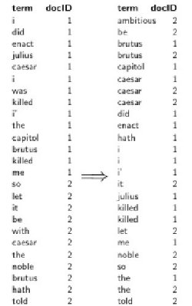
Construct Index in Memory By Sorting
Needs large memory

Slide 5
How to Construct in Disk?
Impossible
Frequently access to disk
External Sorting Algorithm is needed
Splitting a Document into Several Blocks
Sorting in the memory for each block
Combining the result

Slide 6
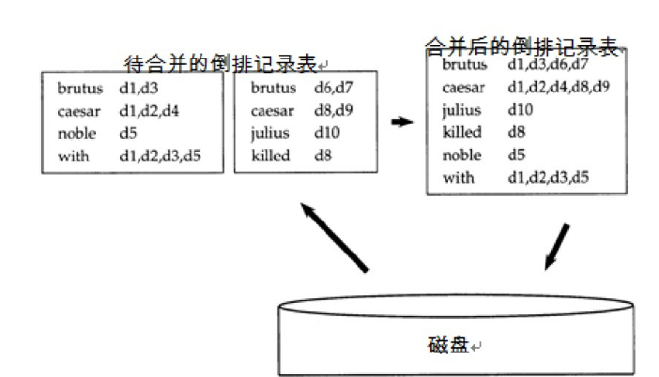
How to Construct in Disk?--BSBI (Block Sort-Based Indexing)
The merged one
Impossible
Frequently access to disk
External Sorting Algorithm is needed
Dividing a Document into Several Blocks
Sorting in the memory for each block
Combining the result
Inverse Index to be Merged
Disk

Slide 7
How to Construct in Disk?--BSBI (Block Sort-Based Indexing)
The merged one
Impossible
Frequently access to disk
External Sorting Algorithm is needed
Dividing a Document into Several Blocks
Sorting in the memory for each block
Combining the result
Inverse Index to be Merged
Disk

Slide 8
Basic Step of BSBI
mapping the word in the document to docID
split the document into equal size
recording the pair < term,docID> for each block
for each block, sorting the pair < term,docID>
merging the result of each block

Slide 9
Problems of BMBI
Need not to mapping the term to termID
Then SPIMI (Single Pass in Memory Indexing) is proposed
Basic Step
split the document into equal size
recording the pair < term,docID> for each block
for each block, sorting the pair < term,docID>
merging the result of each block

Slide 10
Distributed Index
Why not to let more machine to do the indexing for each block in parallel?
Master to instruct the task
Slave to do the indexing and merging

Slide 11
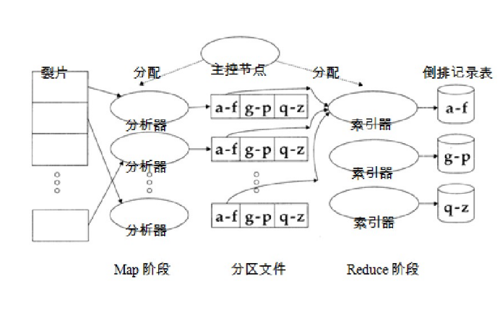
Distributed Index
Split
Allocation
Master
Allocation
Inverted Index
Parser
Indexer
Parser
Indexer
Parser
Indexer
Map Phase
The Middle Result
Reduce Phase

Slide 12
Dynamic Indexing
One method
Keep the whole index in the disk
when one document is modified, record this in a small index in the memory
when searching, both search from the index in the disk and the one in the memory and combine the result
update the whole index in each time interval
Problem
Too frequency？

