Slide 1
Chapter 3 Indexing and Retrieval ----Sorting
Dr. Dai Yu

Slide 2
The disadvantage of bool retrieval
We have introduced bool retrieval
matched or not matched
Bool retrieval is hard for the most of users to be used
Most of the users cannot use bool expression
Most of the users donot like to browse the found record one by one.
Bool retrieval can find too small or too big amount of the results
In the bool retrieval, one needs some skills to help them have the appropriate retrieval result.

Slide 3
Ranked Retrieval
Ranked retrieval can avoid too big or too small result
It needs better sorting algorithm in order to maked the results ranked high have higher relevance than the results ranked low.

Slide 4
Scoring Techniques in Ranked Retrieval
How to evaluate the relevenace degree?
Always gives a score for each pair of query-document

Slide 5

Jaccard Method
Compute the cover degree between two sets
Imagine A and B are 2 sets
JACCARD(A,A)=1
If A∩B=null, JACCARD(A, B)=0

Slide 6
Example of Jaccard
Query: ides of March
Document: Caesar died in March
Jaccard(q, d)=1/6

Slide 7
Disadvantage of Jaccard
Not consider the frequency of the term, that is the number of the word occured in the document
The rare word has more information while Jaccard does not consider this situation
Not consider the length of the document
How to modify?

Slide 8
Why to compress?
Reduce the disk storage
Increase the content in the memory to speed up
Speed up the process of transmit the data from the disk to memory
The decompression should has the high efficiency

Slide 9
Why need compression in Information Retrieval
Compress Dictionary
Read it in the memory as possible
Compress Posting List
Reduce the disk amount
Reduce the reading process from the disk to the memory

Slide 10
Lossy VS Lossless
Lossy Compression
discard some information
example: remove stoplist
Lossless Compression
always be used

Slide 11
Compress the Dictionary and Posting List
The size of the term list is a key in the compression of the dictionary
How to predict the size？
The distribution of the word is the key in the compression of the posting list
How to estimate the distribution?

Slide 12
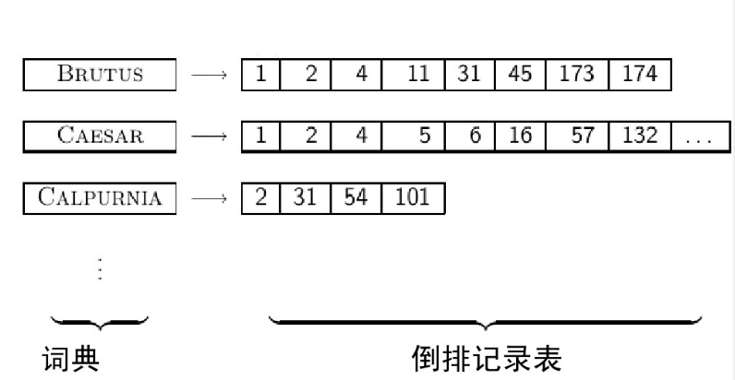
How to construct Inverted index?

Slide 13
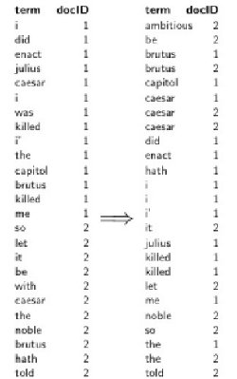
Construct Index in Memory By Sorting
Needs large memory

Slide 14
How to Construct in Disk?
Impossible
Frequently access to disk
External Sorting Algorithm is needed
Splitting a Document into Several Blocks
Sorting in the memory for each block
Combining the result

Slide 15
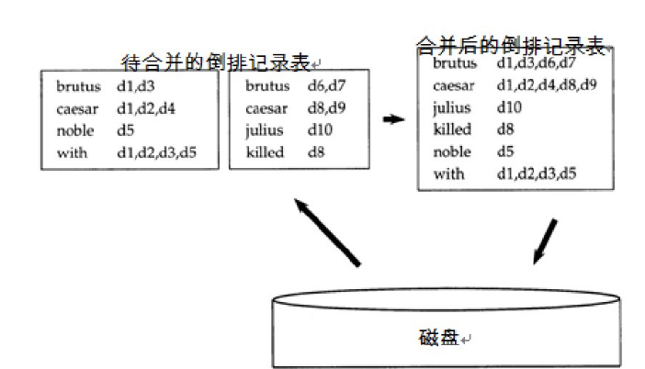
How to Construct in Disk?--BSBI (Block Sort-Based Indexing)
The merged one
Impossible
Frequently access to disk
External Sorting Algorithm is needed
Dividing a Document into Several Blocks
Sorting in the memory for each block
Combining the result
Inverse Index to be Merged
Disk

Slide 16
How to Construct in Disk?--BSBI (Block Sort-Based Indexing)
The merged one
Impossible
Frequently access to disk
External Sorting Algorithm is needed
Dividing a Document into Several Blocks
Sorting in the memory for each block
Combining the result
Inverse Index to be Merged
Disk

Slide 17
Basic Step of BSBI
mapping the word in the document to docID
split the document into equal size
recording the pair < term,docID> for each block
for each block, sorting the pair < term,docID>
merging the result of each block

Slide 18
Problems of BMBI
Need not to mapping the term to termID
Then SPIMI (Single Pass in Memory Indexing) is proposed
Basic Step
split the document into equal size
recording the pair < term,docID> for each block
for each block, sorting the pair < term,docID>
merging the result of each block

Slide 19
Distributed Index
Why not to let more machine to do the indexing for each block in parallel?
Master to instruct the task
Slave to do the indexing and merging

Slide 20
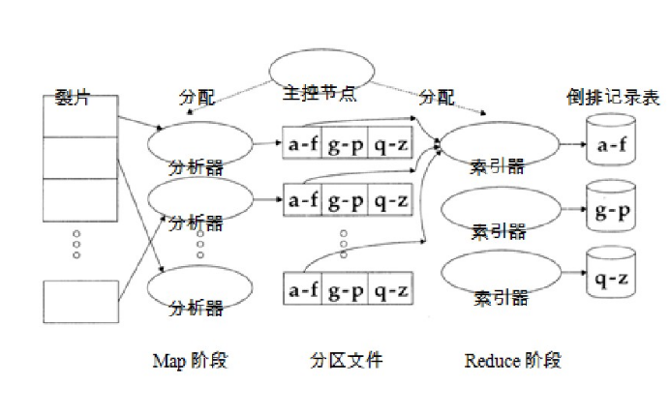
Distributed Index
Split
Allocation
Master
Allocation
Inverted Index
Parser
Indexer
Parser
Indexer
Parser
Indexer
Map Phase
The Middle Result
Reduce Phase

Slide 21
Dynamic Indexing
One method
Keep the whole index in the disk
when one document is modified, record this in a small index in the memory
when searching, both search from the index in the disk and the one in the memory and combine the result
update the whole index in each time interval
Problem
Too frequency？

