Slide 1
Chapter 3 Indexing and Retrieval ----Ranking
Dr. Dai Yu

Slide 2
Background
Usually, we may get a large number of results.
We donot want to browse each record one by one.
How to do?
The results ranked high should be much more closer to the query intent.

Slide 3
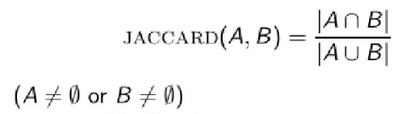
Jaccard
Compute the covering degree between two sets
Imagine A and B are 2 sets
JACCARD(A, A)=1
JACCARD(A,B)=0 if A∩B=null

Slide 4
Example of Jaccard
Query “ides of March”
Document “Caesar died in March”
Jaccard(q,d)=1/6

Slide 5
Disadvantage of Jaccard
Not consider the frequency of the term, that is, the number of occurences of the term in the document
Rare or infrequent word has much more information, while Jaccard does not consider this situation
Not consider the length of the document carefully
if the document is too long, what happened?

Slide 6
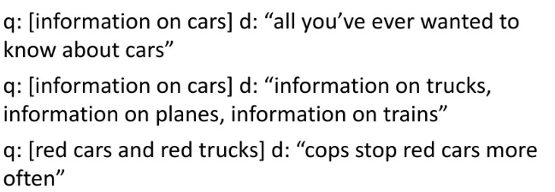
Exercise

Slide 7
Bag of Words
Not consider the sequence of the word occured in a document
John is quicker than Mary.
Mary is quicker than John.
tf-term frequency
tf_{t,d} is the number of the term t occured in the document d
Use raw tf to give a score to a document
While raw tf is not appropriate
If some term occured 10 times in A, while occured 1 time in B, tfA=10, tfB=1
But we cannot say the relavance degree between the two document achieves 10 times
That is, relavence degree is not a ratio to the occured times.

Slide 8
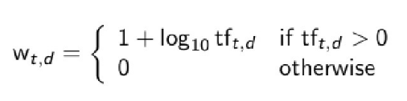

Logarithmic word frequency
The weigh of Logarithmic word frequency of the term t in the document d can be defined as:
The matching deggree beween the query and the document can be defined as:

Slide 9
Weight of the Word
Rare word has more information.
A big weight should be given to the rare word when computing the matching degree.
How to compute the weight?

Slide 10

idf Weight
df_{t} is the number of the documents which contain the term t
Rare word should be given a big weight.
Then, the weight idf must be an inverse ratio to df.
where, N is the number of the documents

Slide 11
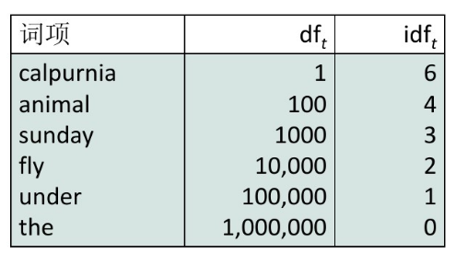

Example of idf
Term

Slide 12
Effect of idf on the Ranking
idf will affect the ranked result of the document according the query which contains at least 2 terms
Example
“arachnocentric line” idf will increase the weight of arachnocentric while decrease the weigh of line

Slide 13

tf-idf Weight
A combination of tf and idf
The document much more relevant in that:
The term occured many times
Or, the term is rare

Slide 14
Vector Space
Use vector to express a document
In the vector, each element is a tf-idf between the document and the term
Then, if we have n term, the number of the dimention of the vector will be n
However,
High dimention, especially for web
Very Sparse

Slide 15
Query as Vector
When to query by using the vector, how to do?
Express the query as the vector
matchmaking between 2 vector
ranking based on the match degree
The key is how to make the matchmaking?

Slide 16
Matchmaking
Compute the distance between 2 points
Euclidean distance
However, sensitive to the length of the vector
Use intersection angle but not the distance
Example
Copy d and connect the copied part at the end of the document d. Then, you can get d'
Infact d and d' is the same from the point view of the sementics
Their distance will be very big when using Eucidean distance
While if use the intersection angle, their angle will be close to 0.

Slide 17
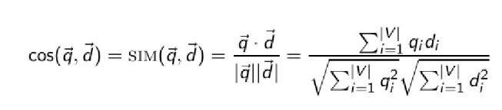
Cosine to Compute the Angle
How to compute?
Here,
qi is the tf-idf weight of the i^{th} term in query q;
di is the tf-idf weigh of the i^{th} term in document d

Slide 18
How to Show the Result?
Using a List.
How to describe the documents in the list?
The description is very important
The user justify the result based on the description
Then, the user need not to click the document and browse the whole document
What to descirbe?
Title,
URL,
Metadata
Sometimes an abstract

Slide 19
Abstract
Two type: static one and dynamic one
Static abstract
No matter what you input, the abstract is still not changed
Dynamic abstract
depend on the query
try to explain why this document is returned

Slide 20
Static Abstract
The static abstract is a sub set of the document
One method: return the top 50 words of the document
Another method: return the abstranct which contains some important sentences in the document
gives the score to each sentency by using some NLP method
composes the sentences with the high score
The other one: uses some complex NLP methods. But the techniques still have not been matured.

Slide 21
Dynamic Abstract
Google's method
Use location index
To improve the efficiency, store the document in the cache
Not put the whole document in the cache, but only store the pre-fix one.

Slide 22
How to improve recall?
Relevance Feedback
Query extension

Slide 23
Relevance Feedback
Basic idea:
User submit a query
The search engine will return a set of documents
The user will tag which document isrelevant and which one is not
The search engine will return a new

Slide 24
Types of relevance feedback
Explicit feedback
Implicit feedback: based on the user's behavior to predict the relevance
Pseudo feedback: with no user's participation, just guess.

Slide 25
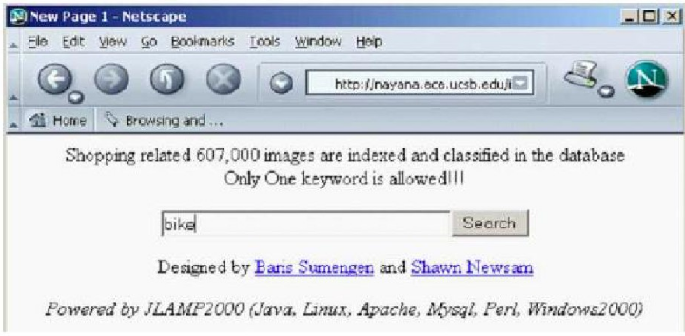
Examples

Slide 26
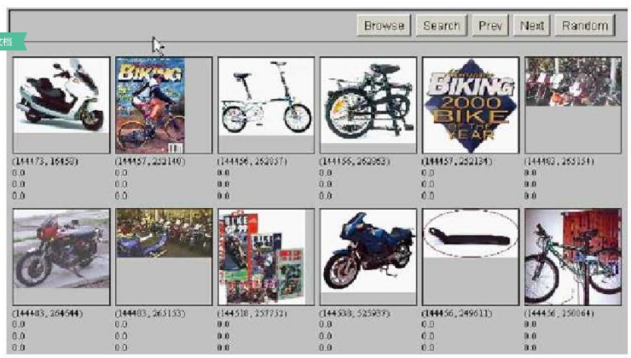
Example

Slide 27
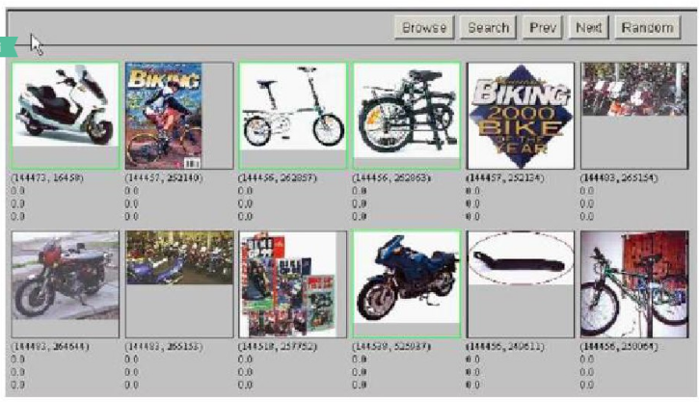
Example

Slide 28
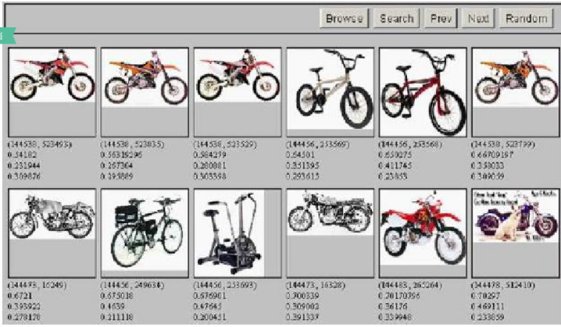
Example

Slide 29
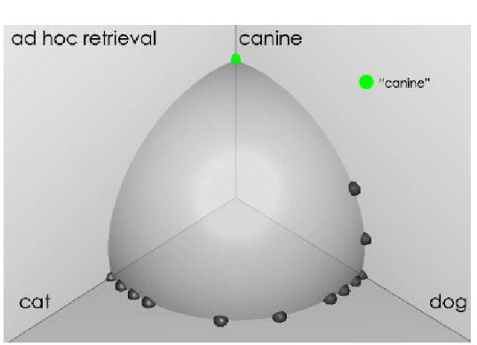
Example

Slide 30
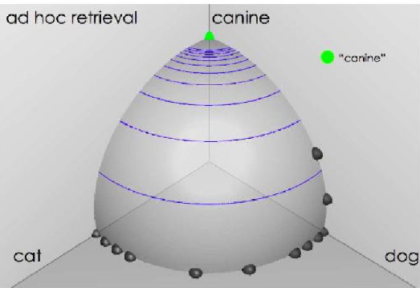
Example: similarity between document

Slide 31
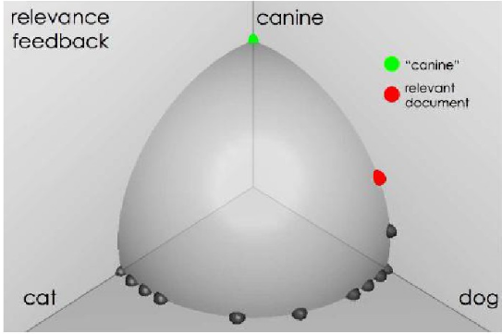
Example: User's Feedback

Slide 32
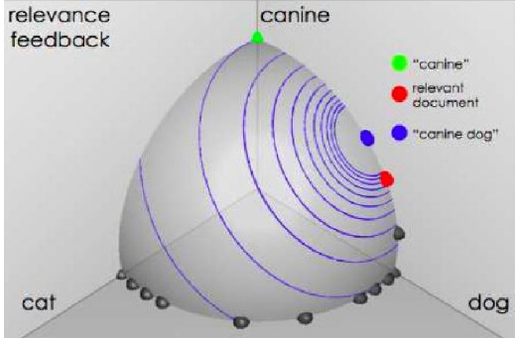
Result

Slide 33
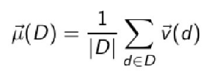

The core of Relevance Feedback
Centroid
The central of a set of data points
D is a set of document
is the vector of the document

Slide 34
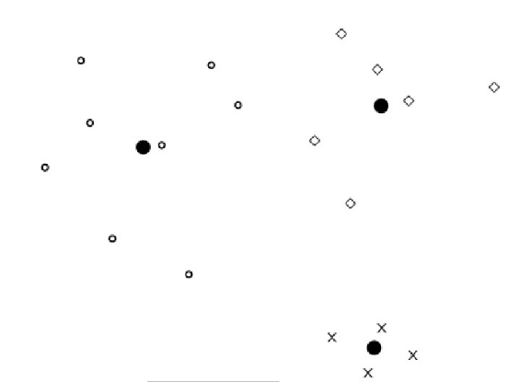
Example

Slide 35

Rocchio Algorithm
Find a vector to diffentiate the relevance and non-relevenance document

Slide 36
About Search Engine
Does current search engine use Explicte Relevance Feedback?
Why?

Slide 37
Implicit Relvence Feedback
Observe the user's behavior
Estimate the user's query intent
Optimize the result

Slide 38
Type of User's Behavior
Keyboard and mouse
click
add to favorites
copy
turn to another page
stop
eye motion
staring
move quickly..

Slide 39
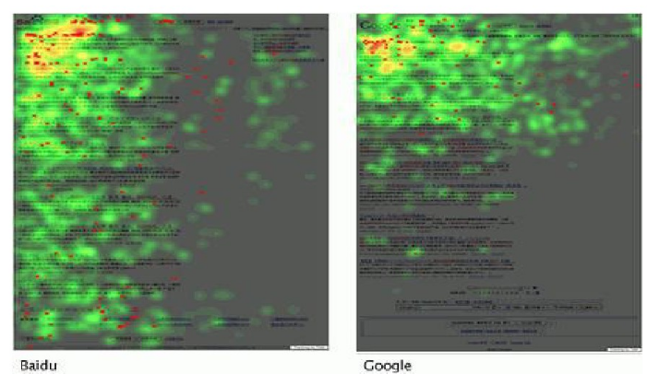
Eye tracking by mouse simulation

Slide 40
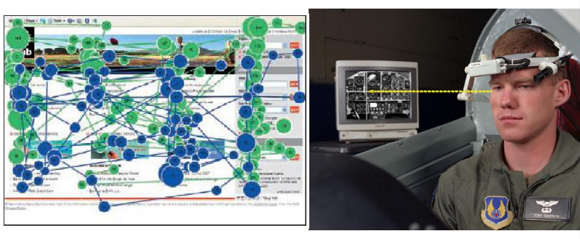
Eye Tracking

Slide 41
Disadvantage of Implicit Relevance feedback
difficult to understand the user's intent

Slide 42
Pseudo-Relevance Feedback
Return result according to uer's query
imagine the top-k is relevant
feedback by using Rocchio algorithm

Slide 43
Query Expansion
By using thesaurus
Hospital-Medical
How to construct thesaurus?
Manually
automatically
Export--based on words co-occurence
car and motorcycle. both of them co-occured with license, road...
How to do?
Mining-based on equivilance class mining in the query log
query “flower pix” usually click the same URL as query “flower clipart”
after submit query “herbs”, the user always search “herbal remedies”

