Slide 1
Chapter 3 Indexing and Retrieval ----Probalilistic Information Retrieval
Dr. Dai Yu

Slide 2
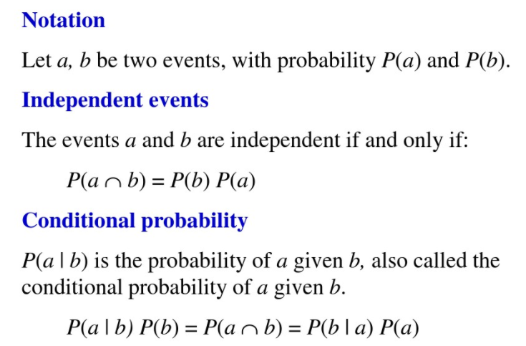
Basic Probability Conception

Slide 3
Random Test and Event
Random Test: under the same situation, the test can be done several times; The results can be different, but we can know all the potential results; however, the result of one test can not be determined before the test.
a coin
Random Event: in a random test, we call the situation happened in the random test as the random event.
flip for a coin, head side or reverse side

Slide 4
Probability and Conditional Probability
Probability: the probability of the event A is the probability that A happens, signified as P(A)
flip for a coin, the probability of head side
Conditional Probability: Under the situation that the event A happens, the probability of the occurence of the event B is called as the conditional probability of B under A, signified as P(B|A)
we have 30 red balls and 40 black balls, if in the first time we pick up the red ball, what is the probability that the second time we pick the black ball?

Slide 5

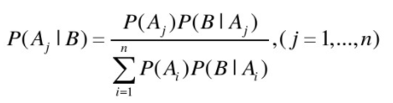
Bayesian Formula
Multiply
P(AB)=P(A)P(B|A)
P(A1A2....An)=P(A1)P(A2|A1)...P(An|A1)
Full Probability: A1, A2, ...An is a partition of the sample space
Bayesian: A1, A2, ...An is a partition of the sample space

Slide 6
Independence of the Events
Independence of two Events: For the event A and B, if P(AB)=P(A)P(B), then A and B are independent.
Independence of 3 Events: For the events A, B, and C, if
P(AB)=P(A)P(B)
P(AC)=P(A)P(C)
P(BC)=P(B)P(C)
P(ABC)=P(A)P(B)P(C)
Then, A, B, and C are independent
Independence of many Events: every 2 events are independent, every 3 events are independent,...

Slide 7
Random Variable
Random variable: if the various results in the random test can be expressed as a value of a variable, then, this variable is called as random variable, which can be expressed as X, Y, Z.
discrete random variable
flip for a coin. The result can be 0 or 1, where 0 is the reverse side and 1 is the head side
continous random variable
the tempreature of Shenyang (-30, 35)

Slide 8
Probability Retrieval
In a retrieval system, for a query, compute the relevant degree of each document
The understanding of the user's query is uncertain
The guess of whether the results matched the query is also uncertain
Probability retrieval is used for computing the probability of the relevance between the query and the document

Slide 9
Probability Retrieval
Probability retrieval uses the probability to combine the query and document together
define 3 random variable R, Q, D
relevant degree R={0, 1}
query Q={q1, q2,...}
document D={d1, d2,...}
Then the conditional probability P(R=1|Q=q, D=d) is used for evaluate the relevant degree between a document and a query.

Slide 10
Probability Retrieval Models
Probability retrieval model based on Logistic regression
Binary independent probability model BIM
Bayesian

Slide 11
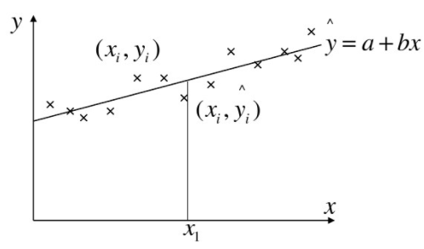

Regression
Regression is a tool for dealing with the relevant relation between variables. The result of the regression can be used for prediction or classification
Simple linear regression: according to the observed data points fiiting a line in oder to make the loss the minimum
Multiple linear regression:

Slide 12

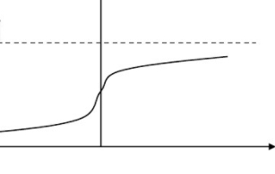

Logistic Regression
Logistic regression is a non-linear regression
Logistic which is also called as Sigmoid function
A non-linear regression can be transformed to a linear regression

Slide 13
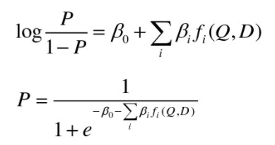
Logistic Regression IR
Basic idea: in order to compute the probabiliy of Q and D, that is, P(R=1|Q,D). Then, we can define several feature functions fi(Q, D) and takes the P(R=1|Q, D) as the combination of these functions.
Cooper proposed a method:
We can define log(P/(1-P)) as a combination of several feature functions. Then, P is a logistic function. That is,

Slide 14
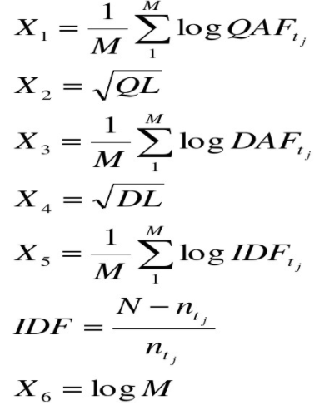
Choice of feature function fi

Slide 15

Logistic Regression IR
The process
get the coeffiicent , then for a new document, compute the probability P by the formula
Advantage
easy to understand by using mathematics
Disadvantage
difficult to choose feature and has not good effect

Slide 16
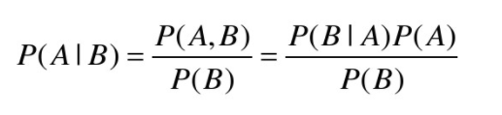
Binary Independence Model--BIM
Bayes
BIM uses Bayes formula to compute the conditional probability P(A|B)
For the same query Q, P(R=1|Q, D) can be simplified as P(R=1|D)

Slide 17
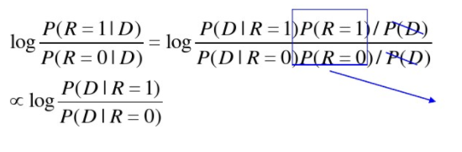
BIM
For each Q, a ranking function RSV(Q, D) can be defined as:
where, P(D|R=1) and P(D|R=0) are the probability of generating D under the situation of revlevance and non-relevance. The ranking as the same increasing ratio with P(R=1|D).
For a same query, it is a constant

Slide 18
How to generate a document?
Basic Idea
The terms follow some distribution
Sampling from the distribution
The terms sampled from the distribution will be combined together to form a document
For P(D|R=1) or P(D|R=0), we can imagine the terms follow the distribution and generate D by sampling.

Slide 19
Two Distributions in Widely Use
Multi variate Bernoulli distribution
The size of the dictionary is M
M coins corresponds to M terms
The probability of i^{th} coins with the head is pi
Imagine M=4 (The terms are： I you can fly), p1=0.7, p2=0.4, p3=0.1, p4=0.05,
then, P(I can fly fly)=0.7*(1-0.4)*0.1*0.05
Multinomial distribution
The size of the dictionary is M
The dice has M sides, each side correponds to a term
The ith side in the front with the probability pi
Imagine M=4 ( I you can fly), p1=0.4, p2=0.3, p3=0.2, p4=0.1
then, P(I can fly fly)=0.4*0.2*0.1*0.1

Slide 20
Compute P(D|R=1) or P(D|R=0)
M independent test (Multi variate Bernoulli)
There are M terms in the space which corresondes to M coins.
The ith coin correspond to the ith term
The head means the term occurs, if not otherwise
Throw the M coins independently.
Record the terms with the head of the coins
Then, these terms compose the document D
Then to compute P(D|R) is to compute the probability of throwing the coins to get the document D.
P(D|R=1) and P(D|R=0) corresponds to 2 sets of coins which needs 2M parameters.

Slide 21

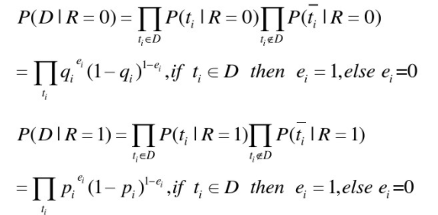
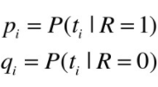
Induce of BIM
D can be seen as

Slide 22
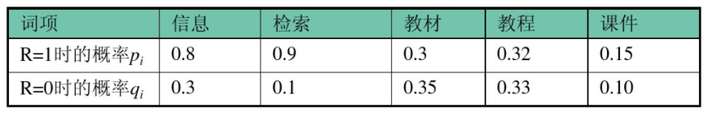
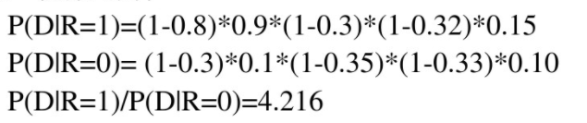
Example
Query: Information Retrieval Couse Book Slides
Document: Retrieval Slides
Term
Information
Retrieval
Book
Course
Slide
Pi with R=1
qi with R=0

Slide 23
How to compute pi, qi
For each query, we cannot get the relevant document set and non-relevant document set. We need to estimate
Method
Initial retrieval: estimate before the first time of the retrieval
Based on result: estimate based on the last time retrieval result

Slide 24
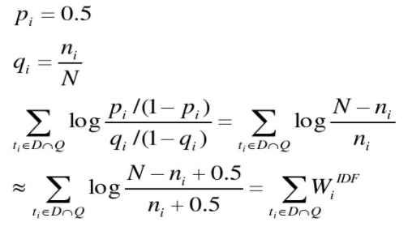
Compute pi, qi
Initial retrieval: pi is a constant, qi is the distribution of the term i in all the documents.

Slide 25
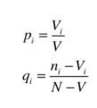
Compute pi, qi
Based on results: imagine the result set is V, if the set Vi contains term i
Then,

Slide 26
Characteristics of BIM
Advantages
based on mathematics
Disadvantages
Estimate parameters
Not consider TF and the length of the document

