Slide 1
Chapter 3 Term Vocabulary & Skip Pointer
Dr. Dai Yu

Slide 2
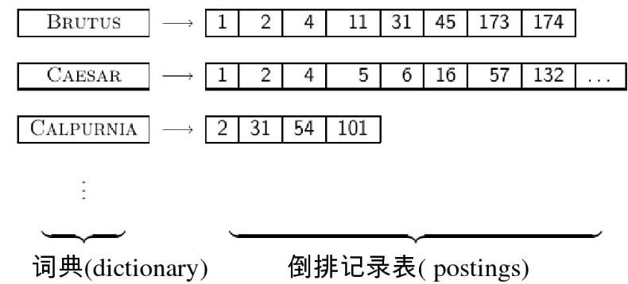
Inverted Index

Slide 3
Tokenization
Input “Friends, Romans and Countrymen”
Output: Token
Friends
Romans
Countrymen
Token is an instance of string
Token will be inserted into the inverted index

Slide 4
Problems in Tokenization
How to generate Token?
Hewlett-Packard
San Francisco
How to deal with number?
How to deal with multiple language?
French
L‘ensemble
Chinese
there is no space between words

Slide 5
Segmentation of Chinese Word
For Chinese, the aim of segmentation is to find the indexing unit.
For example, 李明天天都准时上班
indexing unit
字：李 明 天 天 都 准 时 上 班
the big indexing list
good recall but poor precision. “明天”
词：李明 天天 都 准时 上班
appropriate indexiing list
good precision but rely on the effect of the segmentation
mix of 字 词
fine grained

Slide 6
Problems in Tokenization
Stop list
According to the stop list, delete the word in the word dictionary
the a and to be
But current methods suggest to keep the stop list
some stop list is not useless
Normalization
use the same type to express the same meaning
U.S.A USA
anti-discriminatory, antidiscriminatory
Datetime type
30th July VS 7/30

Slide 7
Problems in Tokenization
Captitalization
Convert all letters to lowercase
Fed (Federal Reserve) vs. fed
example of google. C.A.T. The result is cat not caterpillar
Extension
window->windows
homonym
car=automobile
construct the dictionary manually
Spelling Error
soundex based method
Clinton-->Klinton

Slide 8
Problems in Tokenization
Oringinal Shape
Turn the variant form into the oringinal shape
am, are, is ->be
car, cars, car's- car
the boy's cars are different colors - boy car be different color
Merge part of speech
found->find found
reduce the word to the stem
automate, automatic, automation->automat

Slide 9
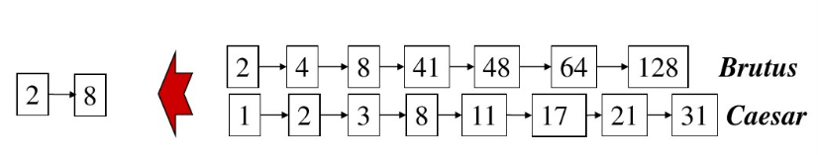
Skip Pointer
Review of Inverted Index
Brutus AND Caesar
Can we speed up the comparing process?
Skip the nodes which cannot be the result

Slide 10

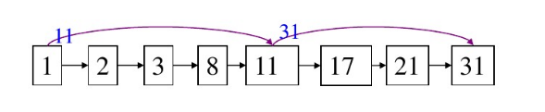
Skip Pointer
An Example. Imagine the pointers points to 8.

Slide 11
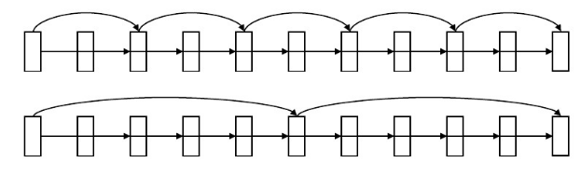
Skip Pointer
How to set the skip pointer?
The more skip pointers, the shorter steps
If the pointers are in uniform distribution, the actual distribution will be overlooked.
If the index is static not changing, then, uniform distribution can be used
If the length of the index list changes all the time, maintaining the uniform distribution is not an easy task.

