Slide 1
Chapter 5 Crawling

Slide 2
Crawling on the Web
Search engine needs to crawling on the web
Difference between dealing withthe documents in the disk

Slide 3
Basic Process
Iinitialize the URL seeds queue
Repeat
Get a URL from the queue
Download and analyze the web page
Extract more URL from the page
Enque these URLs

Slide 4
How to design a crawler?
Problems need to be considered
Scale is large->distributed
Cannot deal with all the web pages, important pages should be considered
Repeatable page: should be detected
Trap for the wrapper
Freshness

Slide 5
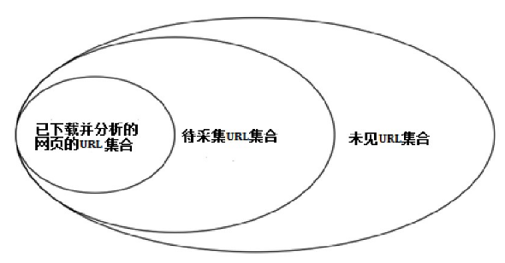
URL frontier
The set of URL which has been crawled
The set of URL to be crawled
URL Not been Seen

Slide 6
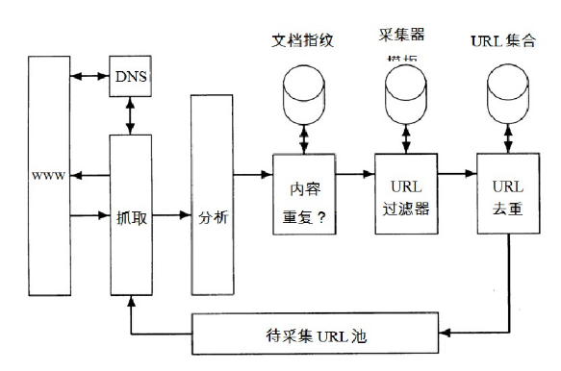
Basic Structure
Fingerprint
Template
URL Set
Repeatability
URL Filter
Filter Repeat
Crawl
Analysis
URL Queue

