Slide 1
Deadlocks

Slide 2
Review: What is a deadlock?
Let S and Q be two semaphores initialized to 1
P₀ P₁
wait(S); wait(Q);
wait(Q); wait(S);
... ...
signal(S); signal(Q);
signal(Q); signal(S);
Deadlock – two or more processes are waiting indefinitely for an event that can be caused by only one of the waiting processes.

Slide 3
Today’s Topic
How to describe a deadlock
Methods for handling deadlocks
  Ignore
  Prevention
  Avoidance
  Detection and Recovery

Slide 4



Resources
Generally, there are many kinds of resources in a computer system, e.g. CPU cycles, memory space, I/O devices
  We can use R₁, R₂, … , R_{m} for representing different resource types,
  Each resource type R_{i} has W_{i} instances,
  Each process utilizes a resource in the order
    Request
    Use
    Release.
Notes:
系统拥有一定数量的资源，分布在若干竞争进程之间。资源分成多种类型，如内存空间、CPU周期、文件、I/O设备等。每种类型有相同数量的实例。
正常操作模式下，进程按如下顺序使用资源：
申请：如果申请不能立即被允许，那么申请进程必须等待直到它获得该资源为止。
使用：进程对资源进行操作。
释放：进程释放资源。
开发多线程应用的程序必须特别关注死锁问题，因为多个线程可能因为竞争共享资源而容易产生死锁。

Slide 5
Deadlock Characterization
Deadlock can arise if four conditions hold simultaneously.
Mutual exclusion: only one process at a time can use a resource
Hold and wait: a process holding at least one resource is waiting to acquire additional resources held by other processes
No preemption: a resource can be released only voluntarily by the process holding it, after that process has completed its task
Circular wait: there exists a set {P₀, P₁, …, P_{n}} of waiting processes such that P₀ is waiting for a resource that is held by P₁, P₁ is waiting for a resource that is held by P₂, …, P_{n–1} is waiting for a resource that is held by P_{n}, and P_{n} is waiting for a resource that is held by P₀.

Slide 6
Resource-Allocation Graph
A set of vertices V and a set of edges E.
V is partitioned into two types:
  P = {P₁, P₂, …, P_{n}}, the set consisting of all the processes in the system
  R = {R₁, R₂, …, R_{m}}, the set consisting of all resource types in the system
E is also partitioned into two types:
  request edge – directed edge P_{i} → R_{j}
  assignment edge – directed edge R_{j} → P_{i}

Slide 7
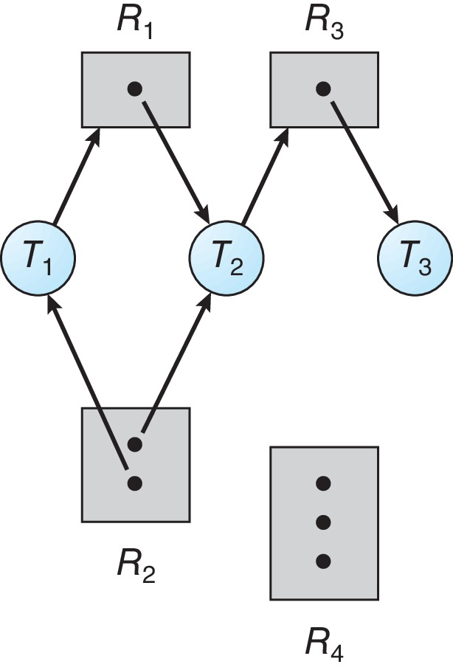
Elements in a Resource Allocation Graph
Process
Resource Type with 4 instances
P_{i} requests instance of R_{j}
P_{i} is holding an instance of R_{j}
P_{i}
Deadlock happens
R_{j}
P_{i}
R_{j}

Slide 8

Basic Facts
If graph contains no cycles
If graph contains a cycle ⇒
⇒ no deadlock
  if only one instance per resource type
  if several instances per resource type
⇒ deadlock
⇒ Possibility of deadlock

Slide 9
Today’s Topic
How to describe a deadlock
Methods for handling deadlocks
  Ignore
  Prevention
  Avoidance
  Detection and Recovery

Slide 10
Methods for Handling Deadlocks
Ensure that the system will never enter a deadlock state:
  Deadlock prevention
  Deadlock avoidance
Allow the system to enter a deadlock state and then recover
Ignore the problem and pretend that deadlocks never occur in the system.

Slide 11
Deadlock Prevention
Invalidate one of the four necessary conditions for deadlock:
Mutual Exclusion
  not required for sharable resources, e.g., read-only files;
  must hold for non-sharable resources, e.g. printer.
    Spooling: Printers can be spooled that only the printer daemon uses printer resource to eliminate deadlock for printers.
    But not all devices can be spooled. There are some other strategies:
      Avoid assigning resource when not absolutely necessary
      As few processes as possible actually claim the resource

Slide 12
Deadlock Prevention (Cont.)
Invalidate one of the four necessary conditions for deadlock:
Hold and Wait – must guarantee that whenever a process requests a resource, it does not hold any other resources
  Require process to request and be allocated all its resources before it begins execution
    may not know required resources at start of run
    ties up resources other processes could be using
  Allow process to request resources only when the process has none allocated to it.
  Disadvantages
    Low resource utilization;
    Starvation possible.

Slide 13
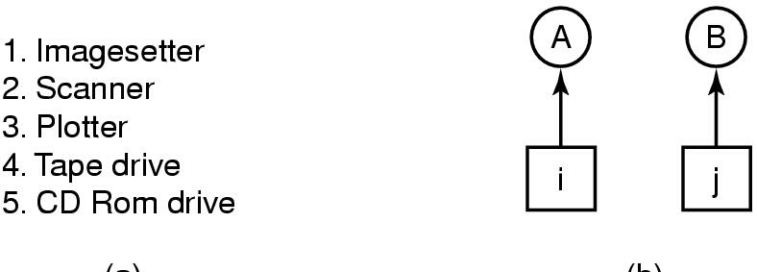
Deadlock Prevention (Cont.)
Invalidate one of the four necessary conditions for deadlock:
No Preemption – sometimes not viable to preemption some non-sharable resources, e.g. printer.
Circular Wait – impose a total ordering of all resource types, and require that each process requests resources in an increasing order of enumeration
Assume i and j are distinct resources, and have different numbers.
i>j
A is not allowed to request j because that is lower than what it already has.
i<j
B is not allowed to request i because that is lower than what it already has.

Slide 14
Deadlock Avoidance
Requires that the system has some additional a priori information available
Simplest and most useful model requires that each process declare the maximum number of resources of each type that it may need
The deadlock-avoidance algorithm dynamically examines the resource-allocation state to ensure that there can never be a circular-wait condition
  Resource-allocation state is defined by the number of available and allocated resources, and the maximum demands of the processes
  Carefully analyzing each resource request to see if it could be safely granted, i.e. make a right choice.

Slide 15
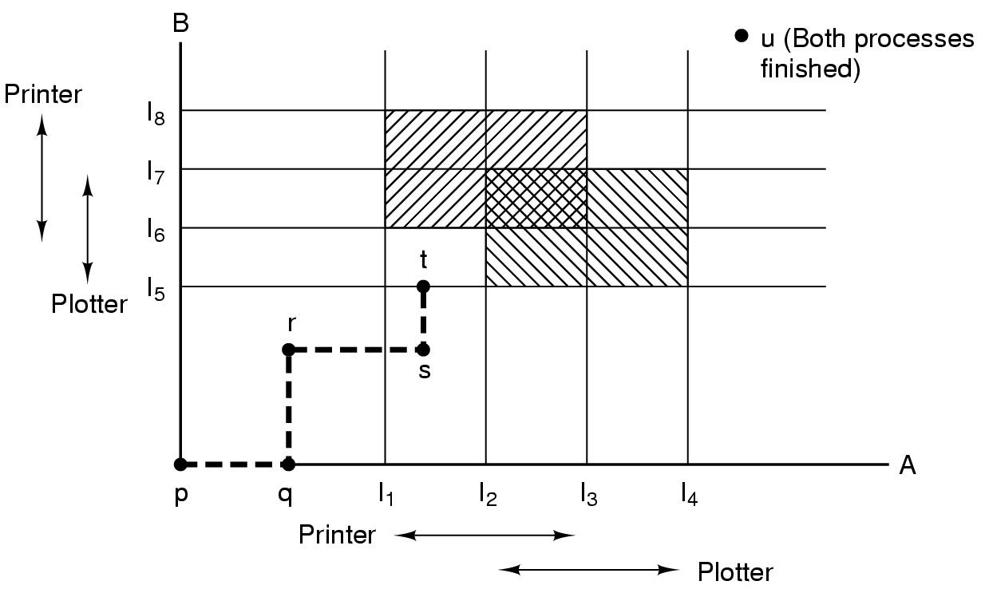
Illustration
Both having printer, which is not allowed to be entered
Unsafe and must not be entered
The only safe thing is run A until it gets I₄.
B is running
Both having plotter, which is not allowed to be entered.
Initial state
A is running
Notes:
Plotter绘图仪

Slide 16
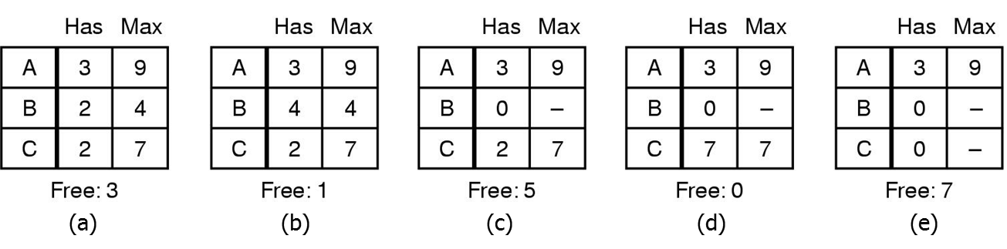
Safe State
System is in safe state if there exists a sequence <P₁, P₂, …, P_{n}> of ALL the processes in the systems such that for each P_{i}, the resources that P_{i} can still request can be satisfied by currently available resources + resources held by all the P_{j}, with j < I
There are 10 resource instances totally. Is state in (a) safe?
State in (a) is safe. The safe sequence is <B, C, A>
Notes:
系统中有几个资源，几个空闲资源，排顺序，先给B，再给C，再给A

Slide 17
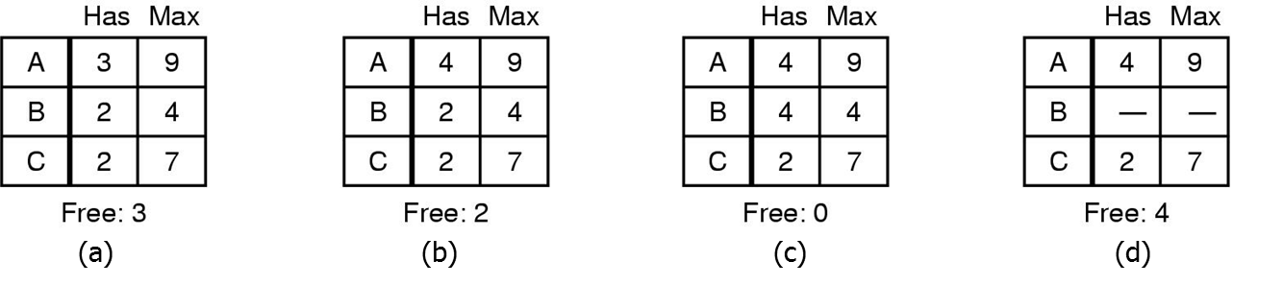
Safe State
System is in safe state if there exists a sequence <P₁, P₂, …, P_{n}> of ALL the processes in the systems such that for each P_{i}, the resources that P_{i} can still request can be satisfied by currently available resources + resources held by all the P_{j}, with j < I
There are 10 resource instances totally. Is state in (b) safe?
State in (b) is not safe.
Notes:
找不到安全序列

Slide 18
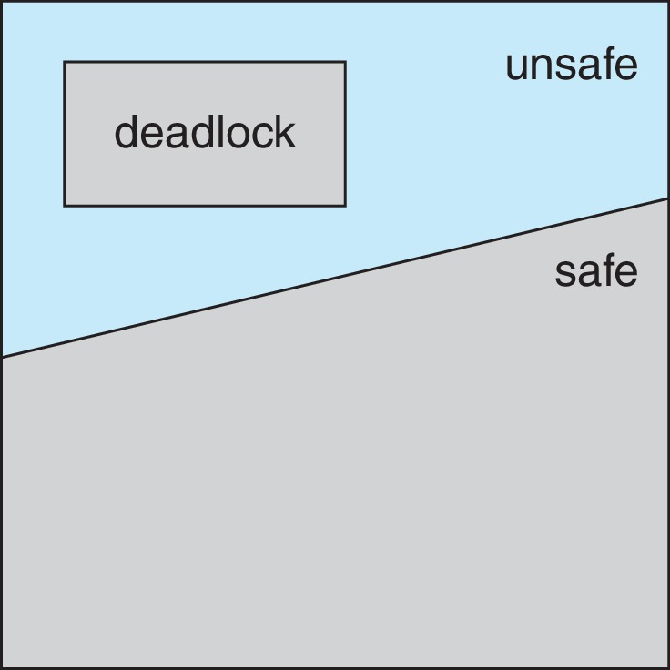
Basic Facts
If a system is in safe state
⇒ no deadlocks
If a system is in unsafe state
⇒ possibility of deadlock
Avoidance
⇒ ensure that a system will never enter an unsafe state.
Notes:
不进入不安全的状态

Slide 19
Deadlock Avoidance Algorithms
Basic idea
  When a process requests an available resource, system must decide if immediate allocation leaves the system in a safe state.
There are two algorithms
  Resource allocation graph algorithm
    Only one instance of each resource type.
  Banker’s algorithm
    Multiple instances of each resource type.
Notes:
进程发出请求，系统是否能够立即为进程分配资源

Slide 20
Resource-Allocation Graph Scheme
Resources must be claimed a priori in the system.
  Introduce a new type of edge, claim edge, to indicate the resource request in the future.
Claim edge P_{i} → R_{j} indicated that process P_{j} may request resource R_{j}; represented by a dashed line
Claim edge converts to request edge when a process requests a resource
Request edge converted to an assignment edge when the resource is allocated to the process
When a resource is released by a process, assignment edge reconverts to a claim edge

Slide 21
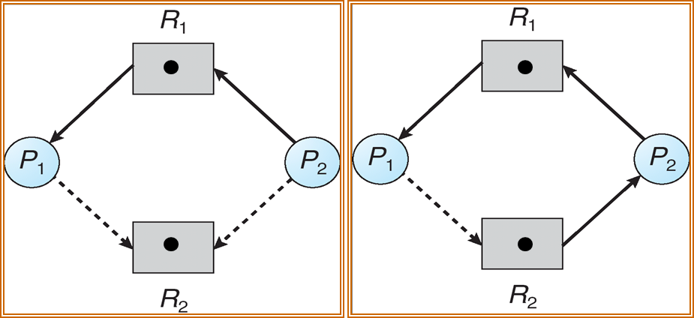
Resource-Allocation Graph
P₂ request R₂
process P₁ and P₂ may request resource R₂
If P₁ requests R₂ , what will happen?
R₂ is assigned to P₂
Notes:
虚线：P1要执行需要请求R2，当P1发出请求，变为实线
出现环，死锁，不能立即执行

Slide 22
Resource-Allocation Graph Algorithm
Suppose that process P_{i} requests a resource R_{j}
The request can be granted only if converting the request edge to an assignment edge does not result in the formation of a cycle in the resource allocation graph.
Deadlock happens

Slide 23
Banker’s Algorithm
Multiple instances of resources
Each process must a priori claim maximum use
When a process requests a set of resources, system must determine whether the allocation of these resources will make the system unsafe.
When a process gets all its resources it must return them in a finite amount of time.

Slide 24
Data Structures for the Banker’s Algorithm
Let n = number of processes, and m = number of resources types.
Available: Vector of length m. If available [j] = k, there are k instances of resource type R_{j} available
Max: n x m matrix. If Max [i,j] = k, then process P_{i} may request at most k instances of resource type R_{j}
Allocation: n x m matrix. If Allocation[i,j] = k then P_{i} is currently allocated k instances of R_{j}
Need: n x m matrix. If Need[i,j] = k, then P_{i} may need k more instances of R_{j} to complete its task
    Need [i,j] = Max[i,j] – Allocation [i,j]
Notes:
Max最大的资源数
Allocation占有的资源数
Need需要的资源数
Available可用资源数

Slide 25
Example of Banker’s Algorithm
5 processes P₀ through P₄;
3 resource types A(10 instances), B (5 instances), and C (7 instances).
Snapshot at time T₀:
Allocation Max Available
A B C A B C A B C
P₀ 0 1 0 7 5 3 3 3 2
P₁ 2 0 0 3 2 2
P₂ 3 0 2 9 0 2
P₃ 2 1 1 2 2 2
P₄ 0 0 2 4 3 3
Need
A B C
7 4 3
1 2 2
6 0 0
0 1 1
4 3 1
Notes:
考试题
总共：占有的一列+available

Slide 26
Safety Algorithm
1. Let Work and Finish be vectors of length m and n, respectively. Initialize:
      Work = Available
      Finish [i] = false for i = 0, 1, …, n- 1
2. Find an i such that both:
  (a) Finish [i] = false
  (b) Need_{i} ≤ Work
  If no such i exists, go to step 4
3. Work = Work + Allocation_{i}
Finish[i] = true
go to step 2
4. If Finish [i] == true for all i, then the system is in a safe state

Slide 27
Example of Banker’s Algorithm
Select P₁:
Allocation Max Work
A B C A B C A B C
P₀ 0 1 0 7 5 3 3 3 2
P₁ 2 0 0 3 2 2
P₂ 3 0 2 9 0 2
P₃ 2 1 1 2 2 2
P₄ 0 0 2 4 3 3
Need
A B C
7 4 3
1 2 2
6 0 0
0 1 1
4 3 1
Need₁<Work, P₁ can be executed.

Slide 28
Example of Banker’s Algorithm
Select P₁:
Allocation Max Work
A B C A B C A B C
P₀ 0 1 0 7 5 3 3 3 2
P₁ 2 0 0 3 2 2
P₂ 3 0 2 9 0 2
P₃ 2 1 1 2 2 2
P₄ 0 0 2 4 3 3
Need
A B C
7 4 3
1 2 2
6 0 0
0 1 1
4 3 1
5 3 2
0 0 0
0 0 0
P₁ finished and released its resources.

Slide 29
Example of Banker’s Algorithm
Select P₃:
Allocation Max Work
A B C A B C A B C
P₀ 0 1 0 7 5 3 5 3 2
P₁ 0 0 0 3 2 2
P₂ 3 0 2 9 0 2
P₃ 2 1 1 2 2 2
P₄ 0 0 2 4 3 3
Need
A B C
7 4 3
0 0 0
6 0 0
0 1 1
4 3 1
Need₃<Work, P₃ can be executed.

Slide 30
Example of Banker’s Algorithm
Select P₃:
Allocation Max Work
A B C A B C A B C
P₀ 0 1 0 7 5 3 5 3 2
P₁ 0 0 0 3 2 2
P₂ 3 0 2 9 0 2
P₃ 2 1 1 2 2 2
P₄ 0 0 2 4 3 3
Need
A B C
7 4 3
0 0 0
6 0 0
0 1 1
4 3 1
7 4 3
0 0 0
0 0 0
P₃ finished and released its resources.

Slide 31
Example of Banker’s Algorithm
Select P₄:
Allocation Max Work
A B C A B C A B C
P₀ 0 1 0 7 5 3 7 4 3
P₁ 0 0 0 3 2 2
P₂ 3 0 2 9 0 2
P₃ 0 0 0 2 2 2
P₄ 0 0 2 4 3 3
Need
A B C
7 4 3
0 0 0
6 0 0
0 0 0
4 3 1
Need₄<Work, P₄ can be executed.

Slide 32
Example of Banker’s Algorithm
Select P₄:
Allocation Max Work
A B C A B C A B C
P₀ 0 1 0 7 5 3 7 4 3
P₁ 0 0 0 3 2 2
P₂ 3 0 2 9 0 2
P₃ 0 0 0 2 2 2
P₄ 0 0 2 4 3 3
Need
A B C
7 4 3
0 0 0
6 0 0
0 0 0
4 3 1
7 4 5
0 0 0
0 0 0
P₄ finished and released its resources.

Slide 33
Example of Banker’s Algorithm
Select P₀:
Allocation Max Work
A B C A B C A B C
P₀ 0 1 0 7 5 3 7 4 5
P₁ 0 0 0 3 2 2
P₂ 3 0 2 9 0 2
P₃ 0 0 0 2 2 2
P₄ 0 0 0 4 3 3
Need
A B C
7 4 3
0 0 0
6 0 0
0 0 0
0 0 0
Need₀<Work, P₀ can be executed.

Slide 34
Example of Banker’s Algorithm
Select P₀:
Allocation Max Work
A B C A B C A B C
P₀ 0 1 0 7 5 3 7 4 5
P₁ 0 0 0 3 2 2
P₂ 3 0 2 9 0 2
P₃ 0 0 0 2 2 2
P₄ 0 0 0 4 3 3
Need
A B C
7 4 3
0 0 0
6 0 0
0 0 0
0 0 0
0 0 0
7 5 5
0 0 0
P₀ finished and released its resources.

Slide 35
Example of Banker’s Algorithm
Select P₂:
Allocation Max Work
A B C A B C A B C
P₀ 0 0 0 7 5 3 7 5 5
P₁ 0 0 0 3 2 2
P₂ 3 0 2 9 0 2
P₃ 0 0 0 2 2 2
P₄ 0 0 0 4 3 3
Need
A B C
0 0 0
0 0 0
6 0 0
0 0 0
0 0 0
Need₂<Work, P₂ can be executed.

Slide 36
Example of Banker’s Algorithm
Select P₂:
Allocation Max Work
A B C A B C A B C
P₀ 0 0 0 7 5 3 7 5 5
P₁ 0 0 0 3 2 2
P₂ 3 0 2 9 0 2
P₃ 0 0 0 2 2 2
P₄ 0 0 0 4 3 3
Need
A B C
0 0 0
0 0 0
6 0 0
0 0 0
0 0 0
10 5 7
0 0 0
0 0 0
The system is in a safe state since the sequence < P₁, P₃, P₄, P₀, P₂> satisfies safety criteria.

Slide 37
Resource-Request Algorithm for Process P_{i}
Request_{i} = request vector for process P_{i}. If Request_{i} [j] = k then process P_{i} wants k instances of resource type R_{j}
  1. If Request_{i} ≤ Need_{i} go to step 2. Otherwise, raise error condition, since process has exceeded its maximum claim
  2. If Request_{i} ≤ Available, go to step 3. Otherwise P_{i} must wait, since resources are not available
  3. Pretend to allocate requested resources to P_{i} by modifying the state as follows:
      Available = Available – Request_{i};
      Allocation_{i} = Allocation_{i} + Request_{i};
      Need_{i} = Need_{i} – Request_{i};
    If safe ⇒ the resources are allocated to P_{i}
    If unsafe ⇒ P_{i} must wait, and the old resource-allocation state is restored

Slide 38
Example P₁ Request (1,0,2)
Check that Request₁ ≤ Need₁
  that is, (1,0,2) ≤ (1,2,2) ⇒ true.
Check that Request₁ ≤ Available
  that is, (1,0,2) ≤ (3,3,2) ⇒ true.
Pretend to allocate
Allocation Need Available
A B C A B C A B C
P₀ 0 1 0 7 4 3 3 3 2
P₁ 2 0 0 1 2 2
P₂ 3 0 2 6 0 0
P₃ 2 1 1 0 1 1
P₄ 0 0 2 4 3 1
Valid request
There are enough resources to be assigned

Slide 39
Example P₁ Request (1,0,2)
Check that Request₁ ≤ Need₁
  that is, (1,0,2) ≤ (1,2,2) ⇒ true.
Check that Request₁ ≤ Available
  that is, (1,0,2) ≤ (3,3,2) ⇒ true.
Pretend to allocate
Allocation Need Available
A B C A B C A B C
P₀ 0 1 0 7 4 3 3 3 2
P₁ 2 0 0 1 2 2
P₂ 3 0 2 6 0 0
P₃ 2 1 1 0 1 1
P₄ 0 0 2 4 3 1
Valid request
There are enough resources to be assigned
2 3 0
3 0 2
0 2 0
Executing safety algorithm shows that sequence <P₁, P₃, P₄, P₀, P₂> satisfies safety requirement.

Slide 40
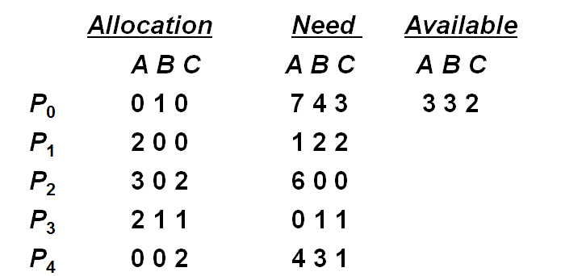
Try it
Can request for (3,3,0) by P₄ be granted?
Can request for (0,2,0) by P₀ be granted?
Can request for (3,0,0) by P₂ be granted?

Slide 41
End of Deadlock

