Slide 1

Processes and threads-1
Operating System
Na Jun
Software college, NEU
naj@swc.neu.edu.cn

Slide 2

Review: computer system
Four components of a computer system
Users – People, machines (e.g., embedded), other computers
Application programs – define the ways in which the system resources are used to solve the computing problems of the users, such as Word processors, compilers, web browsers, database systems, video games, etc.
Operating system – Controls and coordinates use of hardware among various applications and users
Hardware – provides basic computing resources, such as CPU, memory, I/O devices, file storage space, etc.

Slide 3

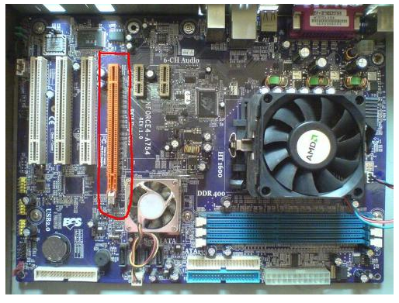
Review: hardware organization
Computer-system operation
  One or more CPUs, device controllers connect through common bus providing access to shared memory
  Concurrent execution of CPUs and devices competing for memory cycles through memory controller
Notes:
操作系统必须保证计算机系统的正确运行，为了确保用户程序不干预系统的正常操作，硬件必须提供合适的机制，以确保正确的行为。
现代通用计算机系统由CPU和若干设备控制器通过共同的总线相连而成，该总线提供了对共享内存的访问。
每个设备控制器负责一种特定类型的设备。CPU与设备控制器可并发工作，并竞争内存周期。为了确保对共享内存的有序访问，需要提供内存控制器来实现对内存的同步访问功能。
Computer-system operation
One or more CPUs, device controllers connect through common bus providing access to shared memory
Concurrent execution of CPUs and devices competing for memory cycles
I/O devices and the CPU can execute concurrently
CPU moves data from/to main memory to/from local buffers
I/O is from the device to local buffer of controller.
Each device controller
is in charge of a particular device type.
has a local buffer.
informs CPU that it has finished its operation by causing an interrupt.

Slide 4
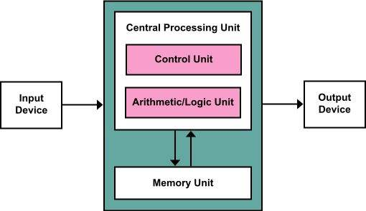
Review: hardware working principle
von Neumann architecture

Slide 5




Startup process
The OS takes over control of the boot process and loads device drivers
Turn on the power
CPU initializes triggered by system clock
BIOS looks for an OS to load and copies its files into memory
Look for CPU’s first instruction in the startup program from BIOS
Run the power-on self test (POST) and check all hardware devices
Notes:
(1)当计算机电源被打开时，CPU初始化自身，这由系统时钟生成的时钟滴答触发；
When the computer's power is first turned on, the CPU initializes itself, which is triggered by a series of clock ticks generated by the system clock.
(2)CPU初始化的一部分是查看系统的ROM BIOS一伙的启动程序的第一条指令；
Part of the CPU's initialization is to look to the system's ROM BIOS for its first instruction in the startup program .
(3)ROM BIOS中存储的第一条指令是在预先制定的内存地址运行POST，即开机自检。POST由检查BIOS芯片开始，然后检查CMOS RAM。如果POST没有检查到电池失败，将继续初始化CPU，检查其他硬件设备，以保证它们能够正常工作。
The ROM BIOS stores the first instruction, which is the instruction to run the power-on self test (POST), in a predetermined memory address. POST begins by checking the BIOS chip and then tests CMOS RAM. If the POST does not detect a battery failure, it then continues to initialize the CPU, checking the inventoried hardware devices (such as the video card), secondary storage devices, such as hard drives and floppy drives, ports and other hardware devices, such as the keyboard and mouse, to ensure they are functioning properly.
(4)一旦POST已经检测完了所有组件都在正常状态并且CPU已经成功初始化，BIOS将查找一个操作系统以加载。BIOS典型地查看CMOS芯片以获知如何找到操作系统，并且，在大部分PC中，操作系统从硬盘驱动器上的C驱动器加载操作系统，尽管这样，BIOS已经具有了能够从软盘、CD或ZIP驱动器获取操作系统的能力。CMOS查找驱动器的顺序是按照启动序列，该顺序的改变通常通过CMOS设置的变化完成的。查找适合的启动驱动器，BIOS将首先遇到启动记录，告诉它到哪里找到操作系统的开始位置，后续的顺序则由操作系统决定。
Once the POST has determined that all components are functioning properly and the CPU has successfully initialized, the BIOS looks for an OS to load. The BIOS typically looks to the CMOS chip to tell it where to find the OS, and in most PCs, the OS loads from the C drive on the hard drive even though the BIOS has the capability to load the OS from a floppy disk, CD or ZIP drive. The order of drives that the CMOS looks to in order to locate the OS is called the boot sequence, which can be changed by altering the CMOS setup. Looking to the appropriate boot drive, the BIOS will first encounter the boot record, which tells it where to find the beginning of the OS and the subsequent program file that will initialize the OS.
(5)一旦操作系统完成初始化，BIOS将其文件拷贝到内存中，并且操作系统将获得启动进程的控制权。
Once the OS initializes, the BIOS copies its files into memory and the OS basically takes over control of the boot process . Now in control, the OS performs another inventory of the system's memory and memory availability (which the BIOS already checked) and loads the device drivers that it needs to control the peripheral devices, such as a printer, scanner, optical drive, mouse and keyboard. This is the final stage in the boot process, after which the user can access the system applications to perform tasks.

Slide 6
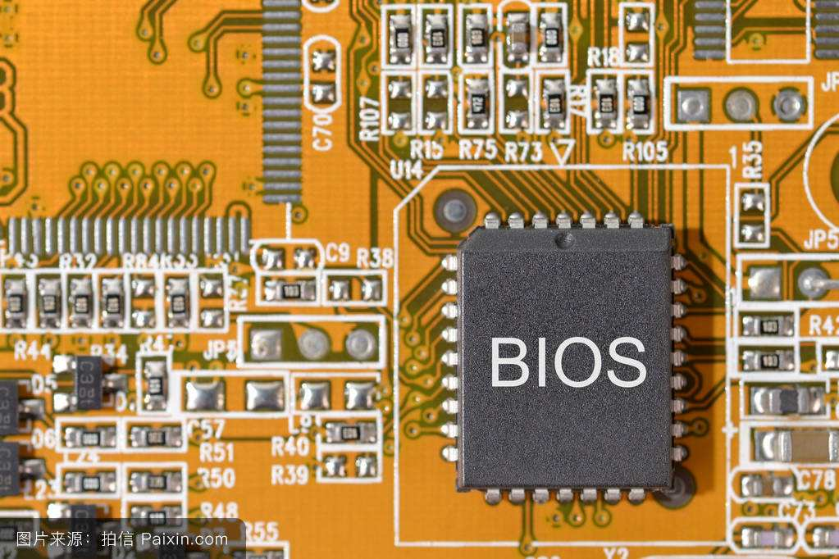
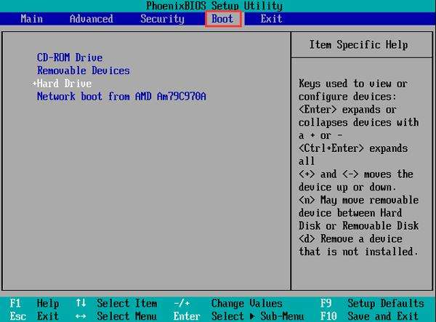
BOIS boot setting

Slide 7
Startup process
The bootstrap program is important, which is loaded at power-up or reboot
  Typically stored in ROM or EPROM, generally known as firmware
  Initializes all aspects of system
    CPU registers, device controllers, memory contents, etc.
  Loads operating system kernel and starts execution
After such initialization and starting its first process, the OS will wait for an event…
Notes:
EPROM = erasable programmable ROM

Slide 8

Running process
Questions
  How to perform the interaction between the OS and its users ?
  What will the OS do on getting an event ?

Slide 9


I/O operations
I/O devices and the CPU can execute concurrently.
  I/O is moving data between device & controller’s buffer
  CPU moves data between controller’s buffer & main memory
I/O devices accessing
  Memory Mapped I/O (as regular memory to CPU)
  Programmed I/O (Each control register is assigned an I/O port number, and CPU can use special I/O instruction to read and write registers)
Notes:
Each device controller is in charge of certain device type.
May be more than one device per controller
Each device controller has local buffer, special registers
A device driver for every device controller
Knows details of the controller
Presents a uniform interface to the rest of OS

Slide 10
Polling or Interrupt
Polling: host is reading the status register over and over until the busy bit becomes clear.
  Inefficient when it is attempted repeatedly, yet rarely finds a device to be ready for service, while other CPU processing remains undone.
Interrupt: arrange for the hardware controller to notify the CPU when the device becomes ready for service.
  The occurrence of an event is usually signaled by an interrupt from either the hardware and the software.
  When the CPU is interrupted, it stops what it is doing.
  On completion, the CPU resumes the interrupted computation.

Slide 11
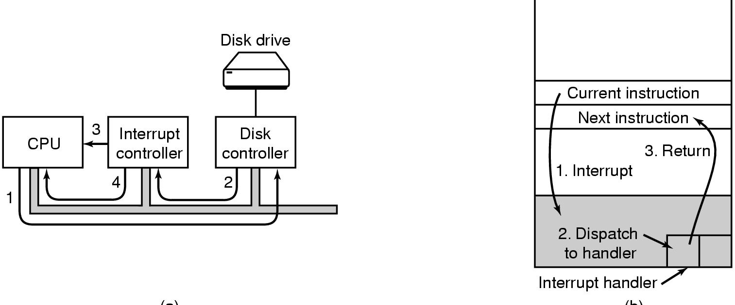
Interrupts
Most operating systems are interrupt-driven
  Hardware: sends trigger on bus
  Software: uses a system call
Handling an
interrupt
Request an interrupt
Notes:
在计算的过程中，中断是一个异步信号，表示需要关注或软件中的表明需要在执行中发生变化的同步信号。
In computing, an interrupt is an asynchronous signal indicating the need for attention or a synchronous event in software indicating the need for a change in execution.
A hardware interrupt causes the processor to save its state of execution and begin execution of an interrupt handler.
Software interrupts are usually implemented as instructions in the instruction set, which cause a context switch to an interrupt handler similar to a hardware interrupt.
Interrupts are a commonly used technique for computer multitasking, especially in real-time computing. Such a system is said to be interrupt-driven.
在操作系统中，中断是非常重要的。现代操作系统是中断驱动的。如果没有进程可执行，没有I/O设备可服务，没有用户可响应，那么操作系统会安静地歇息并等待某种事件的发生。事件几乎总是通过发生中断或陷阱来表征的。陷阱（TRAP）或异常（exception）是因为错误或用户程序的特定请求所引起的软件生成中断。
操作系统的中断驱动特性决定了系统的总体结构。对于每种类型的中断，操作系统都有一段独立的代码决定采取什么动作。中断服务子程序用来负责处理中断。
左侧I/O中断过程：
1，驱动程序通过写设备寄存器通知控制器做什么，然后，设备控制器启动该设备。
2，当控制器传送完毕被告之的要进行读写的字节数量后，使用特定的总线发信号给中断控制器芯片。
3，如果中断控制器已经准备接收中断，它会在CPU芯片的一个引脚上声明。
4，中断控制器把该设备的编号放到总线上，这样CPU可以读总线，并且知道哪个设备刚刚完成了操作。
1，一旦CPU决定取中断，通常程序计数器和PSW就被压入当前堆栈中，并且CPU被切换到核心态。
2，设备编号可以成为部分内存的一个索引，用于寻找该设备的中断处理程序的地址。这部分内存称为“中断向量”。当中断处理程序开始后，它取走已入栈的程序计数器和PSW，并保存之，然后查询设备的状态。
3，在中断处理程序全部完成之后，它返回到先前运行的用户程序中尚未执行的第一条指令。
系统调用提供了进程与操作系统之间的接口。
系统调用通常以汇编语言指令的形式提供。
有的系统允许系统调用直接为高级语言程序所用，如C、C++和Perl等。
System calls provide the interface between a user program and the operating system.
Often be expressed in assembly code.
A procedure library is provided to make it possible to make system calls from C programs and often from other language as well.
Read library procedure
Read system call
1，调用程序首先把参数压栈（1，2和3），C以及C++编译器使用了逆序把参数压入堆栈。
2，对库过程read的实现进行调用（4）。
3，把系统调用的编号放到操作系统所期望的地方，如寄存器中（5）。
4，执行一个TRAP指令，从用户态切换到核心态（6），并在内核中的一个固定地址开始执行。
5，内核代码开始考察系统调用的编号，发出正确的系统调用处理程序，这通常是通过一张由系统调用编号索引的、指向系统调用处理程序的指针表来完成的（7）。
6，系统调用处理程序开始运行（8）。
7，一旦系统调用句柄完成其工作，控制可能会在跟随TRAP指令后面的指令中返回给用户空间库过程（9）。
8，这个过程接着以通常的过程调用返回的方式返回到用户程序（10）。
9，为了完成整个工作，用户程序还必须清除堆栈，如同它在进行任何过程调用之后一样（11）。

Slide 12
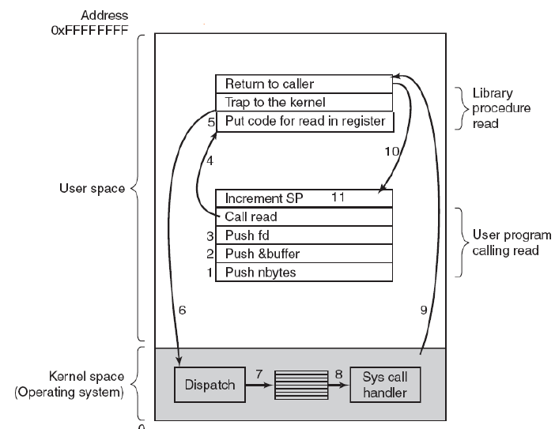
Example of an interrupt

Slide 13
Operating system services
Program execution
  Load a program into memory and run it.
I/O operations
  Provide some means to perform I/O.
File-system manipulation
  Read, write, create and delete files.
Communications
  Exchange of information between processes executing either on the same computer or on different systems.
Error detection
  Ensure correct computing by detecting various errors.

Slide 14
Additional OS functions
Resource allocation
  Allocating resources to multiple users or multiple jobs running at the same time.
Accounting
  Keep track of and record which users use how much and what kinds of computer resources for account billing or for accumulating usage statistics.
Protection
  Ensuring that all access to system resources is controlled.

Slide 15
Common system components
Process Management
Main Memory Management
File Management
I/O System Management
Secondary Management
Networking
Protection System
Command-Interpreter System
Notes:
只有通过分而治之地方法才能创建像操作系统这样庞大且复杂的系统。所划分的每块应该是完全描述好的系统部分，每块都有仔细地定义过的输入、输出和功能。

Slide 16

Process management
A process is a program in execution.
Process management is responsible for
  Process creation and deletion.
  Process suspension and resumption.
  Provision of mechanism for
    Process synchronization.
    Process communication.

Slide 17


Today we will discuss
What is a process
Implementation of processes

Slide 18

What is a Process
An operating system executes a variety of programs:
  Batch system – jobs
  Time-shared systems – user programs or tasks
Process – a program in execution;
  Program (executable) – passive entity in the disk
  Process – active entity, includes program counter, stack and heap, text and data section
Process execution must progress in sequential fashion
Notes:
CPU的活动的称呼：
批处理系统中执行作业；
分时系统使用用户程序或任务。
所有活动在许多方面都有相似之处，所以统称为进程。
进程这个技术术语是1966年由美国麻省理工学院的MULTICS系统设计人员J.H.Saltzer首先提出的。
进程有几种典型的定义：
进程是程序在处理机上的执行互动
进程是一个在处理机上可调度的实体
进程是一个计算过程，它可以与别的计算并发执行
进程是由伪处理机执行的一个程序
进程是程序的一次执行
进程是多道程序系统中控制程序管理下的基本程序单元
进程是一个具有一定独立功能的程序关于某个数据集合的一次运行活动，它是系统进行资源分配和调度的一个独立单位（1978年庐山会议）
进程是执行中的程序，它包括：
程序计数器，指示下一个要执行的指令和相关资源的集合。
进程堆栈段：包含临时数据，如方法参数、返回地址和局部变量
数据段：包含全局变量
在一台多到程序计算机的内存中有四道程序（a）。
这四道程序被抽象为四个各自拥有自己控制流程（各自的程序计数器）的进程，并且每个程序都独立地运行（b） 。
而实际上只有一个物理程序计数器，所以，每个程序运行时，它的逻辑程序计数器被装入实际的程序计数器中，任何时刻仅有一个进程真正执行。

Slide 19
Review: what is a program
A program consists of:
  Code: machine instructions
  Data: variables stored and manipulated in memory
    initialized variables (globals)
    dynamically allocated variables (malloc, new)
    stack variables (C automatic variables, function arguments)
  DLLs: libraries that were not compiled or linked with the program
    containing code & data, possibly shared with other programs
  mapped files: memory segments containing variables
    used frequently in database programs

Slide 20
Preparing a program
compiler/
assembler
Linker
source
file
.o files
static libraries
(libc, streams…)
Header
Code
Executable file
(must follow standard format,
such as ELF on Linux,
Microsoft PE on Windows)
Initialized data
BSS
Symbol table
Line numbers
Ext. refs
Notes:
BSS is Block Started by Symbol，通常是指用来存放程序中未初始化的全局变量和静态变量的一块内存区域 。

Slide 21
Running a program
OS creates a “process” and allocates memory for it
The loader:
  reads and interprets the executable file
  sets process’s memory to contain code & data from executable
  pushes “argc”, “argv”, “envp” on the stack
  sets the CPU registers properly & calls “__start()” [Part of CRT0]
Program start running at __start(), which calls main()
  we say “process” is running, and no longer think of “program”
When main() returns, CRT0 calls “exit()”
  destroys the process and returns all resources
Notes:
CRT0 is a set of execution startup routines (usually part of the standard C library), platform dependent, and required in order to compile using gcc and other GNU tools.
argc：参数个数
argv：参数值
Envp：系统的环境变量

Slide 22
Process vs. Program
process
cpu
Read the cookbook
cookbook
program
material
input
Prepare the material
Open the door
Cooking
switch
Notes:
一个进程是某种类型的一个活动，它有程序、输入、输出以及状态。单个处理机可以被若干进程共享，它使用某种调度算法决定何时停止一个进程的工作，并转而为另一个进程提供服务。

Slide 23

Process vs. Program
Two processes may be associated with the same program:
  Two separate execution sequences
  Text sections are equivalent,
  however data, heap and stack
  sections vary
Program
Difference in size and content
Difference in size and content
Difference content
program counter
program counter

Slide 24
Process states
As a process executes, it changes state
  running: Instructions are being executed.
  waiting: The process is waiting for some event to occur.
  ready: The process is waiting to be assigned to CPU.
  new: The process is being created.
  terminated: The process has finished execution.
Basic
state
Notes:
进程在执行时会改变状态：
新的：进程正在被创建
运行：指令正在被执行
等待：进程等待一定事件的出现（如I/O完成或收到某个信号）
就绪：进程等待被分配给某个处理器，一旦得到处理机即可运行
终止：进程已完成执行
多道系统中同时存在多个进程，由于系统资源有限，不可能同时满足各个进程对资源的要求，这就形成了进程对资源的竞争。
当某种资源被一个进程占用时，其它进程若要求使用该资源就必须等待，等待就是进程的一种状态。
此外，当一个进程占用处理机执行其程序时，该进程所处的是一种执行状态。
当该进程在使用设备进行输出输入时，其它等待处理机的进程之一就要由等待状态转换成使用处理机的执行状态。
由此可见，系统中地进程总是处于不同的状态下，并且它们的状态在动态地转换着。

Slide 25

Diagram of process state
Basic state
Notes:
状态转换的说明
新-就绪：新进程被允许后进入就绪队列
就绪-运行：当处理机空闲时，系统按照一定调度算法从就绪状态中选择一个使其占用处理机运行。
运行-就绪：分配给进程的时间片用完时，或出现一个更紧急的进程时
运行-等待：运行的进程需要等待某一事件发生后，才能继续往下运行
等待-就绪：处于等待的进程，如果其等待的事件已经发生，表示阻塞的原因已解除，则该进程从等待转为就绪
注意点：
等待进程在等待原因解除后，虽然再次具备了运行条件，但不能直接运行，而要先转换成就绪，等待调度
从运行态到就绪态的转换是被动的
从运行态到等待的转换是主动的
从等待到就绪的状态转换是由外部事件引起的

Slide 26
Process creation
There are four principal events that cause processes to be created.
  System initialization.
    Listener, task manager…
  A user request to create a new process.
    Clicking an icon
  Execution of a process creation system call by a running process.
    Unix: fork()
    Windows: CreateProcess()
  Initiation of a batch job.

Slide 27

Process hierarchies
Parent creates a child process, child process can create its own process.
Forms a hierarchy
  Unix call this a “process group”
  Windows has no concept
  of process hierarchy. All
  processes are created equal

Slide 28
Process relationships
Resource sharing
  Parent and children share all resources.
  Children share subset of parent’s resources.
  Parent and children share no resources.
Execution
  Parent and children execute concurrently.
  Parent waits until children terminate.
Address space
  Children duplicate of parent.
  Child has a program loaded into it.
Independent or cooperating
Notes:
进程在执行过程中，能通过系统调用创建多个新进程。创建进程称为父进程，而新进程称为该进程的子进程。每一个新进程可以再创建其他进程，从而形成了进程树。
通常，进程需要一定的资源（如CPU时间、内存、文件、I/O设备），以完成其任务。
子进程可以从操作系统直接获得资源，也可以从其父进程获得资源，为了防止创建过多的子进程造成系统超载，可以限制子进程只能使用父进程的资源。
在进程创建时，它还能从父进程那里得到所需的初始化数据（或输入）。
当进程创建新进程时，有两种执行可能：
1.父进程与子进程并发执行
2.父进程等待，直到某个或全部子进程执行完毕
新进程的地址空间也有两种可能：
1.子进程是父进程的复制品
2.子进程装入另一个程序进来
独立进程：不能影响或被系统内其他进程影响的进程，不与其它任何进程共享数据。
协作进程：能影响或被系统内执行的其他进程所影响的进程，与其他进程共享数据。
提供协作的好处：
信息共享：提供环境以允许对多个用户同样感兴趣的资源并发访问
加快计算：将一个特定任务分成子任务，每个子任务可以与其他子任务并行执行。
模块化：可将系统功能划分成独立进程或线程。
方便：单个用户也可能同时执行许多任务。

Slide 29
Process termination
Conditions which terminate processes
  Normal exit (voluntary)
    Process executes last statement and asking the OS to delete it by using the exit() system call.
    All the resources of the process are deallocated by the OS.
  Error exit (voluntary)
  Fatal error (involuntary)
    E.g., referencing nonexistent memory.
  Killed by another process (involuntary)
    Child has exceeded its allocated resources.
    Task assigned to child is no longer required.
    Parent is exiting, the OS does not allow a child to continue if its parent terminates.
Notes:
1，正常退出。程序运行结束。
2，错误退出。进程出现错误，如需要读的文件不存在，不退出程序，而是需要用户再试一次。
3，严重错误。程序出现错误，引起进程错误，如执行了一条非法指令，引用不存在的内存，或除零错误。系统自行处理这些错误，中断。
4，被其他进程杀死。

Slide 30
Process termination
Process executes last statement and asks the operating system to decide it (exit).
  Output data from child to parent (via wait).
  Process’ resources are deallocated by operating system.
Parent may terminate execution of children processes (abort).
  Child has exceeded allocated resources.
  Task assigned to child is no longer required.
  Parent is exiting, cascading termination.
Notes:
当进程完成执行最后的语句并使用系统调用exit请求操作系统删除它时，进程终止。
这时，进程可以返回数据（输出）到其父进程（通过系统调用wait）。
所有进程资源，包括物理和虚拟内存、打印文件和I/O缓冲，会被操作系统所释放。
进程通过适当的系统调用（如abort）能终止另一个进程。父进程终止其子进程的原因有很多：
子进程使用了超过它所分配到的一些资源，要求父进程有一个检查其子进程的状态的机制。
分配给子进程的任务已不再需要。
父进程退出，级联终止（cascading termination）

Slide 31
Today we will discuss
What is a process
Implementation of processes

Slide 32
Key problems
How to abstract a process
  The data structure of process
How to schedule a process
  Organization model
  Scheduling actions

Slide 33

Data structure of a process
Process control block (PCB) : Information associated with each process:
  Process state
  Program counter
  CPU registers
  CPU scheduling information
  Memory-management
  information
  Accounting information
  I/O status information
Notes:
进程实体由程序、数据和进程控制块3部分组成。
计算机系统内部，各个进程的状态和占用资源情况以及进程之间的关系是不断变化的，为了便于对进程进行管理和控制，系统必须记录下进程的这些信息。进程控制块就是记录进程有关信息的一个数据结构。
每个进程在操作系统内用进程控制块（PCB-process control block）来表示。一个PCB包含与特定进程相关的许多信息：
进程状态：可包括新的、就绪、运行、等待、停止等
程序计数器：计数器表示这个进程要执行的下一个指令的地址
CPU寄存器：包括累加器、索引寄存器、堆栈指针、通用寄存器和其他条件码信息寄存器，这些状态信息在出现中断时也需要被保存，以便进程以后能正确地继续执行。保存现场。
CPU调度信息：这些信息包括进程优先级、调度队列的指针和任何其他调度参数
内存管理信息：包括基址寄存器和界限寄存器的值、页表或段表
计账信息：包括CPU时间、实际使用时间、时间界限、记账数量、作业或进程数量等
I/O状态信息：包括分配给该进程的I/O设备列表、打开文件的列表等

Slide 34
Organization model
Questions
  How to classify processes in OS?
  How many kinds of processes in OS ?
  Which kind of data structure is suitable for organizing processes?
Notes:
PCB的物理组织结构常用的有3种：线性表结构、索引表结构和链接表结构
线性表结构：所有进程的PCB全部放在主存中大小固定的一个连续区域中，形成一个线性表。每次使用一个PCB都需要扫描整个PCB表，适用于进程数较少的系统
索引表结构：对线性表做改进，给线性表中状态相同的进程PCB建立一个索引表。
链接表结构：进程总数在不断变化，线性表和索引表不利于这种变化。因此，有些操作系统适用链表数据结构把处于各种不同状态的进程链接在一起。这些由不同状态进程的PCB链接成的链表又称为状态队列。

Slide 35

Organization model
Processes are organized as different queues
  Job queues: all processes in the system
  Ready queues: all processes residing in main memory, ready and
  waiting to execute
  Device queues:
  processes waiting
  for an I/O device
Processes migrate between various queues during the OS executing.
Notes:
进程进入系统时，会被加到作业队列中。该队列包括系统中所有进程。
驻留在内存中就绪的等待运行的进程保存在就绪队列上。
等待特定I/O设备的进程列表称为设备队列。每个设备都有自己的设备队列。
进程在其生命周期中会在各种调度队列之间迁移。

Slide 36

Process scheduling
Process is driven by events that are triggered by needs and availability, and migrates from one queue to another.
Notes:
进程调度的常用表示方法是队列图。
每个长方形框表示一个队列。有两种队列：就绪队列和一组设备队列。
圆形表示为队列服务的资源，箭头表示系统内进程的流向。
新进程首先处于就绪队列，等待被CPU选中执行（或分派）。执行过程中有几种事件可能发生：
进程可能发出一个I/O请求，并被放到I/O队列中。
进程可能创建一个新的子进程，并等待其结束。
进程可能由于中断而被强制移出CPU，并被放回到就绪队列。

Slide 37
Process scheduling
Process is driven by events that are triggered by needs and availability, and migrates from one queue to another.
new
ready
running
job queue
terminated
waiting

Slide 38
Types of scheduling
Long-term scheduling (or job scheduling): selects which process should be brought into the ready queue.
  Controls degree of multiprogramming
  Tries to balance arrival and departure rate through an appropriate job mix.
  Less frequently (seconds or minutes) and may be slow
Short-term scheduling (or CPU scheduling): selects which process should be executed next and allocates CPU.
  More frequently (milliseconds) and must be fast
Interrupt handling: readies processes, moving them, for instance, from waiting to ready.

Slide 39

Types of scheduling
Medium-term scheduling: mixture of CPU and memory resource management.
  Key idea is swapping: remove process from memory at one time and reintroduced it into memory at the other time to let it continue executing.
  Advantage: improve the process mix and adapt to available memory changing.

Slide 40
Scheduling actions
When CPU switches to another process, the system must save the state of the old process and load the saved state for the new process via a context switch.
  Context of a process represented in the PCB, including process states, CPU registers and memory manage information.
  A context switch means that the memory, as seen by one process is changed to the memory seen by another process.
    Save the state of the current process.
    Load the state of a different process.
Notes:
上下文切换的任务是：将CPU切换到另一个进程需要保存原来进程的状态并装入新进程的保存状态。
进程关联是由进程PCB来表示的。
当发生上下文切换时，内核会将旧进程的关联状态保存在其PCB中，然后装入经调度要执行的新进程的已保存的关联状态。
上下文切换时间是系统额外开销，切换时系统不能做什么有用的工作。
上下文切换速度因机器而不同，它依赖于内存速度、必须被复制的寄存器的数量、是否有特殊指令。
上下文切换时间与硬件支持密切相关。

Slide 41

Illustration of context switch
The CPU switching from process P₀ to process P₁.

Slide 42

Keystone
What is a process
Differences between processes and programs
Process states and related transition conditions

Slide 43
Processes and threads-1
Operating System
The end

