Slide 1
Deadlocks and
CPU Scheduling

Slide 2
Review about deadlock
What is deadlock?
What shall we use to describe deadlock?
How can we prevent deadlock?
How can we avoid deadlock?
  Two or more processes are waiting indefinitely for an event that can be caused by only one of the waiting processes.
  Deadlock can arise if four conditions hold simultaneously.
    Mutual exclusion
    Hold and wait
    No preemption
    Circular wait

Slide 3
Review about deadlock
What is deadlock?
  Two or more processes are waiting indefinitely for an event that can be caused by only one of the waiting processes.
What shall we use to describe deadlock?
  Resource allocation graph
How can we prevent deadlock?
  Attack one of the four necessary conditions of deadlock
How can we avoid deadlock?
  Resource allocation graph algorithm
  Banker’s algorithm

Slide 4
Today’s Topic
Methods for handling deadlocks
  Prevention
  Avoidance
  Detection and Recovery
  Ignore
Framework for controlling process execution

Slide 5
Deadlock Detection
Allow system to enter deadlock state
  Detection algorithm
  Recovery scheme

Slide 6
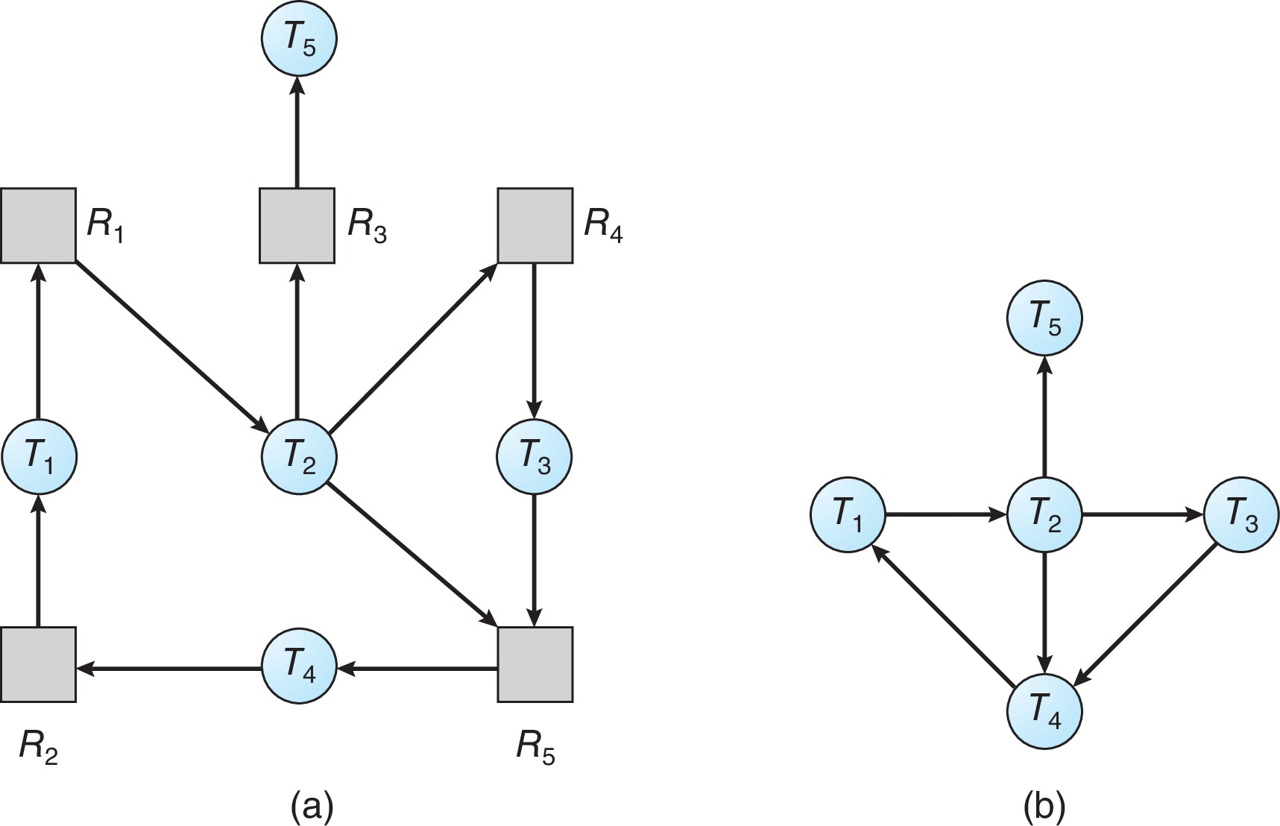
Single Instance of Each Resource Type
Maintain wait-for graph
  Nodes are processes
  P_{i} → P_{j} if P_{i} is waiting for P_{j}
Corresponding wait-for graph
Resource-Allocation Graph

Slide 7
Single Instance of Each Resource Type
Periodically invoke an algorithm that searches for a cycle in the graph.
  If there is a cycle, there exists a deadlock
  An algorithm to detect a cycle in a graph requires an order of n² operations, where n is the number of vertices in the graph

Slide 8
Several Instances of a Resource Type
Similar to the safe algorithm
  Available: A vector of length m indicates the number of available resources of each type
  Allocation: An n x m matrix defines the number of resources of each type currently allocated to each process
  Request: An n x m matrix indicates the current request of each process. If Request [i][j] = k, then process P_{i} is requesting k more instances of resource type R_{j}.

Slide 9
Example of Detection Algorithm
Five processes P₀ through P₄;
Three resource types
A (7 instances), B (2 instances), and C (6 instances)
Snapshot at time T₀:
Allocation Request Available
A B C A B C A B C
P₀ 0 1 0 0 0 0 0 0 0
P₁ 2 0 0 2 0 2
P₂ 3 0 3 0 0 0
P₃ 2 1 1 1 0 0
P₄ 0 0 2 0 0 2

Slide 10
Detection Algorithm
1. Let Work and Finish be vectors of length m and n, respectively Initialize:
  (a) Work = Available
  (b) For i = 1,2, …, n, if Allocation_{i} ≠ 0, then
  Finish[i] = false; otherwise, Finish[i] = true
2. Find an index i such that both:
  (a) Finish[i] == false
  (b) Request_{i} ≤ Work
  If no such i exists, go to step 4
3. Work = Work + Allocation_{i}
Finish[i] = true
go to step 2
4. If Finish[i] == false, for some i, 1 ≤ i ≤ n, then the system is in deadlock state. Moreover, if Finish[i] == false, then P_{i} is deadlocked.

Slide 11
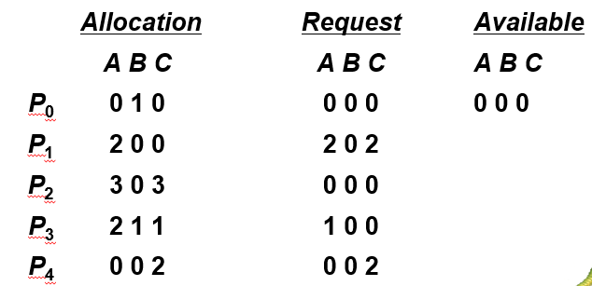
Example of Detection Algorithm
Five processes P₀ through P₄;
Three resource types
A (7 instances), B (2 instances), and C (6 instances)
Snapshot at time T₀:
<P₀, P₂, P₃, P₄, P₁> will result in Finish[i] = true for all i. Thus, there is no deadlock.

Slide 12
Example (Cont.)
P₂ requests an additional instance of type C
How about the state of system?
1
Deadlock exists, consisting of processes P1, P2, P3, and P4

Slide 13
Detection-Algorithm Usage
When, and how often, to invoke depends on:
  How often a deadlock is likely to occur?
  How many processes will need to be rolled back?
    one for each disjoint cycle
If detection algorithm is invoked arbitrarily, there may be many cycles in the resource graph and so we would not be able to tell which of the many deadlocked processes “caused” the deadlock.

Slide 14
Recovery from Deadlock
Process Termination
Abort all deadlocked processes
Abort one process at a time until the deadlock cycle is eliminated
In which order should we choose to abort?
  Priority of the process
  How long process has computed, and how much longer to completion
  Resources the process has used
  Resources process needs to complete
  How many processes will need to be terminated
  Is process interactive or batch?

Slide 15
Recovery from Deadlock
Resource Preemption
Selecting a victim – minimize cost
Rollback – return to some safe state, restart process for that state
Starvation – same process may always be picked as victim, include number of rollback in cost factor

Slide 16
Combined approach to deadlock handling
Combine the three basic approaches
  prevention
  avoidance
  detection
allowing the use of the optimal approach for each of resources in the system.
Partition resources into hierarchically ordered classes.
Use most appropriate technique for handling deadlocks within each class.

Slide 17



Ignore the deadlock
The Ostrich algorithm
Mathematicians: deadlock is completely unacceptable and must be prevented at all cost.
Sometimes, ignoring the deadlock is a wise choice.
Engineers:
is it worth for paying a large penalty in performance or convenience to eliminate deadlocks?
Notes:
鸵鸟在遇见危险时，如果是平时，它会奋力地逃开；如果是孵卵的时候，它会把长脖子沿着地面伸长，把头隐藏在沙堆后面，以保护自己的孩子免于受到伤害。鸵鸟的这种行为是深有智慧的因为高大的身躯再加上伸长的脖子，即使数里外的敌人也看得见，如果把自己扮成沙丘的样子，就不容易被发现了。

Slide 18
Today’s Topic
Methods for handling deadlocks
  Prevention
  Avoidance
  Detection and Recovery
  Ignore
Framework for controlling process execution

Slide 19
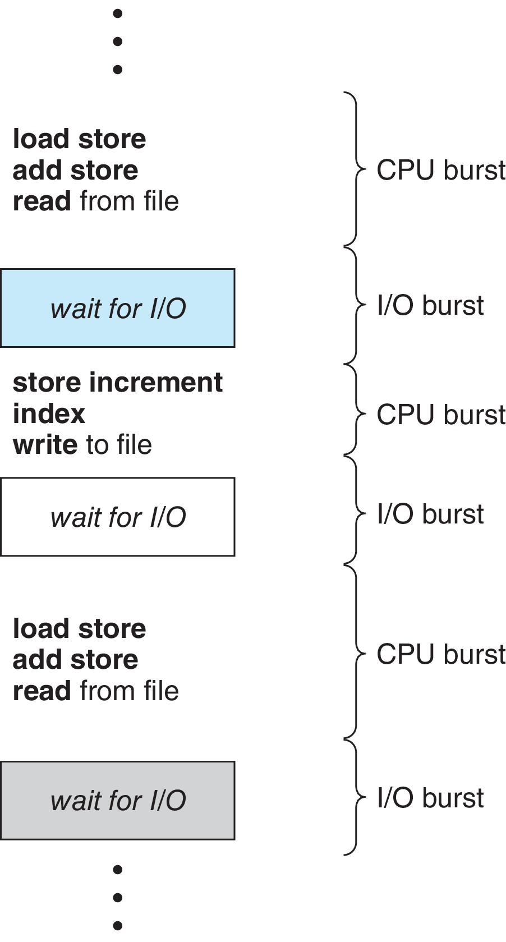
Basic Concepts
Maximum CPU utilization obtained with multiprogramming
CPU–I/O Burst Cycle – Process execution consists of a cycle of CPU execution and I/O wait
  CPU burst followed by I/O burst
  CPU burst distribution is of main concern

Slide 20

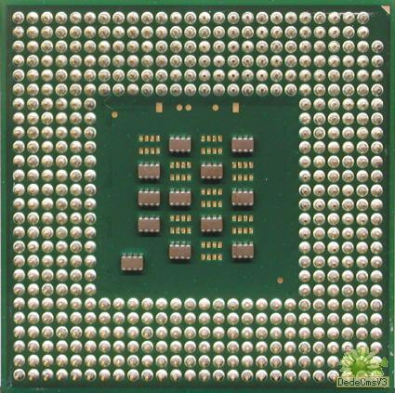

Competition of CPU
CPU burst: computing on CPU
I/O burst: waiting for I/O
Multiple processes competing for the CPU at the same time, and the OS needs to decide which process to run first.
CPU
Multiprogrammed
system

Slide 21
CPU Scheduler
The CPU scheduler selects from among the processes in ready queue, and allocates the a CPU core to one of them
CPU scheduling decisions may take place when a process:
  Switches from running to waiting state
  Switches from running to ready state
  Switches from waiting to ready
  Terminates
Scheduling under 1 and 4 is nonpreemptive
All other scheduling is preemptive

Slide 22
How to schedule
The dispatcher gives control of the CPU to the process selected by the short-term scheduler, including:
switching context
(2) switching to user mode
(3) jumping to the proper location in the user program to restart that program
Be deprived or give up
Ready queue
Dispatcher
CPU
Resource
manager
allocate
require
Resource
Notes:
每当CPU变为空闲时，操作系统就必须从就绪队列中选择一个进程来执行。进程选择由短期调度程序执行。调度程序从内存中就绪可执行的进程里选择一个，并为其中之一分配CPU。
短期调度频繁地为CPU选择新进程，通常每100ms至少执行一次。由于每次执行之间的时间较短，短期调度程序必须要快。如果需要10ms来确定执行一个运行100ms的进程，那么10/(100+10)=9%的CPU时间会仅仅用于（或浪费在）调度工作上。
分派程序是一个模块，用来将CPU的控制交给由短期调度程序所选择的进程，其功能包括：
切换上下文
切换到用户模式
跳转到用户程序的合适位置以重新启动这个程序
分派延迟：停止一个进程而启动另一个进程执行所要花费的时间

Slide 23
Scheduling Criteria
CPU utilization – keep the CPU as busy as possible
Throughput – # of processes that complete their execution per time unit
Turnaround time – amount of time to execute a particular process
Waiting time – amount of time a process has been waiting in the ready queue
Response time – amount of time it takes from when a request was submitted until the first response is produced, not output (for time-sharing environment)

Slide 24
Scheduling Algorithm Optimization Criteria
Max CPU utilization
Max throughput
Min turnaround time
Min waiting time
Min response time

Slide 25
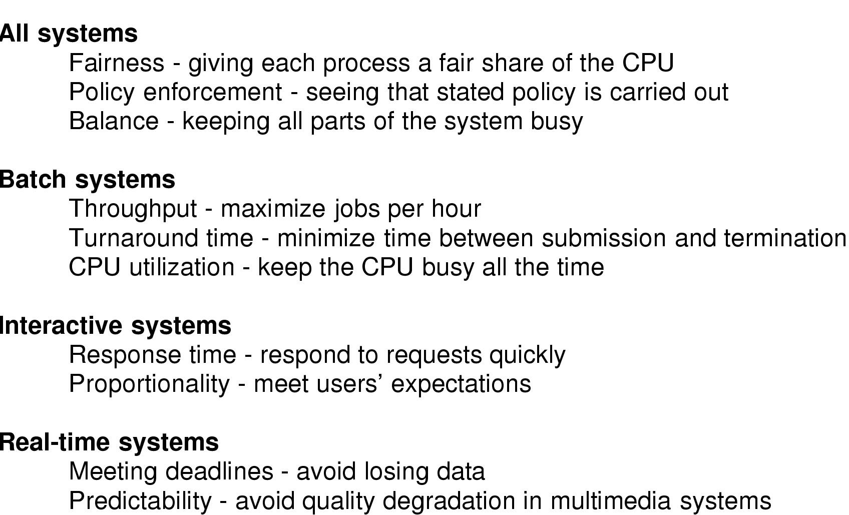
Goal of different OS
Notes:
在所有系统中，公平是很重要的，相似的进程应该得到相似的服务。与公平相关的是，调度程序必须保证能够强制执行某些策略。此外，还应该能够保证系统的所有部分尽可能忙碌，从而在每一秒钟完成更多的工作。
批处理系统中，不会有用户不耐烦地在终端旁等待快捷的相应。这样，非抢占式算法，或每个进程有长时间段的抢占式算法，通常都是可以接受的。这种处理方式减少了进程的切换从而改善了性能。通常检查三个指标，吞吐量、周转时间和CPU利用率。
在交互式系统中，为了避免一个进程霸占CPU拒绝为其他进程服务，抢占是必须的。即便没有进程想永远运行，但是由于程序错误的存在，某个进程也可能无限期地排斥所有其他进程。为了避免这种现象发生，抢占也是必要的。对于交互式系统，最重要的是最小响应时间。此外，均衡性也十分重要，即应该保证进程的而运行时间符合用户对其固有的看法。
实时系统中，抢占有时并不必要，因为进程了解它们可能会长时间得不到运行，所以通常很快地完成各自的工作并阻塞。与交互式系统的差别是，实时系统只运行那些用来推进现有应用的程序，而交互式系统是通用的，它可以运行任意的非协作甚至是有恶意的程序。实时系统的特点是或多或少必须满足截止时间，即最主要的要求是满足所有的（或大多数）截止时间要求。此外，在大多数实时系统中，特别是涉及多媒体的实时系统中，可预测性是很重要的。进程调度程序必须是高度可预测和有规律的。

Slide 26
Scheduling in batch systems
The algorithm used for scheduling is called scheduling algorithm.
Some main algorithms that are only suitable in batch systems are:
  First-Come, First-Served (FCFS)
  Shortest Job First (SJF)
  Shortest Remaining Time First
  Three-Level Scheduling

Slide 27
First-Come, First-Served (FCFS) Scheduling
FCFS is the simplest CPU scheduling algorithm, which is non-preemptive.
  Processes are assigned the CPU in the order they request it.
Be deprived or give up
Ready queue
FIFO
Dispatcher
CPU
Resource
manager
allocate
require
Resource
Notes:
先到先服务调度：先请求CPU的进程被首先分配到CPU，可采用FIFO队列实现

Slide 28
Example of FCFS
Process Burst Time
P1 24
P2 3
P3 3
Suppose that the processes arrive in the order P1 , P2 , P3
Then the Gantt Chart for the schedule is:
P₁
P₂
P₃
0
24
27
30
Waiting time for P1 = ; P2 = ; P3 =
Turnaround time for P1 = ; P2 = ; P3 =
Average turnaround time:

Slide 29
Problem of FCFS
If the three processes are scheduled in order P₂ , P₃ , P₁ , the corresponding Gantt chart is:
where, the average turnaround time is 13, which is much smaller than 27.
Convoy effect : the situation that all the other processes wait for the one big process (P₁ in this example) to get off the CPU, which results in lower CPU and device utilization.
P₂
P₃
P₁
0
3
6
30
Notes:
进程区间变化很大时，平均等待时间也会变化很大。
护航现象（convoy effect）：所有其他进程都等待一个大进程释放CPU，导致CPU和设备的使用率变得更低。
FCFS调度算法是非抢占的。一旦CPU被分配给了一个进程，该进程就会保持CPU知道释放CPU为止。

Slide 30
Shortest-Job-First (SJF) Scheduling
If the run times are known in advance, we can easily avoid the convey effect by picking the shortest job first, which is called SJF.
Be deprived or give up
Ready queue
Ordered by run time
Dispatcher
CPU
long
short
Resource
manager
allocate
require
Resource
Notes:
最短作业优先调度：将每个进程与其下一个CPU区间相关联。当CPU为可用时，它会赋给具有最短后续CPU区间的进程。如果两个进程具有同样长度的CPU区间，那么可以使用FCFS调度来处理。

Slide 31
Example of SJF
Process Burst Time
P₁ 6
P₂ 8
P₃ 7
P₄ 3
The Gantt Chart for the schedule is:
P₄
P₁
P₃
P₂
0
3
9
16
24
Waiting time for P1 = ; P2 = ; P3 = ; P4 =
Turnaround time for P1 = ; P2 = ; P3 = ; P4 =
Average turnaround time:
Notes:
如果使用FCFS调度方案，平均等待时间为10.25ms
可以证明对于给定的一组进程SJF算法的平均等待时间最小。通过将短进程移到长进程之前，短进程等待时间的减少大于长进程等待时间的增加。因而，平均等待时间减少了。

Slide 32
Problem of SJF
It can be proven that SJF is optimal, as it is able to give the minimum average waiting time for a given set of processes.
However, the real difficulty is how to get the length of the next CPU request.
  For long term scheduling, can use the process time limit specified by user when submit the job.
  For short term scheduling, there is no way to know the length, and can only predict its value by computing an approximation.
Notes:
SJF的困难是如何知道下一个CPU请求的长度。
对于长期调度：可以使用用户在提交作业时制定的作业时间极限作为长度，有根据地精确估计进程时间，因此，在长期调度中经常使用SJF
对于短期调度：无法获得下一个CPU区间的长度，因此，只能试图近似SJF调度。

Slide 33
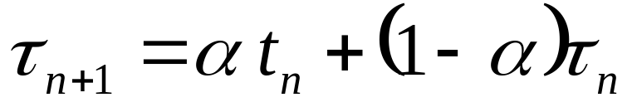

Determining Length of Next CPU Burst
  α =0: τ_{n+1} = τ_{n}, recent history does not count.
  α =1: τ_{n+1} = t_{n}, only the actual last CPU burst counts.
  If we expand the formula, we get
Actual value of n^{th} CPU burst
Predictive value of (n+1)^{th} CPU burst
α ∈[ 0, 1 ]
τ_{n+1} = αt_{n}+(1-α)αt_{n-1}+…+(1 - α )^{j}αt_{n-j}+ …+(1 - α )^{n+1}t_{n}τ₀
where older value has lower effect on the prediction.

Slide 34
Shortest Remaining Time First
SRTF is the preemptive version of SJF.
  the process whose remaining run time is the shortest is always chosen.
  if a new process arrives with CPU burst length less than remaining time of current executing process, preempt.
Notes:
SJF算法可能是抢占的或非抢占的。
当一个新进程到达就绪队列而以前进程正在执行时，就需要选择。新进程与当前运行进程所产生的CPU区间相比，可能有一个更短的下一个CPU区间。
可抢占SJF算法可能会抢占当前运行进程，有时称最短剩余时间优先调度；
非抢占SJF算法会允许当前运行进程先完成其CPU区间。

Slide 35
Process Arrival Time Burst Time
P₁ 0.0 7
P₂ 2.0 4
P₃ 4.0 1
P₄ 5.0 4
The corresponding Gantt Chart for SJF scheduling is:
Example of SRTF
P₁
P₃
P₂
P₄
Average waiting time: 4
Average turnaround time: 7.5
0
7
8
12
16
The corresponding Gantt Chart for SRTF scheduling is:
P₁
P₂
P₃
P₂
P₄
P₁
Average waiting time: 3
Average turnaround time: 7
0
2
4
5
7
11
16

Slide 36
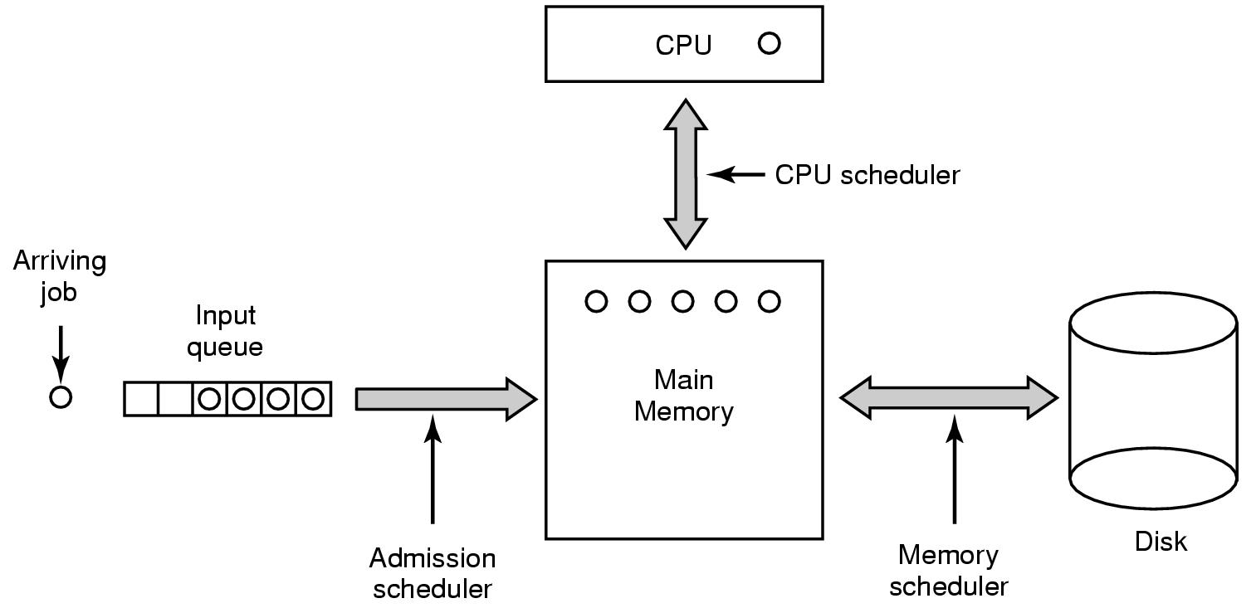
Three-Level Scheduling
3
1
2

Slide 37
End of Deadlock and CPU Scheduling

