Slide 1

Programs, Policy, and Place: Multi-level Strategies To Improve Food Access On Campus Through Research and Evaluation
UCSB Evaluations:
Monitoring the Progress
of Basic Needs Programs
Katie Maynard & Gabriel Etaat
Notes:
To be answered: (Gabe make sure to make slides that answer these)
-What is the structure of basic needs programs at UCSB? Y
-Why collect information from programs/evaluate? Y
-What information is collected from programs? Y
-How does the evaluation team approach data collection? Y
-What sort of analysis is done? N
-What are some metrics? Y
-What have we learned, what are we working towards understanding, and what questions aren’t we asking? N

Slide 2

Evaluations-Who Does It?

Slide 3
Basic Needs Oversight
UC Office of the President
(equivalent to CSU or CCC Chancellor’s Office)
UC Basic Needs Statewide Working Group
UCSB Food Security and Basic Needs Taskforce
(Reports to our Chancellor - equivalent to CSU or CCC President)
Basic Needs Evaluation Team
Oversees data collection by programs
Administers research of student body
Analyzes and reports findings
Notes:
*chancellor vs president

Slide 4
Reporting Responsibilities
State Funds & UCOP
Constantly evolving and often with quick deadlines (may be starting to normalize).
Responsive to legislative and regental inquiries.
Highest level of scrutiny.
CalFresh Sub-Contract & Other Grants
CalFresh - Detailed reporting requirements with submittals every three months.
Each funder/grant has their own reporting needs/protocols.
Internal Partners & Ourselves
Guidance for campus Taskforce on investment of funds.
Improvement of service
Analysis of efficiency (sites/hours that work best)
Engagement with senior administration
Public relations
Data to drive fundraising
Notes:
-acceptance letters indicate need to meet with me to receive funding
-lots of control over fully funded, but plans don’t always happen (i.e. late inern payment in november)
-Partially-it takes time to collect extra data! Not explicitly requested during application phase
-Unfunded: difficulty with programs rejected from funding (tho we tried to partially fund)

Slide 5


UCSB Programs
Fully
Funded
Partially
Funded
Not
Funded
Food Recovery from Portola Dining Commons
Kosher-Halal Food Program
BN Evaluation Team (Us!)
Rapid Rehousing Outreach
Centralized Research Team
Grocery Vouchers for Undocumented Students
Associated Students Food Bank
Financial Crisis Response Team
CalFresh & Food Security Advocate Team
EBT at the Arbor & Tenaya
Social Work Team
Miramar Food Pantry
Career Clothing Closet
Sustainable Technology Repair Resource
Gaucho Family Fund
Notes:
-The BN Evaluations Team is responsible for evaluating all programs to inform the BN Taskforce, but not all programs are tied financially to the Taskforce
-Mostly funded-food and housing, direct services
-not funded: gray area of mental, medical, and student-parent programs
-

Slide 6
Approaching
Data Collection
Fully Funded Programs
Most responsive, must abide Taskforce funding agreements
Opportunistic, but also variable
Partially Funded Programs
Very responsive, forefeights loosing some funds
Can require baseline data, but resources needed for optional data
Unfunded Programs
Moderately responsive, no financial or administrative obligation
Approach with ease, offer assistance
Notes:
-acceptance letters indicate need to meet with me to receive funding
-lots of control over fully funded, but plans don’t always happen (i.e. late inern payment in november)
-Partially-it takes time to collect extra data! Not explicitly requested during application phase
-Unfunded: difficulty with programs rejected from funding (tho we tried to partially fund)

Slide 7
Why Collect Data?
Mandatory Reports
UC GFI Annual Report, FS & BN Taskforce briefing
Numbers speak louder than words, sometimes
Better Services
Student input/behavior
i.e. identifying peak hours/locations for CalFresh Advocacy tabling
Lower Costs
Smarter inventory/staffing/case management
i.e. centralized case-management systems
Notes:
-mandatory: annual as of right now, taskforce as requested
-better services:

Slide 8
The Baseline: Required Information
Student Identification Numbers
Required for every students that registers for a program and at any point of resource delivery
Used to calculate unique vs. total counts, overlap in programs, demographics, income, etc
Inventory/Resources Delivered
Foods, materials, referrals, vouchers, or any other form of service received and provided
i.e. pounds & containers of food delivered, programs referred to
Time & Placed Delivered/Received
Date, time, and location of workshops, tabling, direct services, advising, etc
i.e. food recovery source, advocate tabling place/time, etc

Slide 9
Optional Data
of Interest
Student Registration Data
Information that can’t be extrapolated from identification numbers
i.e. CalFresh status, employment, “How did you hear about us?”, email
Detailed Inventory/Operations Records
Going beyond BN Evaluation Team requirements for ongoing record keeping
i.e. workshop summaries, outreach methods, detailed sourcing logs
Post-Service Evaluation Survey
Gauging how well the program served its purpose beyond the interaction
i.e. long-term housing security from one-time housing voucher

Slide 10
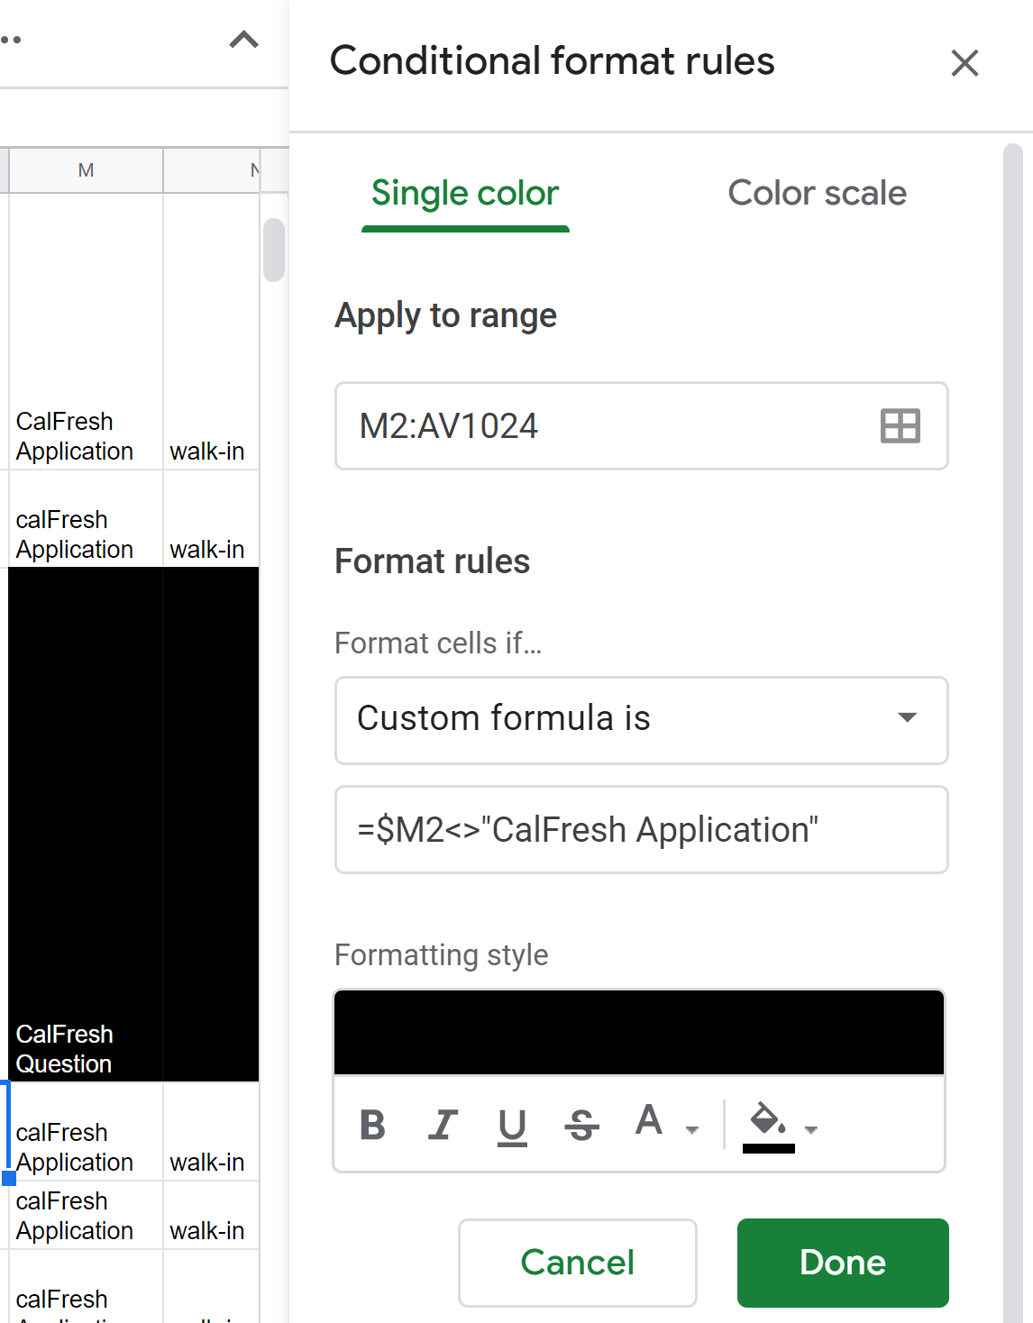
Data Logs Formatting
Shared Excel Workbook or Google Sheets
Dropbox or Google Drive data sharing
If privacy is a concern, regularly emailed documents with alterations
Automating Workbooks
Drop-down menus
Data Formatting
Conditional Formatting
Functions
Cross-sheet analysis

Slide 11
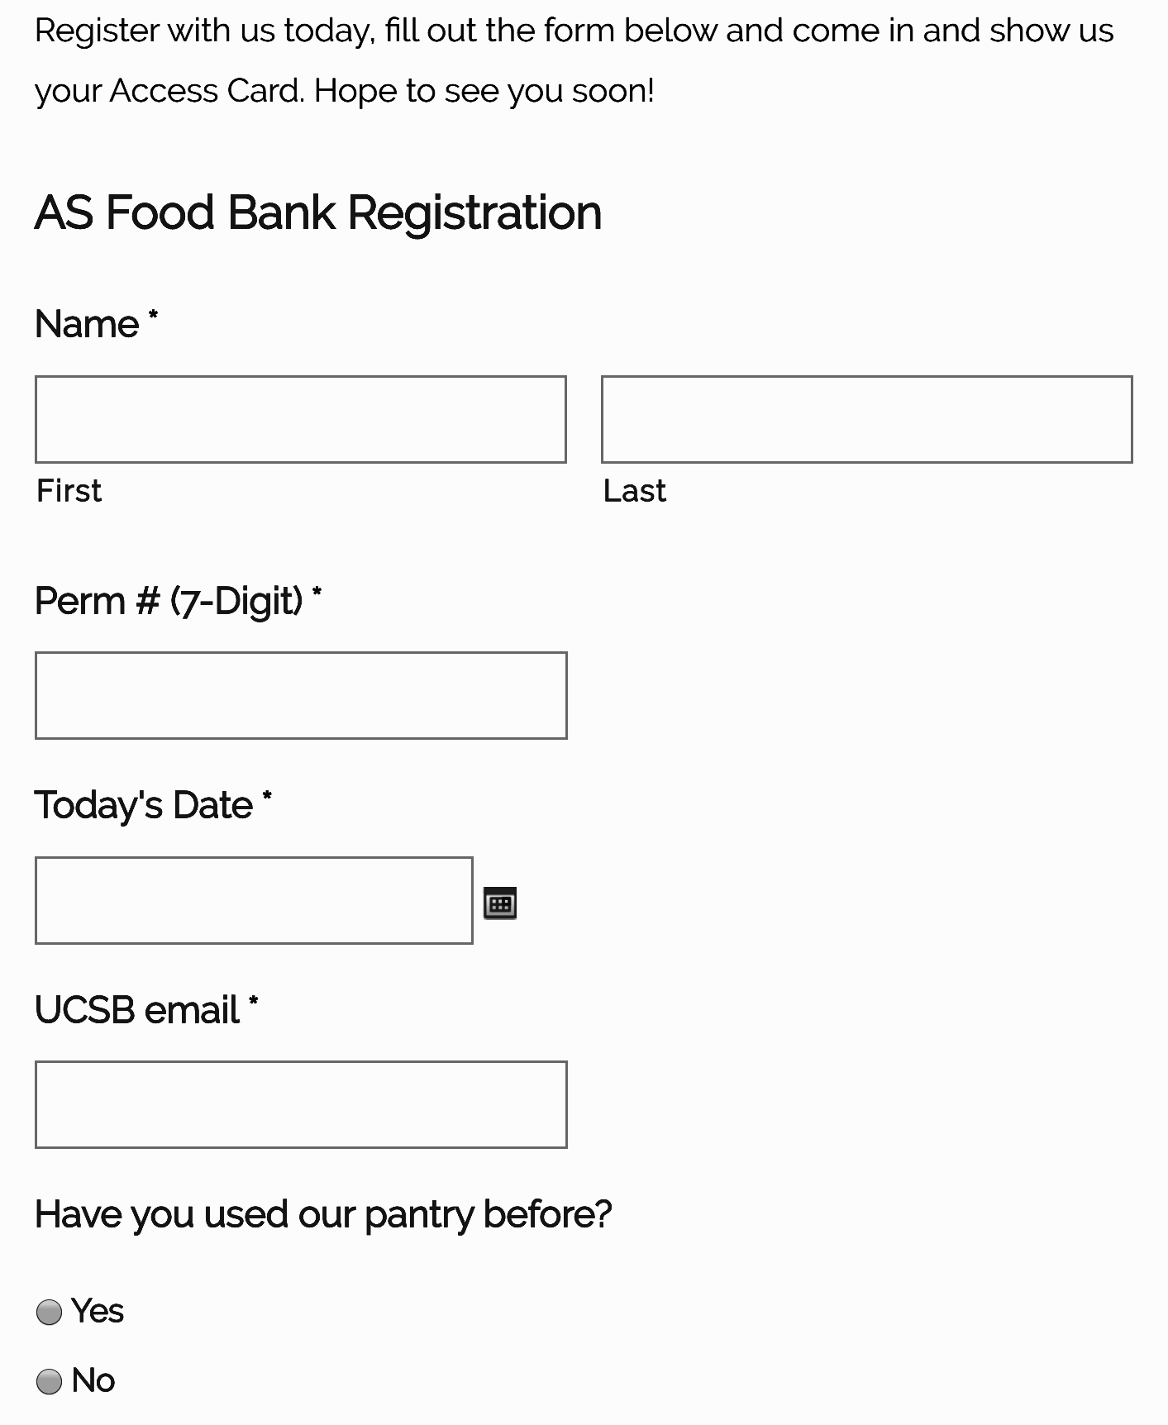
Data Collection Example: AS Food Bank
Registration Page
WordPress surveys - easy to download and sync csv data
Easily accessible - QR code printed by front desk
Efficient - one-time registration allows for frequency and demographic information to be seperate
Privacy - sign-in sheets may violate FERPA regulation
Source:https://foodbank.as.ucsb.edu/register-today/

Slide 12
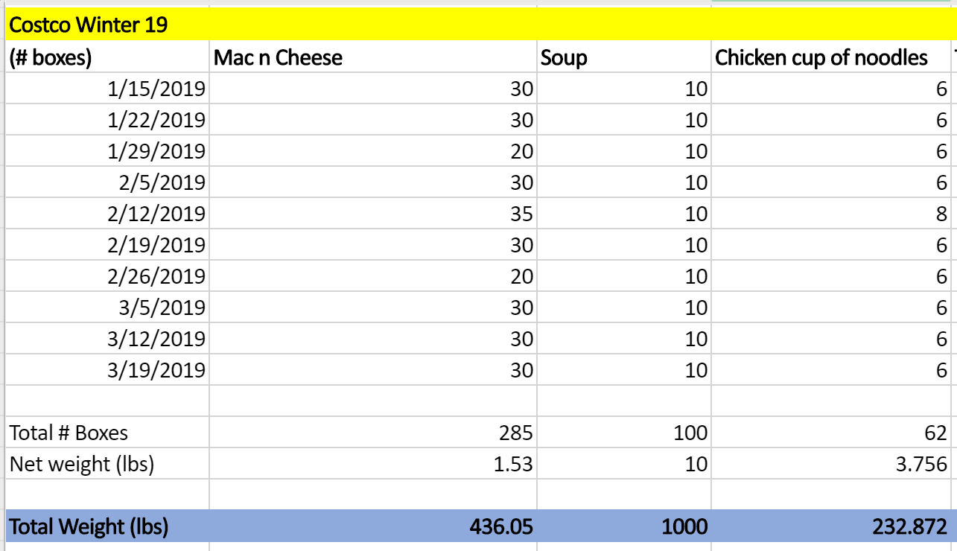
Data Collection Example: AS Food Bank
Inventory Data
Invoices and receipts documented for budgeting and analytics
A legend for container-pound-price conversions, automated cells, and categorization of food items

Slide 13
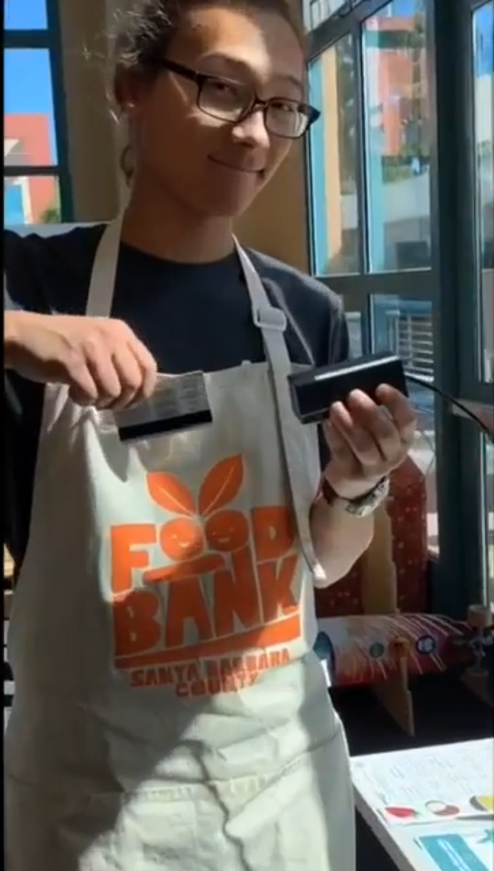
Data Collection Example: AS Food Bank
Visits Log
Measuring frequency and totals
Access Cards - everything we need in one swipe
Output = Input - Excess
Digitization and sign-in efficiency time-sensitive
Notes:
-Eval team need to hand-input records sometimes, FoodCycling, inefficient

Slide 14
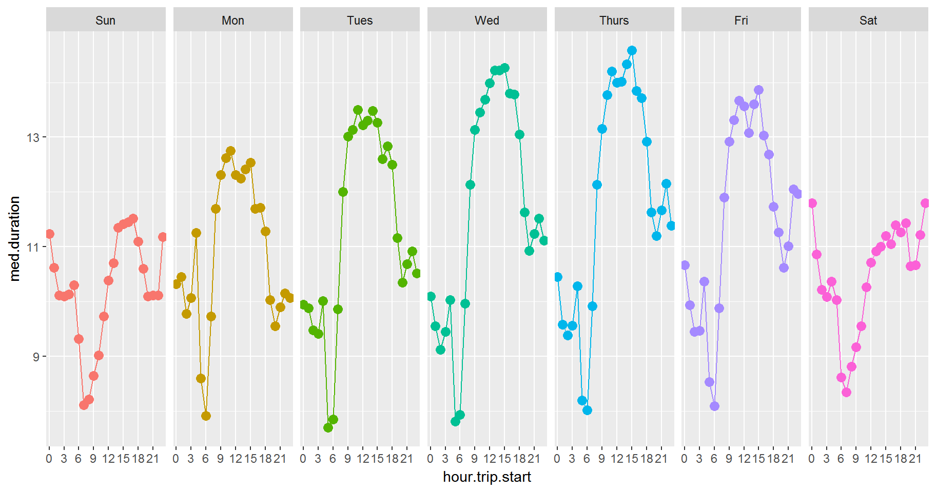
Analysis Methods & Display
Formerly: Excel & Google Sheet
Straightforward, but limited
Individual program analysis ease
Limited flexibility with visuals
Moving Forward: RStudio
Regression & time analysis functionality
Demographic & cross-program data = large
Improved training and staffing
Source: http://lab.rady.ucsd.edu/sawtooth/business_analytics_in_r/Viz1.html

Slide 15
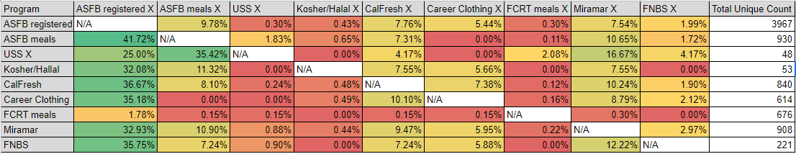
18-19 Campus Assessment
At least 6,694 unique students served (out of 25,976)
At least 198,336.8 lbs of directly distributed foods to students
Around 3,400 students applied for CalFresh, 643 were assisted by advocates
121,807 total contacts made
...only 18 programs were analyzed, 9 of which collected didn’t collect perm #’s

Slide 16
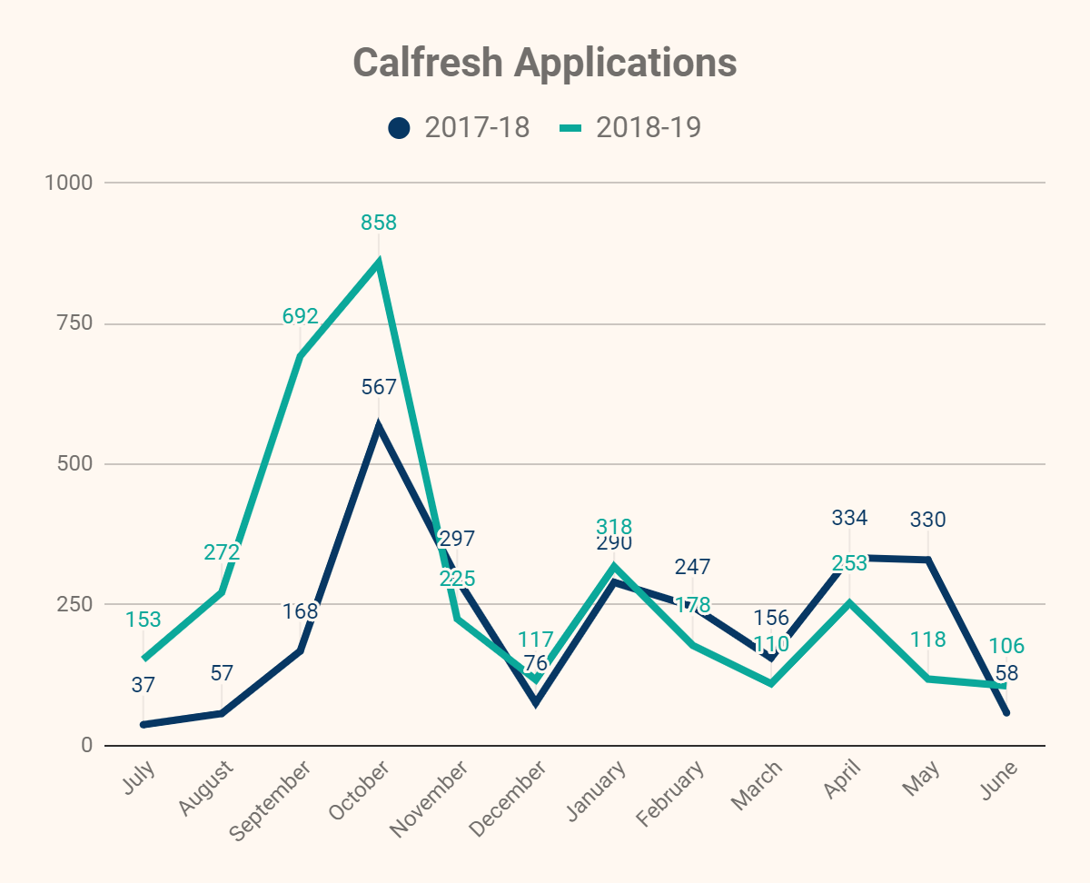
18-19 Program Assessment:
CalFresh
Total Applications: 3400
Strong start, but plateau?
Approval rate: 77.3% (for direct applications, does not include indirect app approvals)
Average benefits: $120
Total Advocate Contacts: 1020
Impact on campus:
$446,589 in EBT spent at the Arbor
67,838 total transactions
Locations: total visits/hours worked
Name (First Last) | Preferred Method of Contact | Perm # | Email | Date | Time | Location | Class Level | Year | Assistance Type | Method of Assistance | Phone # | Address (## Street, Apt., City, Zip) | County | Can we contact as CFO? | "How did you hear about us?" | Online or Paper App? | Displaced?
Emmanuela Kubari | Test | 3856689 | emmanuelaskubari@gmail.com | 7/17/2019 | 1:45:00 PM | ASFB | Undergrad | 4th | CalFresh Enrollment | Outreach | (619) 717-7412 | 6643 Del Playa Drive Goleta, Ca 93117 | Santa Barbara County |  | Other | Online | No
Yvette Ramirez | Email | 6665301 | yramirez00@ucsb.edu | 7/18/2019 | 2:00:00 PM | ASFB | Undergrad | 4th | CalFresh Enrollment | Outreach | (916) 272-3910 | 6643 Abrego Rd. Unit B2 Goleta, Ca 93117 | Santa Barbara County |  | Other | Online | No
Rueben Berumen | Email | 3694825 | rjberumen7@gmail.com | 7/31/2019 | 12:00:00 PM | ASFB | Undergrad | 2nd | CalFresh Enrollment | Outreach | (209) 303-7173 | 6667 El Colegio Road Goleta, Ca 93117 | santa Barbara County |  | Other | Online | No
Alex Klimek | Email | 566836 | alexklimek@ucsb.edu | 7/31/2019 | 2:45:00 PM | ASFB | Undergrad | 1st | CalFresh Enrollment | Outreach | (760) 813-2539 | 130 S. Patterson Ave #60304 Santa Barbara, Ca 93111 | santa Barbara County |  | Flyer | Online | No
Taylor Curtis | Phone Call | 4574943 | taylorcurtistlc@gmail.com | 8/5/2019 | 2:00:00 PM | El Centro | Grad | 4th | CalFresh Enrollment | Walk-in | 951-750-0609 | 6661 Berkshire Terace #22 Goleta, Ca 93117 | santa Barbara County |  | Website | Online | No
Felix Duong | Email | 6860639 | felixduong@ucsb.edu | 8/5/2019 | 3:15:00 PM | El Centro | Undergrad | 2nd | CalFresh Enrollment | Walk-in | 510-493-8929 | 6617 Sabado Tarde Road Goleta, Ca 93117 | santa Barbara County |  | Friend Referral | Online | No
Veronica Leal | Phone Call | 5499223 | veronicaleal2017@icloud.com | 8/5/2019 | 3:30:00 PM | El Centro | Undergrad | 3rd | CalFresh Enrollment | Walk-in |  | 6694 Picasso Road Goleta, Ca 93117 | santa Barbara County |  | Friend Referral | Online | No
Erick Diaz | Phone Call | 6264857 | erickdiaz@ucsb.edu | 8/5/2019 | 3:30:00 PM | El Centro | Undergrad | 3rd | CalFresh Enrollment | Walk-in |  |  |  |  | Presentation | Online | No
Samantha Mejia | Email | 4286977 | samanthamejia123@yahoo.com | 8/7/2019 | 2:15:00 PM | RCSGD | Undergrad | 4th | CalFresh Enrollment | Walk-in | (619) 721-4072 | 6512 Seville Road Apt. 2 Goleta, Ca 93117 | santa barbara county |  | Friend Referral | Online | No
Brandon Lau | Email | 3352028 | brandonjless!ucsb.edu | 8/7/2019 | 2:30:00 PM | RCSGD | Grad | 2nd | Meal Vouchers | Walk-in | (469) 951-3868 | 6553 Cordoba Road #4 Goleta, Ca 93117 | santa barbara county |  | Friend Referral | Paper | No
Lorenzo Palomera | Email | 3079324 | lpalomera@ucsb.edu | 8/7/2019 | 2:30:00 PM | RCSGD | Undergrad | 2nd | CalFresh Enrollment | Walk-in | (805) 607-7481 | 6509 Seville Road Apt. 7 Goleta, Ca 93117 | santa barbara county |  | Friend Referral | Online | No

Slide 17
18-19 Assessment Challenges
Assigning Clear Responsibilities
Data collection, manual entry, file sorting, analysis, and communication
Eval team-recognizing assistance need by program ahead of time
Informal/Small Groups and Events
Small, but they add up
Program leaders training in data best practices
Beyond a Headcount-What Impact are we having
Small, but they add up
Program leaders training in best practices

Slide 18
19-20 Evaluations: Moving Forward
Campus-Wide Programs Survey
One-stop, uniformed survey for all programs
Avoid survey fatigue at critical time of year
Better evaluation of program overlaps
Centralized Research Team
Graduate Student Researcher
Moving beyond counting heads
Questions
Effectiveness of programs to meet goals & ROI
Characterizing student housing insecurity and causes
Better understanding of how race affects basic needs
Do students coming to the campus from different parts of the state have different food/housing security issues?
Where did all the sophomores go?
Expanded literature review
Notes:
From 18 to 68 Efficient and centralized More Approach with ease, offer assistance

