Slide 1
Rebuilding a Community: Residential Development Trends in the Aftermath of California Wildfires
Environmental Studies Program Senior Thesis Presentation
Present By: Gabriel Etaat
Advised By: Prof. Robert Heilmayr
June 10th, 2020
Notes:
-Thank you Prof Pulver. Today I will be presenting on my thesis, titled
-I’d like to add that none this could have been possible if not for the help of my incredible thesis adviser, Prof. Robert Heilmayr

Slide 2
Introduction
Topic Overview
16 of the 20 most destructive wildfires in California’s history took place in the past 20 years ¹
More than 350,000 California residents live in “Very High” risk wildfire zones ²
Previous literature indicates poorer at-risk regions are more susceptible to long-term housing impacts than wealthier at-risk regions ³
Thesis Question
When and to what degree do California communities exhibit significant indicators of rehousing in the aftermath of destructive wildfires?
¹ CAL FIRE (2019). Top 20 Most Destructive California Wildfires
² Dixon et al. (2018). The impact of changing wildfire risk on California’s residential insurance market
³ Davies et al. (2018). The unequal vulnerability of communities of color to wildfire.
Notes:
-Before I dive into the logistics of my research, I’d just like to share a few concerning facts that led me to pursue this topic..
-1. Wildfires all across the world are become more frequent and more intensive as factors such as greenhouse gas emissions continue become more relevant…(1)
-2. Not only are the fires themselves becoming a larger presence in the California landscape, but homeowners have become increasingly more vulnerable to the threats they pose. This is indicated by the ….. (2)
-3. Lastly, ….. (3)
-With these concerns in mind, I decided to contribute to the growing pool of literature on this topic by posing the research question, …..

Slide 3


Research Rationale
Academic Contribution
Policy Contribution
Take a regression analysis approach to map out year-to-year trends as opposed to case studies
Provide an original database of wildfire household impacts based on county fire reports
Further explore the relationship between the socioeconomic status and adaptability of different regions
Indicate whether rapid-rehousing policies are achieving their intended goals
Explore home building permitting regulations and processes unique to California residence and their implications to impacted homeowners
Inform whether income-specific housing grants by region may support more equitable rehousing patterns
Notes:
-As I began my thesis, I carefully chose my focus and design in order to support the gaps I’d noticed within academia and policy.
-From an academic standpoint, many of the studies published on this topic chose a case-study approach. These researchers observed about 1-5 wildfires at a time, each of which typically impacted 100-200 households each. Although there are benefits to this kind of approach, I opted for a regression analysis over a much larger observation pool. By taking this approach, I was able to create a generalized timeline to depict how an average community may be expected the rehouse over each subsequent year
-Due to this approach, I was prompted to create an original wildfire database where 26 wildfires could be easily compared and identified as inputs for my model. No existing database took into account the number of structures destroyed by a given wildfire, so I had to dig through a variety of county fire reports, government agency websites, and authenticated newspaper articles in order to produce this data, which could be used by researchers in the future.
-Furthermore, I was able to explore the relationship between the socioeconomic status and adaptability of regions by placing the per capita income as an indicator within the regression model.
-From a policy perspective, my research is most reflective of local and state institutions, although these outcomes are comparable to results from other regions. The primary policy question this research attempts to answer is whether widespread emergency funds related to rehousing post-wildfire are effective in their goals, which are generally to promote as quick of a rebuilding process as possible. (Amy presentation, reactive plan)
-Although many of these funds are sourced from federal agencies such as the Federal Housing Administration, local rehousing characteristics are also considered in the interpretation of the regression output, such as how California-specific development regulations add time-intensive obstacles with few exemptions for individuals facing emergencies such as a destroyed household.
-Lastly, I hope that this research will help to inform whether…

Slide 4
Research Methods
Two-Way Fixed Effects Regression Model
Regressing both the number of structures destroyed by a wildfire and the income bracket of a given region on the number of housing permits issued in the 7 years following an instance
Fixed effects for trends across all 58 counties and 21 years (1998-2018)
Indicator Values
The coefficients B₁ through B₇ indicate the percent change each structure destroyed from a wildfire has on increased permits issued in subsequent years
The coefficients B₉ through B₁₅ indicate the additional affects a region’s per capita income has on permitting trends given that a wildfire is observed
log(total_mf_sf_perm_{t,c}) = B₀ + B₁struc_dest_{t-7,c} + B₂struc_dest_{t-6,c} + … + B₇struc_dest_{t-1,c} + B₈over_40_{t,c} + B₉over_40_{t,c}*struc_dest_{t-7,c} + B₁₀over_40_{t,c}*struc_dest_{t-6,c} + … + B₁₅over_40_{t,c}*struc_dest_{t-1,c} + ԑ
Notes:
-In order to obtain results with the highest possible accuracy, I chose a two-way fixed effects regression model for my analysis. I did this by ….(1)….
-House building permits, which must be applied for by any individual interested in building or even repairing their home after a wildfire, was used as the determining factor for rehousing due to it’s reflection of statewide policy mandates and the accuracy to which this data can explain changes in local housing profiles.
-Fixed effects were implemented by considering both the time and region in which a given event or characteristics were exhibited, which is indicated in this study by the 58 unique counties in California and one of the 21 years in the timeperiod observed.
-At the bottom of this slide is a representation of the primary regression model utilized for this analysis. It may seem complicated, but it can be broken down into a few primary components
-First off, we have the variable total_mf_sf_perm, which represented the number of housing units issued in a given year and county, as indicated by the subscripts t and c. This dependent variable is logged, such that a one unit change in an independent variable will produce a x percent change to permits issued for comparison purposes
-This variable is regressed by a number of terms, all of which was some variation of either struc_dest or over_40.
-struc_dest represents the number of structures destroyed by a wildfire if one is observed in a given year and county combination, the odds of which are 25 out of 1218
-over_40 is a binary variable indicating whether a not a county had a per capita income above or below $40,000 in a given year
-The coefficients B1 – B7… . For example, B1 indicates the % change each individual structure destroyed by a wildfire will have on the number of housing permits issued 7 years following the wildfire instance, assuming the county is in the lower income braket
-This assumption is mandated by the interaction terms represented by the coefficients B9-B15. These terms indicate … . For example, if B9 were a statistically significant, positive value, than wealthier counties would experience higher rates of rehousing 7 years following a wildfire instance. However, if B9 were found not to be statistically significant, we would have to assume the wealthier and poorer counties rebuild at about the same rate 7 years following

Slide 5
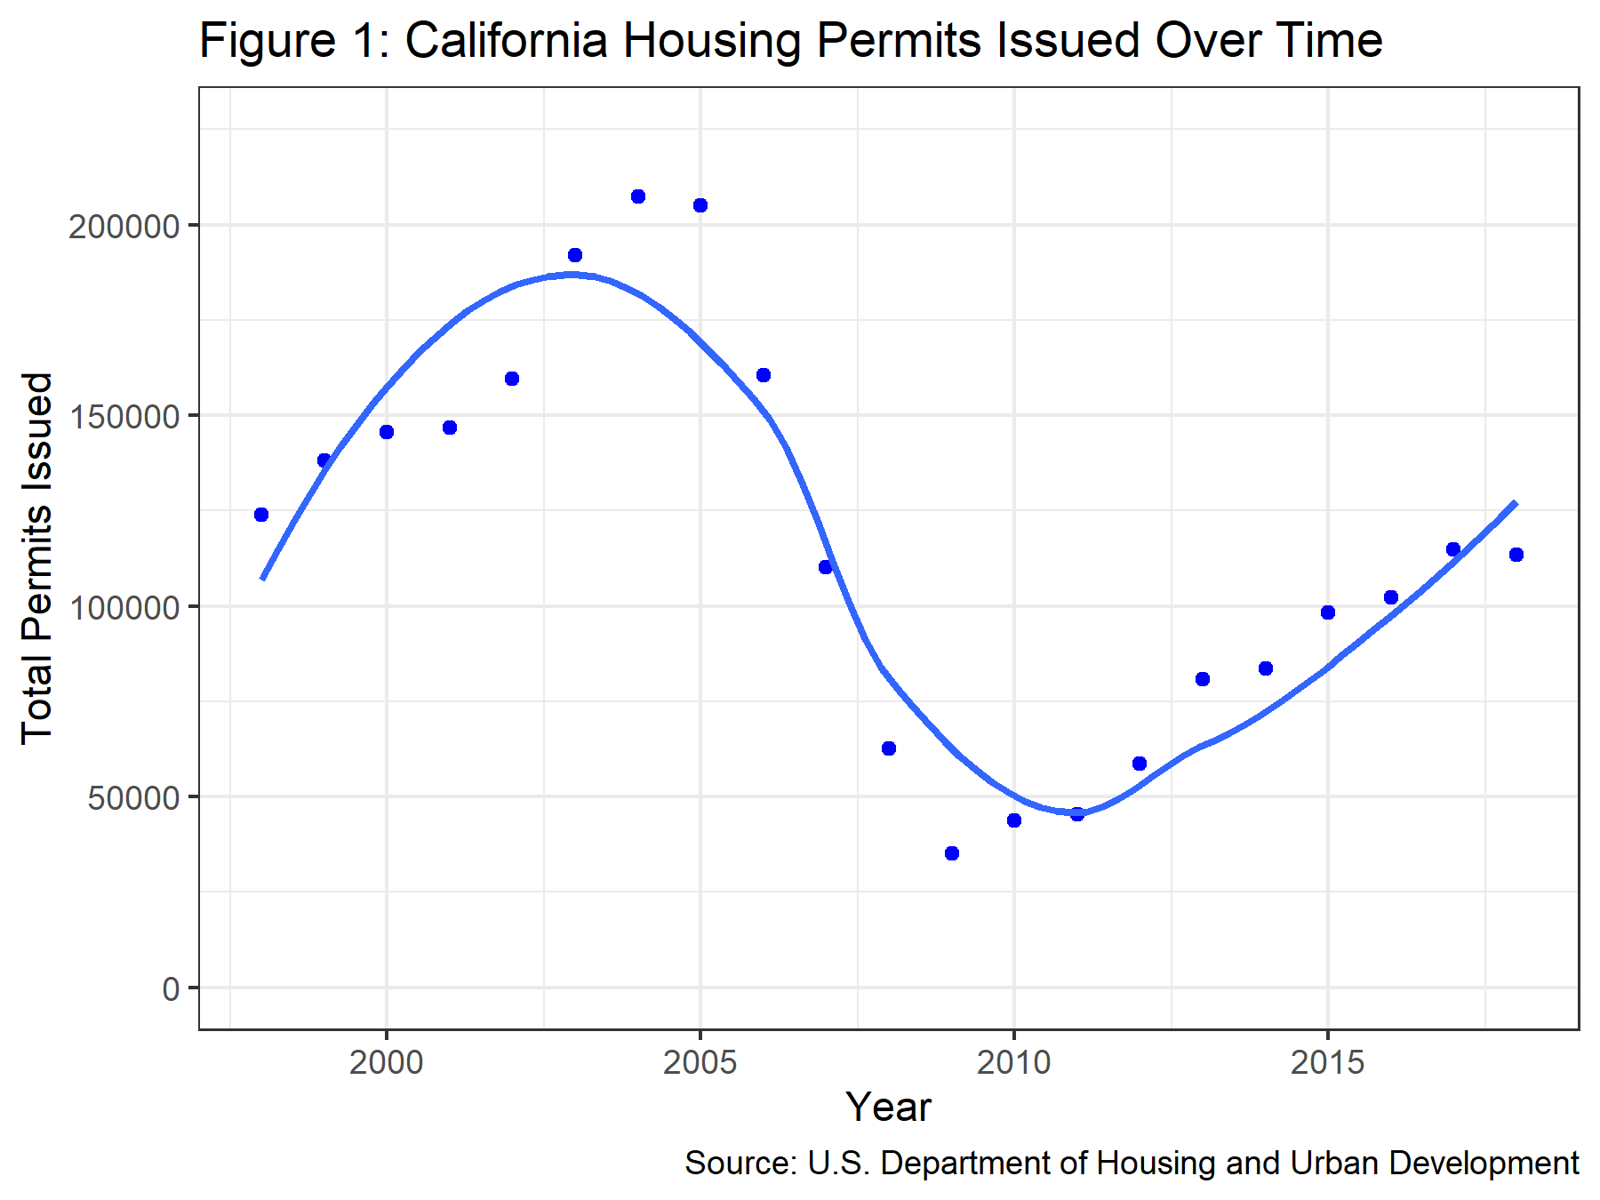
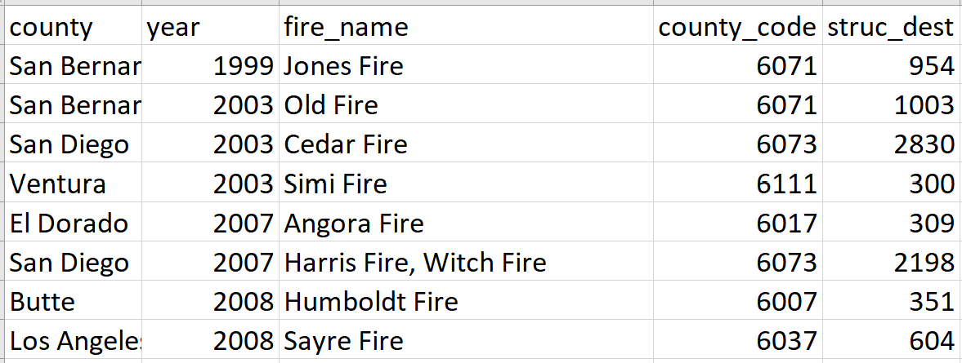
Data Inputs
A fixed-effects approach needed to assume all non-time and region specific effects are constant, e.g. The Great Recession
Four datasets pertaining to existing housing, permits issued, demographics, and wildfire instances were analyzed to yield the final model results
Notes:
-So before we go ahead and see what the regression model has to say about this trend, it’s important to first understand some of the characteristics that define this relationship. This is especially important because the fixed-effects approach carries the assumptions that all county-specific characteristics constant over time and all year-to-year trends proportionate across all counties are not accounted for in the output of our model. For example, as indicated by the graph on the right, the overall California permitting trends took a severe dip around the time of the Great Recession. Because this affect was found to be consistent across all counties, we did not include data specific to this characteristic.
-Data that was required for this model came from four sources, all grouped by county and year. …(2)…. The table at the bottom of the screen is a sample from my wildfire database, and indicates how, although a single county may have been impacted by multiple fires in a given year, data was wrangled into this specific county-and-year format for compatibility, with the total number of structures destroyed by these events combined in a given observation.

Slide 6
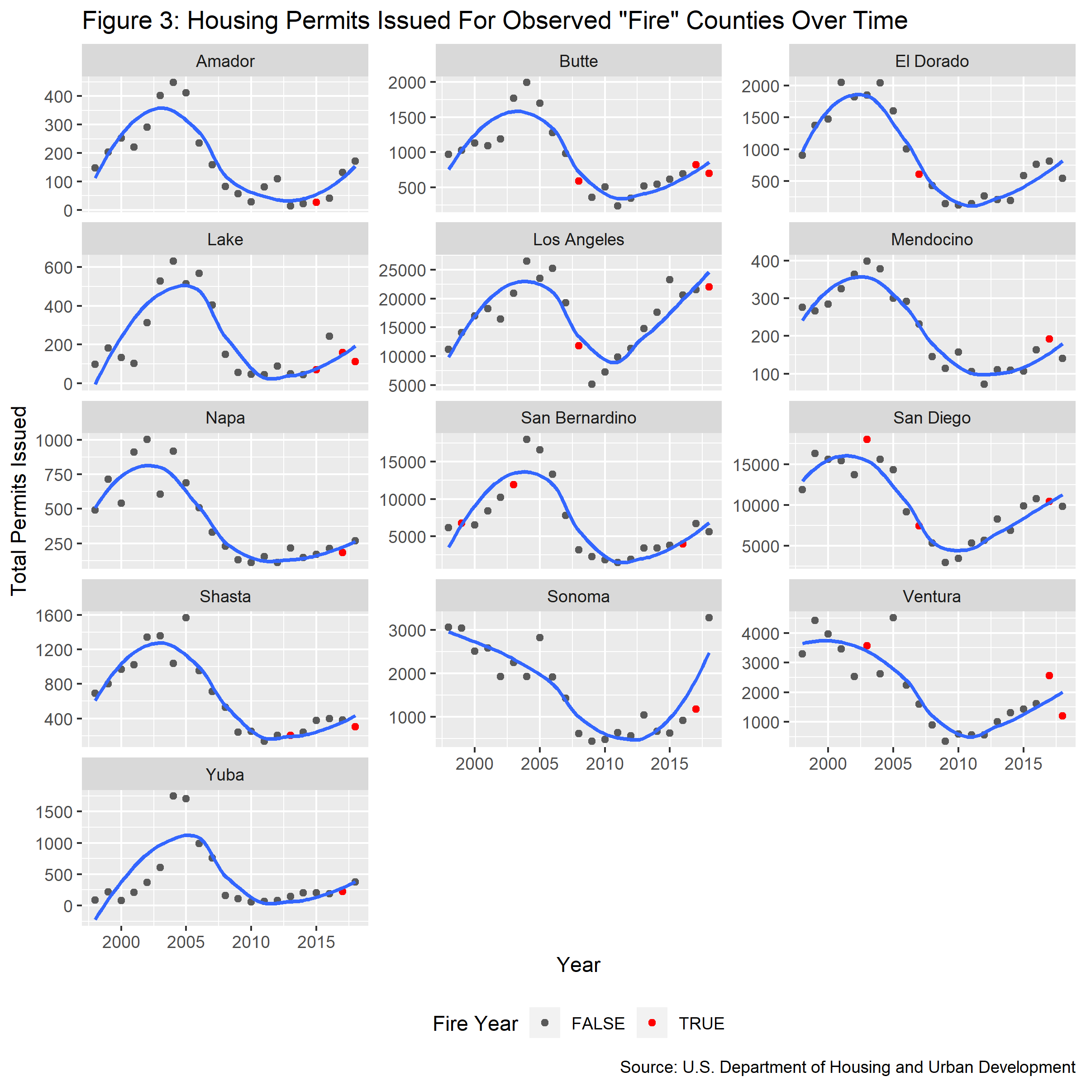
Initial Observations
Notes:
-As we can see here, 13 of the 58 counties in California were observed to have been impacted by an observed wildfire, which ranged from 120 to 18,804 structures destroyed across 26 fires. As discussed before, the great recession appears to have had similar impacts across all regions in our treatment group, although smaller counties exhibit higher variability from this state-wide trend. The red dots on this graph represent years where wildfire are observed, so according to my hypothesis there should be higher increases following these red dots across all counties than would typicall be expected given regular factors, but visually this is too difficult to decipher
-Another indication of this graph is that most wildfires took place in later years, such as the 2017 North Bay Fires. This had important implications for the results of our regression analysis, as there was more variability of rehousing efforts for later years than ones where permit data was available

Slide 7
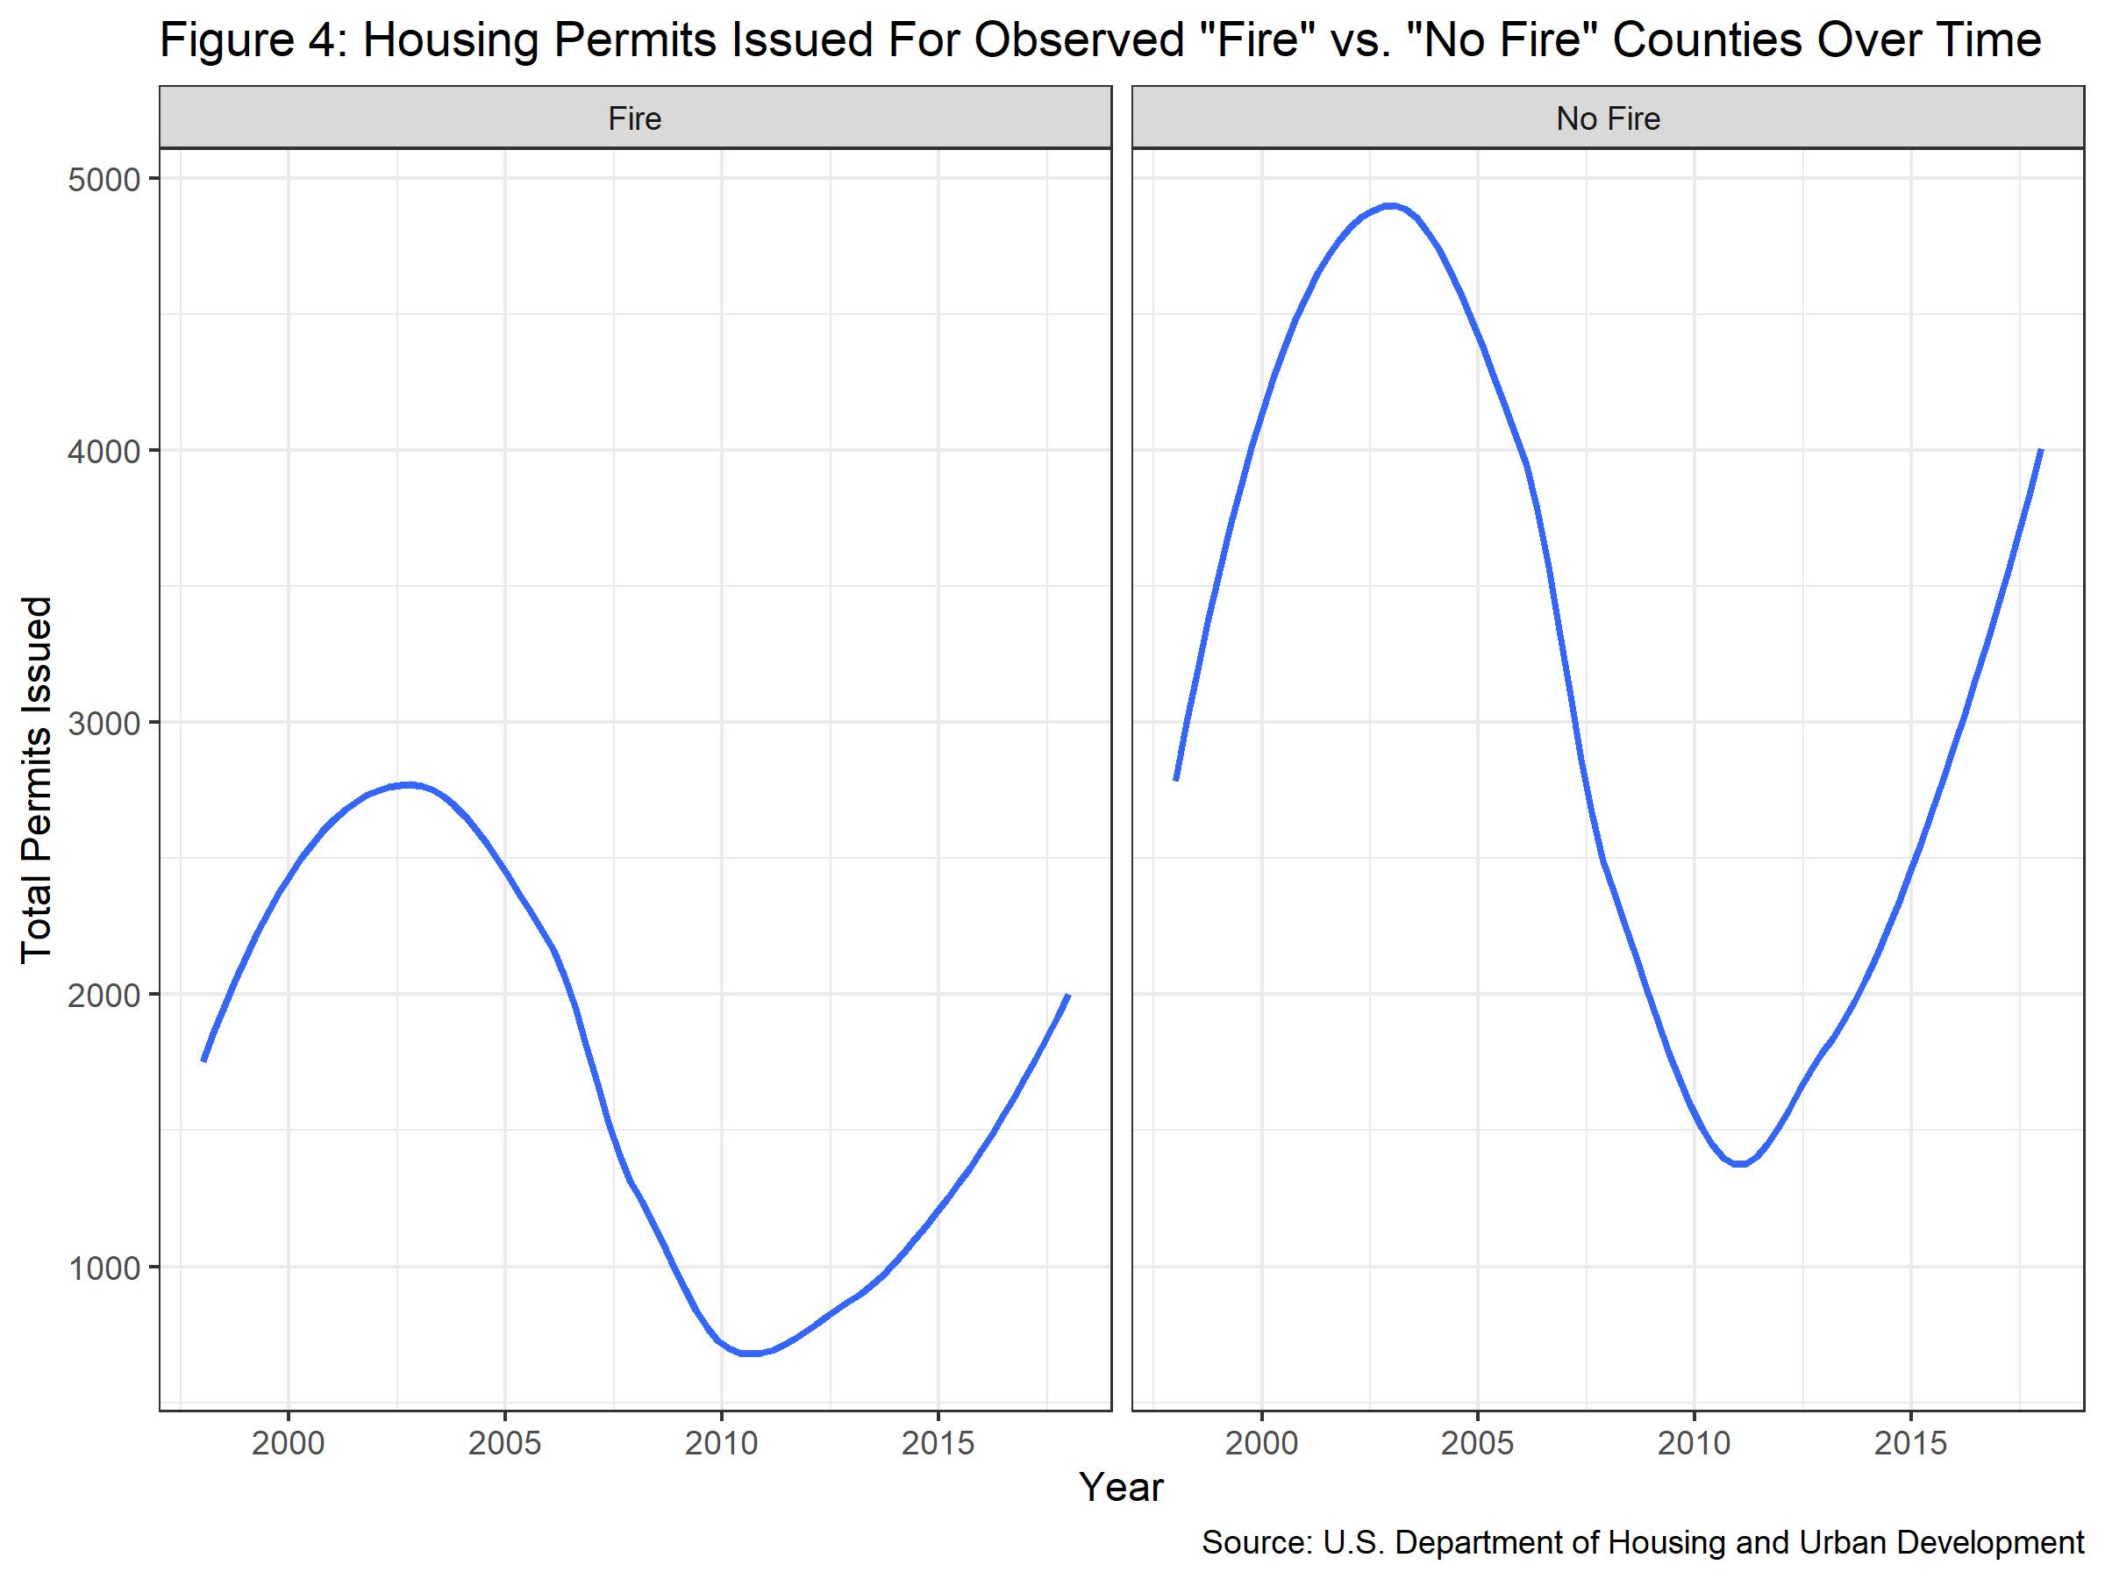
Initial Observations
Notes:
-here we see that counties in the “treatment” and control groups exhibit similar overall permitting trends over time, although the fire counties do tends to issues fewer permits on average. I’ll be skipping ahead for the sake of time but the main takeaway here is that the regions in my study or comparable for the purposes they’re intended for

Slide 8
Regression Output
7-Year Model
Significant, positive affects 4-7 years following a wildfire
Each structure destroyed by a given wildfire results in a 0.0058% to 0.0063% increase in permits approved during this period
No significant relationship between the income bracket of a region and its ability to recover at different times or degrees of impact in any year
In an “averaged” scenario, that 58% of all houses destroyed would be recovered 8 years after a wildfire
Other Regression Models
Variations in residence type by permit, observation periods, income measures
Findings: Multi-family structures not significant, wildfire affects only observed in post-fire periods, evidence of significant rebuilding up to 12 years prior
Notes:
-In the primary 7-year regression model depicted in my earlier slides, we found that significant, positive affects from wildfires on housing were observed 4-7 years following the instance of a wildfire. These coefficients indicated that, with 95% certainty, each structure destroyed ….(2)… . Although these changes appear small, larger wildfires could easily see over a 10% increase in the permits distributed in a single year, although the average was typical closer to about a 4% increase.
-Surprisingly, …(3)… . Therefore, I failed to prove that the socioeconomic makeup of a region was a significant indicator for its ability to rebuild, although variations of this approach were tested in subsequent models.
-To put these numbers into perspective, an “averaged” approach was employed where these estimates were applied to a hypothetical county with the average characteristics of the 13 treatment counties. In this scenario, should a fire have taken place in 2008 of average size, or about 534 structures destroyed, then 58% of… (4)… . This assumption also takes into account the average one-year lag between the issuance of a building permit and the actual completion of the rebuilding process.
-Variations of this model were employed, where variables and time periods were swapped in order to identify biases or further observations. A few quick takeaways from these models are that multifamily structures were not a significant composition of the structures rebuilt after wildfires, the effects of the wildfires were not observed at all in years previous to fire instances, and evidence exists that this significant permitting period stretches on between 4-11 years after a fire, although data limitations in later time periods prevented me from confirming this observation.

Slide 9
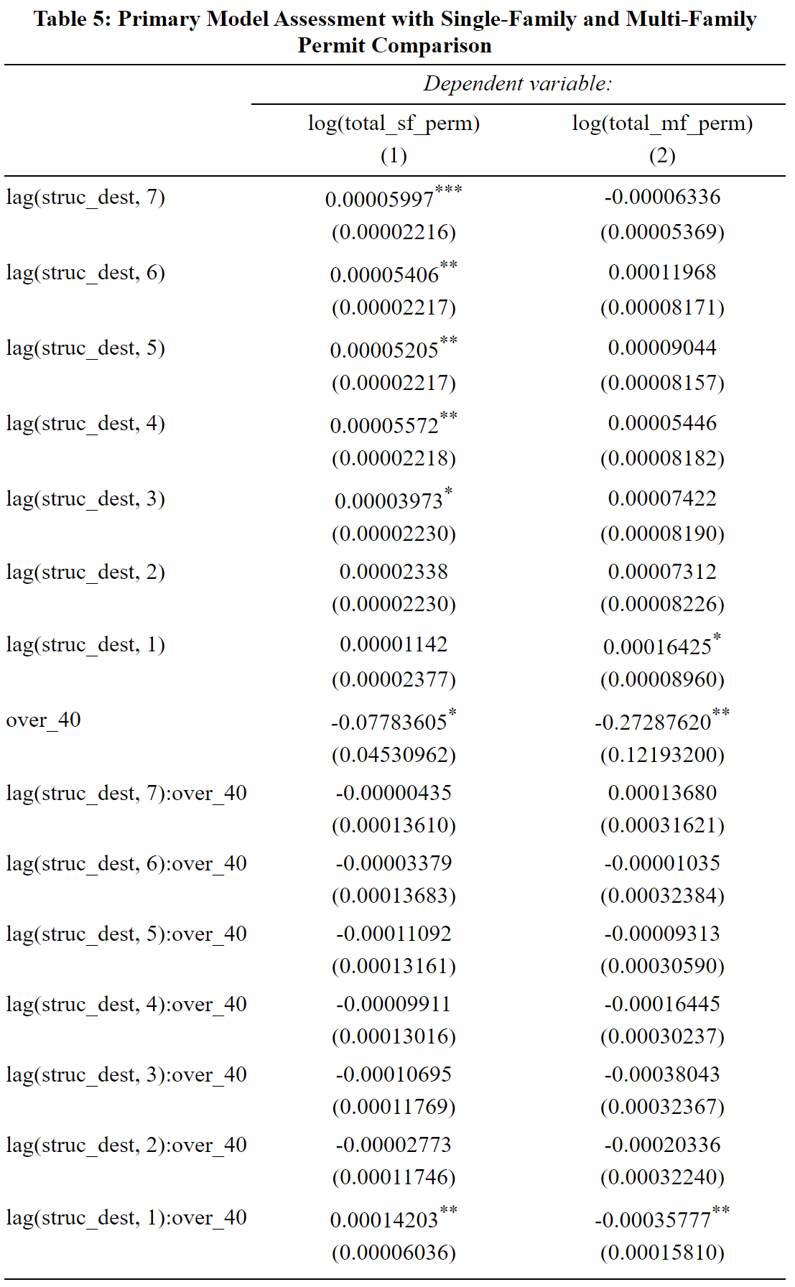
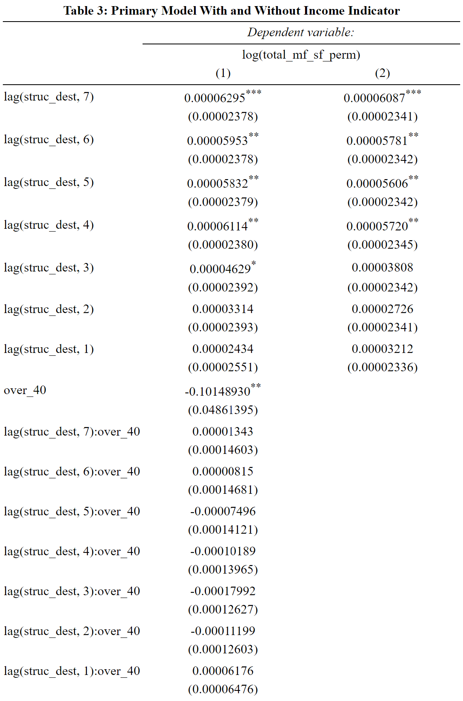
Regression Output
Notes:
-here are some examples of the output from our regressions. I’m running a little short on time so I’m just going to skip over these.

Slide 10
Conclusion
Main Takeaways
Significant rebuilding efforts are not being observed in the immediate aftermath of wildfires
The per capita income of a region does not significantly impact its ability rebuild sooner or to a different degree
Research Limitations
All exogenous factors assumed constant, county-level proxy, wildfire observations skewed towards later periods
Recommendations
Existing policies with the intent of expediting the rehousing process through grants should be supplemented with a permitting exemptions
Grants and transitional housing may serve a temporary solution, but wildfire risk-based zoning practices should be considered as a long-term solution
Notes:
After performing this analysis, these values were put into context with the findings from my literature review and other readings on the topic to make the following conclusions.
-First off, the outcomes of my model support exiting research that …(1)…
-Furthermore, somewhat contrary to existing beliefs, …(2)…. This may be accounted for by the wide availability of low-income specific grants facilitated by all local agencies which serves to assist those who need the most help initiating the rebuilding process.
-Several limitations and assumptions were taken into account as well. For example, the results of this model could have been biased by exogenous county-and-year specific factors that also impact the issuance of housing permits. The use of a county-level approach as opposed to a a more specific region, as well as the skewed nature of fires to more recent years, may have also interfered with the precise reliability of the results.
-However, given these outcomes, it is my recommendation that … . This would entail changes to how permits are approved, with the possible implementation of exceptions to lengthy approvals in order to facilitate a quicker review and approval of these housing requests.
-It is also my recommendation that, while …, . I was not able to dive into the future risks of rebuilding over fire-prone regions, but this is an inevitable factor that must be considered, with options for both rebuilding and relocating for homeowners

