Slide 1
SmartLoan Analytics
Intelligent Loan Management and Analytics System Using Python
GROUP MEMBERS
CHOLA CHILUFYA — 2410856
Sibamba Mumbula — 2410781
EUNICE KUNDA — 2410776
Caroline Musonda — 2300908
Gabriel Mwelwa — 2410761
Mumba Adrian — 2611537
PYTHON
SQLITE
ANALYTICS
Notes:
Introduce the group and state that SmartLoan Analytics is a desktop Python application for managing customers, loans, repayments, analytics and reporting.

Slide 2
The Problem
Why a dedicated loan-management desktop application was needed
• Manual and spreadsheet-based records can introduce duplication and data-entry errors.
• Repayment and overdue tracking becomes harder as the portfolio grows.
• Stored data alone is not enough; management needs trends, KPIs and risk insights.
• SmartLoan centralizes operations and analytics in one desktop application.
1
Central database
2
Automated controls
3
Decision insights
SmartLoan Analytics • BICT Python Programming Project 2/18
Notes:
Explain the operational pain points first, then connect each pain point to a SmartLoan design response.

Slide 3
Project Objectives
The system was designed to satisfy both functional and software-engineering requirements
• Secure authentication and role-based access
• Customer and loan management
• Repayment and penalty management
• Validation and exception handling
• Analytics and Matplotlib visualization
• PDF and CSV reporting
• Three original algorithms with Big O analysis
• Logging, audit trail and automated testing
SmartLoan Analytics • BICT Python Programming Project 3/18
Notes:
Do not read every bullet. Group them into security, operations, analytics, algorithms, and quality assurance.

Slide 4
Technology Stack
A lightweight Python desktop stack suitable for an academic prototype
Python
Core language
Tkinter
Desktop GUI
SQLite
Relational storage
Matplotlib
Charts
ReportLab
PDF reports
pytest
Automated tests
Git
Version control
SmartLoan Analytics • BICT Python Programming Project 4/18
Notes:
Explain why this stack is appropriate: Python for development speed, Tkinter for desktop UI, SQLite for local persistence, and supporting libraries for analytics, reports and tests.

Slide 5
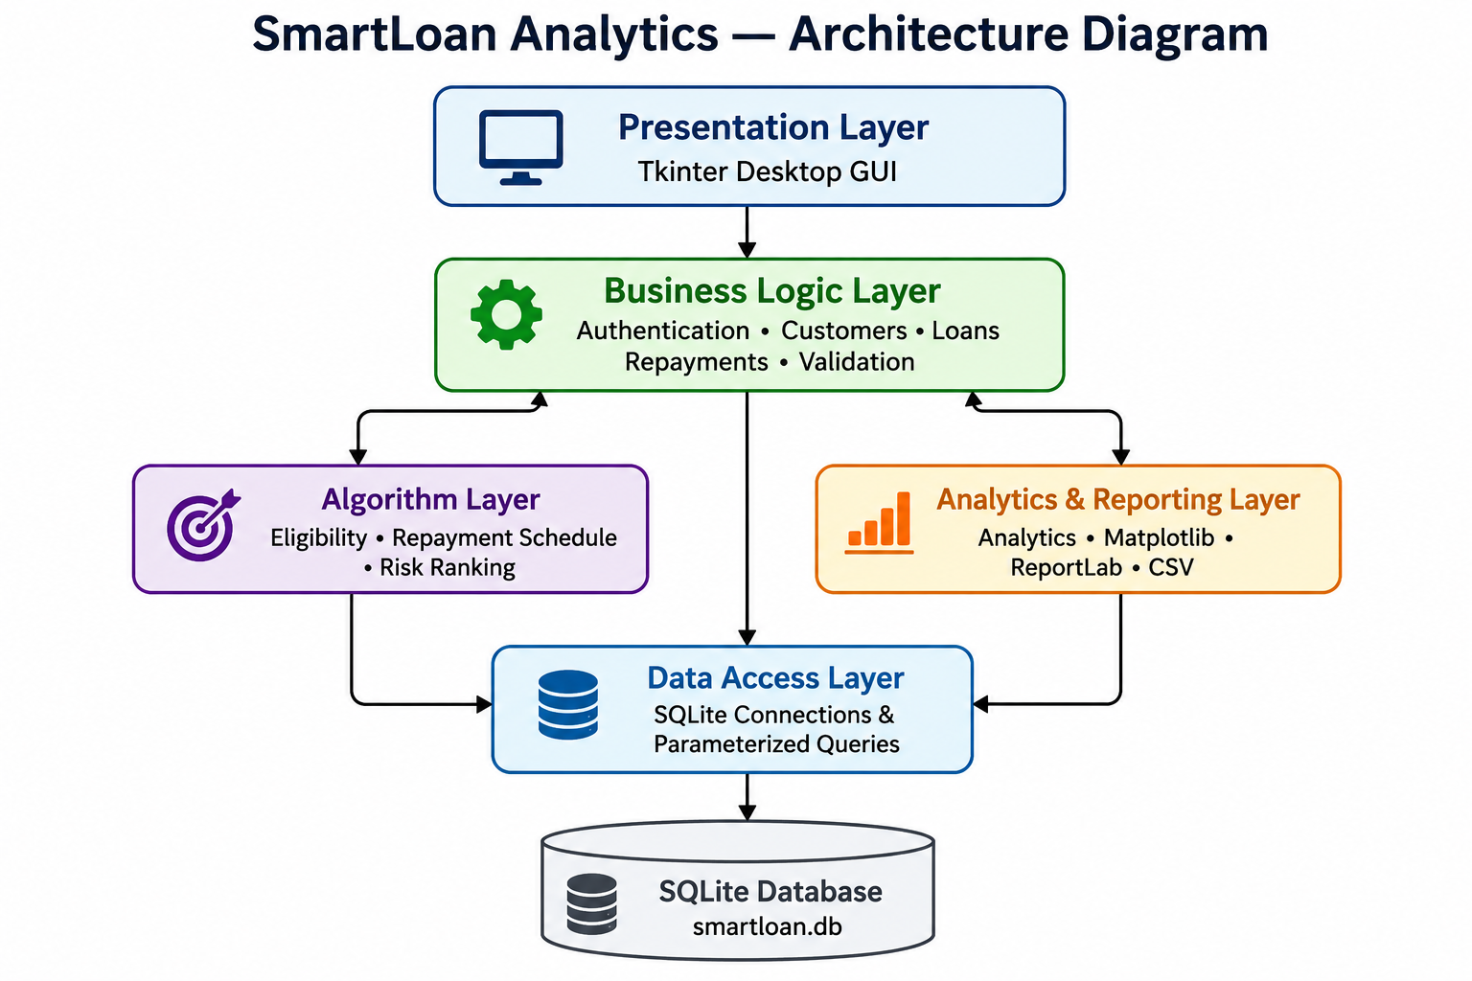
Layered Architecture
Separation of concerns improves maintainability, testing and future extension
SmartLoan Analytics • BICT Python Programming Project 5/18
Notes:
Walk top to bottom: Presentation, Business Logic, Algorithm and Analytics layers, Data Access, then SQLite. Emphasize separation of concerns.

Slide 6
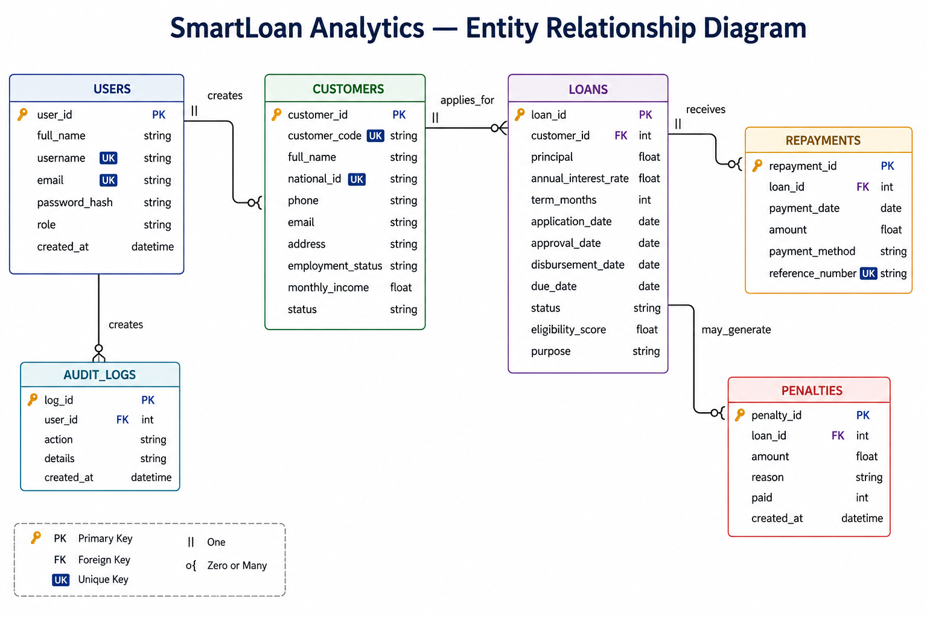
Database Design
Relational entities keep customer, loan and transaction data connected
SmartLoan Analytics • BICT Python Programming Project 6/18
Notes:
Explain the one-to-many relationships: one customer can have many loans; one loan can have many repayments and penalties; one user can create many audit records.

Slide 7
Main System Functions
End-to-end workflow available from the role-aware dashboard
Login
Dashboard
Customers
Loan Application
Approve / Disburse
Repayment
Analytics
Reports
Logout
The demonstration should show a complete loan lifecycle rather than isolated screens.
SmartLoan Analytics • BICT Python Programming Project 7/18
Notes:
During the live demo, follow this sequence. This helps the lecturer see that the modules form one coherent system.

Slide 8
Dataset
Synthetic, reproducible data supports testing and analytics without exposing real financial PII
220
synthetic customers
650
loan records
500+
assignment minimum exceeded
• Repayment records are generated for relevant loan states.
• Penalty records are linked to overdue loans.
• A fixed random seed makes demonstrations and tests reproducible.
• No real customer NRC, bank-account or confidential financial information is used.
SmartLoan Analytics • BICT Python Programming Project 8/18
Notes:
Stress that the dataset is self-generated and synthetic. Explain why reproducibility and privacy matter.

Slide 9
Algorithm 1 — Eligibility Scoring
Transparent rule-based academic scoring
O(1)
Time complexity
O(1)
Space complexity
• Inputs: monthly income, requested amount, term and existing debt.
• Uses a fixed number of arithmetic and comparison operations.
• Returns a bounded eligibility score for the prototype.
• Academic demonstration only — not a regulated credit-scoring model.
Why O(1)?
No loop grows with the number of customers or loans. The same fixed set of calculations runs for one application.
SmartLoan Analytics • BICT Python Programming Project 9/18
Notes:
Be ready to open algorithms/eligibility_scoring.py and point to the fixed calculations. Mention the academic-model limitation.

Slide 10
Algorithm 2 — Repayment Schedule
One schedule entry is generated for each month of the loan term
O(n)
Time complexity
O(n)
Space complexity
• n = loan term in months.
• The loop executes once per month.
• The returned list stores n schedule rows.
1
2
3
4
5
6
Month 1 → Month 2 → … → Month n
SmartLoan Analytics • BICT Python Programming Project 10/18
Notes:
Point to the loop over term_months in algorithms/repayment_schedule.py. Explain why both time and returned storage grow linearly.

Slide 11
Algorithm 3 — Risk Ranking
A transparent manual ranking algorithm identifies higher-risk loans first
O(1)
score per loan
O(n²)
manual ranking
O(n)
space
• Risk score uses overdue days, outstanding balance and missed payments.
• Selection sort repeatedly chooses the highest remaining risk score.
• Nested loops make the manual ranking O(n²).
• Production improvement: O(n log n) Timsort/SQL ordering, or a heap for top-k results.
SmartLoan Analytics • BICT Python Programming Project 11/18
Notes:
Explain why selection sort was used for visibility of the underlying logic, not because it is the fastest production choice.

Slide 12
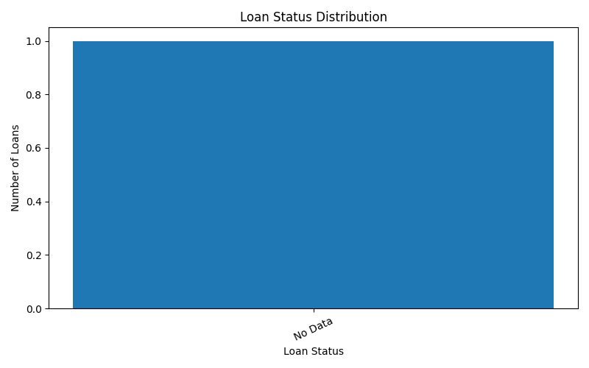
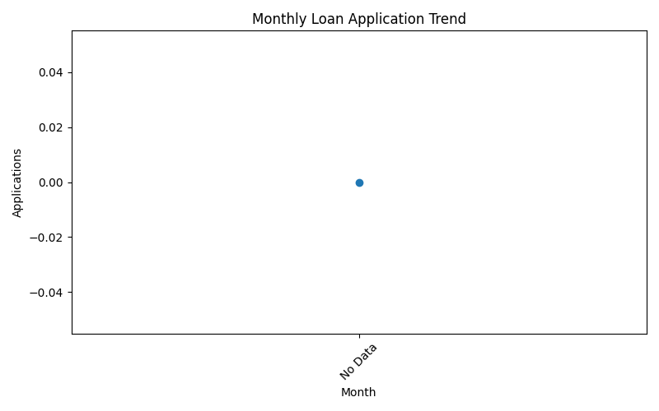
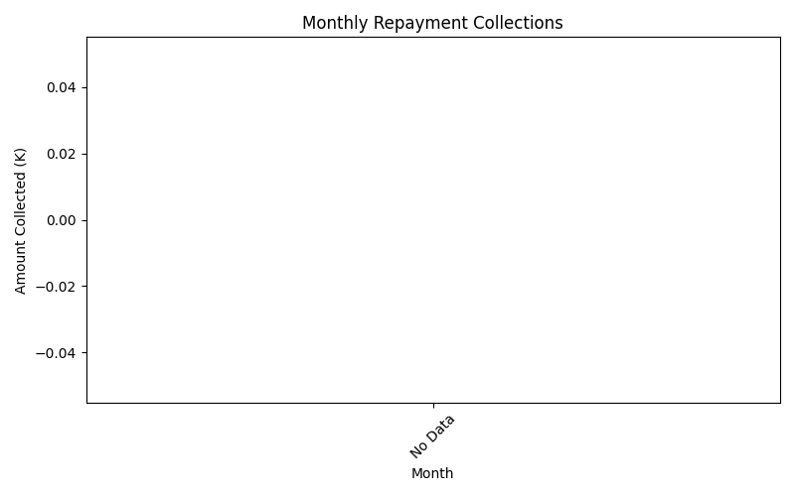
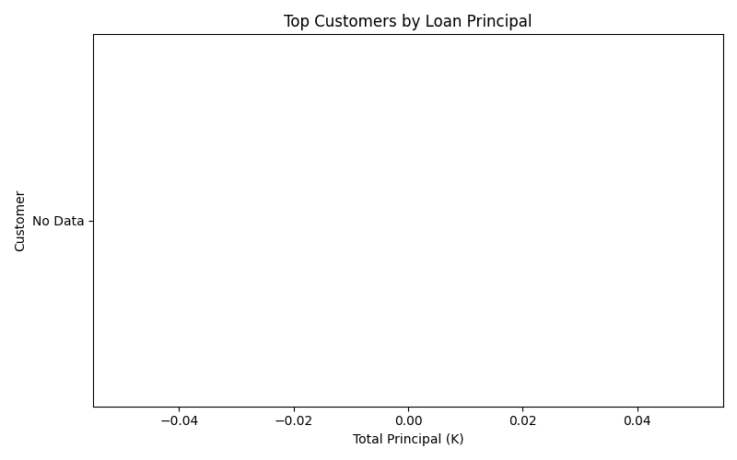
Analytics & Visualization
Charts convert operational records into trends, comparisons and management indicators
SmartLoan Analytics • BICT Python Programming Project 12/18
Notes:
Use bar charts for categorical comparison and line charts for time trends. Mention portfolio KPIs and risk ranking as additional management insights.

Slide 13
Validation, Security & Logging
Controls protect data quality, access and traceability
SECURITY
• Password hashing
• Role-based access
• Parameterized SQL
VALIDATION
• Missing/format checks
• Duplicate detection
• Loan-specific rules
RESILIENCE
• Safe exceptions
• Rotating logs
• Audit trail
SmartLoan Analytics • BICT Python Programming Project 13/18
Notes:
Give one example for each column: hashed passwords, duplicate customer validation, and a logged error or audit event.

Slide 14
Testing & Verification
The final baseline was checked through automated and manual verification
50
passing pytest tests
✓
compilation verified
GUI
manual workflow testing
• Authentication and role tests
• Customer, loan and repayment tests
• Dataset generation tests
• Algorithm correctness tests
• Analytics and report tests
SmartLoan Analytics • BICT Python Programming Project 14/18
Notes:
Run python -m pytest -q during the demo if time permits. State that the Phase 12 baseline had 50 passing tests.

Slide 15
Current Limitations
The prototype is intentionally scoped for academic demonstration
• Desktop/local architecture limits concurrent multi-user deployment.
• SQLite is not intended for high-concurrency enterprise workloads.
• Eligibility and risk models are simplified academic rules.
• The dataset is synthetic rather than institutional production data.
• No payment gateway, credit bureau or external identity integration.
SmartLoan Analytics • BICT Python Programming Project 15/18
Notes:
Present limitations confidently. Acknowledging them demonstrates engineering judgement and defines the boundary of the prototype.

Slide 16
Future Improvements
A clear path exists from academic prototype to a more production-oriented platform
PostgreSQL
Client/server multi-user deployment
MFA
Stronger identity controls
Backups
Encrypted and tested recovery
Payments
Gateway integration
Finance
Reducing-balance amortization
Data
Authorized institutional datasets
Analytics
More advanced forecasting and risk models
SmartLoan Analytics • BICT Python Programming Project 16/18
Notes:
Connect each future improvement to a current limitation. This shows that the group understands scalability and production concerns.

Slide 17
Conclusion
SmartLoan Analytics demonstrates a complete Python software-engineering workflow
Software Engineering
OOP
Databases
Algorithms
Analytics
Reporting
Testing
Documentation
A working application is only one part of the submission — the group can also justify, test and defend its design.
SmartLoan Analytics • BICT Python Programming Project 17/18
Notes:
Close by linking the system back to the assignment objectives: design, implementation, algorithms, analytics, testing and professional communication.

Slide 18
Thank You
Questions & Oral Defence
Notes:
Invite questions. Each group member should be ready to explain design decisions, algorithms, Git commits and a small live code modification.

