Slide 1





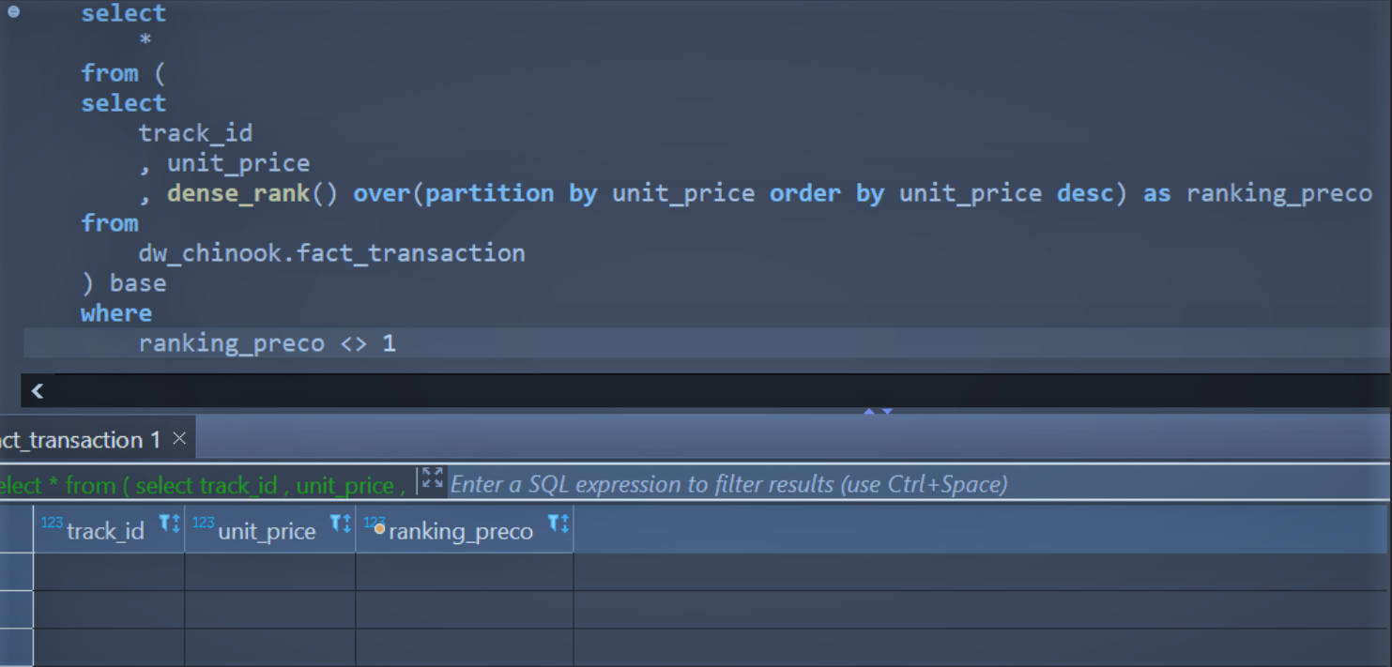


“If I have R$ 1.000.000,00 to invest on music licences, what is the composition of the music portfolio that brings the highest return on investment at the lowest payback?”
Pre Concepts:
All labels are sold buy same price ($ 0.99):
Therefore, Pearson's correlation coefficient is 1 between revenue and quantity of labels sold for a specific label or artist;
As Chinook Music Store sells all the labels by same price, this study assume all labels are bought by same price as well.
Create Your Way Forward.
Chinook Music Investment

Slide 2
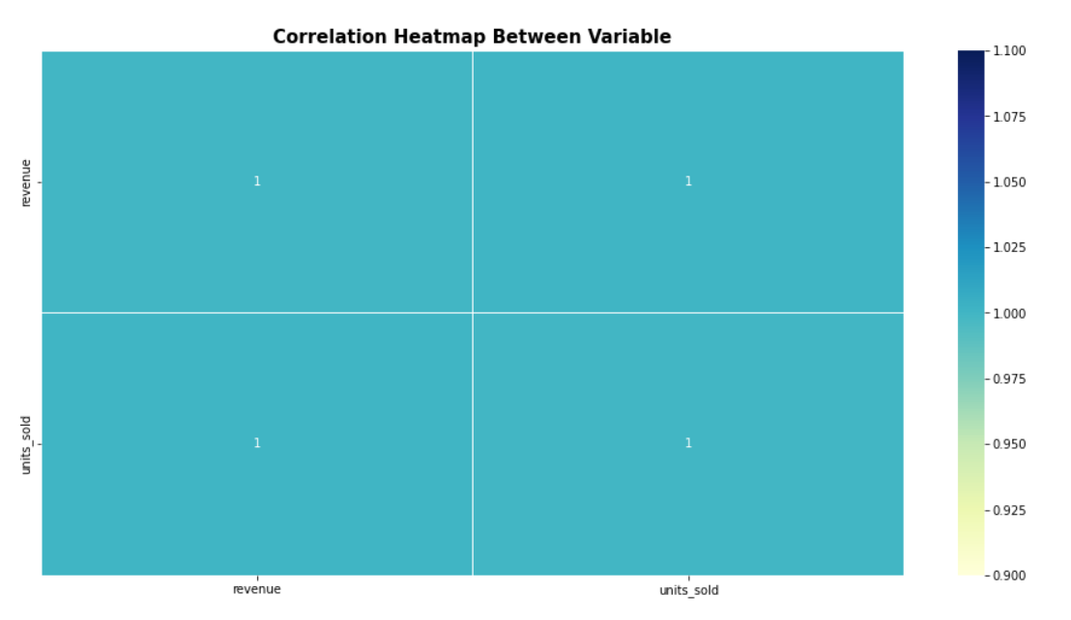
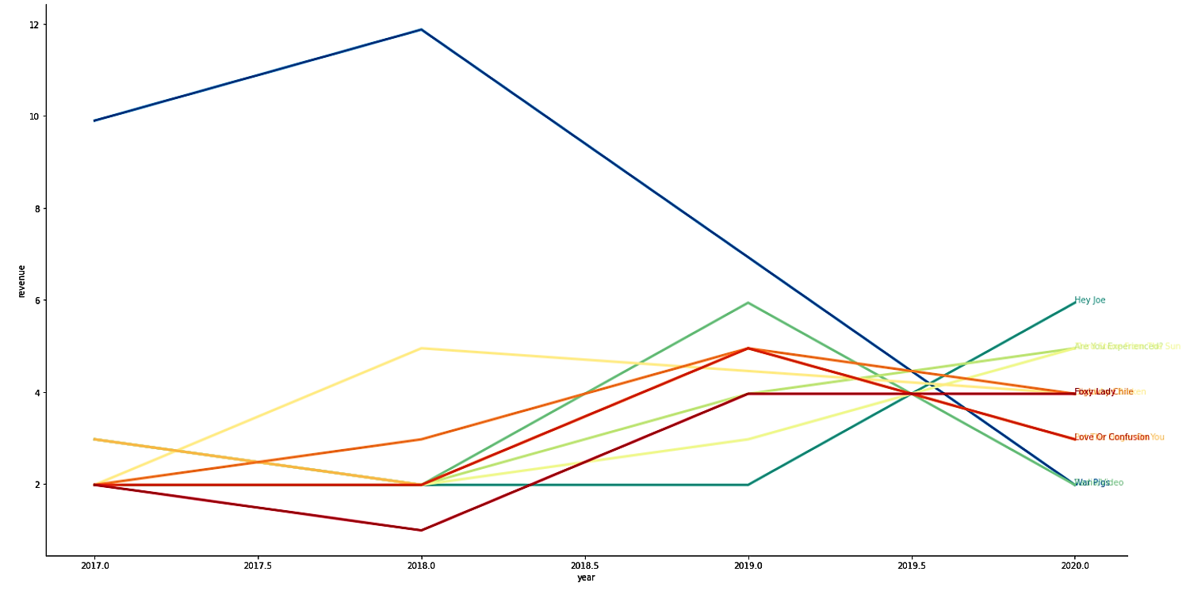
How pick the best labels up to compose the portfolio - part 1
Extract DF with revenue and quantity of units sold per track per year
Extract a DF with the top 10 tracks based on revenue and quantity of units_sold
Merge both DF

Slide 3
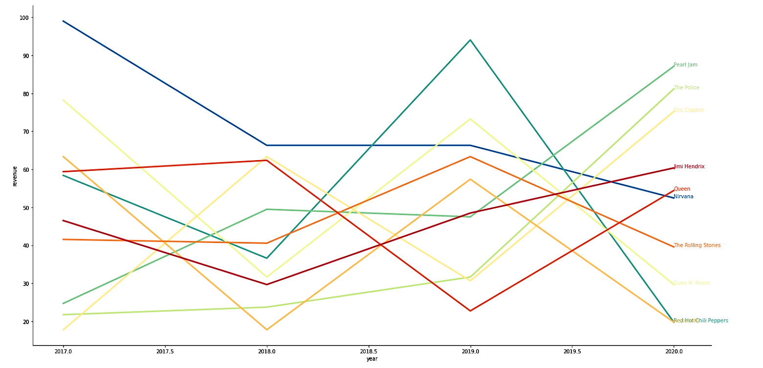
How pick the best labels up to compose the portfolio - part 1
Same was made for artists
Extract DF with revenue and quantity of units sold per track per year
Extract a DF with the top 30 tracks based on revenue and quantity of units_sold
Merge both DF

Slide 4
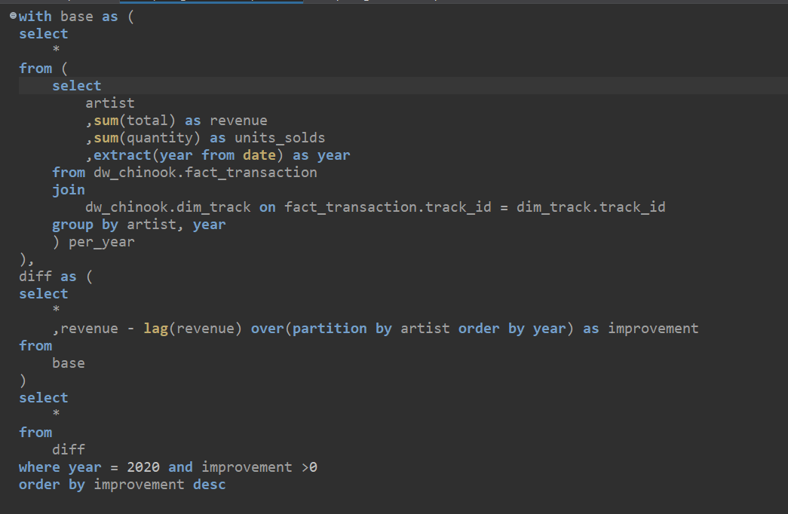
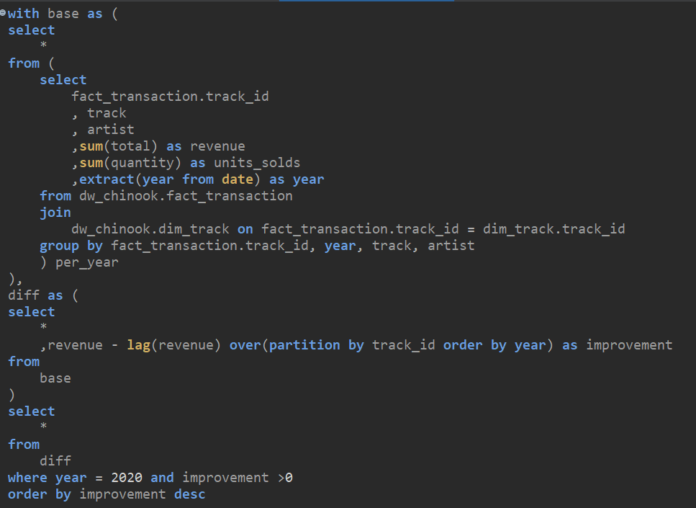
How get the most uptrends labels ?
“Create a column that represents the diff between previous year revenue and the next one.”

Slide 5
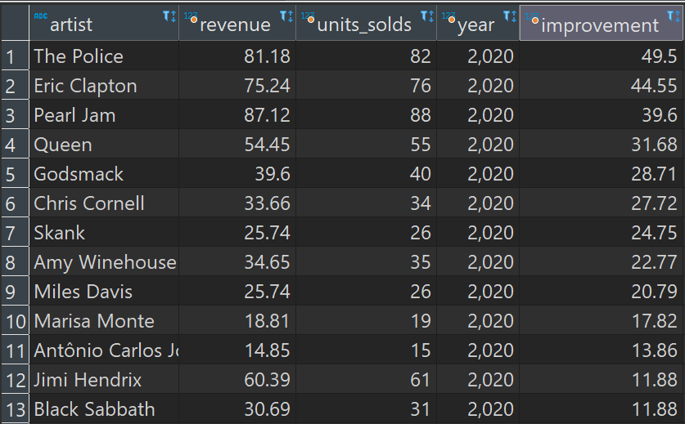
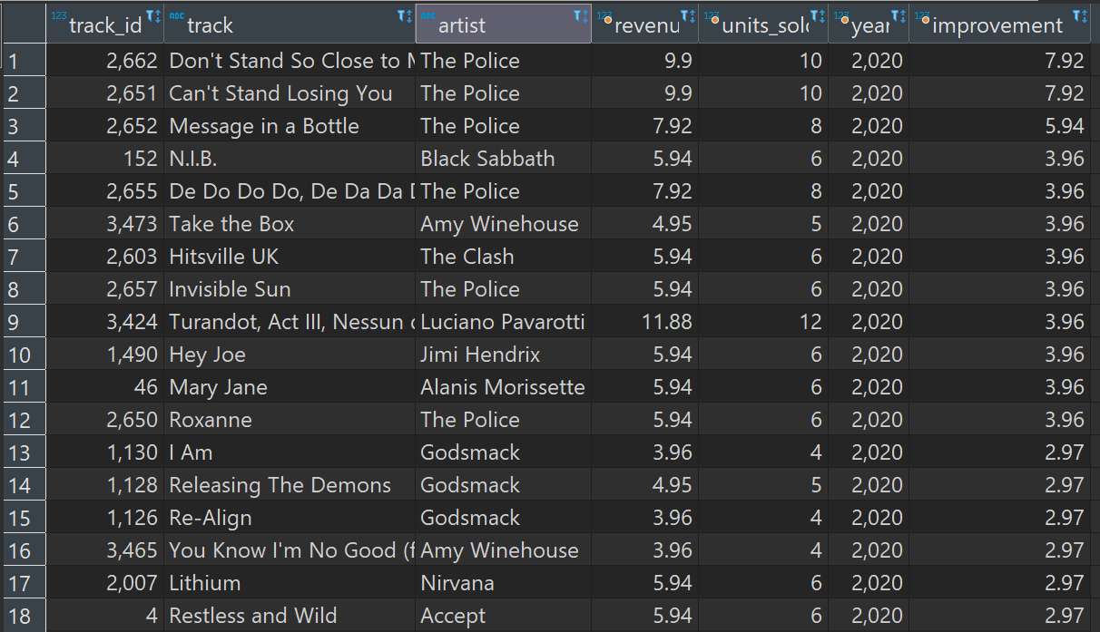
How get the most uptrends labels ?
“Picking 6 uptrends labels of uptrends artists”

Slide 6
Music Portfolio
Music | Artist | Percentage(%)
Don't Stand So Close to Me '86 | The Police | 10
Can't Stand Losing You | The Police | 10
N.I.B. | Black Sabbath | 20
Take the Box | Amy Winehouse | 20
Hey Joe | Jimi Hendrix | 20
I Am | Godsmack | 20
Create Your Way Forward.
Thank you
More Info

