Slide 1
Predicting Vehicle Crash Type from Crash Report Incident
Gabriel Xu, Andrew Chen

Slide 2
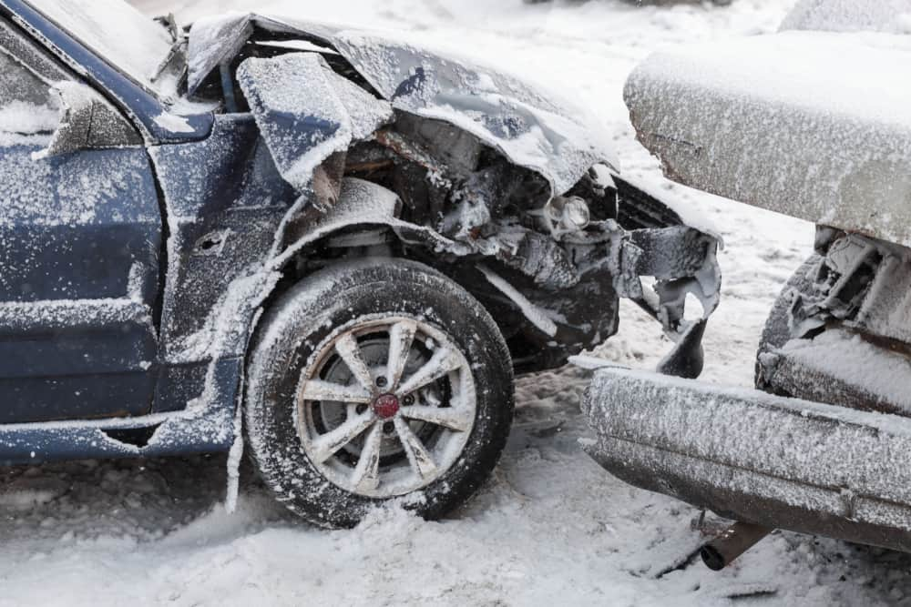
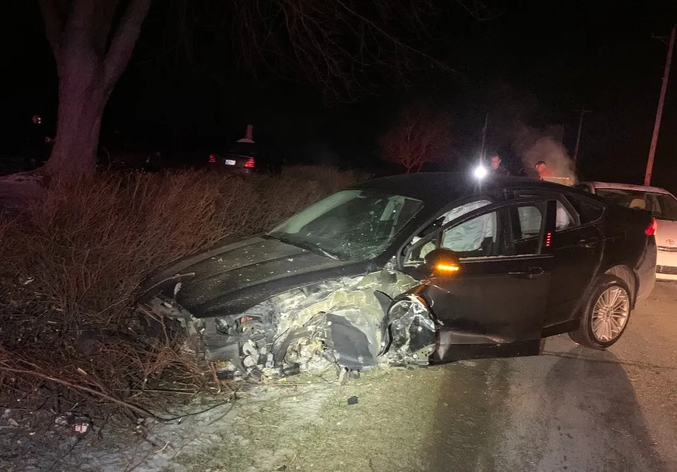
Problem and Background
Vehicle crashes are common, over 6 million per year in the U.S.
Resulted in 40,990 deaths in the U.S. in 2023
In order to prevent this, consider which factors influence the severity of crashes
Allows us to know how better to prevent injuries and fatalities
Identify which locations are more dangerous

Slide 3
Dataset Overview
24241 instances
42 attributes
Vehicle Crashes occurring in the Town of Cary, North Carolina
Classifying instances as “fatalities”, “injury”, or “crash”
Required preprocessing steps
Examples of attributes:
rdsurface
rdcondition
lightcond
weather
trafcontrol

Slide 4
Preprocessing
Removed columns
tamainid
records
contributing_factor
vehicle_type
contrcir1_desc, contrcir2_desc, ...
vehicle3, vehicle4, ...
New/modified columns
num_vehicles
class
ta_time
Normalize data
24241 instances, 20 columns
0.18% fatalities, 13.34% injury, 86.47% crash

Slide 5
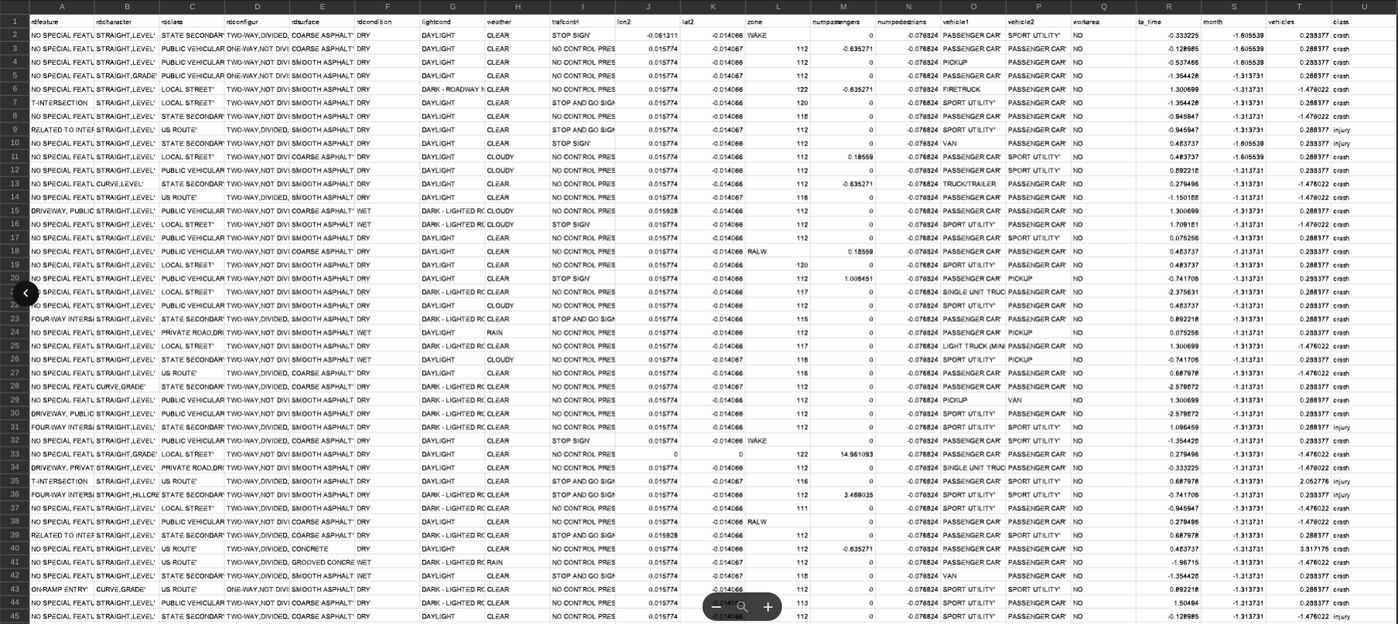
Dataset after Preprocessing

Slide 6
Attribute Selection
CorrelationAttributeEval
InfoGainAttributeEval
ReliefF
CfsSubsetEval
Self-Selected

Slide 7
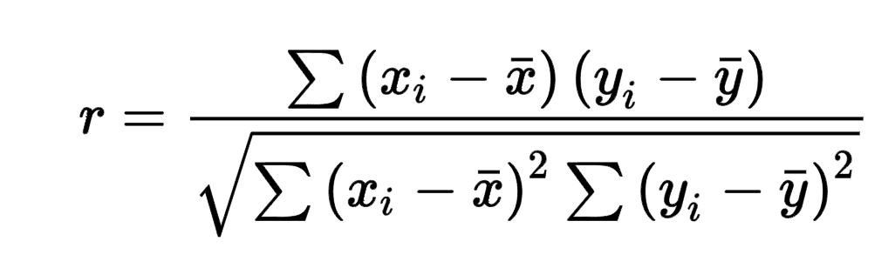
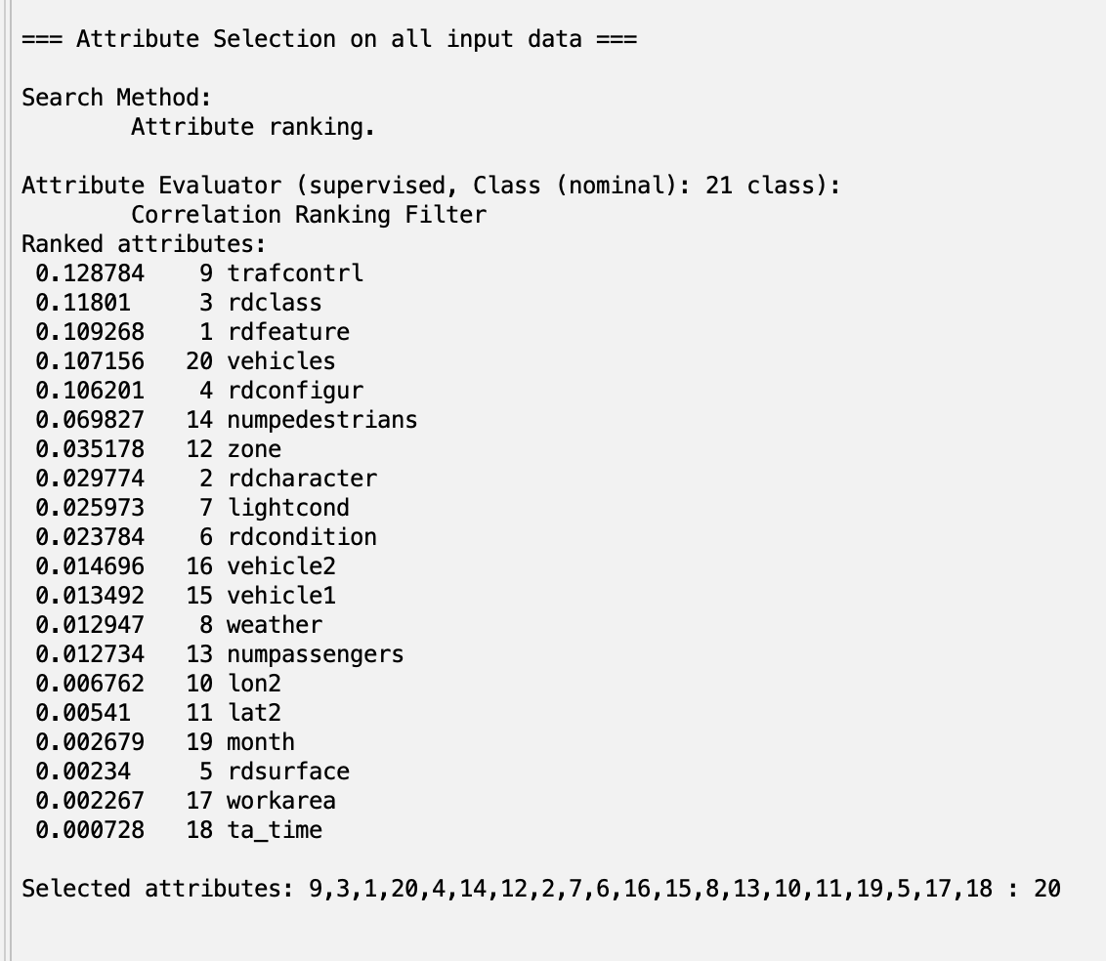
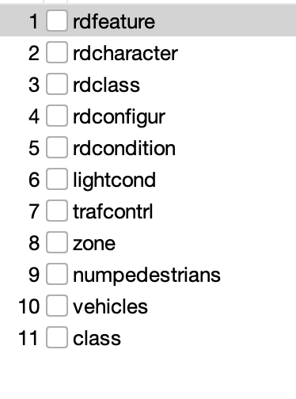
CorrelationAttributeEval
Cutoff value of 0.02

Slide 8
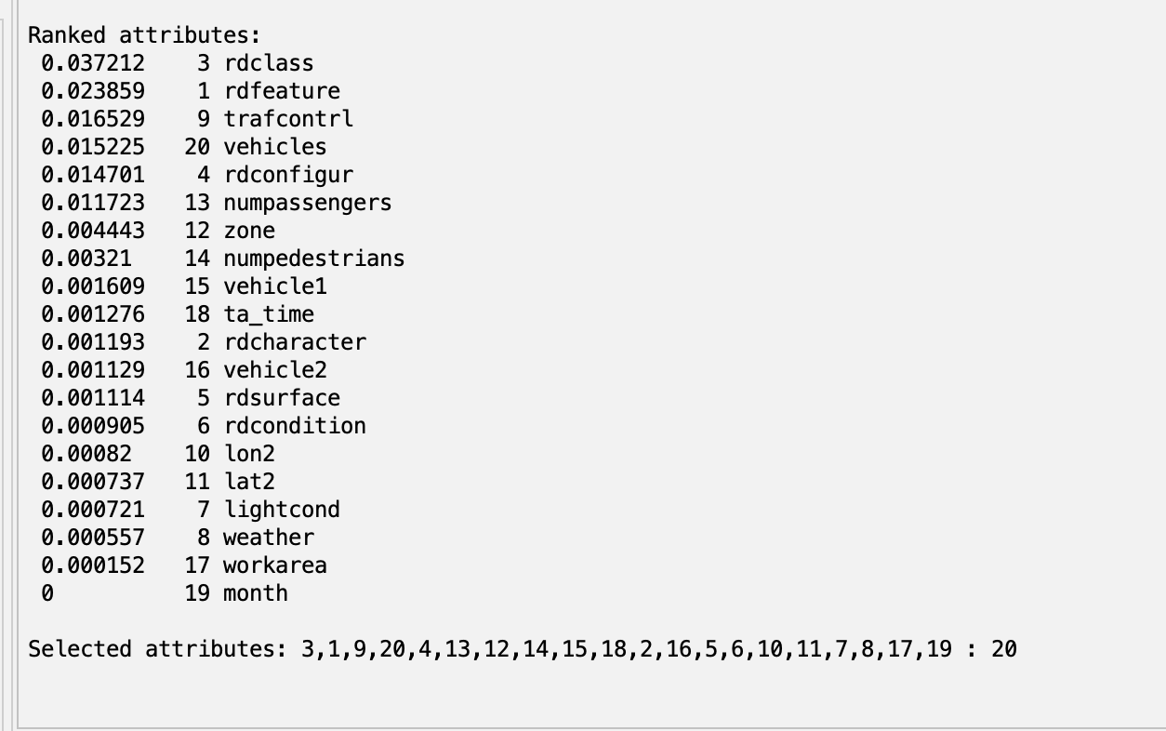
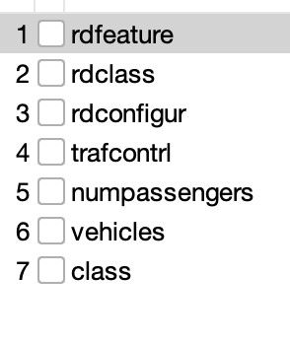
InfoGainAttributeEval
Cutoff value of 0.01

Slide 9
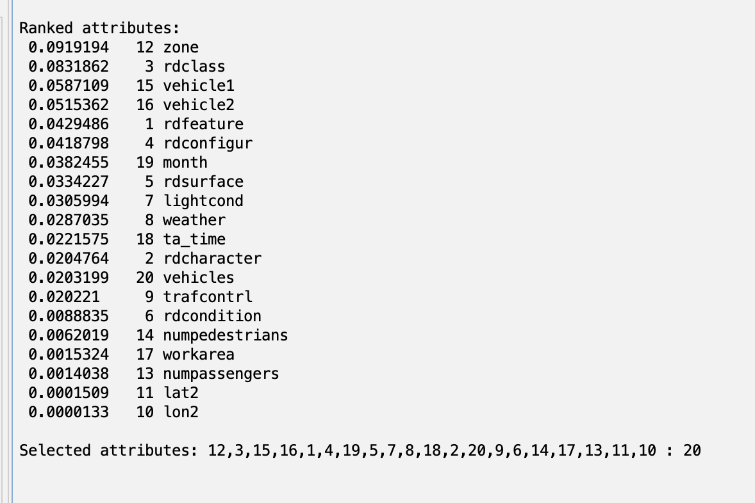
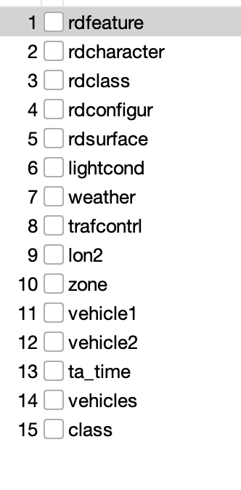
ReliefF
Cutoff value of 0.02

Slide 10
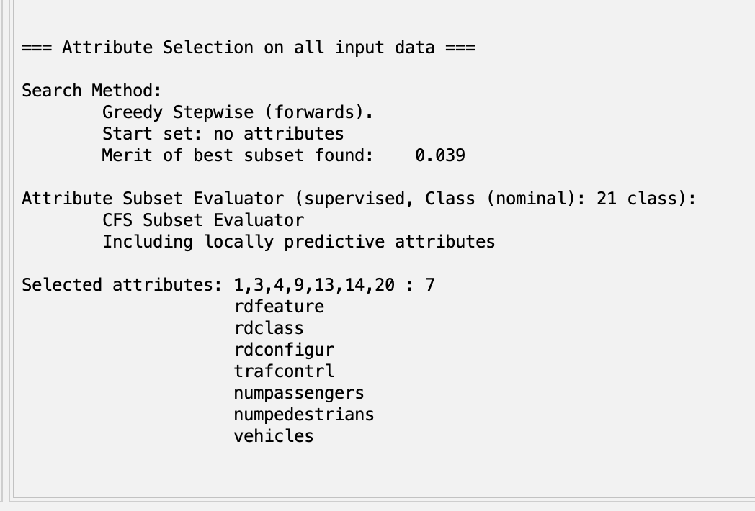
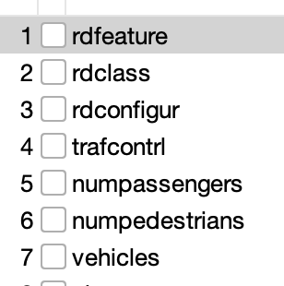
CfsSubsetEval

Slide 11
Self-Selected
1) weather
2) trafcontrl
3) lightcond
4) rdcondition (Road Condition)
5) rdfeature
6) vehicle1 and vehicle2
7) numpassengers
8) numpedestrians

Slide 12
Classifier Models
K-fold cross-validation
Naive Bayes
A probabilistic classifier based on Bayes’ theorem, assuming feature independence
J48
Builds decision tree by repeatedly splitting data based on attribute with the highest information gain
RandomForest
Constructs multiple decision trees using random subsets of data and features, then aggregates votes
DecisionTable
Summarizes data patterns by building and organizing conditions and corresponding actions in a table
OneR
Selects the single best-performing feature and builds a simple rule based on it

Slide 13
Results (Accuracy)
 | Naive Bayes | J48 | Random Forest | Decision Table | OneR
Self-Selected | 85.12% | 86.47% | 85.18% | 86.44% | 86.44%
CorrelationAttributeEval | 82.76% | 86.47% | 84.89% | 86.46% | 86.43%
InfoGain | 85.05% | 86.47% | 85.74% | 86.45% | 86.44%
ReliefF | 84.44% | 86.46% | 84.32% | 86.43% | 86.43%
CfsSubsetEval | 85.04% | 86.47% | 85.76% | 86.45% | 86.43%

Slide 14
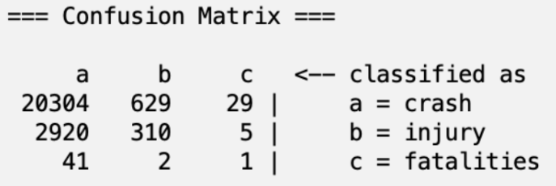
Conclusion and Future Work
Best model was CfsSubsetEval with Naive Bayes
85.0519% Accuracy
0.85 TPR
0.785 FPR
0.799 Precision
0.850 Recall
0.814 F-Measure
0.114 MCC
Injury and fatality classes have TP rate
Tradeoff between majority and minority classes
Address class imbalance

Slide 15
Questions?

