Slide 1

BIG DATA PRESENTATION
Professor: Mr. Min Sothearith
Presenter: Mr. Chang Tong & Ms. Chea Lina
UrbanCart Analytics Term Project
Customer Value, Product Profitability, and Data Trustworthiness

Slide 2
What We'll Cover
01
The Three Business Questions
02
From Raw Data to Trustworthy Data
Why UrbanCart commissioned this analysis
Three messy sources, one reconciled picture
03
SQL Extraction
04
NumPy Analytics
10 queries — and an honest note on tooling
RFM, similarity, regression, Monte Carlo — built by hand
05
8 Findings
06
Recommendations
What the data actually says
What UrbanCart should do next
2

Slide 3
Three Questions From Leadership
Q1
Q2
Q3
Which customers are worth investing in?
Which products are actually profitable?
Can our own data be trusted?
Revenue alone doesn't say who's loyal vs. who bought once and left.
High sales volume isn't the same as high margin after discounts and returns.
Three sources were never designed to be combined — legacy CRM, supplier catalog, live database.
3

Slide 4
DATA DESCRIPTION
The Data Behind This Analysis
2,500
300
9,000
Customers
Products
Orders
20,362
4,000
12,000
Order Line Items
Reviews
Web Sessions
Three sources: a live SQLite database, a legacy CRM export (1,427 rows, 4 date formats, ~48 duplicate emails), and a supplier product catalog (266 SKUs, 255 overlapping with the database). Jan 2022 – Dec 2024, 9 countries.
4

Slide 5
METHODOLOGY
SQL Extraction — 10 Business Queries
Ten SQL queries were written against ecommerce.db to extract the tables used throughout this analysis — covering revenue by category, top customers, month-over-month trends, return rates, engagement patterns, and more.
A NOTE ON TOOLING
My local SQLite setup wasn't running queries correctly through the usual client, so I ran the queries directly from the terminal instead.
1. Revenue, order count & AOV by category
6. Top-rated products (≥15 reviews)
2. Top 20 customers by lifetime spend
7. Session engagement by device
Terminal output isn't formatted as a readable table by default, so I used an AI agent to help parse and rebuild the raw output into clean, readable tables for further analysis and for this presentation.
3. Month-over-month revenue trend (LAG())
8. Product revenue RANK() within category
4. Return rate by category
9. Payment-method mix by country
5. Customers active in all of the last 3 quarters
10. Own question: highest-margin category by country
The queries and underlying results are unaffected — this was a formatting and workflow step, not a change to the analysis itself.
5

Slide 6
CLEANING & INTEGRATION
Getting the Data Ready to Trust
4 date formats → 1
Legacy signup dates standardized into a single datetime column
1,427 → 1,377 rows
Junk, blank, and duplicate customer records removed (48 duplicate emails resolved)
3 outliers flagged
Product prices reviewed via IQR method — flagged, not dropped
255 of 267 SKUs matched
Supplier catalog reconciled with internal product table; 12 SKUs exist only in the catalog
186 duplicates removed
Exact-duplicate order line items identified and removed
6

Slide 7
NUMPY ANALYTICAL METHODS
Four Routines, Built From First Principles
No pandas.qcut, no sklearn shortcuts — every routine implemented directly on NumPy arrays, then validated against a library function used only to verify.
RFM Segmentation
Product Similarity
Recency, Frequency, Monetary scored via np.percentile + np.digitize, combined into a single loyalty score.
cos(A,B) = (A·B) / (‖A‖‖B‖) — computed via matrix multiplication for every product pair at once.
Validated vs. pandas.qcut
Validated vs. sklearn cosine_similarity (diff ≈ 0)
Regression (Normal Equation)
Monte Carlo Simulation
β = (XᵀX)⁻¹Xᵀy, solved exactly with np.linalg.inv — R² computed by hand.
5,000 simulated demand trials per product via np.random.normal — stockout probability + 95% CI.
Validated vs. sklearn LinearRegression
Validated against a trivial known-outcome case
7

Slide 8
05
Eight Findings
What the cleaned data actually says, backed by a chart and a number for each.

Slide 9
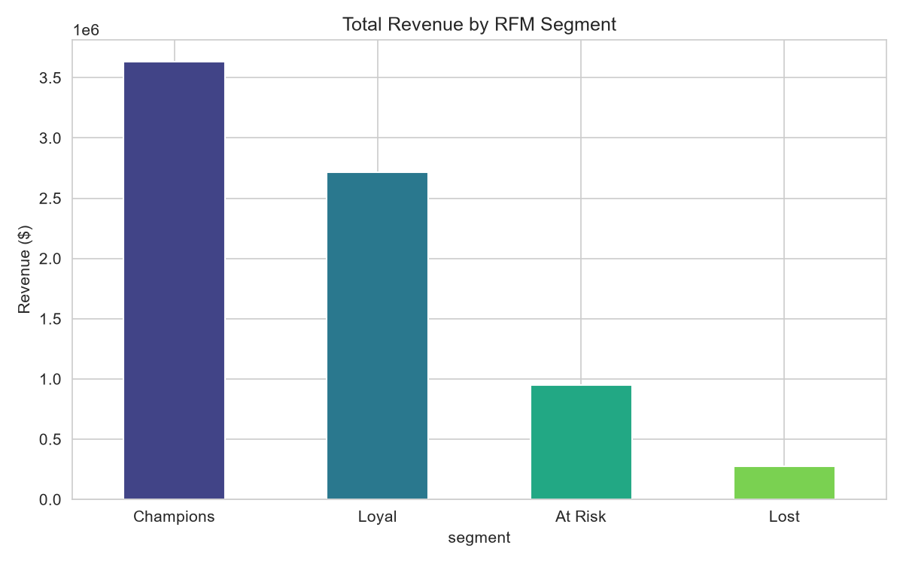
FINDING 1 OF 8
Best Customer Segment: Champions
REVENUE SHARE
48%
“Champions” are just 504 of 2,191 purchasing customers (23%) but generate $3.63M — nearly half of all revenue. They aren't demographically distinct (same age, same top country as everyone else). This is a behavioral story, not a demographic one.
9

Slide 10
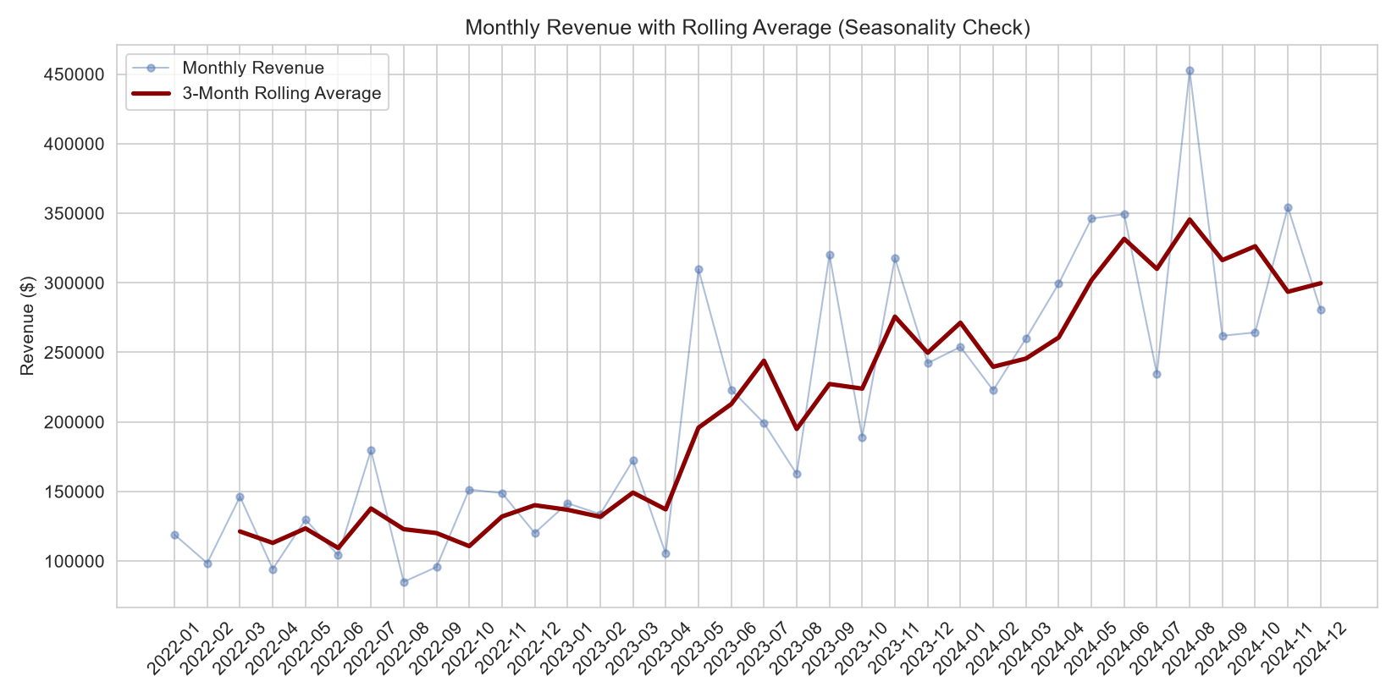
FINDING 2 OF 8
Revenue Is Seasonal, Not Flat
BEST VS. WORST MONTH
+80%
November averages $273,696 in revenue; February averages just $151,670 — a swing of roughly 80%. The 3-month rolling average confirms this repeats every year. Inventory and staffing plans should not assume flat monthly demand.
10

Slide 11
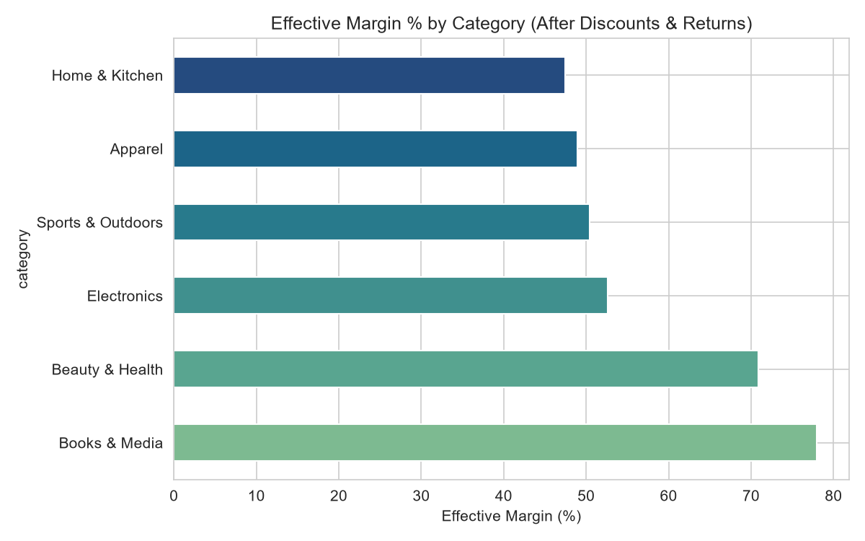
FINDING 3 OF 8
Books & Media Wins on Margin
TOP CATEGORY MARGIN
77.95%
Books & Media leads on effective margin after discounts and returns — well ahead of Beauty & Health (70.9%) and far ahead of Electronics, Apparel, Sports, and Home & Kitchen (47–53%). Revenue rank and margin rank tell different stories.
11

Slide 12
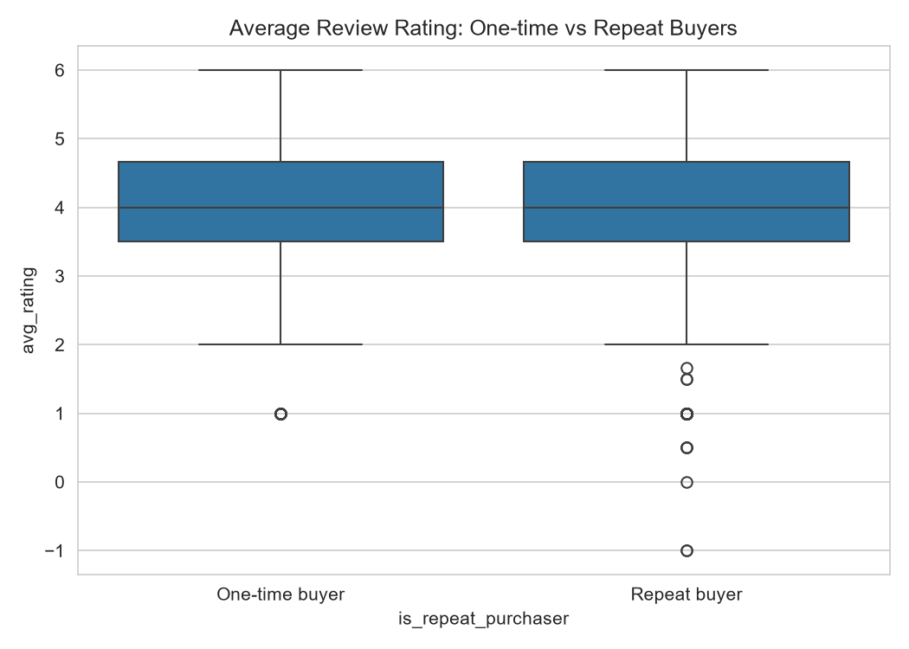
FINDING 4 OF 8
Ratings Don't Predict Loyalty
RATING ↔ REPEAT CORRELATION
0.036
The correlation between a customer's average rating and how often they buy is essentially zero. Repeat buyers rate only marginally higher (3.96 vs 3.93). Retention strategies built on “improve ratings to drive loyalty” aren't supported here.
12

Slide 13
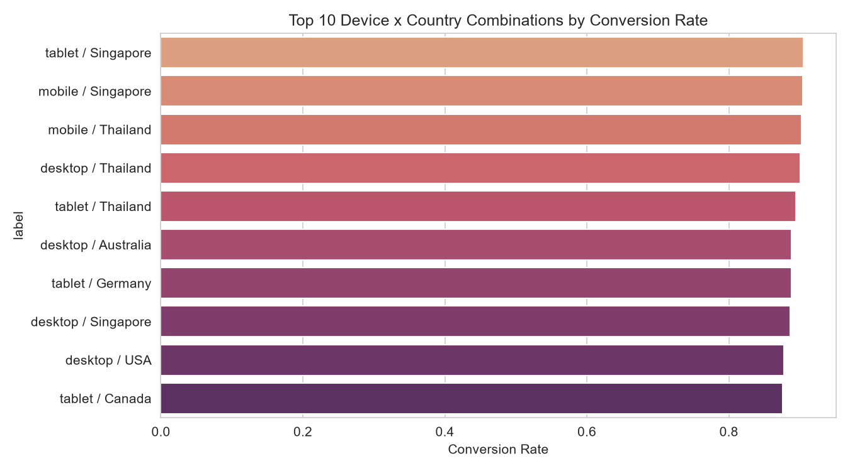
FINDING 5 OF 8
Tablet + Singapore Converts Best
TOP CONVERSION RATE
90.5%
Tablet sessions from Singapore convert at 90.5% — the best of any device×country pairing. The USA, UrbanCart's largest market, converts lower at 87.8%. The biggest market isn't the most efficient one.
13

Slide 14
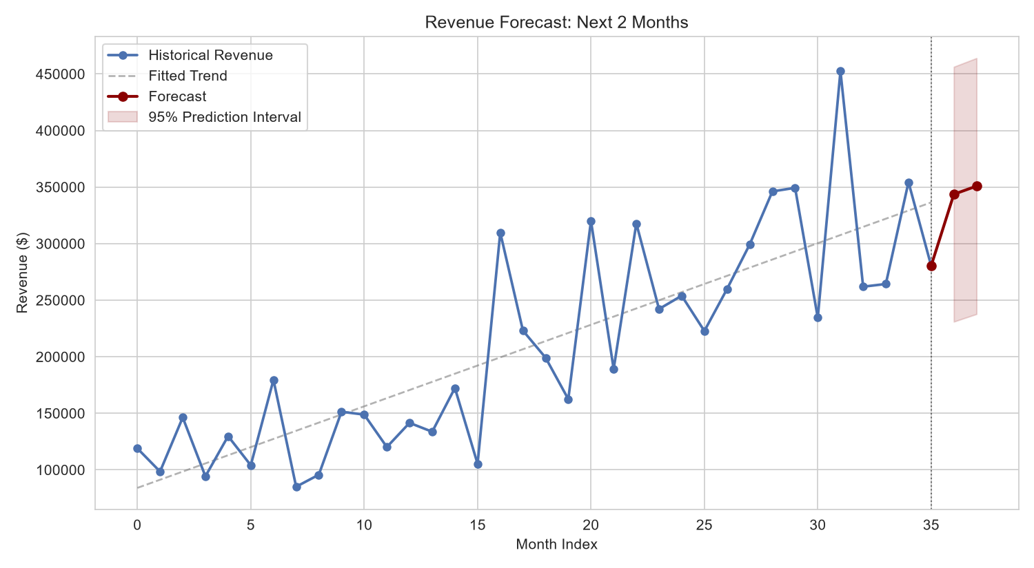
FINDING 6 OF 8
Revenue Forecast: Next 2 Months
MODEL FIT (R²)
0.667
The linear trend explains two-thirds of month-to-month variation. Next 2 months are projected at $343,660 and $350,871, with a wide 95% interval ($231K–$456K) — a reasonable floor estimate given known seasonality.
14

Slide 15
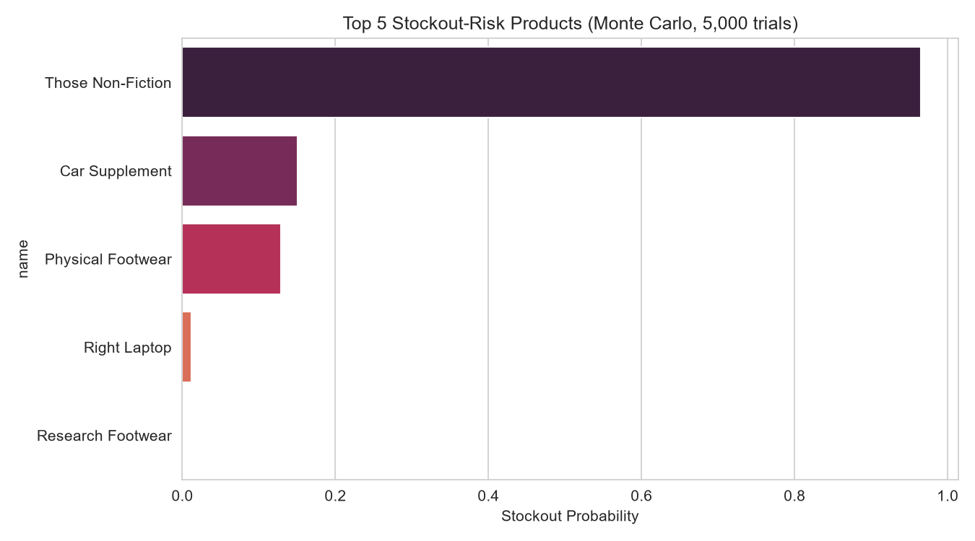
FINDING 7 OF 8
Top Stockout Risk: Zero Stock
“THOSE NON-FICTION” STOCKOUT PROB.
96.5%
This Books & Media product currently holds zero units of stock against historical demand of ~1.9 units/month. This is an immediate, actionable gap — not a forecasting nuance. Recommended reorder point: ~4 units.
15

Slide 16
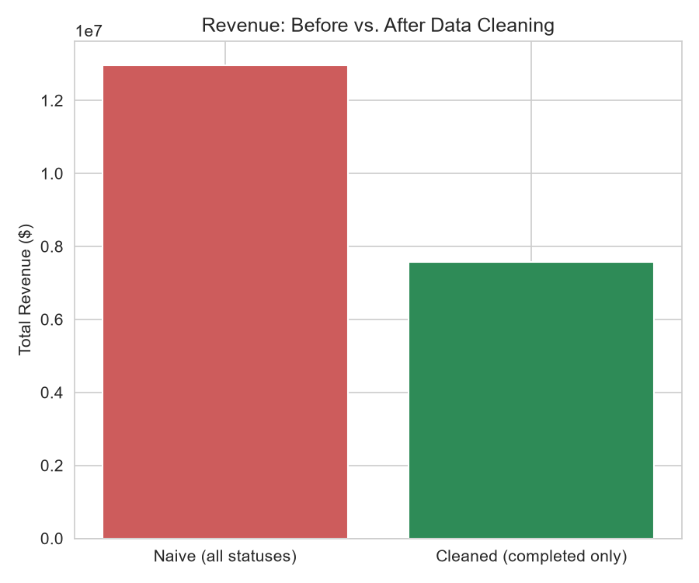
FINDING 8 OF 8
A 71% Revenue Overstatement
OVERSTATEMENT IF UNCLEANED
71.3%
Counting cancelled, returned, and pending orders as real sales overstates revenue by 71% ($12.97M vs. the real $7.57M). 43% of all orders never completed. Any past decision built on raw order totals was likely built on nearly double the truth.
16

Slide 17
RECOMMENDATIONS
What UrbanCart Should Do Next
1
Fix revenue reporting now
Filter every report to completed orders only — corrects the 71% overstatement immediately.
2
Reorder “Those Non-Fiction”
Zero stock against a 96.5% stockout probability. Not a forecast — an active gap.
3
Build retention around Champions
48% of revenue from 23% of customers, identifiable only by RFM behavior, not demographics.
4
Shift budget toward Q4
November outperforms February by ~80%. Stop planning around flat monthly demand.
5
Re-test rating-based loyalty bets
0.036 correlation between rating and repeat purchase — look elsewhere for the real driver.
17

Slide 18
REUSABLE PIPELINE
One Command, Start to Finish
Every table, analysis, and chart in this deck can be regenerated from the three raw input files in under 3 seconds — handed off, rerun next quarter, or audited by anyone.
1
2
3
4
Extract
Clean
Analyze
Visualize
Load DB + CSVs, run all 10 SQL queries
Dates, dedup, missing values, merges
RFM, similarity, regression, Monte Carlo
8 charts + summary, saved to figures/
python run_pipeline.py
18

Slide 19
URBANCART ANALYTICS TERM PROJECT
Thank You
Questions & Discussion

