Slide 1

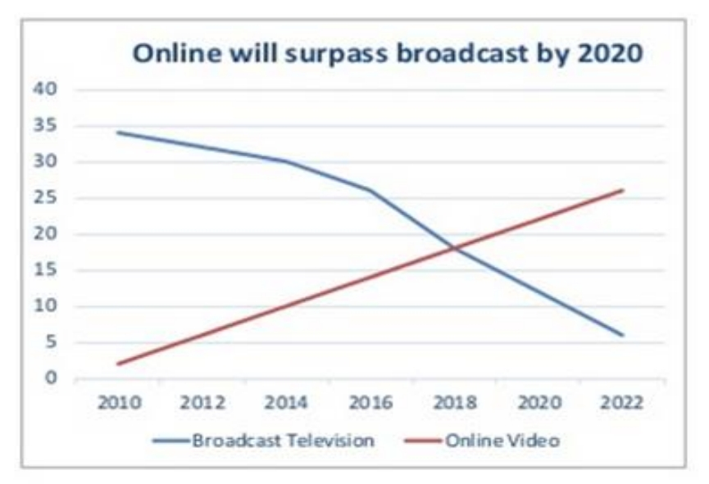
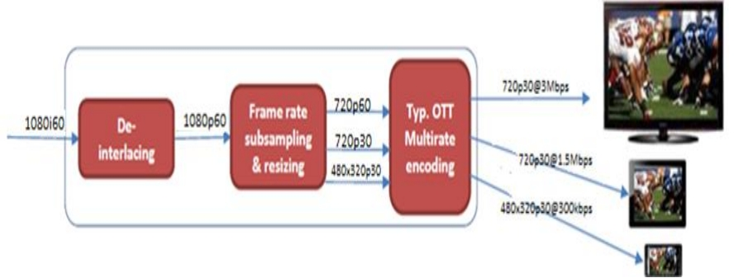
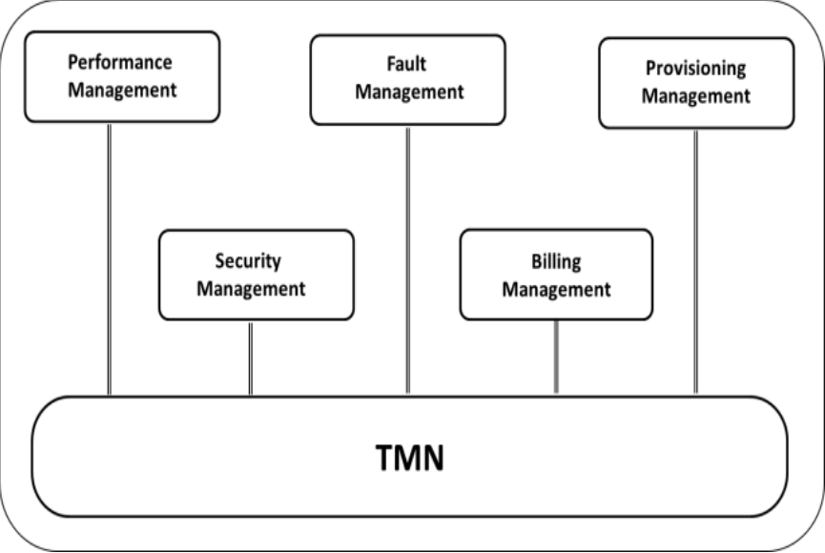
What Will 5G Be? Trends for nanotechnology, video
systems, networks management, radio frequency,
spectrum management, and regulation in Brazil
Yuzo Iano, Abel Dueñas, Angelo Moretti, Cibele A. Makluf, Diego Pajuelo, Eduardo Camargo, Hermes J. Loschi, Julio León,
Paulo E. R. Cardoso, Silvio R. M. de Carvalho, and Telmo C. Lustosa.
School of Electrical Engineering
University of Campinas
Introduction
With this new concept of television, future
Spectrum Management and
Regulation
networks are going to be converged in a
same idea, how to make accessible to all
During 2014, preliminary interest and discussions about a possible 5G standard have evolved into a full fledged conversation that has captured the attention and imagination of researchers and engineers around the world.
the people this new addressed content for the next years. The solution has to cover all the parties, Government, Internet Service Providers, OVDs, Mobile Network Operators (MNOs), and Technology Providers. All these efforts would converge in a new 5G standard that is being developed by great part of the best companies in the world and engineering associations.
Spectrum management’s point of view that 5G demands a very wide range of frequencies. This significant change in the spectrum band being used means it will be possible allocate a large number of channels, which together can occupy a bandwidth of up to 1 GHz, unthinkable in bands currently used today.
This article is an attempt to summarize and overview the development of network management, radio frequency and video systems, including nanotechnology.
Nanotechnology
According to Fig. 2, the preference of the users for dynamic video year-by-year is increasing in linear way and is decreasing with a steep slope for Digital Television Systems.
The Internet Marco Civil includes important issues for 5G, that the regulatory point of view is the Personal Mobile Service (Serviço Móvel Pessoal – SMP) and the Multimedia Communication Service (Serviço de Comunicação Multi- mídia – SCM). In this context, network neutrality, privacy, and the right to information are legal issues that technological development should
Nanotechnology will impact both in mobile devices as the core of the network. Mobile devices, along with the intelligence embedded in human environments, will create a new platform that enables ubiquitous sensing, computing, and communication. With the use of nanotechnology, mobile devices can act as smart sensors, with applications in the most diverse sectors.
include.
Final Considerations
Video Systems
5G represents the overcoming of challenges of extremely high data rate, zero-latency (ms level), extremely high density connectivity, extremely high density of traffic volume, and extremely high mobility.
A big problem in the television services is the diversification produced by the existences of different standards. This lead to improvements on the STBs instead of leading development into better quality of experience, better resolutions or higher frame rate.
Fig 2 – User Preference Forecast until 2022 [4]. The challenges of Dynamic Television in a
5G network will be to transmit Ultra High Definition; temporal resolution better than 60 FPS; higher perceptual quality; bit depth of 10, 12, and 14 bits; and a better adaptive streaming mechanism to handle dynamic adjustment in a 5G environment.
As this article has highlighted, it is a long road ahead to truly disruptive 5G networks. Many technical challenges remain spanning all layers of the protocol stack and their implementation, as well as many intersections with regulatory, policy, and business considerations.
Over-The-Top (OTT) Television is a digital service that consists in transmitting video content peer-to-peer over the Internet without control/management of the Internet Service Provider (ISP). The road is a combination of a Content Delivery Networks (CDN) and Internet per se.
Network Management
All 5G network equipment should be connected, directly or through intermediaries, to the data network TMN. Operating systems should be developed aiming to support teams of central management, maintenance teams, and the various users on various administrative and financial functions. In terms of management functions, a 5G network must have, at a minimum, the functions shown in Fig. 3
Therefore, the first approach towards 5G should be about Broadcast Solutions. After that, ensuring a high data rate (50Gbps) should be the focus. Thirdly, the end-to-end delay must be reduced by 5 times, compared to the current delay in 4G. Besides that, 5G should be also addressed to maximize the backbone network's capability for more
As can be shown in Fig 1, the process is very simple and intuitive beforehand
simultaneous peer-to-peer sessions. Finally, 5G should ensure improve Quality of Experience, be universal and open access.
Fig 1 – OTT System
References
The difference between these type of technology, used by Youtube or Netflix, and Digital Television Systems is the UE because of their hardware-flexibility and software-oriented market.
1. J. G. Andrews, S. Buzzi, W. Choi, S. V. Hanly, A. Lozano, A. C. K. Soong, and J. C. Zhang, “What will 5G be?,” IEEE J. Sel. Areas Commun., vol. 32, no. 6, pp. 1065–1082, 2014..
A new concept of television called Dynamic television or Online Television is promising to be the new universal service.
2. J. Calabuig, J. F. Monserrat, and D. Gomez-Barquero, “5th generation mobile networks: A new opportunity for the convergence of mobile broadband and broadcast services,” IEEE Commun. Mag., vol. 53, no. 2, pp. 198 –205, 2015.
3. Y. Liu and X. S. Shen, “Cognitive Resource Management for Heterogeneous Cellular Networks,” 2014
Fig 3 – TMN – Functional Areas
4. Lei 12.965/2014 - Estabelece princípios, garantias, direitos e deveres para o uso da Internet no Brasil
Brazilian Technology Symposium (BTSym’20)
October 26th, 27th and 28th, 2020

