Slide 1




A Sidescroller Game by Ted‘s Entertainment

Slide 2

Abstract
Reflect Idea
Management
Methodology
Strategy
Quality
Testing
Technical Aspects

Slide 3


Reflect Idea
Sidescroller game
Main character
Enjoyable and simple game
11.12.2019
1

Slide 4
Management
Rational Unified Process (RUP)
YouTrack
Time Management
Quality Management
Change Management
Issue Management
Procedure Management
SRS- and SAD-file
11.12.2019
2

Slide 5
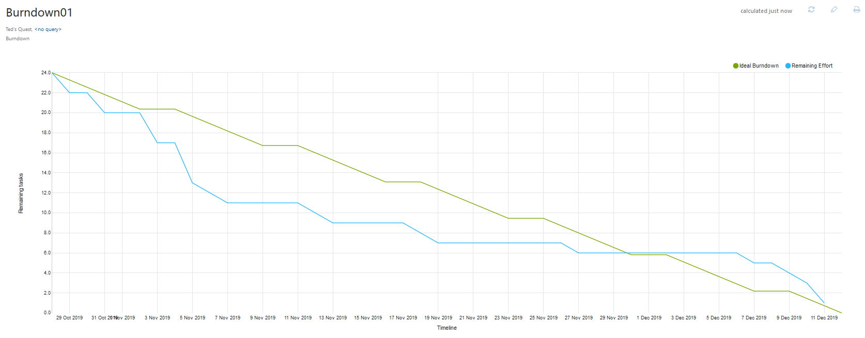
November
Dezember
11.12.2019
3

Slide 6
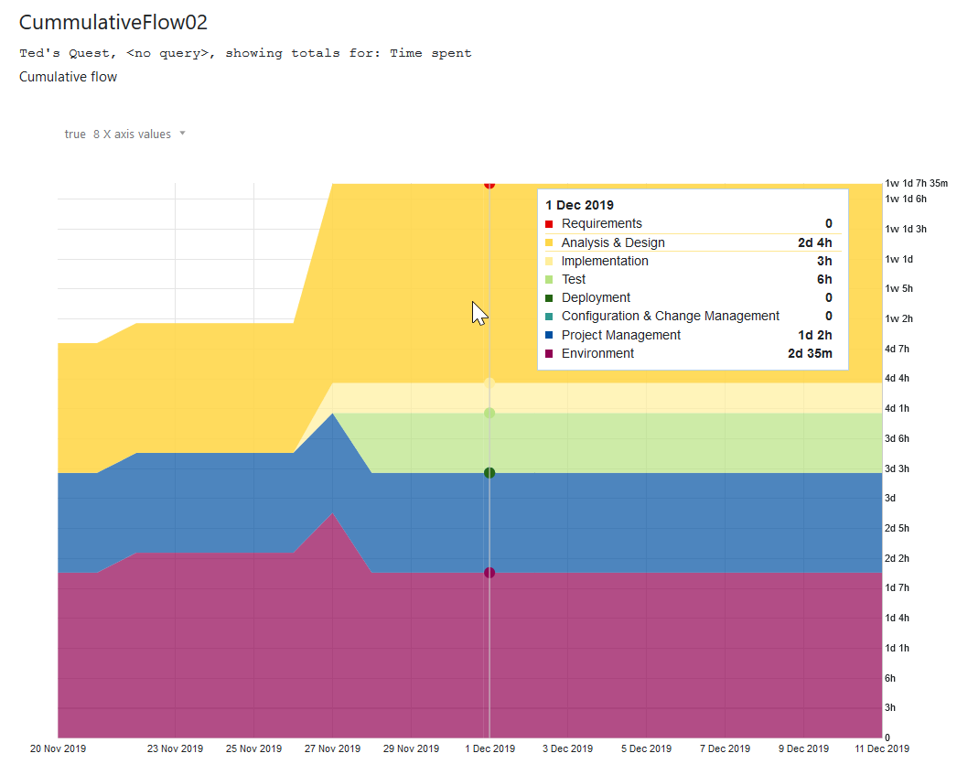
11.12.2019
4

Slide 7
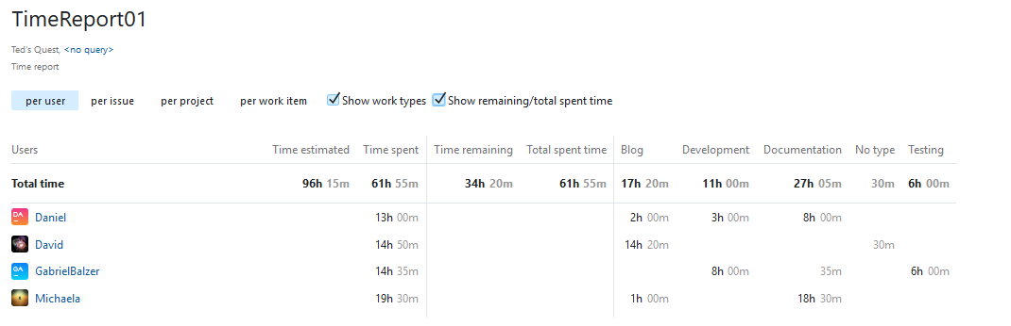
https://dhbw-karlsruhe.myjetbrains.com/youtrack/reports/time/141-2?line=issue&print&workType&remainingTime
https://dhbw-karlsruhe.myjetbrains.com/youtrack/reports/gantt/148-0?view=actual
11.12.2019
5

Slide 8
Methodology
Agility
Scrum-based Management
(https://dhbw-karlsruhe.myjetbrains.com/youtrack/dashboard?id=f29a1b9e-a4f4-4c06-8ad9-c7f0e6cc7e58 )
11.12.2019
6

Slide 9
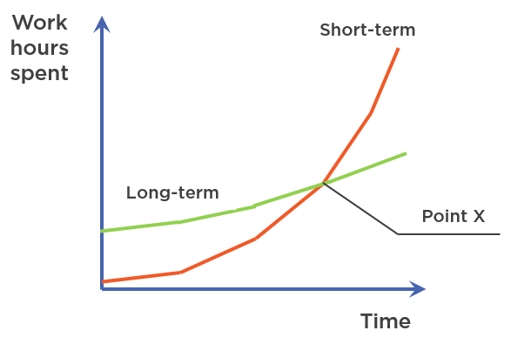
Strategy
short-term
Blog Continue Development
long-term
Blog Scrum Small steps for great efficiency Regularity
https://enterprisecraftsmanship.com/images/2017/2017-08-17-2.png
11.12.2019
7

Slide 10

Strategy
First Level Development:
Game for Computer
1-2 manually crafted Levels
Second Level Development
Game for Android Smartphone
Infinite Mode
Additional manually crafted Levels
Third Level Development
Automatically generated Levels
Store for Clothing and Weapons
https://ak5.picdn.net/shutterstock/videos/7060045/thumb/3.jpg
11.12.2019
8

Slide 11
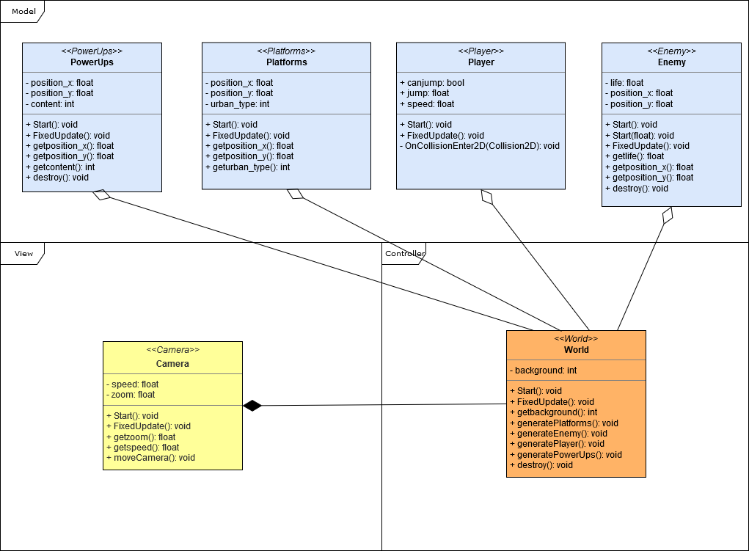
Quality
MVC-based Architecture Model
Configuration Management (https://dhbw-karlsruhe.myjetbrains.com/youtrack/issue/TQ-15 )
Automatically self-updating tools (YouTrack, GitHub)
11.12.2019
9

Slide 12
Testing
11.12.2019
10

Slide 13
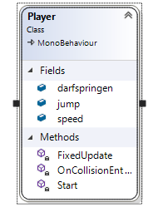
Technical Aspects
11.12.2019
11

Slide 14
Technical Aspects
Demo Game
11.12.2019
12

Slide 15
Technical Aspects (Use Cases)
Main Menu:
https://github.com/GabrielBalzer/hypercasualgame/blob/master/documentation/UC_Mainmenu.md
Settings:
https://github.com/GabrielBalzer/hypercasualgame/blob/master/documentation/UC_Settings.md
Story Menu:
https://github.com/GabrielBalzer/hypercasualgame/blob/master/documentation/Activity_dia_storymenu.png
Jump:
https://github.com/GabrielBalzer/hypercasualgame/blob/master/documentation/Activity_dia_jump.png
Move Right:
https://github.com/GabrielBalzer/hypercasualgame/blob/master/documentation/Activity_dia_moveright.png
11.12.2019
13

Slide 16
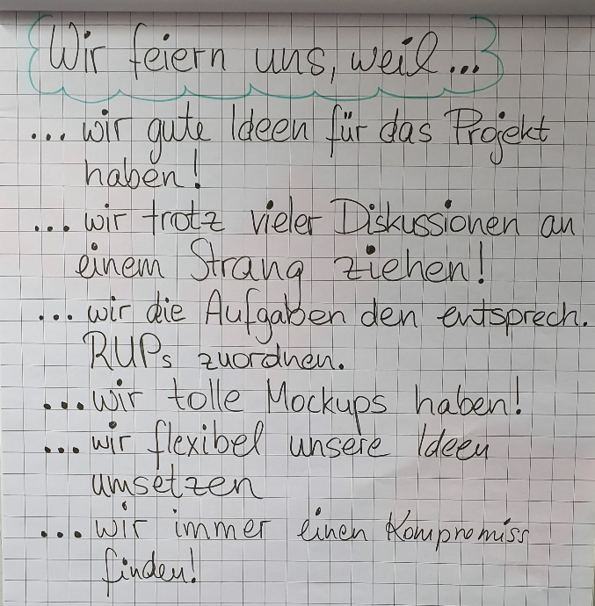
11.12.2019
14

