Slide 4
A
B
C

Slide 5
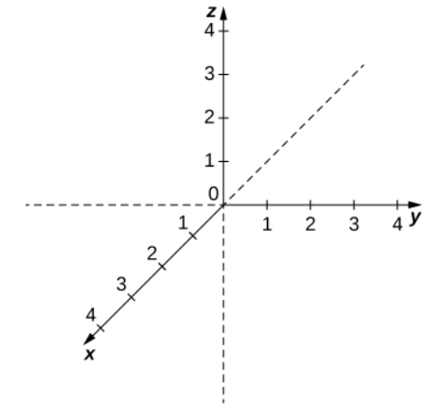

Slide 8














$$r=1$$
$$r=2$$
$$r=3$$
$$r=4$$
$$a$$
$$a$$
$$a$$
$$a$$
$$b$$
$$b$$
$$b$$
$$c$$
$$b$$
$$c$$

