Slide 1
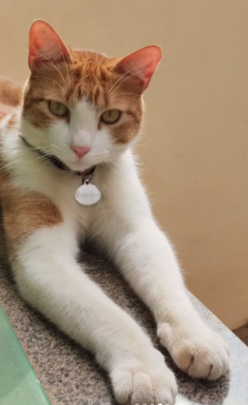
CLIP - Radford et al., OpenAI, ICML 2021 · ViT-B/32 configuration
Multi-Head
Self-Attention
↓
MLP
↓
LayerNorm
(×12 layers)
[CLS]
Token Extraction
1 x 768
Projection Head
· L₂ Norm
1 x 512
Image
Embedding
I ∈ ℝ⁵¹² ‖I‖ = 1
49 patches + [CLS] Token & PosEmb × 768
224 x 224 x 3
Split into 32×32 patches
Cosine Similarity Matrix · InfoNCE Loss
“An orange cat on a balcony.”
/
[SOS] An orange cat on a balcony [EOS]
Causal Self-Attention
↓
MLP
↓
LayerNorm
(×12 layers)
BPE Tokenizer
Byte-Pair Encoding; vocabulary size 49,152
Token Embedding · PosEmb
seq_len × 512
[EOS]
Token Extraction
1 x 512
Projection Head
· L₂ Norm
1 x 512
Text
Embedding
T ∈ ℝ⁵¹² ‖T‖ = 1

Slide 2

Qwen-VL - Bai et al., Alibaba DAMO Academy, 2023 · ViT-bigG/14
LayerNorm
Q, K, V proj
Split heads
Self-Attention
+ Residual
LayerNorm
FFN Gate (GELU)
FFN Down
+ Residual
256 queries
+ relative 2D positional bias 32×32 → interpolated
K, V projections
Cross-Attention
FFN + Residual
1024 x 1664
<img> + 256 visual tokens + 1 </img>
256 × 4096
1024 patches × 1664
(Patch Embedding)
448 × 448 × 3
Split into 14×14 patches
x48 blocks
total: [258 + seq_len, 4096] · 1 <img> + 256 visual tokens + 1 </img> + N text tokens
Additional tokens
<img>
...
</img>
<ref>…</ref>
textual reference for grounding
<box>…</box>
normalized coordinates (0–1000)
“An orange cat on a black chair.”
/
An orange cat on a black chair. [EOS]
BPE Tokenizer
Byte-Pair Encoding; vocabulary size 151,936 tokens +
Embedding lookup
seq_len, 4096

