Slide 1
SEDA Agosto/2026
Report Mensal
Confidential material

Slide 2
OVERALL
GROWTH
GTM
TRIGGERS
EPP
HIGHLIGHTS & NEXT STEPS
SUMÁRIO

Slide 3

GENERAL

Slide 4
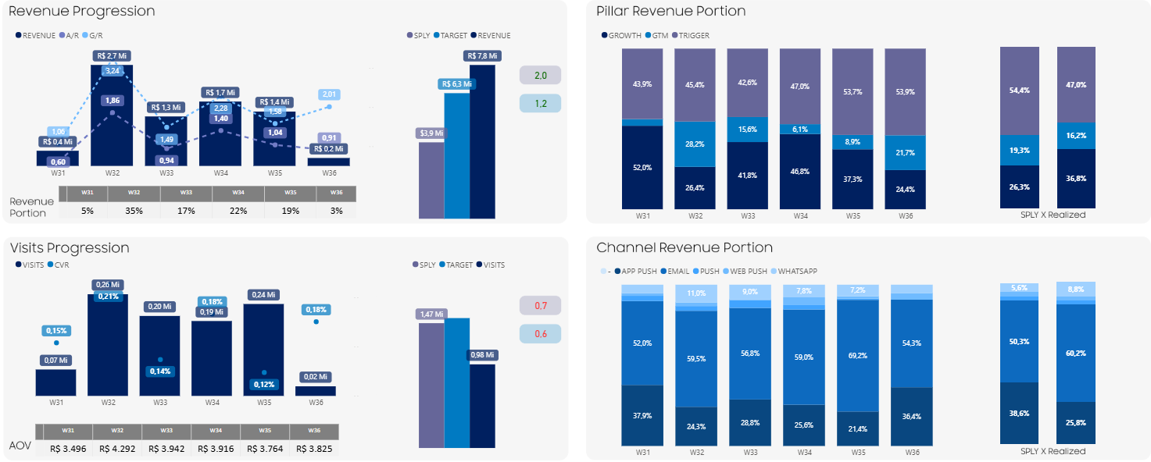
BIG NUMBERS | Overview 2026
August reached R$7.8M and 2.01 G/R, driven by Growth at 2.85 G/R and supported by Triggers at 1.63 G/R, while GTM remained in Q8H8B8’s demand-building phase.
Monthly context: W32 peaked with Father’s Day and W34 with Live Commerce; other weeks were softer, but deliveries showed some growth.
Aug’25 x ’26
Aug’26 Overview
Revenue
R$ 7,8M
2.01 G/R
Pillars
GROWTH
R$ 2,85M
2.85 G/R
GTM
R$ 1,22M
1.63 G/R
TRIGGERS
R$ 3,64M
1.73 G/R
②
①
①
②
HIGHLIGHT
Revenue reached R$7.75M at 2.01 G/R, with all pillars growing YoY.
Growth was the main incremental driver, reaching R$2.85M and 2.82 G/R.
Triggers: R$3,64M, performance increased week by week, supported by Transactional.
W32 was the strongest week, supported by Live Commerce and Father’s Day, G/R 3,07 and A/R 1,88.
All BUs grew above YOY: MX 2.33 G/R, DA 1.09 and VD 1.64.
LOWLIGHT
35% of revenue came from W32, efforts need to be better divided along month. There is a performance variation almost ~50% between weeks.
Visits got only A/R 0.6 motivated by the CTOR fallen.
GTM was supported by W32 and W33, other weeks delivered above-average revenue.
W31 and W36 only one or two days, this caused the decline in A/R, even though the goals were reached.
Notes:
W27–W28 concentrated the strongest revenue contribution, supported by Double Date and Why Shop. Performance softened in W29–W30 as commercial pressure shifted toward Q8H8B8 demand generation, before Growth recovered in W31 through Father’s Day and Live Commerce.

Slide 5
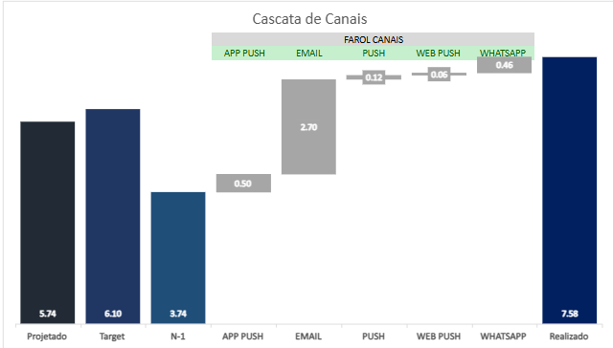
BIG NUMBERS | KPIs August 2026
August reached R$7.8M | 2.01 G/R, with growth driven mostly by Email, while A/R closed at 1.2 above the goal.
0,17%
OR
2.75
CTOR
CVR
AOV
Units
1,10B
7,66%
77,3M
0,55%
1,1M
983k
0,17%
1,9K
R$3,98K
2.370
R$7,8M
Deliveries
1,04
Opens
0,57
Cliques
Visits
2.75
Orders
1.23
1.64
Revenue
G/R
1.19
1.61
0.52
0.66
1.62
2.01
Target
R$ M YoY
HIGHLIGHT
Revenue grew to R$7.8M | 2.01 G/R, reaching the monthly target.
Email led revenue at R$4.7M and 2.40 G/R, supported by an order volume 95% higher than in 2025 and higher AOV.
App Push reached R$2.0M and 1.34 G/R, driven by Opens that were 27% higher and a CVR 40% higher than in 2025.
Email + App Push represented roughly 86% of channel revenue, WhatsApp showed the strongest growth in August.
CVR G/R reaching 2.75, principal reason came from higher AOV and Units also grew in the last month.
LOWLIGHT
CTOR fall despite Open Rate increase, so engagement needs attention.
Visits decrease related YoY, email content needs a better approach.
REVENUE | G/R
2.01
R$ 7,8M
2.01
CRM CHANNELS
REVENUE | G/R
APP PUSH
R$ 2,0M
1.34
E-MAIL
R$ 4,7M
2.40
PUSH
R$ 212k
1.22
WEB PUSH
R$ 185k
1.60
WHATSAPP
R$ 682k
3.17
*Valores de canais /1.000.000

Slide 6
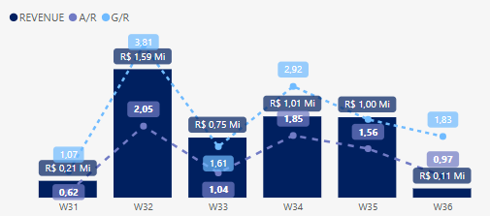
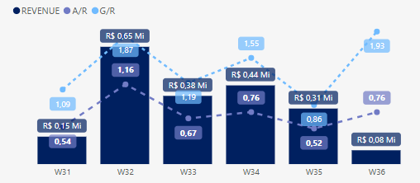
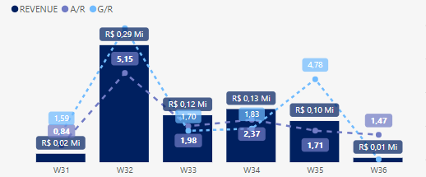
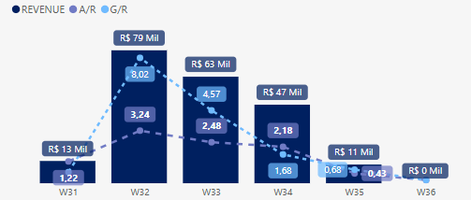
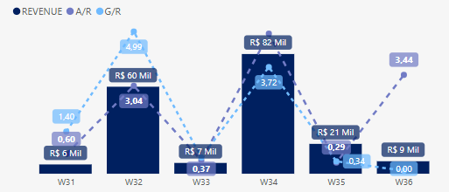
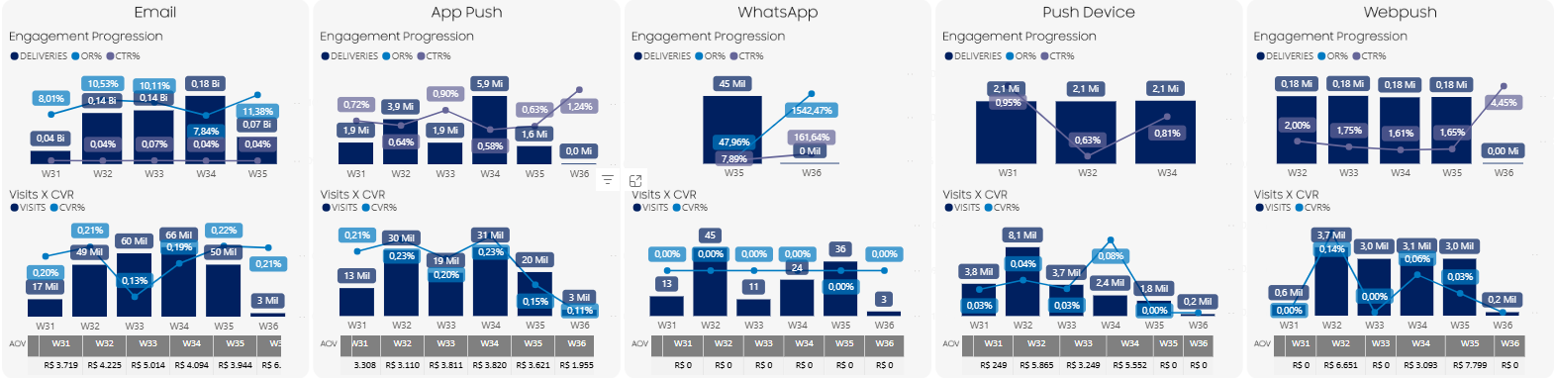
BIG NUMBERS | Channels
Channel performance clarifying Email was consolidated and Whatsapp growth was detached.
E-mail
App Push
WhatsApp
Push Device
WebPush
HIGHLIGHT
Email: Consolidated as the main CRM channel with 4.7M of revenue, showing a growing revenue during month.
App Push: R$2M | 1.34 G/R, despite 50% fewer deliveries; CVR 0.29%, 37% more Opens than 2025.
WhatsApp: 3.17 G/R, CVR 0.52%, 503% higher than 2025 and almost duplicating the number of orders.
Web Push has a CVR 532% higher YoY and Push Device higher AOV (R$3.602), 88% higher on YoY.
LOWLIGHT
App Push clicks fell as blasts dropped (15 → 8–9/week in some weeks), but Rev/Deliv rose +30%+ in response.
WhatsApp stayed Trigger-only most weeks; only touched GTM once (W34, OR 88.3%, R$37K) — unused in Growth all month.
Growth CVR fell 20% on W31 and 30% on W33 causing a lower CTOR.

Slide 7
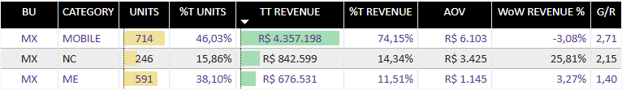
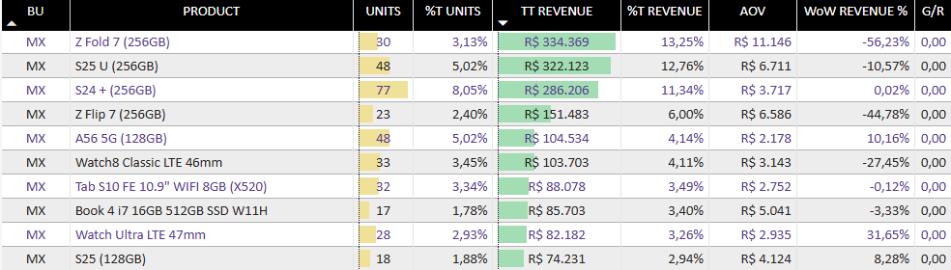
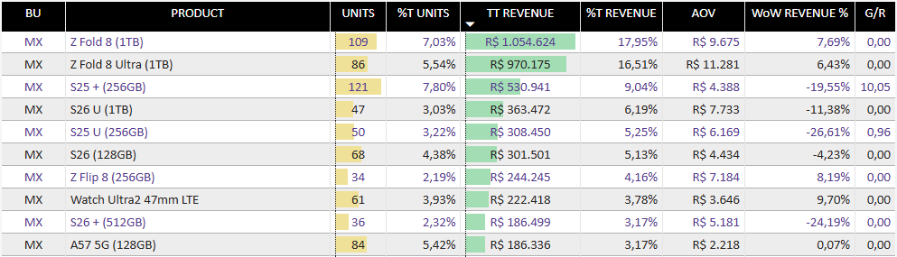
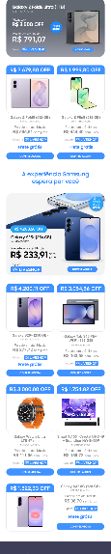
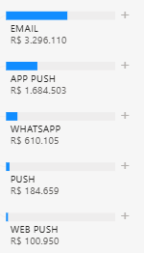
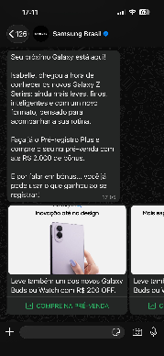
CRM | MX – Aug’26 Sales Results
MX reached R$5.90M and 2.33 G/R, driven by Mobile, GTM appeared as part of relevant share with Q8H8B8 release.
Big Numbers
Revenue
R$ 5,9M
2,33
Unit
1551
1,6
Portion Shop/App (R$)
6,59%
Portion Shop/App (units)
7,18%
G/R
GROWTH
33%
GTM
19%
TRIGGER
48%
Categories
Products
Mobile: core business at R$4.36M, 74% of MX share , 2.71 G/R
NC: R$842,6k, 2.15 G/R and ME R$676,5K, representing more than 25% of MX revenue.
Z Fold Family led with R$2.02M and 34% of revenue, followed by S Family.
Watch Ultra2 47mm presents a consistent growth week by week (50% ~ 278%), being one opportunity to diversify basket. Tab follows same pattern.
2025:
2026:
Channels
Top Assets
High & Lowlights
App + Email = 85% MX sales
Email (56%) consolidated as the main channel in MX.
HIGHLIGHTS
MX led CRM revenue: R$5.9M | 2.33 G/R.
Mobile delivered R$4.36M | 2.71 G/R.
Z Fold Family delivered R$2M, followed by line S.
NC reached R$842,6k | 2.15 G/R.
GTM contributed 19% of MX revenue in August.
LOWLIGHTS
74% of revenue still depends on Mobile.
Product concentration remains high in S-series, despite decreasing tendency.
Last month, sales were dominated by smartphone, low diversity of SKUs.
| 56%
Liveshop | W34
R$ 167k | CVR 0,23%
| 29%
| 10%
| 3%
| 2%
Q8B8H8 | W32
R$ 59k | CTOR 25,10%

Slide 8
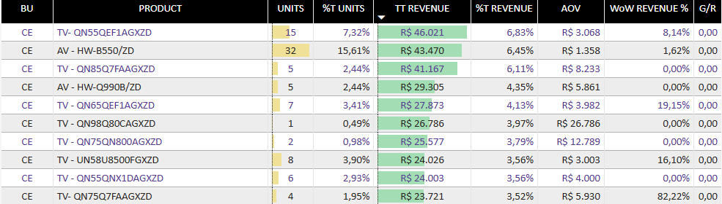
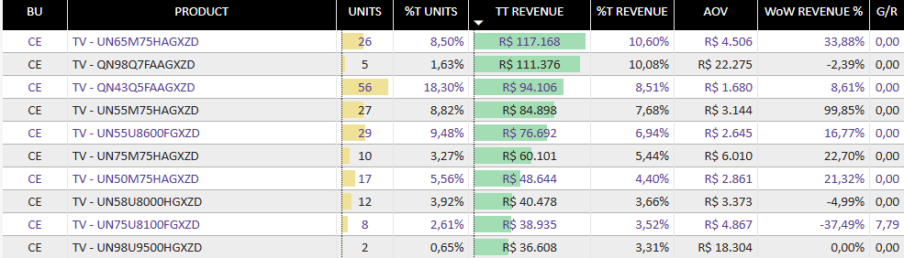

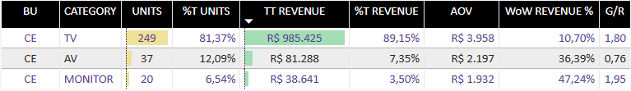

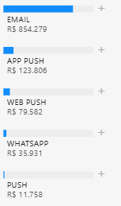
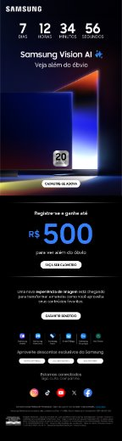
CRM | VD – Aug’26 Sales Results
VD reached R$1,1M and 1.64 G/R, Mini LED appeared on #1 on TV and BU needs more diversification of channels and products.
Big Numbers
Revenue
R$ 1,10M
1.64
Unit
306
1.49
Portion Shop/App (R$)
4,27%
Portion Shop/App (units)
3,97%
G/R
GROWTH
53%
GTM
3%
TRIGGER
44%
Categories
Products
TV: core category at R$985,4K, 89% of VD revenue, with 1.80 G/R.
Monitor deliveries higher G/R, 1.95, in the past month.
• Mini LED: #1 family at R$310K, taking the lead in VD revenue.
• QLED remained relevant at R$205K, followed by Crystal UHD, but presents volatile performance last month.
2025:
2026:
Channels
Top Assets
High & Lowlights
Email: main revenue channel at R$854K | 77% share.
App Push: contributed R$123K | 11%, remaining the second-largest channel.
Web Push: generated R$79K | 5%, with WhatsApp and Push Device residual.
CE | Odyssey Monitores | E-mail | T1​
HIGHLIGHTS
VD reached R$1,10M | 1.64 G/R, delivered higher growth.
Mini LED family led revenue at R$310K.
QLed deliveried R$205K revenue with 2 models, 61 units.
Growth + Triggers represented 97% of VD revenue, creating a balanced commercial base.
Monitor shows the best G/R 1.95.
Crystal UHD peaking +206,6% WoW on W35 (G/R 2,76).
LOWLIGHTS
VD revenue remains highly concentrated in TV.
Email 77% showing diversification channel gap.
AV G/R is below the sply, fell ~70% on W33.
| 77%
| 11%
| 7%
| 3%
CE | VD One | E-mail | T1​ | Revenue: R$10k
| 2%

Slide 9
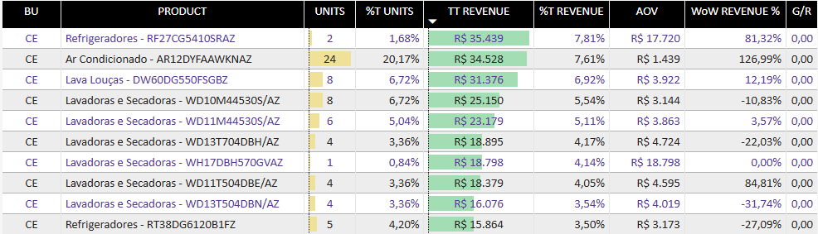
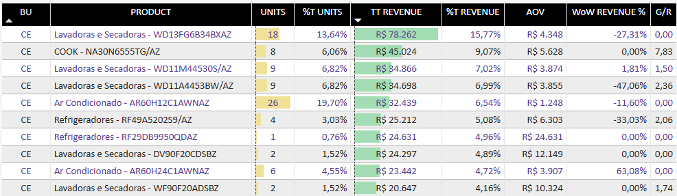

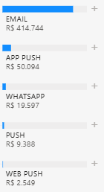
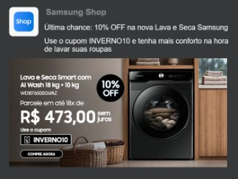
CRM | DA – Aug’26 Sales Results
DA reached R$496K and 1.09 G/R, led by Washer Dryer and Cook while Growth remained the main CRM commercial pillar.
Big Numbers
Revenue
R$ 496k
1.09
Unit
132
1.11
Portion Shop/App (R$)
4,27%
Portion Shop/App (units)
3,97%
G/R
GROWTH
55%
GTM
4%
TRIGGER
41%
Categories
Products
HA generated R$400K and 1.06 G/R,
AC reached R$95,8K and 1.24 G/R, showing potential to equilibrate DA share.
Washer Dryer dominated DA with R$192,7K, 38,8% of family revenue.
Cook showed on second place with R$45K revenue, led by Trigger.
2025:
2026:
Channels
Top Assets
High & Lowlights
Email: R$414,7K | 83,5%
App Push: R$50K | 10%
Email is a big driver of revenue in DA.
HIGHLIGHTS
DA: R$496K | 1.09 G/R.
Washer Dryer: key driver, R$192,7K.
AC: growth opportunity, R$95,8K | 1.24 G/R, +213% WoW on W33
Growth was main pillar drove 55% of revenue.
Triggers support DA with R$202k revenue base.
LOWLIGHTS
Channel diversification needs improvement, APP Push and Whatsapp are possibly opportunities.
Cook appeared because of transactional trigger, not because of the pillar effort.
Ref almost zeroed on W33 and grew 8 times on W34, being strongly volatile.
| 83,5%
CE | Winter Promo | App Push | T3​ | Revenue: R$18,4k
| 10%
| 4%
| 2%
| 0,5%

Slide 10
TRIGGERS

Slide 11
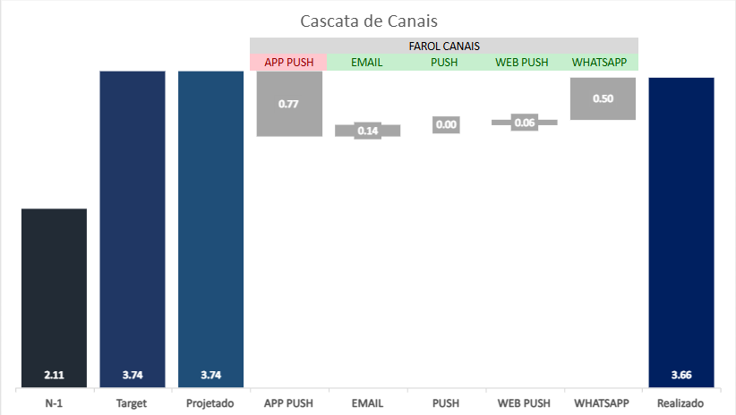
BIG NUMBERS | TRIGGERS - KPIs AUG/2026
Triggers reached R$3.64M and 1.74 G/R, Transactional reduced Cart dependency.
CVR
AOV
Units
156K
0,39%
934
R$3,9K
1163
R$3,64M
Visits
1.65
Orders
1.16
1.47
Revenue
1.19
1.48
1.74
G/R
Target
R$(M) YoY
HIGHLIGHT
Triggers: R$3.64M | 1.74 G/R, was the principal growth engine.
All KPIs grew last month, delivering a bigger conversion rate.
Cart is responsible for 50%-80% of revenue every week.
S25+ had the best increase (10.12 G/R) in trigger.
LOWLIGHT
Transactional and PPX Onboarding supported the revenue diversification on triggers.
Inactive Users presents returns for the first time on W31, but zeroed after W35.
Despite revenue increase, trigger didn’t reach the target last month.
Triggers still showing irregular functioning, Browser Abandonment zeroed on W33 and W34, now under LAO revision.
Deliveries fell because of fails, resulting in artificial CVR growth.
REVENUE | G/R
Cascata de Canais
R$ 3,64M
1.74
0.97
CRM CHANNELS
REVENUE | G/R
APP PUSH
R$ 883k
1.01
E-MAIL
R$ 2,07M
1.81
PUSH
-
-
WEB PUSH
R$ 138k
2.30
WHATSAPP
R$ 554k
0.50
*Valores de canais /1.000.000

Slide 12

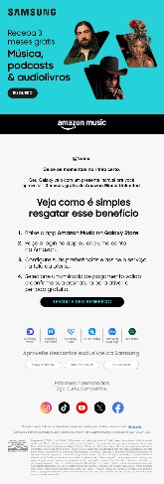
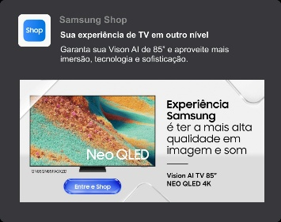
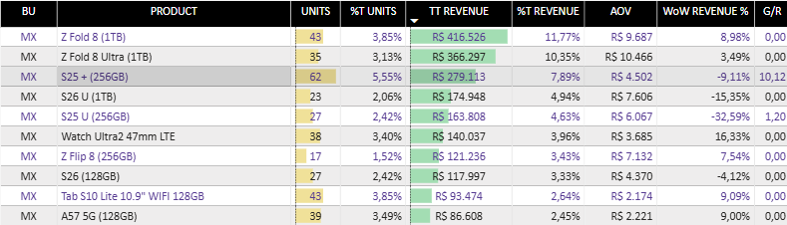
TRIGGERS | Overview
Trigger diversification gained new actors like PPX Onboarding.
Roadmap
Triggers by Week
5 triggers activated – 29 total active.
  3 SEDA activations: Onboarding SMTP, Cross sell, Campanha Serie A57/37
  4 LAO activations: Cart and Browser Ab per Category, Purchase Anniversary, 45 Days without engagement
Strategy adjustments:​
  Wishlist
SEDA​ - New implementation
  Stock alert
  Repurchase
  Onboarding Monitor and Ref
  Recuperação de Churn
Abandoned Cart: main revenue engine, peaking again in W32.
Browser Abandonment and Transactional: strongest secondary support, represent 18% share.
HIGHLIGHT
Browser Abandonment + Transactional added R$685K, expanding revenue beyond Cart.
PPX Onboarding gained relevancy on W32 and W35.
12 triggers were generated revenue last month.
First Purchase is on TOP5 trigger.
Test A/B on Price Drop: subjects more attractive (emojis and Caps) had 35% more engagement.
LOWLIGHT
Revenue diversification is still limited, with Cart remaining the dominant journey.
Inactive Users had instable performance last month.
Wishlist revenue is too small, trigger needs revision.
Only 4 automations deliveries revenue bigger than R$100k.
LAO​ - New implementation
  Browser and Cart Abandonment EPP​
  Repurchase/Upgrade
  PPX onboarding
Cart. Ab.
R$ 150,5k
R$ 733,5k
R$ 445,5k
R$ 556,8k
R$ 596,3k
R$ 63.255k
Products performance
New Triggers
Z FOLD 8 led with R$783K, followed by S25 at R$443K.
Watch Ultra2 and Tab S10 Lite appearing as product diversification.

Slide 13
Growth

Slide 14
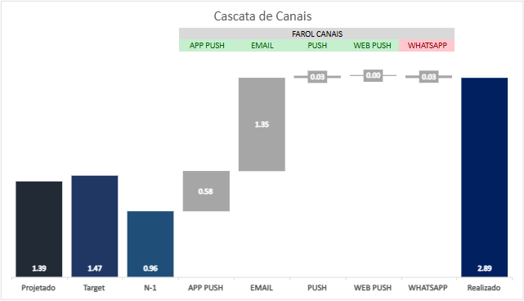
BIG NUMBERS | GROWTH - KPIs Aug’26
Growth reached R$2.9M | 2.85 G/R | 1.85 A/R, driven by stronger conversion and key commercial moments such as Why Shop and Live Commerce.
0,18%
OR
1.50
CTOR
CVR
AOV
Units
674M
9,2%
59,7M
0,49%
464,4k
396k
0,18%
713
R$4.057
833
R$2.9M
0.94
Opens
0.56
Cliques
Visits
1.50
Orders
1.28
2.27
Revenue
Deliveries
G/R
2.38
2.40
0.94
1.47
2.22
2.85
Target
R$ M YoY
REVENUE | G/R
HIGHLIGHT
R$2.9M | 2.85 G/R | 1.85 A/R, Growth was the second pillar.
713 orders | 2.22 G/R, with CVR at 0.18%.
Push grew almost ten times on YoY.
Email supported 67% Growth revenue, responsible for scale.
LOWLIGHT
CTOR shows the bigger fell than others KPIs, probably caused by duplication of Opens G/R.
Whatsapp wasn’t used in August, could be used to increase revenue in key moments.
App Push scaled, but lost efficacy: deliveries +216%, Rev/Deliv -40%.
1.82
3.01
R$ 2.8M
CRM CHANNELS
REVENUE | G/R
APP PUSH
R$ 866,7K
2.4
E-MAIL
R$ 1.95M
3.3
PUSH
R$ 32,2k
9.8
WEB PUSH
R$ 47.2k
1.11
WHATSAPP
R$ 0
0.00
*Valores de canais /1.000.000

Slide 15
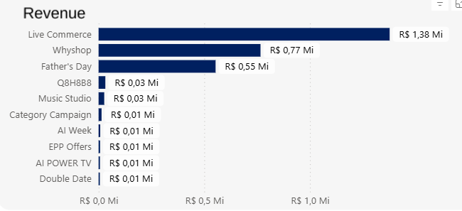
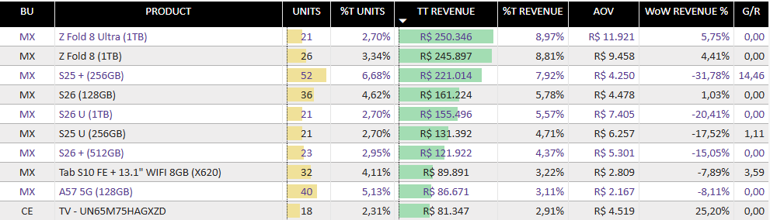
GROWTH | Aug’26 Campaigns
Live Commerce and Why Shop increased Growth’s revenue being one of the most relevants CRM pillar.
Revenue by Campaign
Product Sold
Live Commerce and Whyshop: recurring base of Growth
Father’s Day: lifted W31–33 → seasonal campaign
Z Fold 8 Family led with R$496K / 17% of revenue.
S26 Family reached R$438K and S25 Family only R$352K.
Tab S10 FE showing little growth.
HIGHLIGHT
Live Commerce: R$1.38M | 47% of Growth revenue, main recurring campaign.
Father’s Day: R$550k | 19% of Growth revenue.
Z Fold Family: R$496k | 17% of Growth revenue.
S25 + (256GB) has G/R 14.46, appearing as #3 more sold product.
Learning validated by Test A/B: new framing to announce discount, from “% OFF” to “R$ OFF” had better results on CVR.
LOWLIGHT
Revenue was concentrated in Live Commerce, Growth needs new promotions or key campaigns.
Sales were based on MX products, CE only appears at the end of TOP10.
Common Campaigns
Why Shop
R$770k
5.5 G/R
Live Commerce
R$1,38M
2.8 YoY
Campaign portion x Week
Top conversion
Live Commerce sustains all Growth performance.
Father’s Day delivery revenue at August beginning.
Liveshop | W34
R$ 167k | CVR 0,23%

Slide 16
GTM

Slide 17
BIG NUMBERS | GTM - KPIs August’26
GTM susteined main launches on August, with strong activation and intention Generation; Awareness, the challenge was change scale in engagement.
CTR
0,13%
OR
0.55
CTOR
CVR
AOV
Units
401,1M
4,63%
15,6M
0,62%
530,0k
430,1k
0,07%
299
R$4.071
374
R$1,22M
0.82
Opens
0.62
Cliques
Visits
2.99
Orders
1.36
1.30
Revenue
Deliveries
G/R
0.65
0.70
0.36
0.40
1.21
1.63
PERFORMANCE BY CAMPAIGN OBJECTIVE
GB New Owners N-1 ~ N-4
HIGHLIGHT
Q8H8B8 led GTM, with a successful launch and 2.17x A/R.
VD One exceeded Handraiser targets, with Full Forms as the main highlight.
Bottom-funnel performance exceeded N-1, driven by the flagship launch month.
LOWLIGHT
Scale did not guarantee engagement: qualified audiences progressed better than broader Awareness efforts.
Secondary campaigns showed lower interaction depth, concentrating engagement around the main launches.
Pressure Rule limited CE reach, reducing the potential for awareness.
August
W32
W33
W34
W35
Q8H8B8 – Pre-Order G O
 | SSG Health P N
 |  |  | Galaxy A Spotify P N
 |  |  | Galaxy Book M N
Amazon Music P N |  | Amazon Music P N
Odyssey Monitores P O |  |  | Odyssey Monitores P O
Music Studio P O |  |  | VD – Handraiser G O
 |  |  | Music Studio P O
HANDRAISER
AWARENESS & ENGAGEMENT
LAUNCH ACTIVATION
Capture and qualify intent
Build awareness and drive interaction
Sustain the launch and advance the journey
VD One
S26 FE | Book6 | Music Studio
Q8H8B8
2.17x
Full Forms vs. Target
MIXED PERFORMANCE
3.3x
Campaign A/R
POSITIVE
KEY DETRACTORS
ACIMA DO TARGET
Book6 New Owners
8.52% OR | 5.13% CTOR
CE: Music Studio 0.36% CTOR
MX: S26 FE 0.22% CTOR
ACIMA DO TARGET
Target exceeded, with stronger capture quality and higher Full Form volume.
Qualified strategies delivered positive KPIs, while isolated high-scale efforts and delivery constraints pulled overall engagement down.
Main journey of the month, with strong activation across the funnel.

Slide 18
GTM | Ago’26 Scorecard por Objetivo de Campanha
Target and audience qualification were determinants to performance: intention journeys and launch increasing with Awareness efforts.
CAMPAIGN
OBJECTIVE
SUCCESS KPI
EVIDENCE
KEY LEARNING
STATUS
HOW TO EVOLVE
VD One
Handraiser / Intenção
HR vs. Meta
FF/OC vs. Meta
28,5K HR
2.58 A/R FF | 1.13 A/R OC
Target reached one week ahead of schedule, with E-mail Full Forms as the main highlight.
ABOVE
Leverage HRs and intent signals in Pre-Order and the next journey phases.
Q8H8B8
Launch Activation
OR / CTR / CTOR
+ Revenue
EDM T1 – L2: 11,0% OR | 10,36% CTR | 17.9% CTOR
R$ 269,7K Revenue
Main journey of the month; qualified audiences sustained strong interaction throughout the launch.
Replicate learnings from HR, Co.A and engaged audiences in upcoming launches.
ABOVE
Galaxy Book6
Awareness &
Consideration
OR / CTOR
New Owners: 10,04% OR
4,91% CTOR
Category affinity increased interaction depth.
ABOVE
Prioritize owners and audiences closer to the category.
Music Studio
Awareness &
Engagement
OR → CTOR / CTR
7,46% OR → 0,36% CTOR
0,03% CTR
Generated attention, but opens did not progress into interaction.
PARTIAL
Strengthen the value proposition, creative/CTA and audience affinity.
Galaxy S26 FE
Awareness &
Engagement
Reach → CTOR
→ Visits
31,1M deliveries | 0,22% CTOR
227 visits
Relevant scale without proportional interaction depth.
BELOW
Reassess audience, timing and benefit-led messaging.
Odyssey Monitores
Awareness &
Engagement
CTR / Click→Visit
~0,50% CTR | até 68%
Click→Visit
Strong post-click quality, but reach was limited by the Pressure Rule.
PARTIAL
Preserve qualified audiences and reduce pressure-rule conflicts.
Amazon Music +
Galaxy A Spotify
Benefit-led
Engagement
OR / CTR / Visits
(+ CVR if commercial)
Amazon: 0,28% CTR | ~1,3K visits*
Spotify: 7,57% OR | 0,09% CTR
The benefit generated pockets of interest, but interaction depth varied by audience and touch.
Personalize the benefit by product/audience and validate with effective reach.
PARTIAL
TAKE AWAY
August shows different performance levels by objective: Handraiser and the main launch journey delivered strong results, while awareness campaigns need to improve progression from exposure to interaction.
Metrics marked with an asterisk are examples from weekly/touch-by-touch analyses and should be interpreted within the context of each campaign.

Slide 19
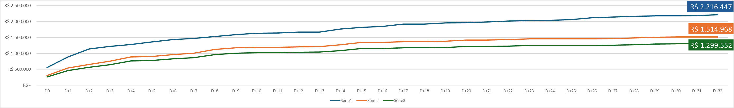
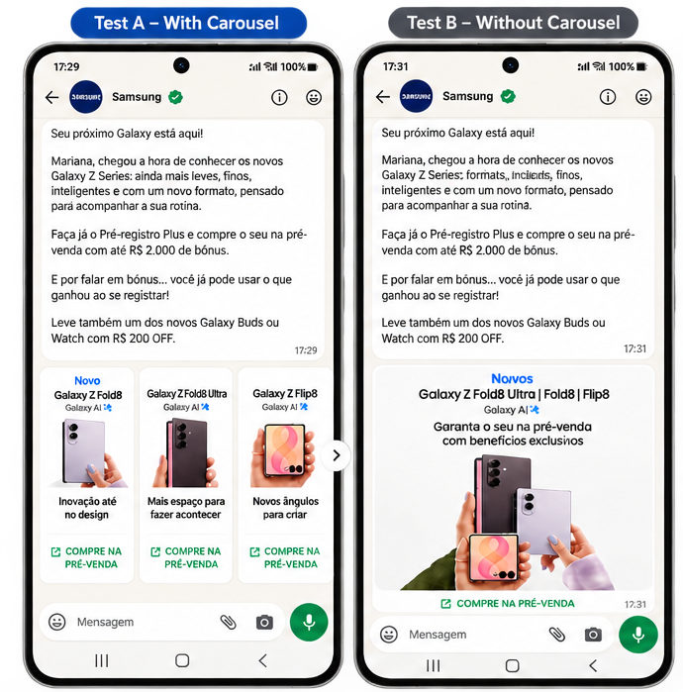

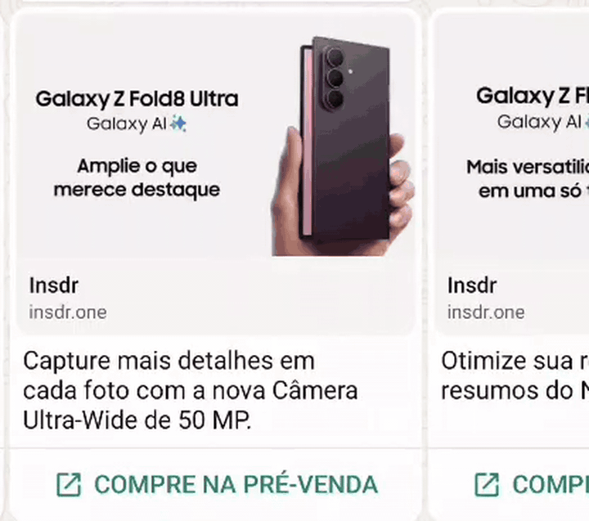
GTM | Q8H8B8 – Pre-Order
BIG NUMBERS
TOTAL REVENUE
Total Revenue vs. N-1
Overall CVR
Units
Total GTM MX Revenue
Total GTM MX CVR
R$ 2.17M
1.7x
0,02%
220
R$ 967K
0.06%
3.3x A/R
vs. FF7
2.0x vs. FF7
1.5x vs. FF7
1.23 A/R
3,0x vs. FF7
OVERALL RESULT
GTM Performance
1. KEY AUDIENCE GROUPS
The strategy combined high-intent audiences with new segmentation cuts, helping distinguish what is ready to scale from what still requires Test & Learn.
HANDRAISERS
CLOSED OFFER
PERSONAS
COMPETITORS / Co.A
AI TAG • NOVO
The result combined a balanced pillar mix with strong portfolio contribution, with Z Fold8 leading product revenue since the start of the campaign.
CONVERSION CORE
PERSONALIZED OFFER
POCKETS OF POTENTIAL
ENGAGES, DOES NOT CONVERT
1ST USE
1. PORTION BY PILLAR
2. PRODUCTS SOLD
3% of E-mail deliveries → R$451K. In Push, 4% of deliveries → 79% of revenue.
R$51.3K and 8 orders. Strong conversion efficiency at lower scale.
POWER HOT led engagement; JOYHOT generated R$19.6K in revenue.
Strong initial interest but weak response to offers; opportunity to revisit proposition and timing.
First CRM exploration. HEALTHUSER in Push showed a positive signal; volume is still too small for a firm diagnosis.
CRM revenue mix
Z FOLD8
#1
revenue
GTM
43%
~40% of revenue
TRIGGERS
41%
WATCH ULTRA2
highest
growth
GROWTH
15%
~4,0x vs. N-1
2. Test & Learn WhatsApp - Carousel
GTM and Triggers account for 84% of the mix; by product, Z Fold8 leads revenue while Watch Ultra2 stands out in growth.
3. Canal
2,2x PEDIDOS
Carousel generated 11 orders vs. 5 for the single image, with similar engagement across formats.
E-MAIL
REVENUE DRIVER
Top-performing channel, driven by HR Visitors and the cross-Growth strategy.
2,9x vs. N-1 1,4x A/R
PUSH DEVICE
Strong conversion, with the best engagement and CVR indicators among Personas.
EFFICIENCY ↑ vs. N-1
1,7x RECEITA
R$57.3K vs. R$34.6K. The gain came mainly after the click, with stronger conversion efficiency.
EFFICIENCY
APP PUSH
MAIN GAP
Main campaign gap, impacted by lower effort/deliveries and weak conversion among Competitors/Co.A.
BELOW N-1 / TARGET
Order/Visit was 2.2x higher (0.45% vs. 0.21%), indicating that broader product exploration helped turn interest into purchase.
KEY LEARNING
WHATSAPP
BOTTOM OF FUNNEL
Strong conversion efficiency, driven by Triggers and GTM, with HR and the Carousel format standing out.
R$263K | ROI 89%
TAKE AWAY |
Q8H8B8 exceeded target by 40%, combining early intent capture, strong HR and E-mail performance, and broader audience strategies with new AI TAG tests.

Slide 20
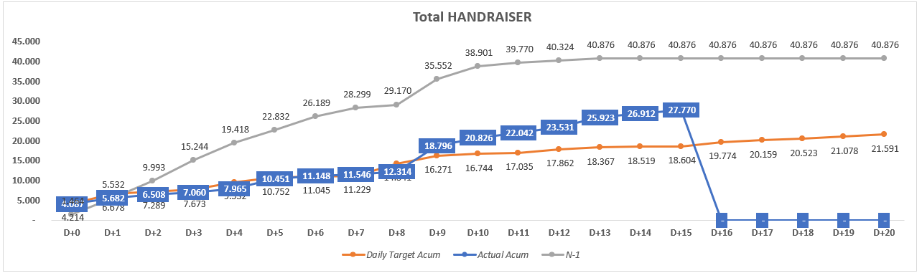
GTM | VD ONE - Teaser
BIG NUMBERS
TOTAL HR
FULL FORM
ONE CLICK
CRM HR
ORGANIC FF
E-MAIL FF
FF / CLICK
27.8K
10.6K
17.2K
22.9K
4.7K
5.0K
18.1%
1.49x A/R
2.59x A/R
1.18x A/R
82% do total
44% dos FFs
1.47x A/R
2.22x A/R
HR TOTAL
HYPOTHESES / PERFORMANCE DRIVERS
1. High Full Form conversion efficiency
Even with fewer E-mail clicks, users who progressed in the journey converted to FF above expectations.
CTR
→
FF
→
FF/Click
0.66x
1.47x
2.22x
VD One reached 27.8K HRs to date, exceeding target by 49%. Full Form was the main highlight, reaching 2.59x target.
2. Channels played different roles across the journey
E-mail
Main CRM driver for HR and FF
5.0K FF | 1.47x
CRM
22.9K | 82%
App Push
Delivery scale; FF close to target
610 FF | 0.95x
Organic
4.7K | 17%
Mídia
0.2K | 1%
Webpush
Strong traffic, with no HR conversion
CTR 2.61x | FF 0
KEY DRIVERS
LEARNING: The creative optimization, including GIFs, a hard-sell approach, and more explicit product messaging, improved engagement and FF/OC conversion, reaching 9.3% OR in one of the EMKT touchpoints.
• CRM accounted for 82% of HRs, with 22.9K captures.
• Organic represented ~44% of all Full Forms.
• FF reached 10.6K vs. 4.1K expected — 2.59x target.
OPPORTUNITY: Evolve the HR strategy based on intent and engagement signals, combining source, channel, and behavior to drive more targeted journeys across GTM and Growth.
TAKE AWAY | VD One exceeds the HR target by 49%, driven by Full Form efficiency; the next step is to scale qualified traffic and conversion for launched products.

Slide 21
EPPs

Slide 22
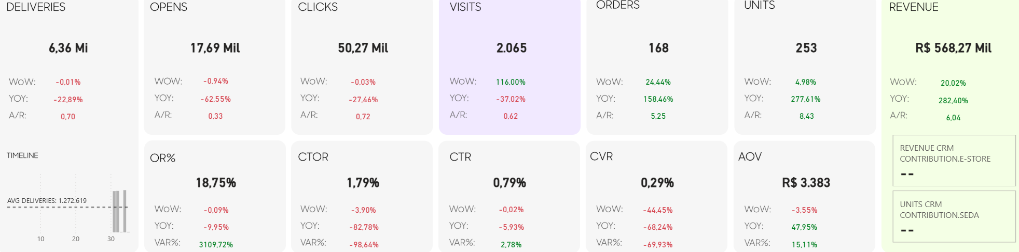
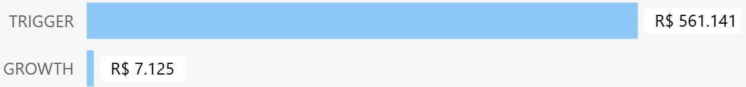
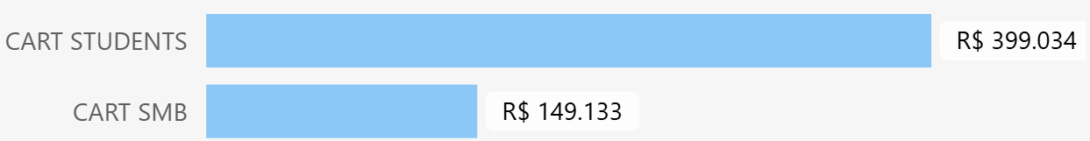
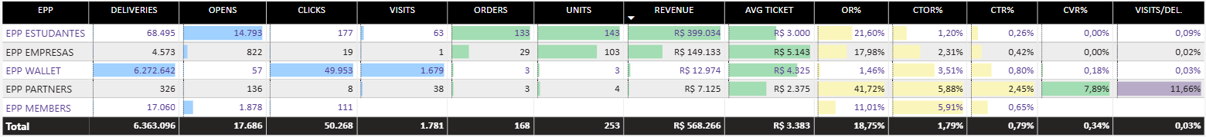
EPPs | Triggers e non-triggers
EPP revenue more than tripled YoY despite lower reach, with ~99% of revenue concentrated in Students and SMB triggers.
Big Numbers
Revenue
568k
3.84
Unit
262
3.78
G/R
HIGHLIGHT
Revenue reached R$568k (+282% YoY), driven by strong EPP trigger performance.
Students generated R$399k (+319% YoY), while SMB delivered R$149k (+798% YoY), together accounting for ~96% of total EPP revenue.
LOWLIGHT
Engagement declined despite the revenue growth: Deliveries fell 23% YoY, while Opens and Clicks decreased 63% and 27%, respectively. Wallet concentrated most of the volume but generated only R$13k, showing a significant gap between reach and revenue contribution.
Revenue by Pillars & Triggers
Pillars
Triggers
EPPs Details
Students: Main revenue driver, contributing R$399k and leading EPP performance in August.
SMB: Strongest growth lever, reaching R$149k and nearly 8x YoY revenue growth.
Partners: Highest efficiency, with room to scale.

Slide 23
HIGHLIGHTS & NEXT STEPS

Slide 24
SUMMARY & NEXT STEPS | Sep & Oct
SEDA
GROWTH
GTM
OVERALL
Highlight:
R$7.8M | 2.01 G/R → August exceeded the target, where all pillars grew in line with their respective strategies.
Next Step:
Scale Growth operation and improve GTM KPIs to better qualify audiences at the same time.
MX
Highlight:
R$5.9M | 2.33 G/R → increase Watch and Galaxy Book penetration.
Next Step:
Diversify beyond smartphones through Watch and Galaxy Book. Retarget engaged Q8H8B8 audiences through Growth..
VD
Highlight:
R$1.10M | 1.64 G/R → Mini LED family led products sales.
Next Step:
Increase basket size to diversify products, increase Soundbar offer.
DA
Highlight:
R$496K | 1.09 G/R → Cook emerged as an opportunity; explore its potential.
Next Step:
Repeating efforts from W32 test whether Washer Dryer can peak again.
Highlight:
R$2.9M | 2.85 G/R →Live Commerce sustained the pillar.
Next Step:
Balance the product mix, reduce the weight of foldables, focus on Tv and Watch Ultra.
Replicate the new discount framing validated on W34.
Investigate the loss in efficiency on APP Push, identify a new way to balance the two main channels Growth.
Highlight:
R$1,22M | 1.63 G/R
Next Step:
Evolve HR to buyers.
Increase engagement rate: CTR and CTOR.
Incorporate learnings to GTM journeys.
Testing and replicating Q8H8B8 e VD One, keep learning audiences tests.
TRIGGERS
EPP
Highlight:
R$3.64M | 1.74 G/R → journey beyond Cart.
Next Step:
Scale triggers generating less than R$100K in revenue.
Stabilize automation performance from Inactive Users and Browser Abandonment.
Investigate causes of decline in Transactional performance.
Monitor CTR distortion caused by the decline in deliveries.
Highlight:
EPP: stable growth, despite low traffic.
Next Step:
Increase AOV from Wallet, several visits with low number of orders.
Partners has the potential to bring more revenue.
Try to replicate CTR and CTOR performance and CTOR from Partners to Students and SMB.

Slide 25
THANK YOU!

