Slide 1
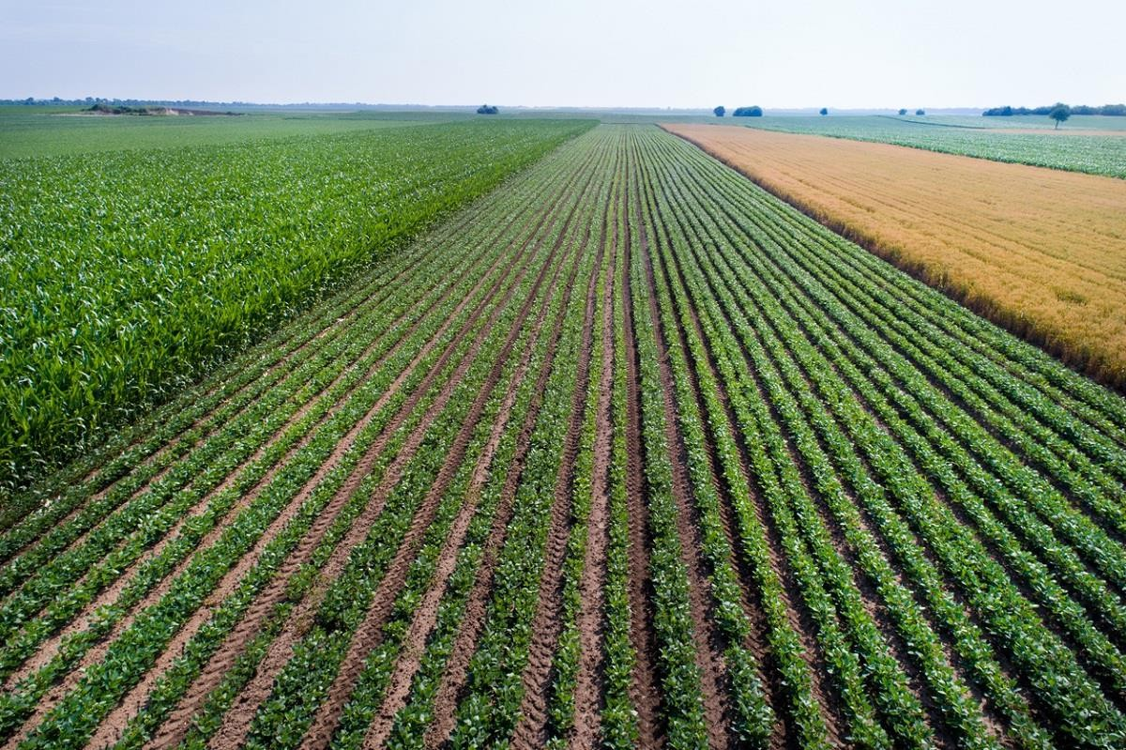
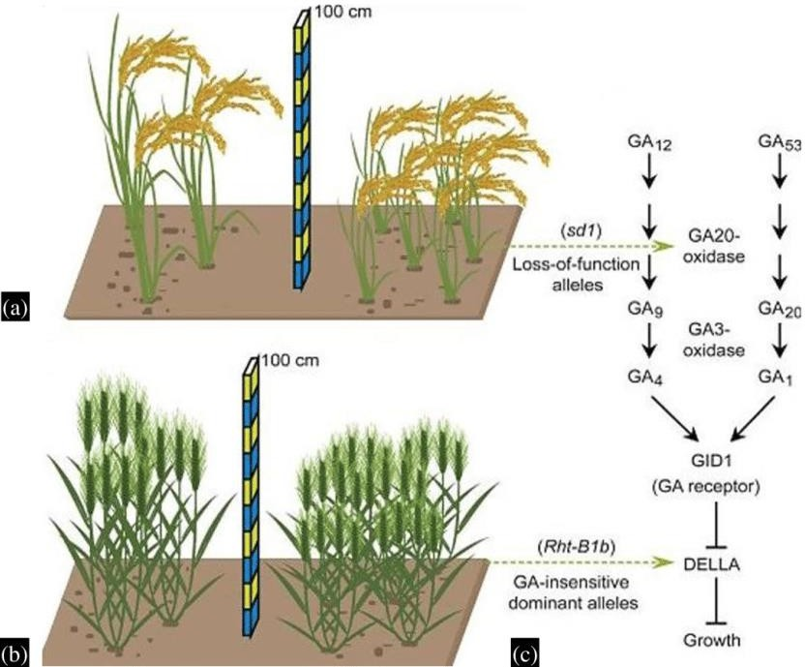
GREEN REVOLUTION

Slide 2
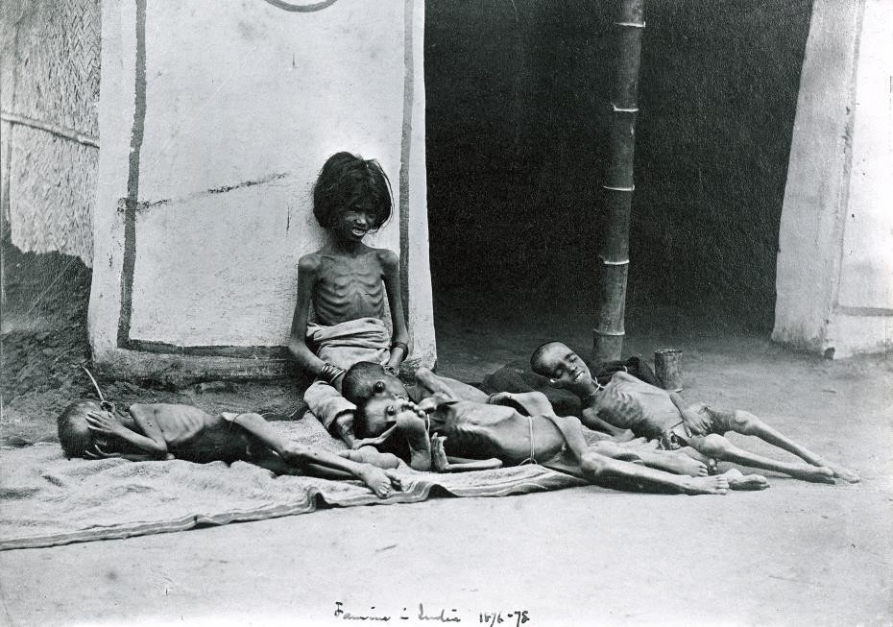
History of Green Revolution
Food problems have haunted mankind since time immemorial.
By the 19th century, there was growing pessimism about the possibility of feeding ever-growing populations, as exemplified in the writings of Thomas Malthus (1766– 1834).
The task seemed even more daunting as advances in medicine and public health led to longer life expectancies and more children born.

Slide 3
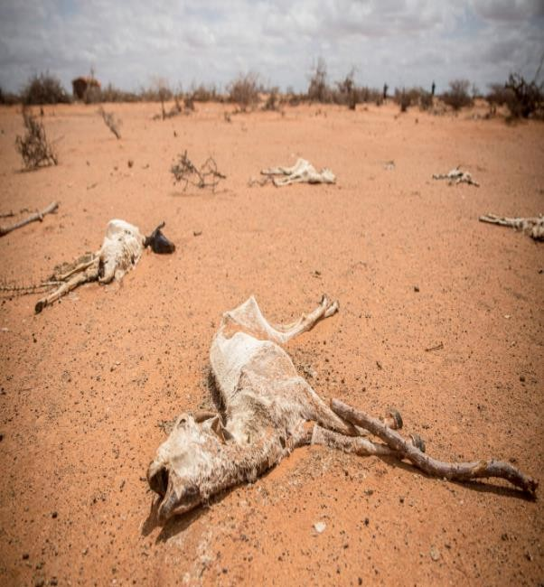
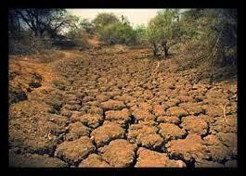
History of Green Revolution
By the mid-1960s, hunger and malnutrition were widespread, especially in Asia, which increasingly depended on food aid from rich countries.
Back-to-back droughts in India during the mid-1960s made the already precarious situation worse
A 1967 report of the U.S. President’s
Advisory Committee concluded that “the
Science
scale,
severity and duration of the world food problem are so great that a massive, long-range, innovative effort unprecedented in human history will be required to master it.”

Slide 4


History of Green Revolution
The Rockefeller and Ford foundations took the lead in establishing an international agricultural research system to help transfer and adapt scientific advances to the conditions in developing countries.
The first investments were in research on rice and wheat, two of the most important food crops for developing countries. The breeding of improved varieties, combined with the expanded use of fertilizers, other chemical inputs, and irrigation, led to dramatic yield increases in Asia and Latin America, beginning in the late 1960s.

Slide 5
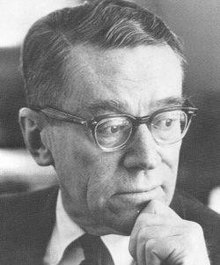
William S. Gaud
U.S. Agency for International
Development |  | (USAID)
Administrator coined the |  | term “Green
Revolution” | to | describe the
phenomenal growth in agriculture in 1968.

Slide 6
Although the term Green Revolution originally described developments for rice and wheat, high-yielding varieties (HYVs) have since been developed for other major food crops important to developing countries, including sorghum, millet, maize, cassava, and beans.
Moreover, a full-fledged system of international agricultural research centers now works on many aspects of developing- country agriculture

Slide 7

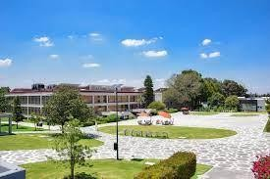
History of Green Revolution
Borrowing from rice-breeding work undertaken in China, Japan, and Taiwan, the International Rice Research Institute (IRRI) in the Philippines developed semi-dwarf varieties that met most of these requirements.
Similar achievements were made for wheat after Norman Borlaug crossed Japanese semi- dwarf varieties with Mexican wheats at what is now known as the International Center for Maize and Wheat Improvement (CIMMYT) in Mexico

Slide 8

Norman Borlaug (March 25, 1914 –September 12, 2009)
American scientist
receives 2007.
a 1970 Nobel Laureate, was honored for his
the Congressional Gold Medal in
work in the 'Green Revolution,' saving millions of lives from famine in India, Mexico, and the Middle East.
"the father of the Green Revolution".

Slide 9
Methods used in green revolution
Double/ Multiple Cropping system
Seeds with superior genetics
Proper irrigation system
High Yielding Variety (HYV) of seeds
Use of pesticides and fertilizers
Use of modern machinery (Tractor, Harvester, Thrasher)
Expansion of farming areas

Slide 10
Causes of green revolution
High Yielding Varieties of Seed.
Chemical Fertilizers.
Irrigation.
Multiple Cropping.
Modern Agricultural Machinery.
Credit Facilities.
Agricultural Research.
Plant Protection.
Rural Electrification.
Soil Testing and Soil Conservation.

Slide 11
Basic elements used methods of green revolution
Continued expansion of farming areas: Green Revolution continued with quantitative expansion of farmlands.
Double-cropping existing farmland: Instead of one crop season per year, the decision was made to have two crop seasons per year. There had to be two monsoons” per year. One would be the “natural monsoon” and the other an “artificial monsoon”.
Using seeds with superior genetics: This was the scientific aspect of the Green Revolution to use High Yielding Variety (HVY) of seeds.

Slide 12
Effects of green revolution
Increase in Production
Capitalistic Farming
Effect on Rural Employment
Reduction in Imports of food grains
Development of Industries
Effect on Prices
Base for Economic Growth
Effect on consumers
Effect on Planning
Increase in Trade
Change in Thinking of Farmers

Slide 13
Limitation of green revolution
The Green Revolution, howsoever impressive, but NOT a 100% success.
The new farming techniques, has given birth to the serious pollution of drinking water causing cancer and other diseases.
A recent Punjabi University study found a high rate of genetic diseases among farmers, which was attributed to pesticide use.
The new inorganic fertilizer, pesticides and chemicals are ruining the soil.
Lead to unemployment and Rural-Urban Immigration.

