Slide 1
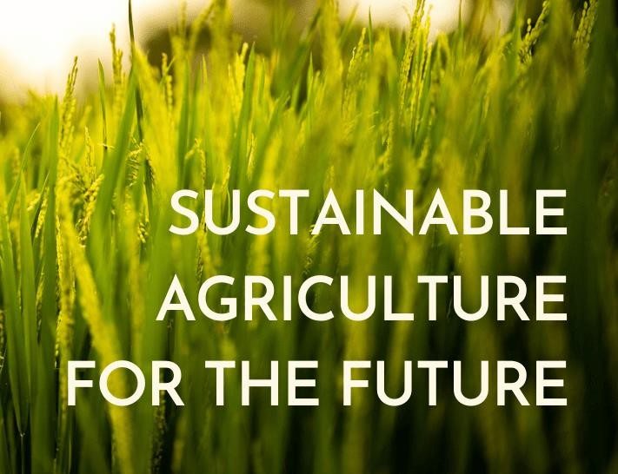
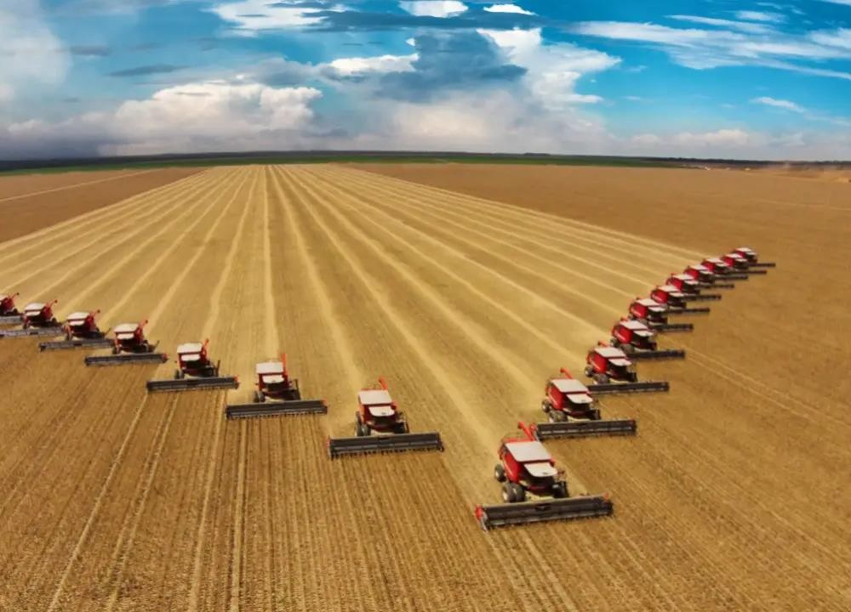
MODELS OF AGRICULTURE

Slide 2
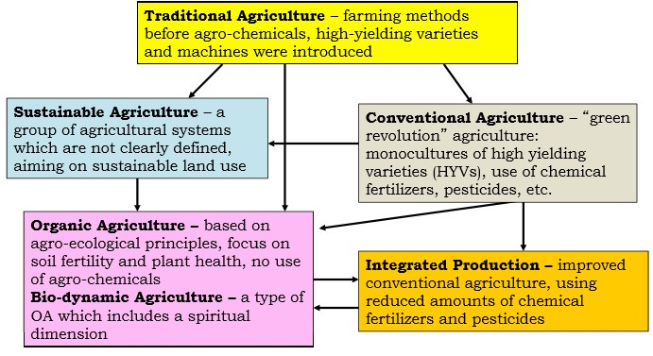
Different Farming Systems

Slide 3
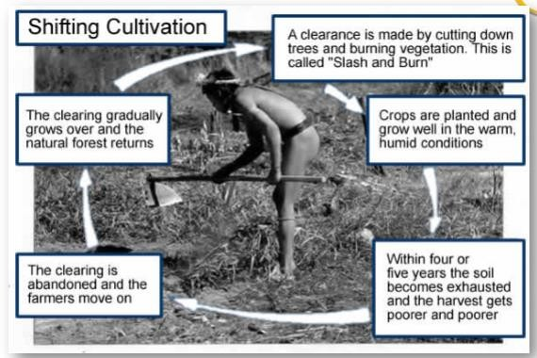
TRADITIONAL FARMING SYSTEM

Slide 4
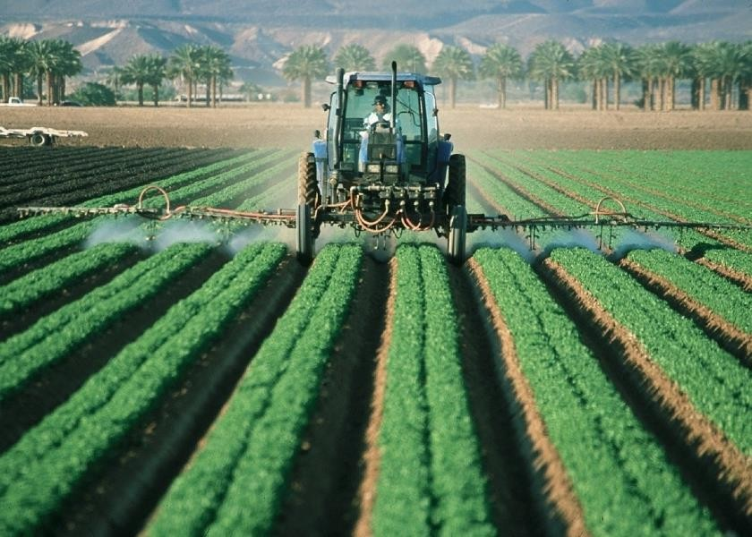
MODELS OF AGRICULTURE
The primary goal of agriculture = manage photosynthesis to produce food, fiber and other plant products for human use.
This can be done through two general models: industrial and sustainable.
A. Industrial (Conventional) Agriculture
Agriculture
is an industrial enterprise in which farms are factories and fields the production plants. The products that are made (production units) may be animals or grain.

Slide 5
A. Industrial (Conventional) Agriculture
The producer acquires and uses production inputs to make specific products. Fresh inputs are acquired for each production cycle. The prevailing philosophy is one of a component approach to crop production, whereby the producer focuses on individual farming practices and methods. An industrial plant is designed for a specific production practice, where components are assembled to make a product. In the industrial model of crop production, obstacles to production are removed through the use of innovative technologies.
The natural environment is modified or controlled. Control also makes it potentially possible for steady progress to occur.

Slide 6
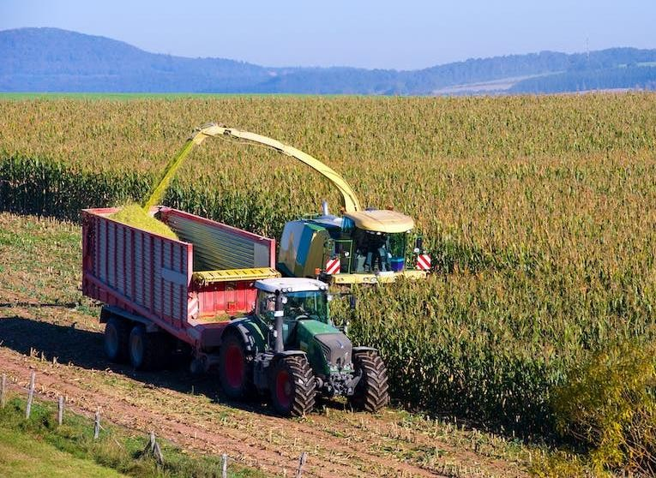
A. Industrial (Conventional) Agriculture
Conventional agriculture is the term for the predominant farming practices, methods, and systems of crop production adopted by producers in a region of production. In
technologically advanced
regions,
generally
these
capital-
production systems are
intensive and chemical-dependent.
Crop
productivity is significantly increased but at a cost to the environment and human health.

Slide 7
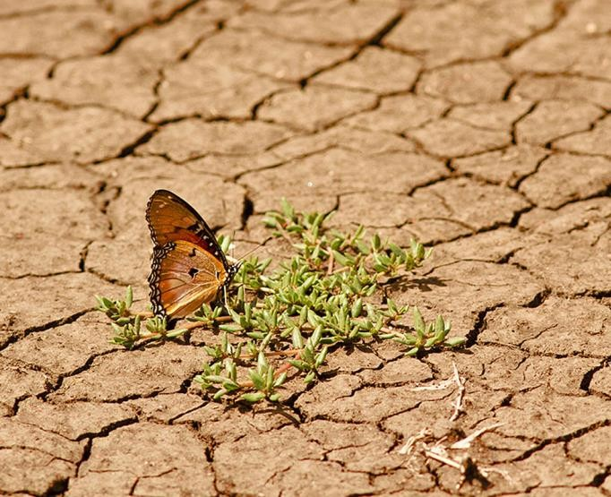
NON-SUSTAINABLE/INDUSTRIAL AGRICULTURE
A. The Green Revolution
-a strategy for increasing food production by targeting maximum yields through a high input of resources.
-has led to more and more problems (economic problems, ecological problems)
deterioration of agroecosystems, e.g. a more limited variety of species of flora and fauna, resistances in pests, deficiencies in the environment and in foodstuffs.

Slide 8
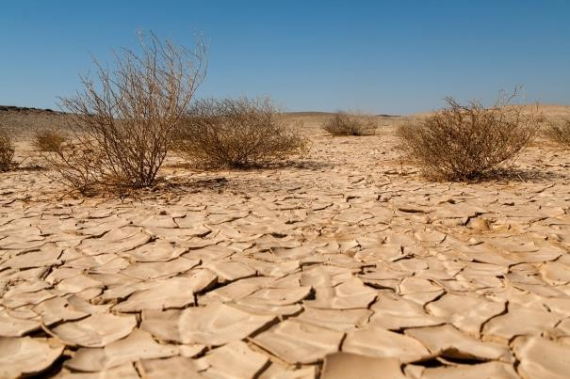
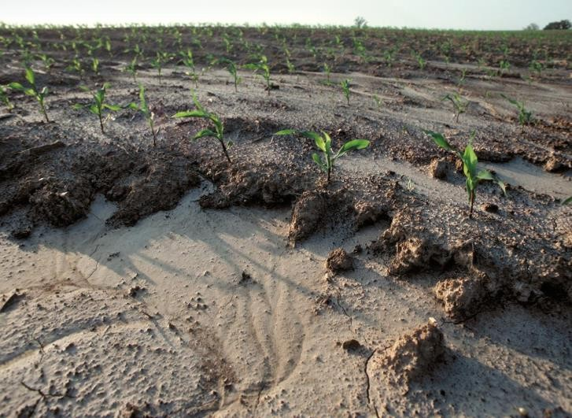
A. The Green Revolution
Drought & desertification
soil erosion
land degradation
ground water mining in well-irrigated regions
extinction of thousands of indigenous varieties of crops and has replaced them with monocultures that require high chemical inputs.
polluted land and water systems
Pesticides leave residues in food and are a hazard to health.
high rates of displacement of small holders, who could not keep up with the vicious cycle of credits and debt associated with high external input agriculture. It has even affected social relationships.
This maximum yield strategy has proved to be non-sustainable.

Slide 9
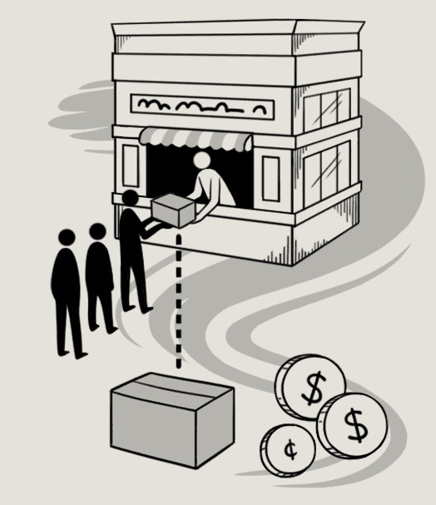
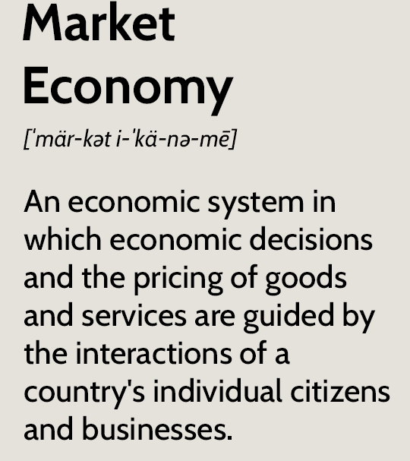
B. Market Economics and Market Agriculture
-the basis of conventional development policies.
-market is the main instrument to regulate supply and demand and hence the flow of materials.
-Profit making is the main driving force. The market economy is based on a linear concept: using huge quantities of energy and raw materials as inputs, processing and transporting them around the globe, and selling them to consumers.

Slide 10
Market economics, translated to agriculture has favored:
Production for the market, leading to increased production of export crops (the external costs being loss of local food self-sufficiency and reinforcement of rural inequities);
Intensified but often inefficient use of external inputs (leading to external costs like pollution, lower food quality, indebtedness and increasing use of non- renewable energy);
Monocropping and simplification of the agroecosystem (leading to soil erosion, loss of diversity, and loss of indigenous knowledge);
Reliance on “modern” technologies and lifestyle (undermining the traditional social and cultural strengths of communities, and increasing the burden on women) (Shiva, 1992).

Slide 11
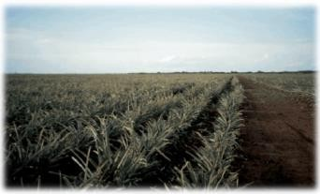
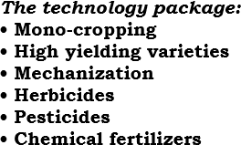
CONVENTIONAL FARMING SYSTEM: THE GREEN REVOLUTION

Slide 12
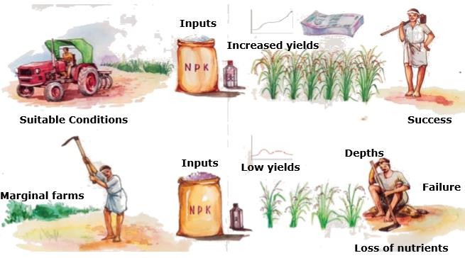
SUCCESS & SHORTCOMINGS OF THE GREEN REVOLUTION
Debts

Slide 13
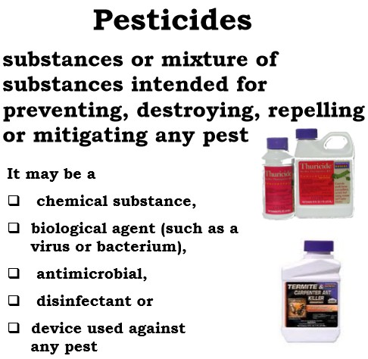
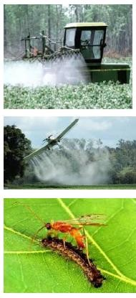

Slide 14
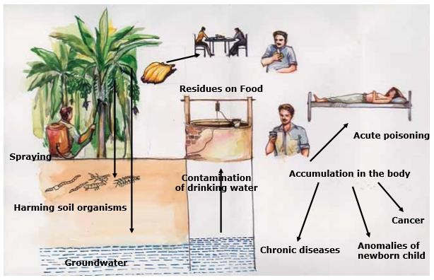
PESTICIDES:
“Plant Medicine” or Poison?

Slide 15
CONVENTIONAL FARMING: Reality
A. Agricultural commodities contain harmful residues from the usage of pesticides, chemicals, etc.
-USDA, on their tests and researches on 1995 which was followed on 2002, found out that among the 12 most commonly eaten agricultural commodities and wheat samples, 73%-90% were contaminated by pesticides, even after washing and peeling
EPA & US Dept. of Health Findings
5are toxic to the nervous system.
18 are harmful to the skin, eyes and lungs.
About half are comprised of cancer- causing chemicals.
17 cause genetic damage.
10 are harmful to reproductive organs.
6 disrupt normal functions of hormones.

Slide 16
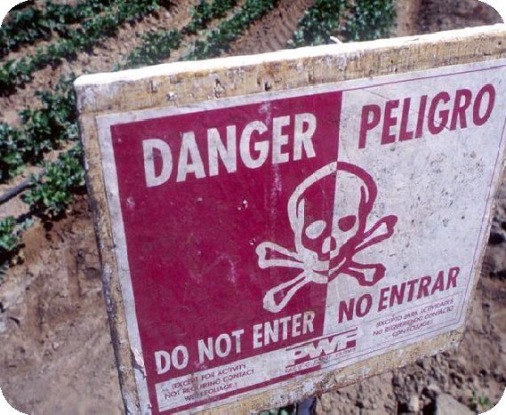



CONVENTIONAL FARMING:
Reality
Pesticide causes:
cancer cases
birth defects
Allergies
other disorders of the nervous,
neurological, hormone,
behavioral, reproductive,
endocrine, and immune systems.
lower sperm counts
Intelligence degradation

Slide 17
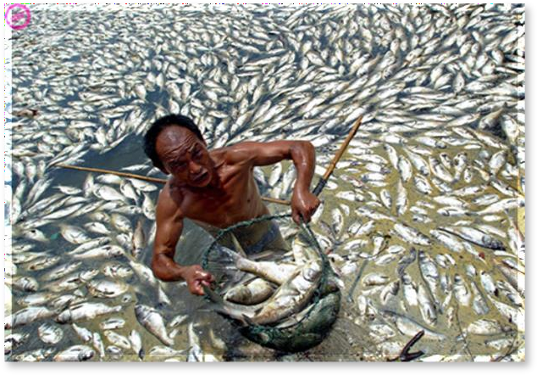
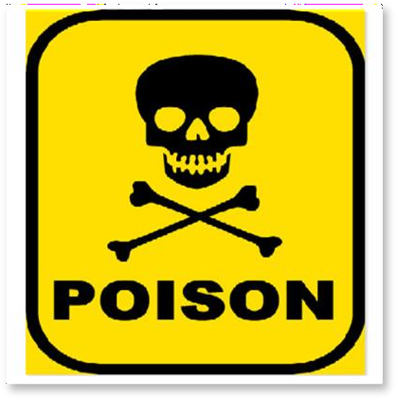
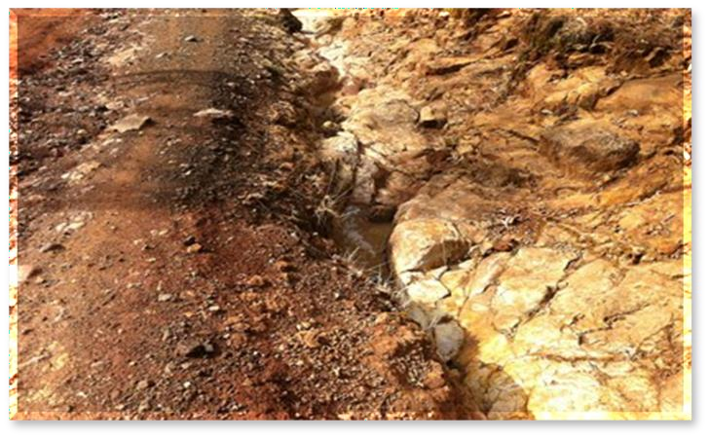
CONVENTIONAL FARMING: Reality
B. Pesticides that are being used to treat insect pest infestations gave way to much more resistant kinds or strains of pests.
C. Commercial chemicals that are being used in crop production contaminate water for drinking, including the rivers, oceans, and other bodies of water.
D. Conventional farming through the use of chemical/commercial fertilizers causes soil degradation.

Slide 18
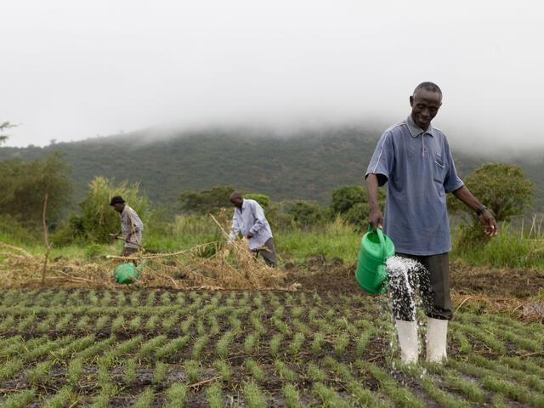
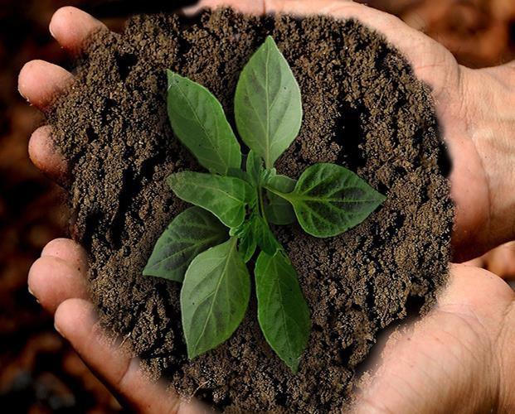
B. Sustainable Agriculture
agricultural production should be viewed from a
whole-systems perspective.
producers to conduct their agricultural activities in
harmony with the biosphere.
the natural resource base of agricultural production should be conserved and protected;
the environment should be protected.
the producer, focuses more on managing the internal resources (natural resources) of the farm (or agroecosystem) rather than on production inputs that are purchased and introduced into production.

Slide 19
B. Sustainable Agriculture
seeks to increase crop productivity without the adverse effects to the environment and society as a whole.
Since this is a concept that emphasizes a goal rather than a set of practices, producers adopt various farm-based innovations to accomplish the general goal. The innovative aspect of sustainable agriculture comes about because there is no one correct way to arrive at the general goal. This is because each producer’s farming situation is different, regarding soils, climate, cropping system, method of production, and market needs.

Slide 20
HISTORICAL ROOTS OF SUSTAINABLE AGRICULTURE
early beginnings in Europe during the post WW I years when factories that were used to manufacture explosives in Europe were transformed into factories for the manufacture of fertilizers. The early beginnings can be traced to Dr. Rudolf Steiner who introduced biodynamic agriculture and founded the Anthroposophical Society in Germany. This movement was later banned during Hitler’s regime but another movement soon followed in France, England and Switzerland when pioneers Howard, Balfour, and Muller introduced the Bio-intensive French method, ecological farming, etc. Soon similar initiatives in other parts of the world followed, e.g. natural farming was introduced by M. Fukuoka in Japan, the introduction of Dr. Conklin of agro-forestry, organic agriculture in the US and Canada, “permaculture” in Australia and most recently, community ecology, which originated in Latin America.

Slide 21
HISTORICAL ROOTS OF SUSTAINABLE AGRICULTURE
In 1972, leaders and representatives of these movements came together to organize themselves into what is now known as the International Federation of Organic Agriculture Movements (IFOAM). The term ‘sustainable agriculture’ then became common reference among its members.
Roots in the Philippines
The idea of sustainable agriculture came to the Philippines through various means. Filipinos who have had links with the different organic agriculture movements abroad initially brought back the ideas into the country. International NGOs and volunteer organizations introduced sustainable agriculture to farmers in the different communities where they were assigned. In the late 1950s, Dr. Harold Conklin published a report regarding his findings with the Mangyan Hanunuo agriculture in Mindoro. This

Slide 22
Roots in the Philippines
introduced sustainable agro-forestry in the country and elsewhere in Asia. In the late 1970s, local NGOs and farmers’ organizations became the leading advocates of sustainable agriculture throughout the archipelago.

Slide 23
Features/Dimensions of Sustainable Agriculture
Ecologically sound
Economically viable
Socially just and equitable, and humane
Culturally appropriate and sensitive
Grounded on holistic science
Founded on the use of appropriate technology
Fully develops the human potential

Slide 24
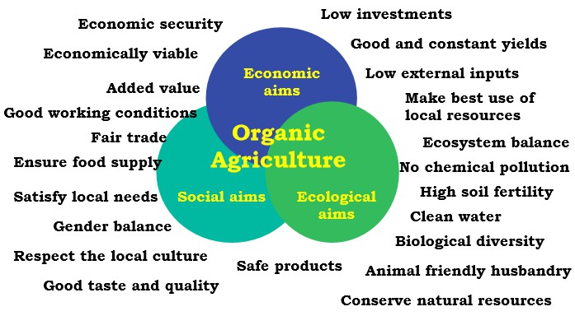
SUSTAINABILITY AIMS

Slide 25
Characteristics of Sustainable Agriculture
Flexible
Experiential
Participatory
Proactive

Slide 26
Goals of Sustainable Agriculture
According to Pretty (1996), sustainable agriculture is any production system that systematically pursues the following goals (Zamora, in Go et al, 1999):
A thorough incorporation of natural processes such as nutrient cycling, nitrogen fixation and pest-predator relationships (rather than pesticides) for pest management. For nutrient management, this involves the recycling of nutrients, use of compost, green manure, and other forms of organic fertilizers.
A minimization or elimination of the use of external and non-renewable inputs such as pesticides and synthetic and highly soluble fertilizers that damage the environment or harm the health of farmers and consumers.

Slide 27
Goals of Sustainable Agriculture
Practice of alternative crop and livestock breeding and selection. Appropriate and highly adapted plant varieties and animal breeds will be conserved, multiplied and utilized.
Practice of diversified and integrated farming system with special focus on functional diversity in the farm.
The full participation of farmers and local and indigenous peoples in all processes of problem analysis, technology development, adaptation and extension.
A more equitable access to productive resources and opportunities.
A greater productive use of local knowledge, practices and resources.
The incorporation of a diversity of natural resources and enterprises within the farms.
An increase in self-reliance among farmers, local and indigenous communities.
The recognition of the role of women in the development process.

Slide 28
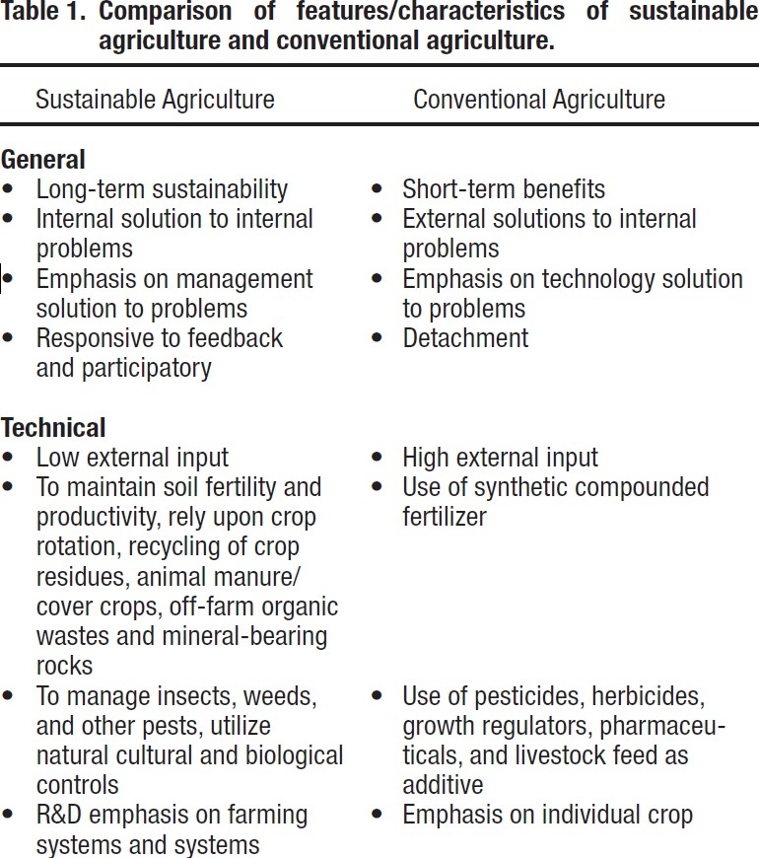
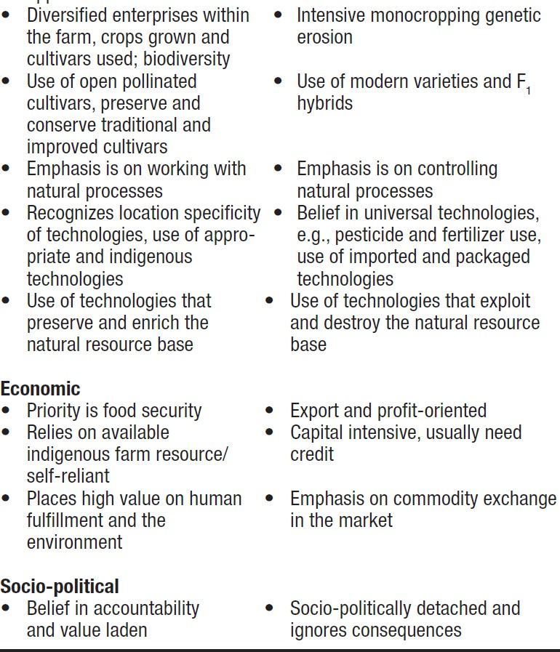

Slide 29
References:
-Certification of Environmental Standards (CERES)
-International Federation of Organic Agriculture Movement (IFOAM)
-Organic Certification Center of the Philippines (OCCP)
-PCARRD Organic Agriculture Training Manual
-Sustainable Agriculture (Canare, Koerkamp)

