Slide 1

GUI for image segmentation
Renjiu Hu
Nov. 28th, 2021

Slide 2
Design
The GUI should be able to load original and save processed images.
The GUI should be able to use traditional numerical method and deep learning method to obtain the segmented images.
Implementation
Image loading and saving functions have been packed in pyQt5.
Manual region plot has replaced the traditional numerical method for exhibition
A U-net neural network found online has been used to display the auto-segmentation.

Slide 3
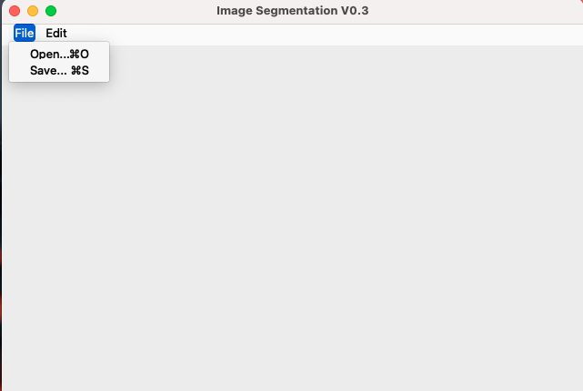
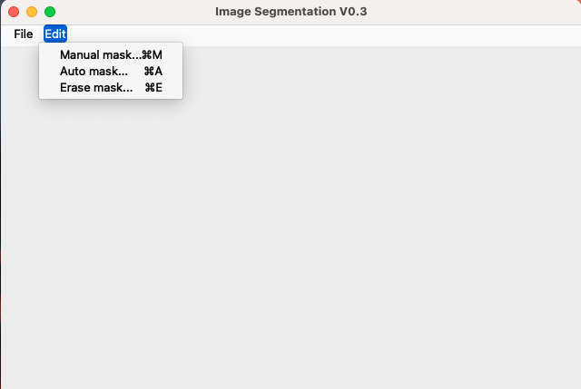
Toolbar
File:
“Open” can load an image in the window
”Save” can store the segmented image
Edit:
“Manual mask” allows users to draw the segment line themselves
”Auto mask” automatically returns the mask of the object
“Erase mask” returns the original image.

Slide 4
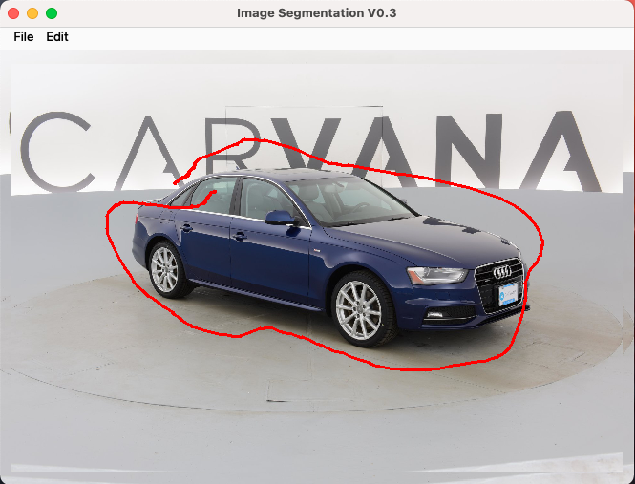
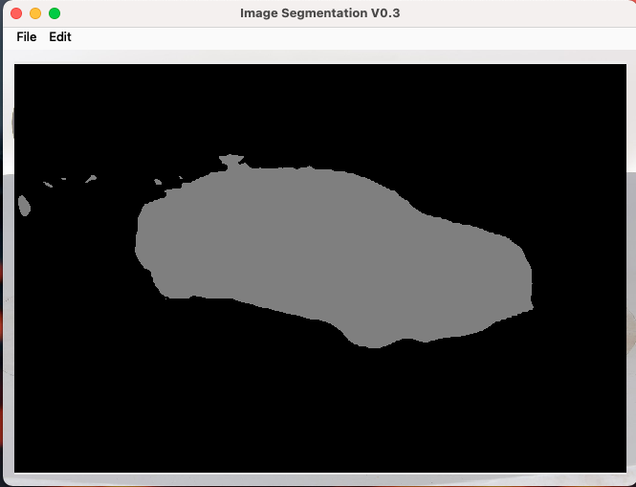
Segmentation
“Manual mask” returns image with segment lines. Further region coloring is needed.
“Auto mask” returns the mask image, users can further post-process the output as a vague mask on the original image.

Slide 5
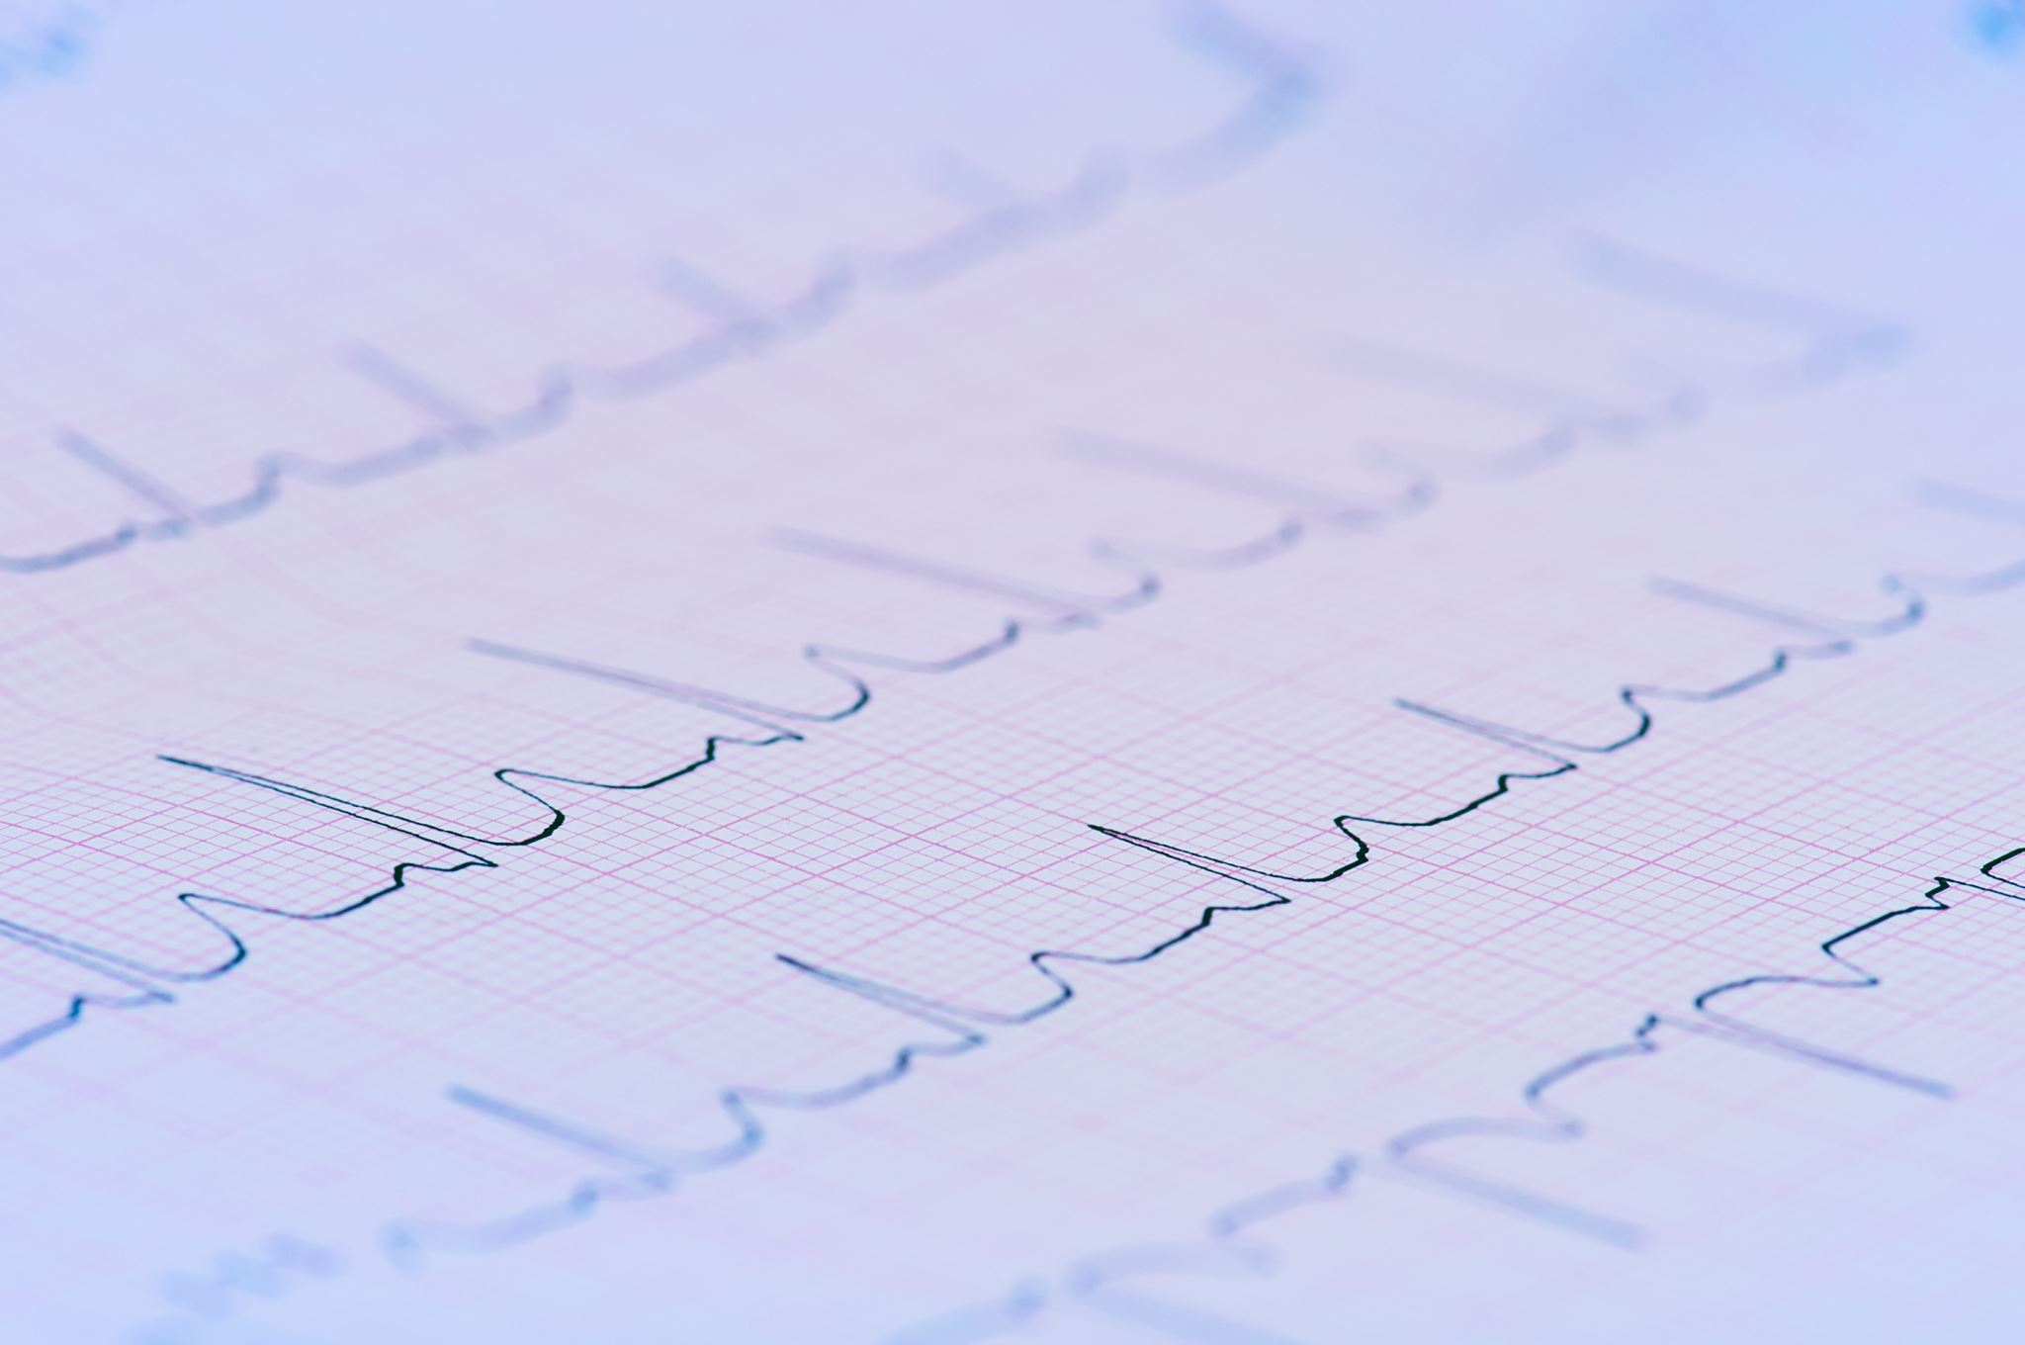
Plan
Replace the random U-net with medical-image-based DNN. (could directly plug-in if exists)
Replace the “Manual mask” with traditional numerical method. (could directly plug-in if exists)
Polish the GUI.

