Slide 1
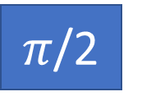








$$f_{q1}=3.689 GHz$$
$$f_{q3}=\text{3.689 }\text{GHz}$$
$$f_{q2 }=3.440 GHz+f\left(t\right)$$
q1
$π$/2
$π$/2
$$readout$$
q2
$$flux bias pulse →f(t)$$
q3
$π$ OR 0
$$readout$$
Time

