Slide 1



INFRES, INC.
PROJECT
FLIXCHILL

Slide 2





ABOUT US
SCRUM Master - Maxence JAMME
Fav tech & Role
Developer - Rogerio GASTAO
Fav tech & Role
Analyst & Architect - Damien PASCUAL
Fav tech & Role
Tester - MARTINEZ Gabriel
Fav tech & Role

Slide 3
SCRUM MASTER
TASKS
DONE
&
NOT DONE
OPEN TRELLO

Slide 4
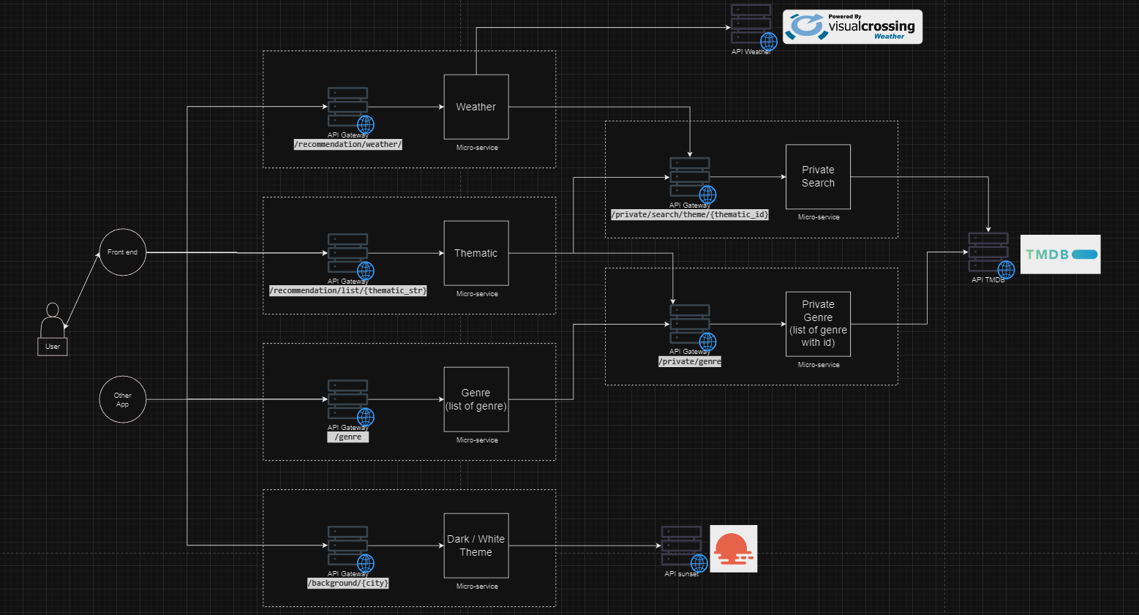
ANALYST & ARCHITECT
OPEN DIAGRAM

Slide 5

DEVELOPER
TECH USE
ISSUE
SHOW IMPLEMENTATION

Slide 6




TESTER
GUIDE THROUGT THE APP
AUTOMATIC TEST
SAMPLE CALLS

Slide 7
THANK'S FOR WATCHING
If you have any questions, don't hesitate !
INFRES, INC.

