Slide 1


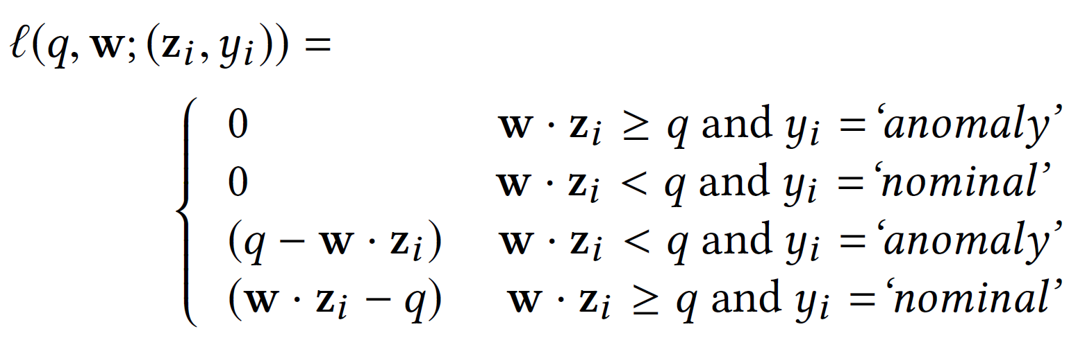
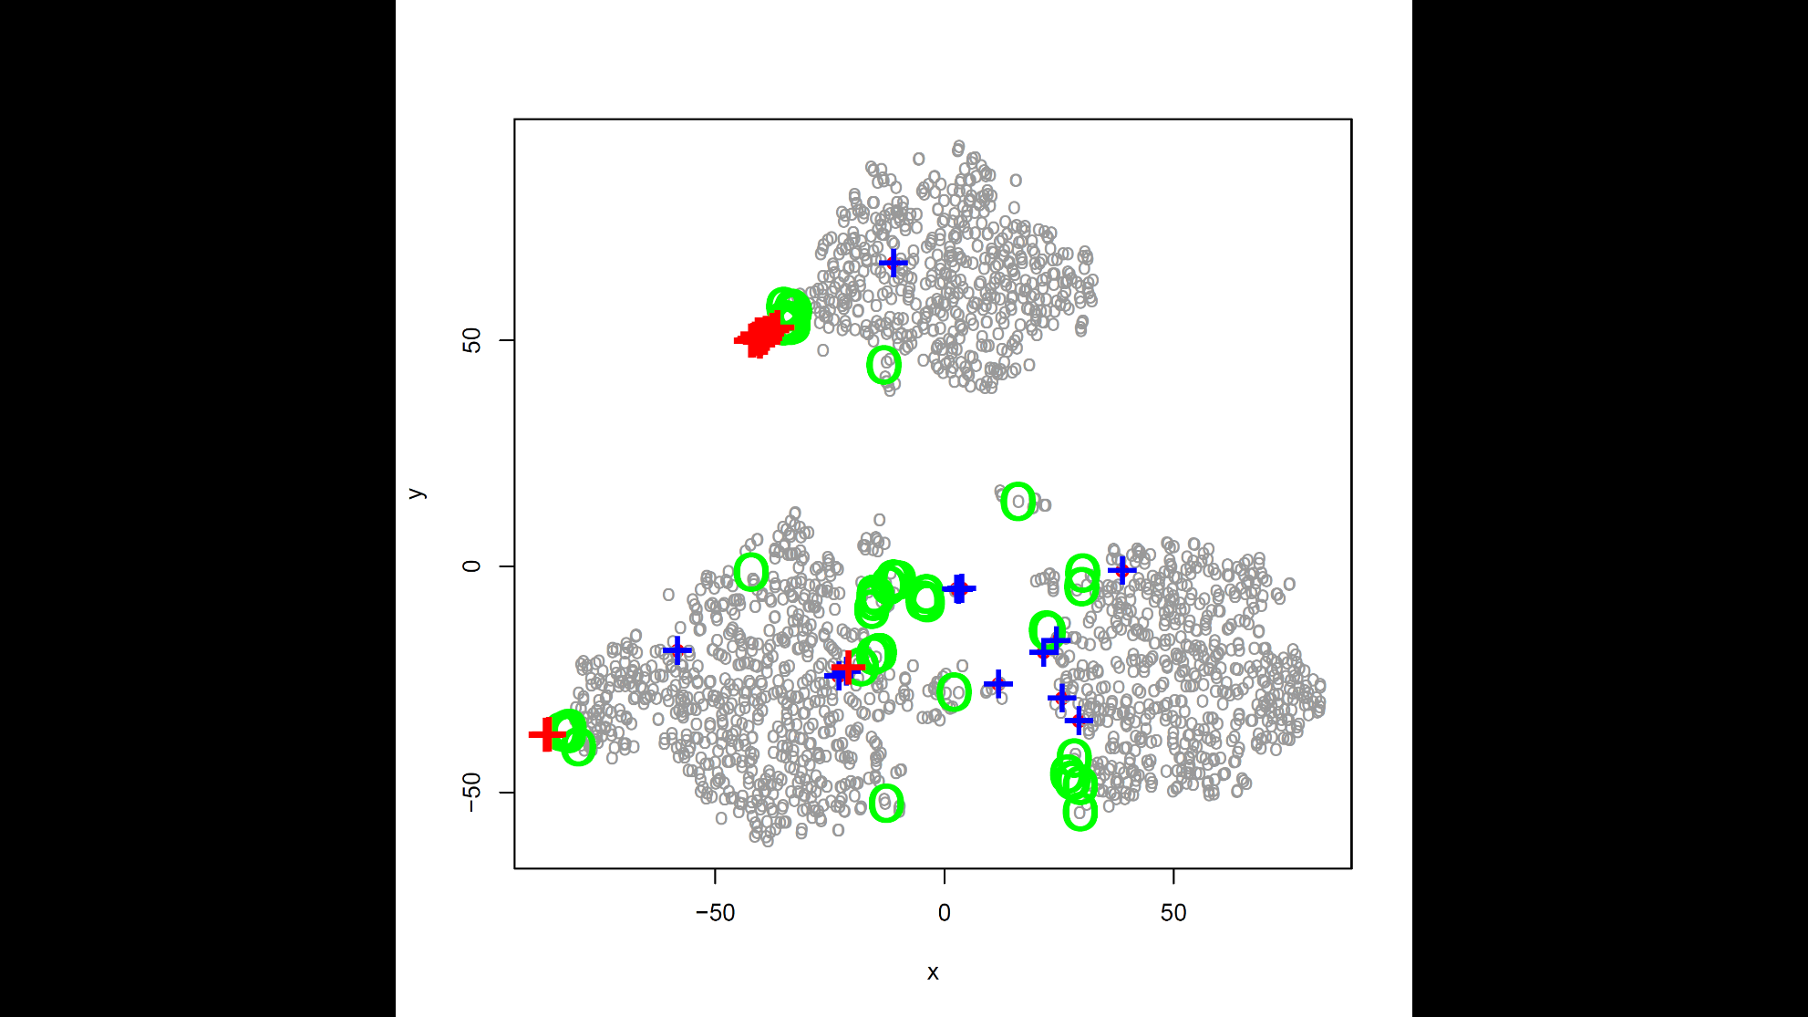
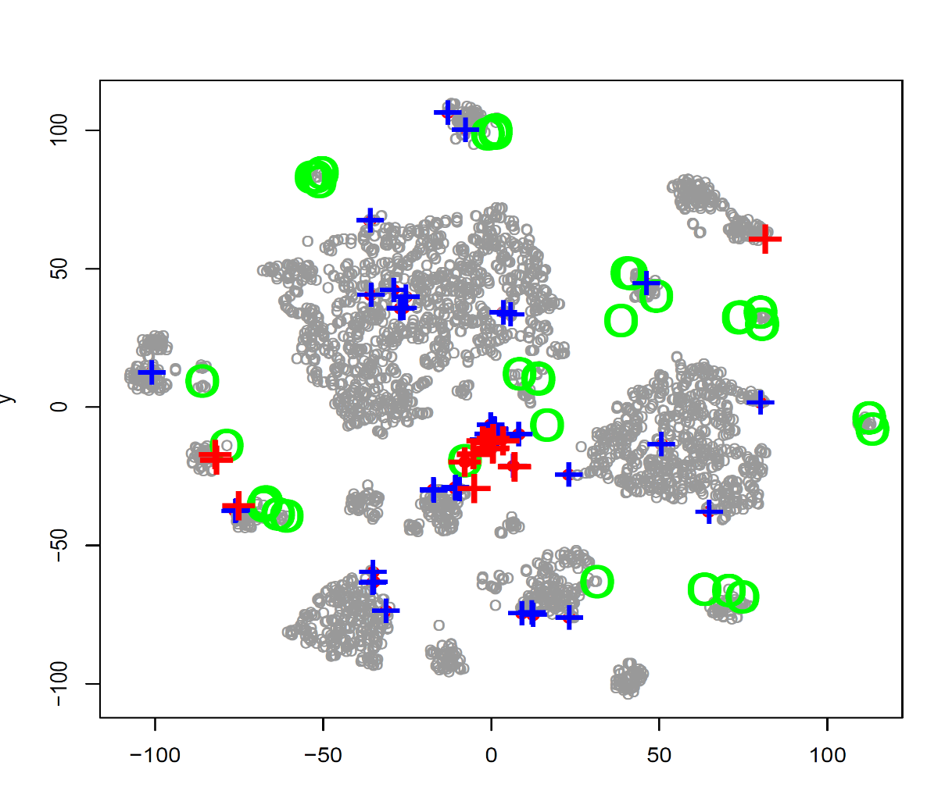
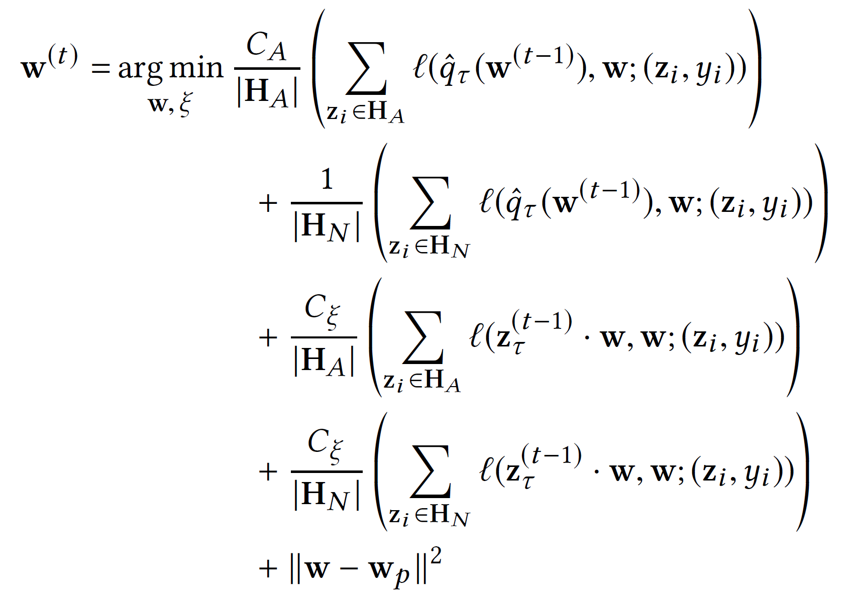
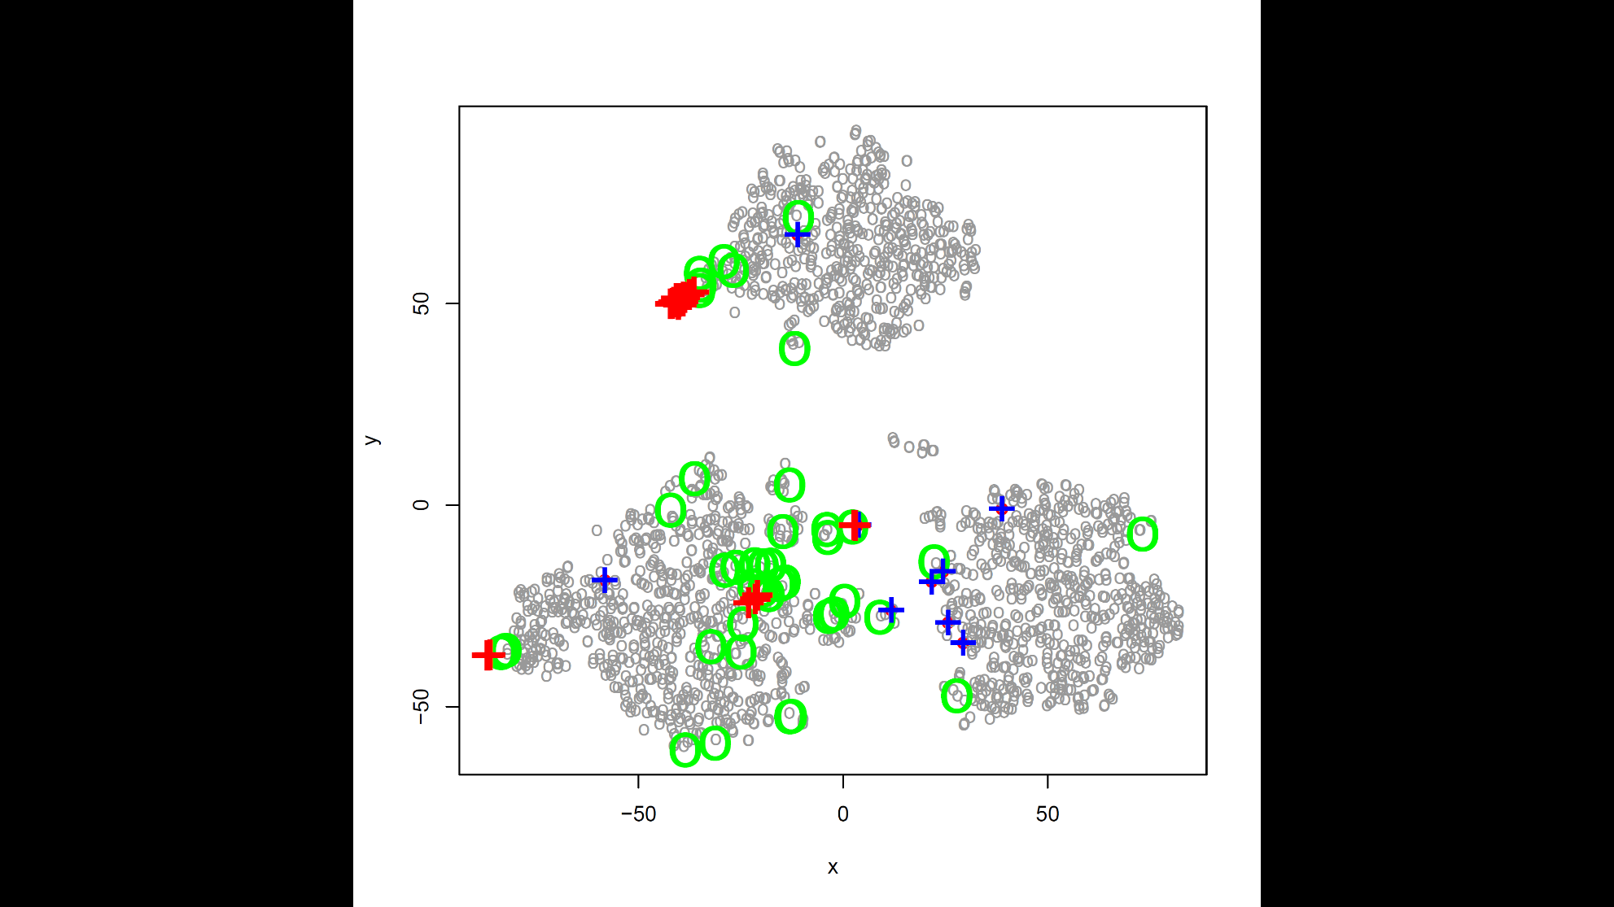
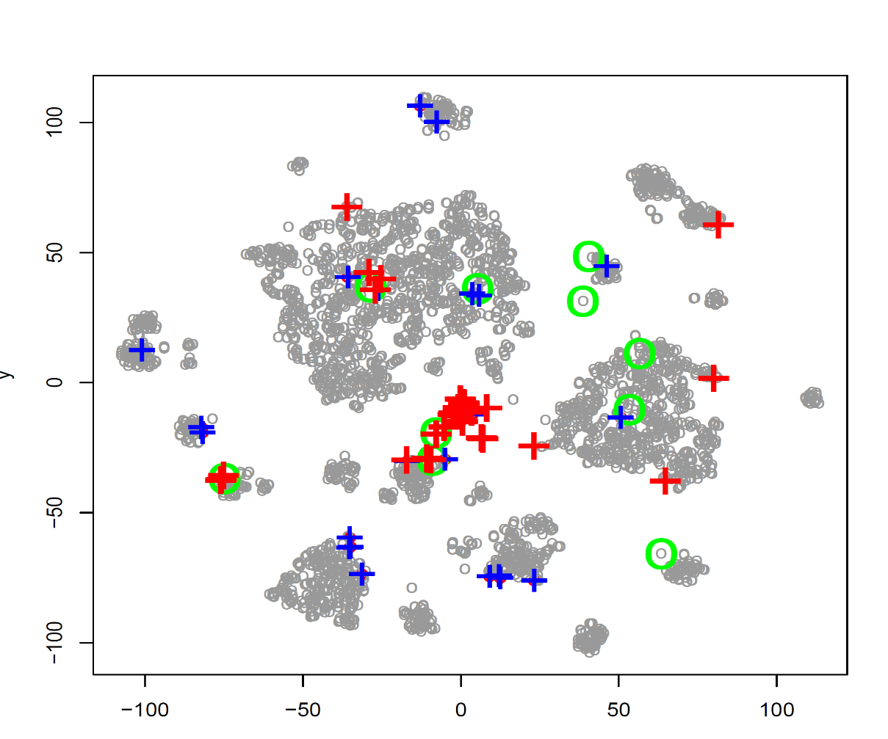


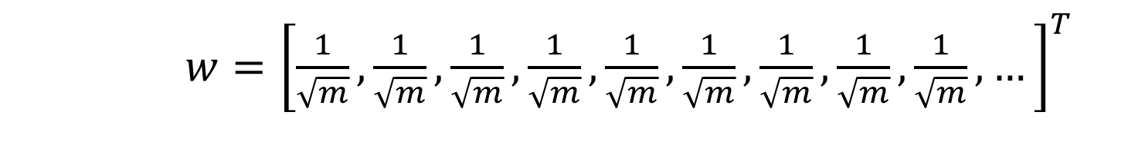






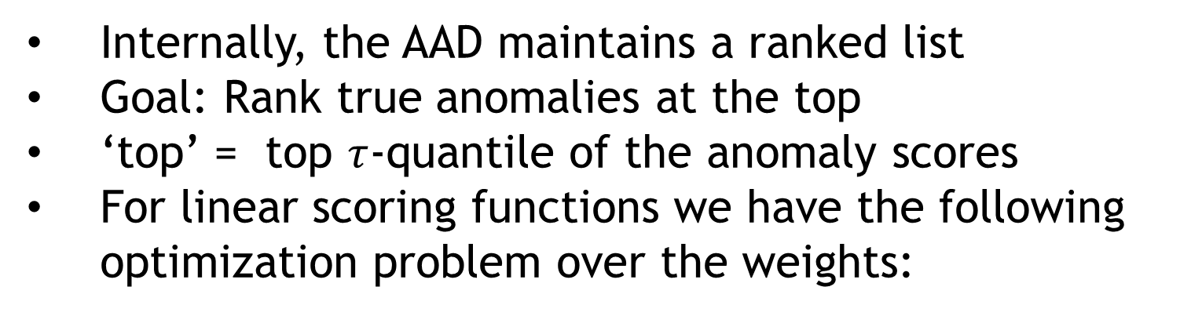
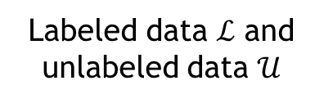
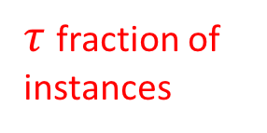
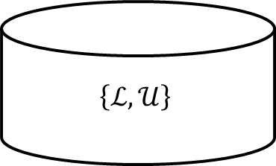

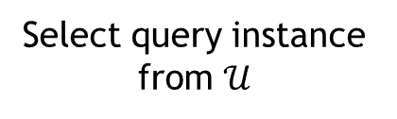

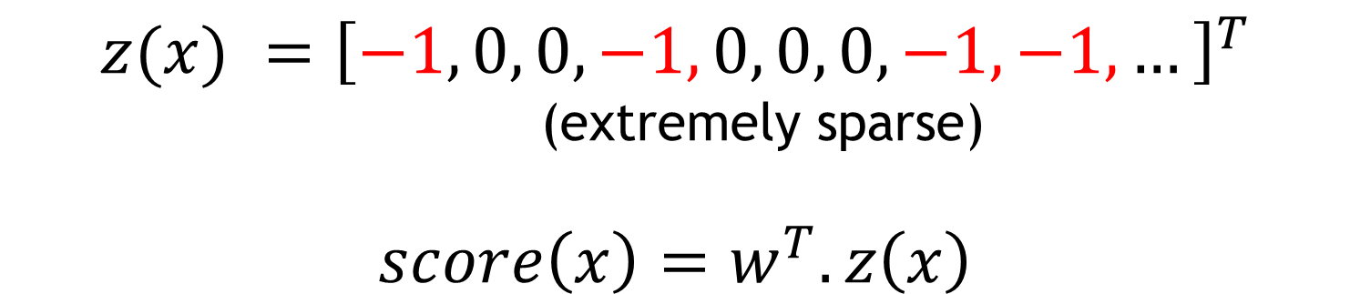
Incorporating Feedback into Tree-based Anomaly Detection
Shubhomoy Das, Weng-Keen Wong, Alan Fern,
Thomas G. Dietterich and Md Amran Siddiqui
School of EECS
Oregon State University
ACTIVE ANOMALY DISCOVERY (AAD)
WEIGHTED REPRESENTATION OF TREES
Labeled data $ℒ$ and unlabeled data $𝒰$
<
≥
$$\left\{ℒ,𝒰\right\}$$
Train with $\left\{ℒ,𝒰\right\}$
Tree-based detector
<x,y=A/N>
Continue loop until budget expires
Select query instance from $𝒰$
<x,?>
query
Maximize the number of true anomalies presented to the user
ANOMALY DETECTION
Anomalies are those points that are generated by a process that is distinct from the process generating “normal” points
analyst
$$x$$
MAIN INTUITION:ACCURACY AT THE TOP
$w=$ ${\left[\frac{1}{\sqrt{m}},\frac{1}{\sqrt{m}},\frac{1}{\sqrt{m}},\frac{1}{\sqrt{m}},\frac{1}{\sqrt{m}},\frac{1}{\sqrt{m}},\frac{1}{\sqrt{m}},\frac{1}{\sqrt{m}},\frac{1}{\sqrt{m}},…\right]}^{T}$
$$q_{τ}$$
decreasing anomaly scores
$$z(x) ={\left[−1, 0, 0, −1, 0, 0, 0, −1, −1, …\right]}^{T}$$
(extremely sparse)
$$score\left(x\right)=w^{T}.z\left(x\right)$$
CHALLANGES
Too many false positives ☹
Solution: Incorporate analyst feedback into anomaly detector
anomalies on this side
$τ$ fraction of instances
nominals on this side
Internally, the AAD maintains a ranked list
Goal: Rank true anomalies at the top
‘top’ = top $τ$-quantile of the anomaly scores
For linear scoring functions we have the following optimization problem over the weights:
EFFECTS OF FEEDBACK
TREE-BASED ANOMALY DETECTORS
Isolation Forest
HS-Trees
RS-Forest
RPAD
Random Projection Forest
…
Increase focus where anomalies have been discovered previously
Abalone Baseline
𝝤 False Positive
+ False Negative
+ True Positive
𝗈 True Negative
ANN Thyroid 1v3 Baseline
ISOLATION FOREST
Random feature and random split point
Nominal
Anomaly
<
≥
Remove focus from unpromising regions
Isolation tree in an Isolation Forest
$$q_{τ}^{t}$$
$$q_{τ}^{t+1}$$
$$q_{τ}^{t+2}$$
…
Abalone IF-AAD
ANN Thyroid 1v3 IF-AAD
RESULTS
Abalone
Covtype
Mammography
Leaf instances
A node’s score is a function of path length
$$w^{t}$$
$$w^{t+1}$$
$$w^{t+2}$$
CONTOUR RESULTS
Cardiotocography
KDDCup99
ANN Thyroid 1v3
Synthetic Dataset
True anomalies
RUNTIME PLOTS
Random splits from a single tree
Score contours from a single tree
Covtype
Mammography
Shuttle
CONCLUSION & FUTURE WORK
Average of 10 trees. Typically 100 trees in practice
Baseline discovers 12 anomalies in 35 iterations
AAD discovers 23 anomalies in 35 iterations
Human feedback is essential and improves the unsupervised learner ☺
Extend to other types of anomaly detectors
Explanation based feedback

