Slide 1

Incorporating Feedback into Tree-based Anomaly Detection
Shubhomoy Das, Weng-Keen Wong, Alan Fern,
Thomas G. Dietterich and Md Amran Siddiqui
School of EECS

Slide 2
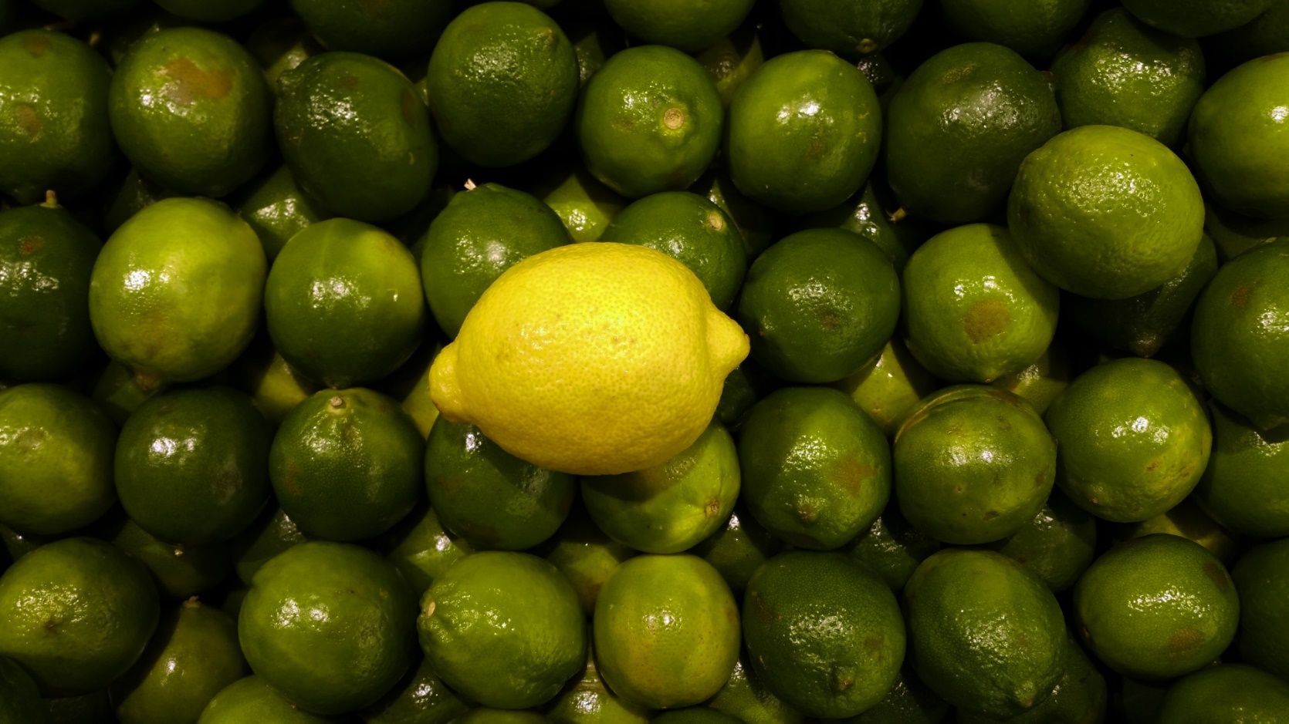
Anomaly Detection
Goal: Identify rare or strange objects

Slide 3
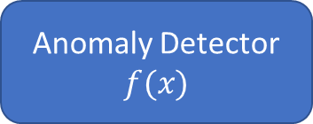
Typical Investigation
Anomaly Detector
$$f(x)$$
Ranking
Major problem: Statistical anomalies don’t necessarily correspond to semantic anomalies
Need to deal with large number of false positives
.
.
.

Slide 4

Investigation with Feedback
Anomaly Detector
$$f(x)$$
Ranking
Ranking is adaptive
Reduces false positive
Anomaly
Nominal
.
.
.

Slide 5
Tree-based Anomaly Detection
Isolation Forest
HS-Trees
RS-Forest
RPAD
Random Projection Forest
…

Slide 6
Isolation Forest
Typically 100 trees in practice
Random feature and random split point
<
≥
Shallow leaf indicates anomaly
Deeper leaf indicates nominal

Slide 7


Weighted Representation of Trees
<
≥
$z(x) ={\left[−1, 0, 0, −1, 0, 0, 0, −1, −1, …\right]}^{T}$
(extremely sparse)
Weights for isolation forest:
$w=$ ${\left[1, 1, 1, 1, 1, 1, 1, 1, 1,…\right]}^{T}$
Different set of weights will result other tree based detectors
$score\left(x\right)=w^{T}.z\left(x\right)$
$$x$$

Slide 8






Active Anomaly Discovery
Nominal
Anomaly
$$q_{τ}^{t}$$
$$q_{τ}^{t+1}$$
$$q_{τ}^{t+2}$$
…
$$w^{t}$$
$$w^{t+1}$$
$$w^{t+2}$$

Slide 9
Result
True anomalies
Synthetic Dataset
Baseline discovers 12 anomalies in 35 iterations
AAD discovers 23 anomalies in 35 iterations

Slide 10
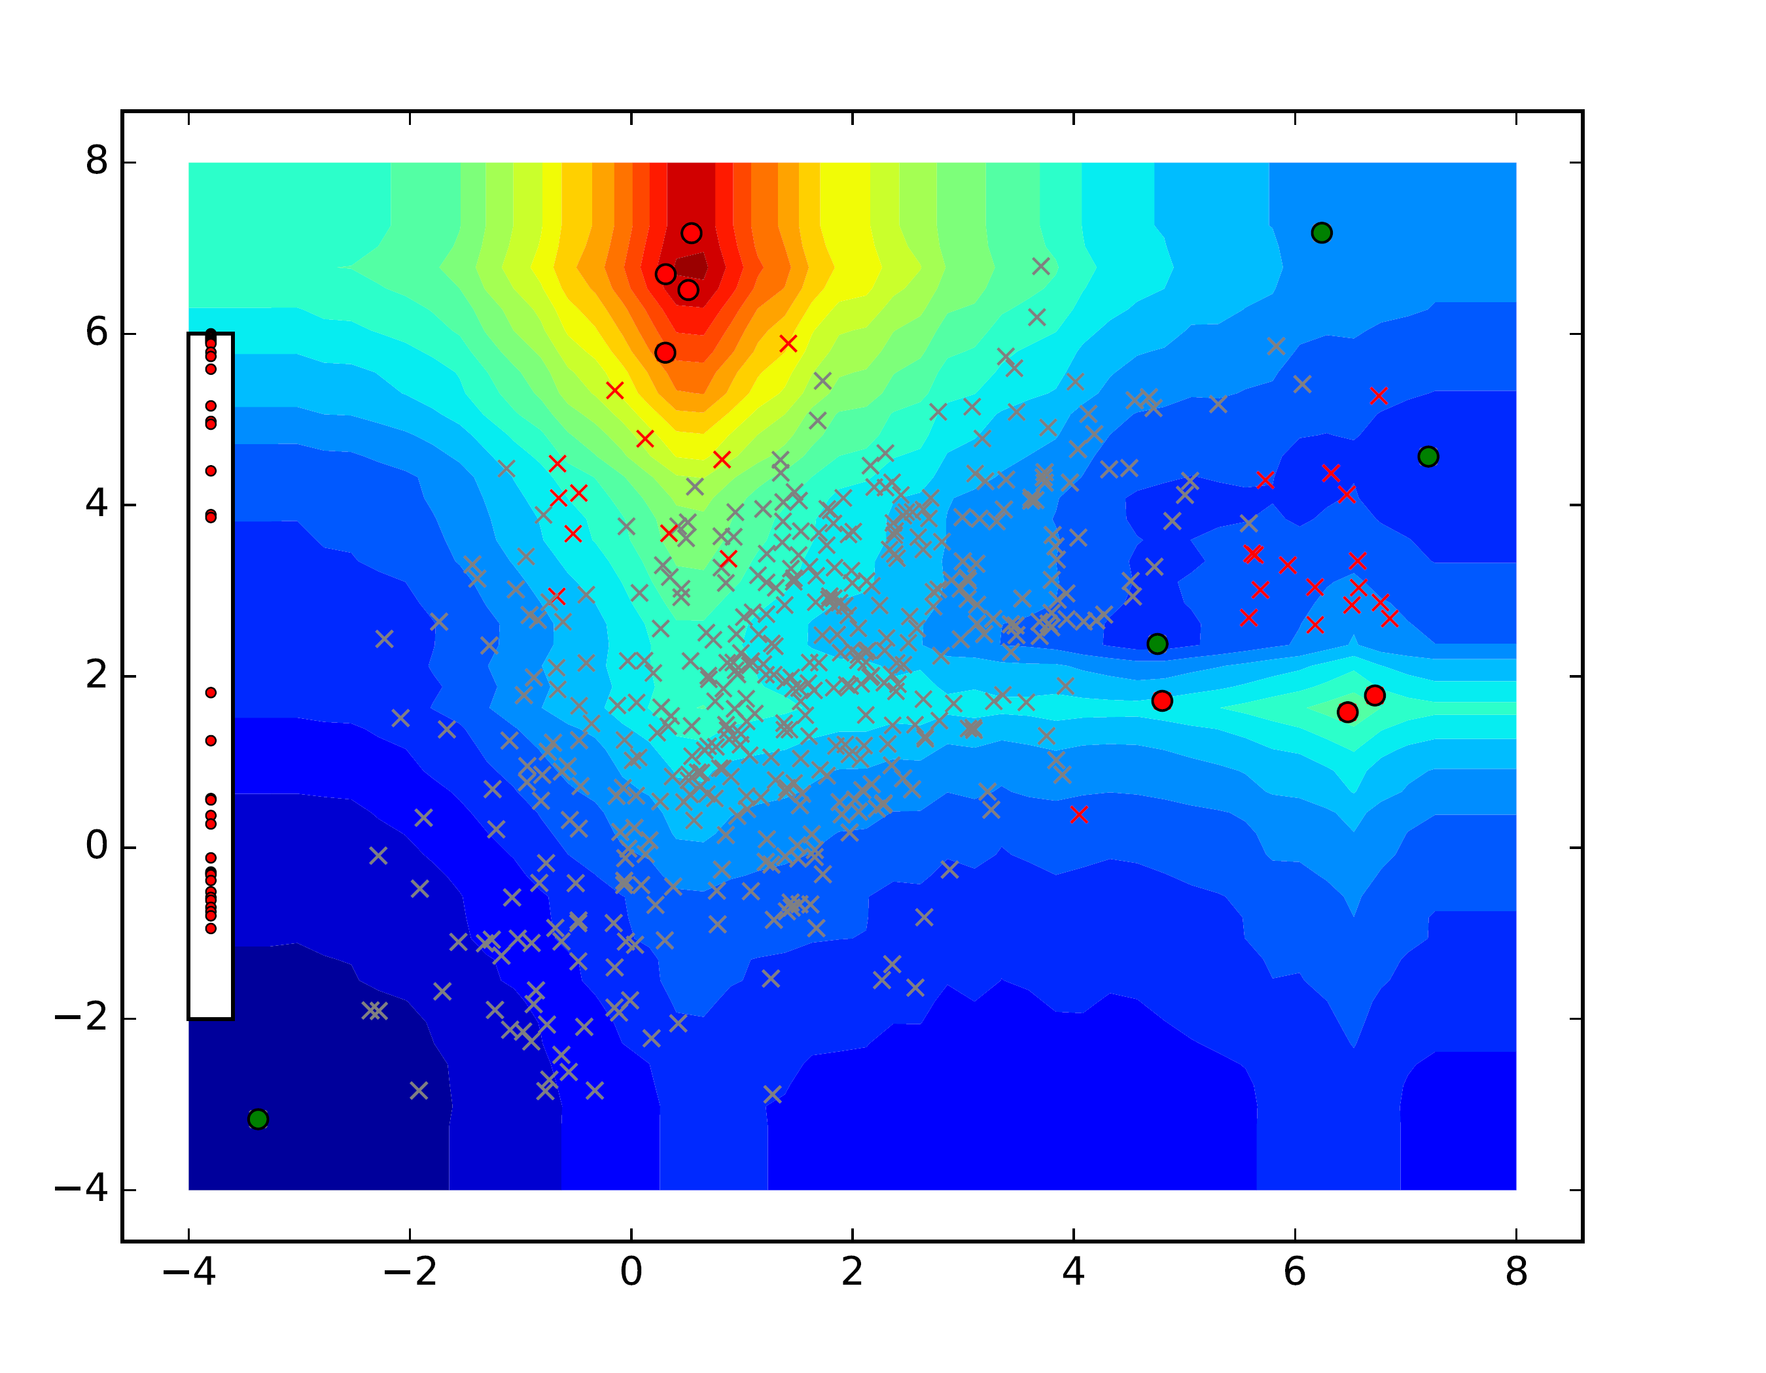
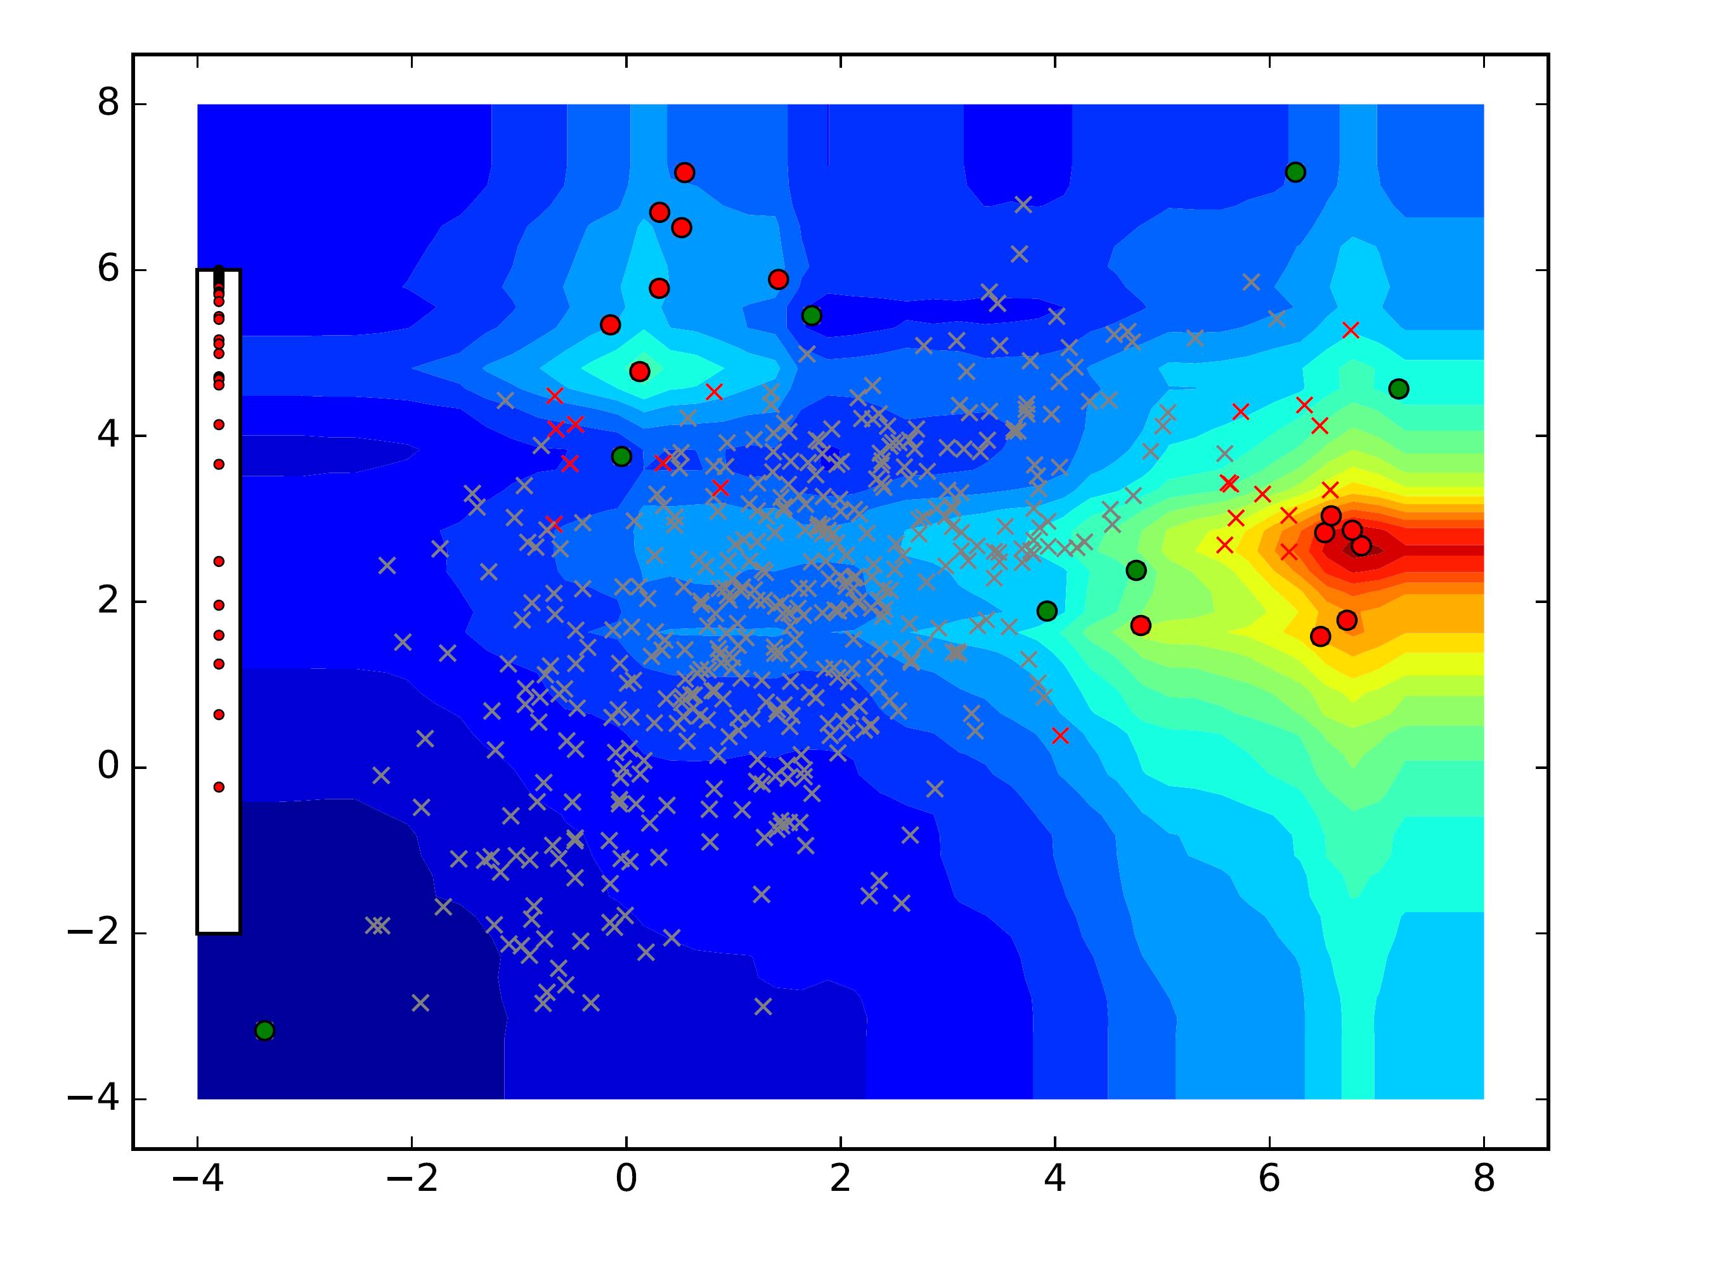
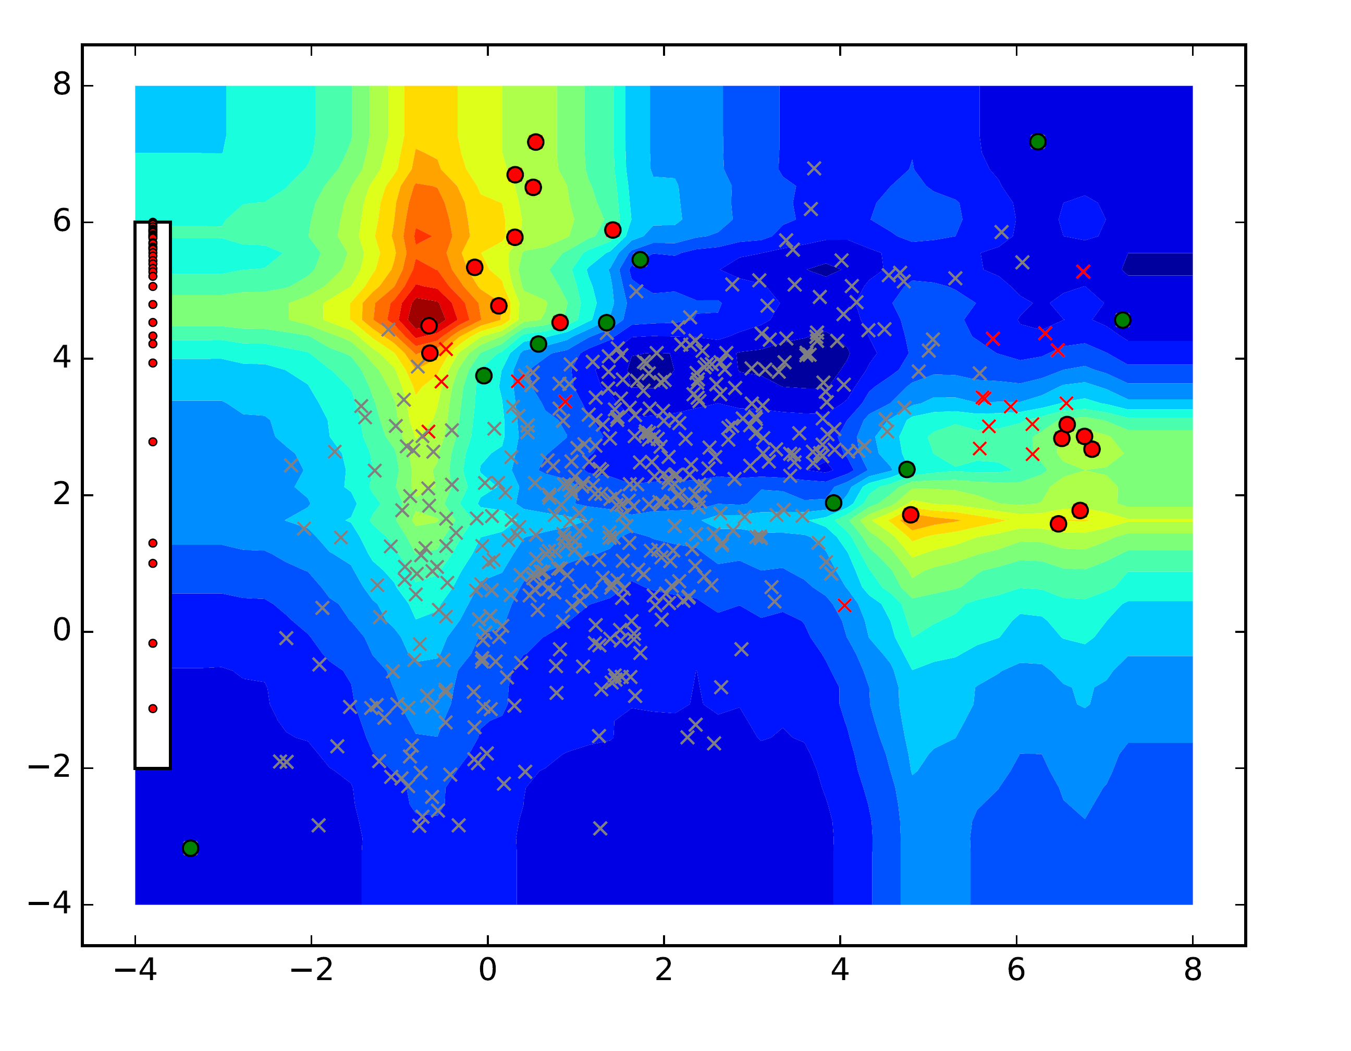
Result
0 Feedback
10 Feedback
20 Feedback
25 Feedback
35 Feedback

Slide 11
A closer look at the data with t-SNE
Abalone Baseline
ANN Thyroid 1v3 Baseline
Effect of feedback
Increase focus where anomalies have been discovered previously
Remove focus from unpromising regions
Abalone IF-AAD
ANN Thyroid 1v3 IF-AAD
𝝤 False Positive
+ False Negative
+ True Positive
𝗈 True Negative

Slide 12
Abalone
Covtype
Mammography
Cardiotocography
KDDCup99
ANN Thyroid 1v3
Notes:
The x-axis is the number of queries presented to the user; y-axis is the number of true anomalies observed. The good algorithms climb quickly. We are consistently one on the top ones.

Slide 13
Conclusion & Future Work
Human feedback is essential and improves the unsupervised learner ☺
Extend to other types of anomaly detectors
Explanation based feedback

Slide 14
Questions?

Slide 15
Extra Slides

Slide 16
Results (adjusting tree weights instead of node-weights)
Abalone
Covtype
Mammography
Cardiotocography
KDDCup99
ANN Thyroid 1v3
Notes:
In IF-AAD-Tree, instead of treating Isolation Forest as an ensemble of nodes, we treat it as an ensemble of trees. Thus, there are 100 ensemble members. We adjust the weights of each tree following the AAD approach. We see that IF-AAD-Tree has similar performance as IF-AAD on most datasets, and is slightly worse in Mammography and ANN-Thyroid 1v3. The reason is likely that IF-AAD has higher capacity to fit labeled data because the number of ensemble members in IF-AAD is much higher (few thousands) than IF-AAD-Tree (100 in the experiments).

Slide 17
Timing Plots
Covtype
Mammography
Shuttle
Notes:
Scales linearly with the amount of labeled data

