Slide 1
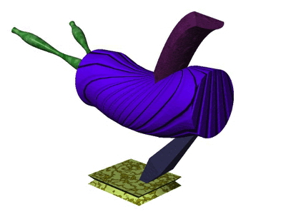
Notes:
Fa3_1111_X

Slide 2
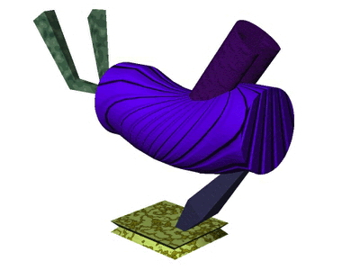
Notes:
Fa3_1231_X

Slide 3
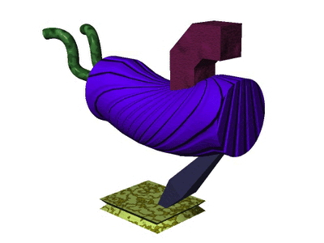
Notes:
Fa3_1321_X

Slide 4
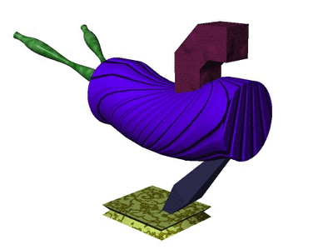
Notes:
Fa3_1121_Y

Slide 5
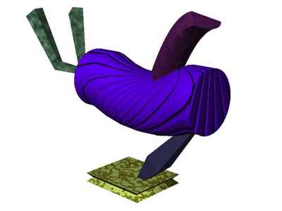
Notes:
Fa3_1211_Y

Slide 6
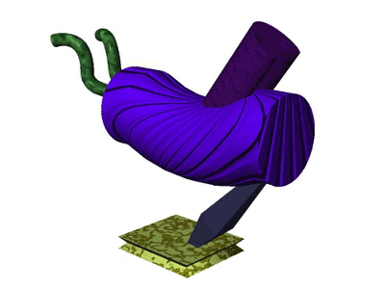
Notes:
Fa3_1331_Y

Slide 7
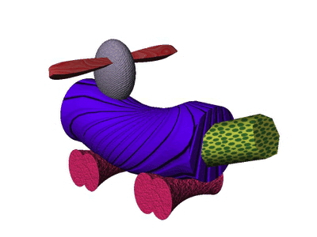
Notes:
Fa2_2121_m

Slide 8
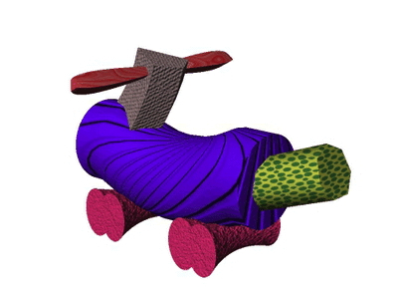
Notes:
Fa2_2122_m

Slide 9
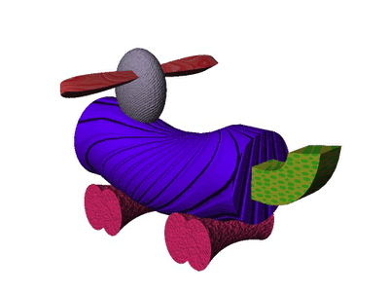
Notes:
Fa2_2221_m

Slide 10
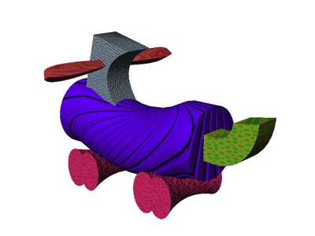
Notes:
Fa2_2223_m

Slide 11
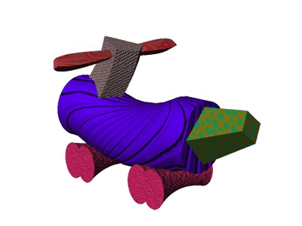
Notes:
Fa2_2322_m

Slide 12
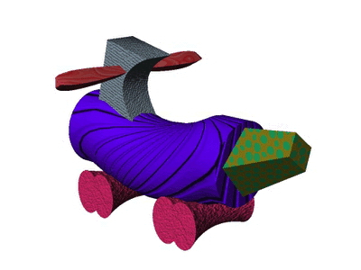
Notes:
Fa2_2323_m

