Slide 1
R-Type
B5 – Advanced CPP

Slide 2
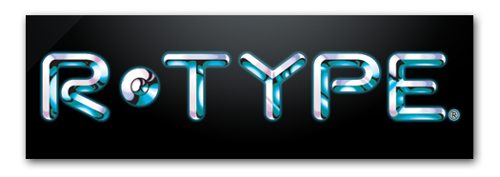
R-Type, the game
Space themed 1987 arcade game
Horizontal Shooter – Shoot 'em up
Simple Gameplay:
- Kill evil aliens
- Acquire power-ups
- Defeat Bosses
- Go to next level

Slide 3
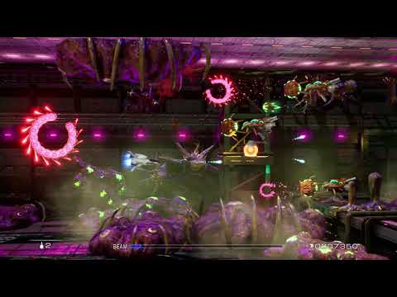
Gameplay Demo

Slide 4




Objectives
Design you networked game-engine in C++
- Network programming
- Game Engine architecture
- Networked Multiplayer Game
Explore advanced topics
- Architecture
- Network
- Game design
Adopt proper software engineering practices
- Documentation
- Build/packaging tools
- VCS workflow
- Cross-platform programming

Slide 5
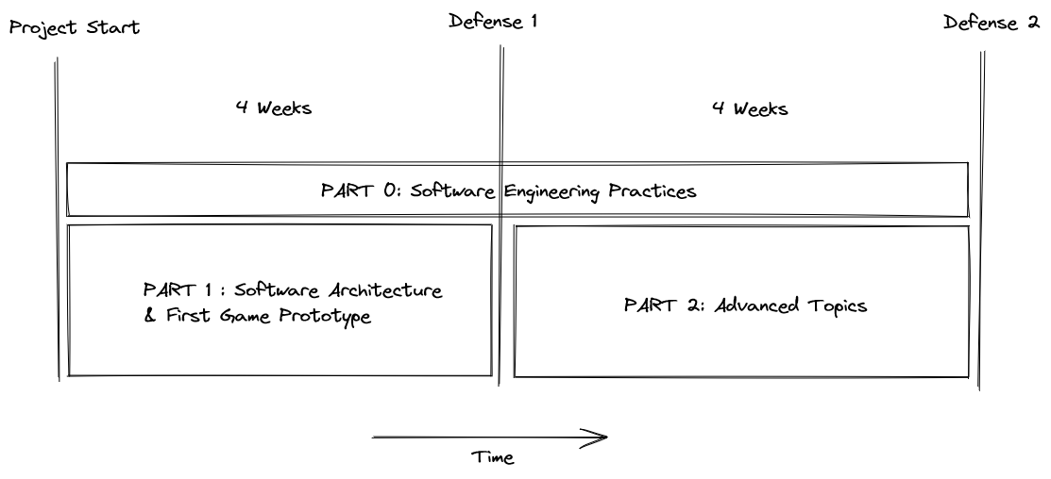
Overview
Part 0 – Software Engineering
- "Professional" product
- Both defense – 1 credit each
Part 1 – Prototype
- Core features
- Basic gameplay
- 1st defense - 2 credits
Part 2 – Advanced software
- Improve the prototype
- Pick & choose advanced topic
- 2nd defense - 2 credits
Bonus – National Jury
- A grade only
- 2 bonus credits for best projects

Slide 6
Part 0 – Software engineering
The difference between project and product

Slide 7
Project or Product ?
Project
- "Work on my computer"
- "Here are the dependencies you need"
- "Just ping me if you have questions"
- "Hop on the discord if you have idea"
Product
- Work everywhere
- Install its dependencies
- Well-made documentation
- Contributing rules & guidelines

Slide 8

Expectations
Self-contained project
- No need to manually download dependencies
Cross-platform – At least 2 platforms supported
- Windows/Linux (No, WSL doesn't count)
- Mac is also unix based (an argument can be made about M1 chips)
Proper VCS workflow
- Branches
- No "live-share"
- Explicit commits title & body
Packaged Release
- CMake´s CPack module
- Github's Release page

Slide 9

Documentation
Proper documentation is MANDATORY!
It must be up to date!
Useful Readme
- Install info
- Usage
- Examples
- etc.
Developer documentation
- Diagrams (layers, subsystems, UMLs, etc.)
- Subsystems explanation
- Tutorials/wiki/how-to's
- In-code documentation

Slide 10
Documentation - Protocol
What make a good protocol documentation
- language agnostic
- enough to write a client
- acknowledge possible errors
- explain how to handle them
- Follow standard formatting (RFC)
Tips:
- Integer, internal padding, etc. are compiler & language dependent
- Enums means nothing. Values do.
- Diagrams can be clearer than words

Slide 11
Various considerations
PDF & Words aren't proper documentation format.
In code documentation formats
- allows for IDE integration
- allows for interactive doc generation
- are a good practices
Some tools are widely used
- Markdown, RestructuredText, Sphinx, Doxygen
Github markdown support links.

Slide 12
Part I – Prototype
Starting a project, the correct way

Slide 13
What is a prototype ?
Not feature complete
- Core feature are there
- Don't care too much about details
Make careful architectural choices
- But remember that you will refactor later
Good questions to ask
- Do I need network in an online multiplayer game ?
- Do I need a menu ?
- How does my current choices impact the future of the project ?

Slide 14
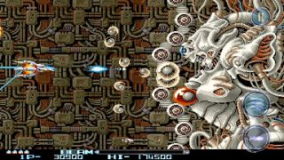
Objectives
Design your networked multiplayer engine
- Have a proper software architecture
Create a basic R-Type like Gameplay
- Moving player
- Moving monster
- Basic interaction (killing enemies, dying, etc.)
Have a proper base for Part II

Slide 15
Part II - Improvements
Beyond the prototype

Slide 16
Where to go now ?
The only way is further
- Refactoring is progress
3 technical tracks​
- Advanced Game engine​
- Advanced Networking​
- Advanced Game-design​
Each track have several topics​
- You can choose topics from each tracks​
- Quality & difficulty > quantity​
- Emphasis on future proofing​
​
More information next kick-off​

Slide 17
Design, Concept & Idea
Let’s make some multiplayer game engine !

Slide 18
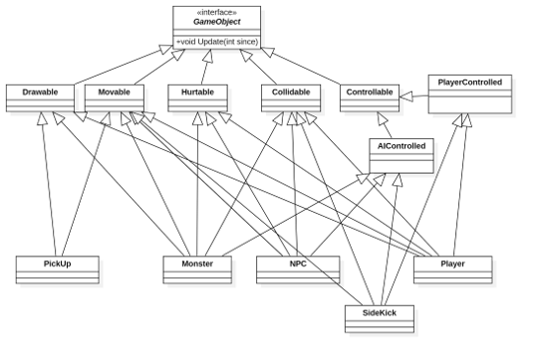
Engine Design – OOP shortcomings
Should unrelated objects have a common ancestors ?
How many ancestors should an object have?
  Does it make sense ?
How to handle dynamic changes ?
How to handle configuration ?
Can we do better ?
  Composition over inheritance !

Slide 19
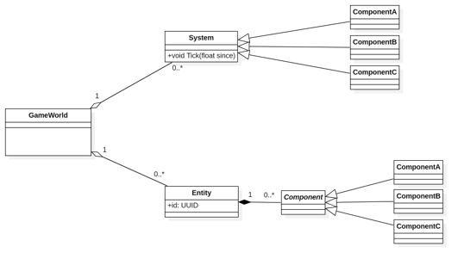
Engine Design – ECS
Entity
- Identify a "thing" inside the engine
- Can be a simple ID
Component
- Identity a trait or capability an Entity has
- Simple POCO (struct)
- Contains data
Systems
- Implement the actual logic and behaviors
- Simple functions (or script)
- Most works on only a few components
- Apply the same function to all entities with given components

Slide 20
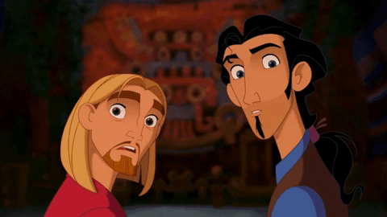
Multiplayer Design – What should the server do ?
Everything ?
- Can ensure data consistency
- Usually, a bad idea
- Networking is sloooow
"​Only" Room, chat & Match making ?
- Who is responsible for data consistency ?

Slide 21
Multiplayer Design – Where is the Engine ?
Server side only
Client is simpler
Rendering and input handling only
Client is lost without constant stream of data.
Server must handle inputs
Server & Client side
Server is responsible for data
Client can react "instantly" to the inputs
("tighter" controls).
Some way of reconciliation is needed (rollback ?)
More "balanced" usage that client side only.
Less processing overall (the server don't care about inputs, only actions and positions)
Client side only
One client must ensure consistency
Each client render its own game
Host can cheat
Host must be powerful enough for 2 games.

Slide 22

Network programming for games
Some question to ask
- What should I send ?
- How often ?
- Do I need speed or reliability ?
- What happen if it never arrive ? Arrive twice ?
Some answer
- User input is important
- Game data isn't (you can lose part of it)

Slide 23
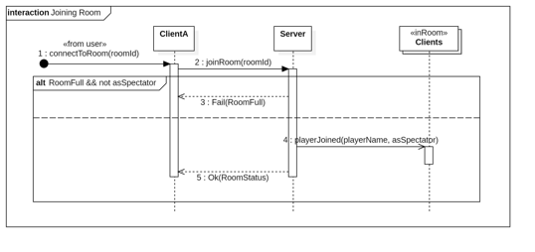
Network Programming – Protocol Design
Text or Binary ?
- Text is human readable
- Binary is shorter, faster & doesn't require parsing
Only send necessary data
Model your protocol
- Make programming easier
- Visual information is easier to understand

Slide 24
Resources
Where to look, and what to use ?

Slide 25
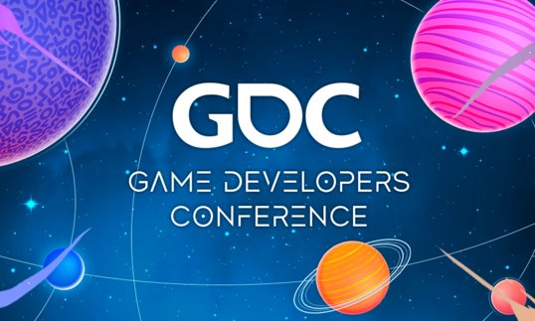
Research resources
List of curated articles
https://github.com/ThusSpokeNomad/GameNetworkingResources
- Gaffer on Games: What Every Programmer Needs To Know About Game Networking
- Ruoyu Sun: Game Networking Demystified
Quake3 engine writeup
https://fabiensanglard.net/quake3/index.php
GDC Conferences
- Overwatch Gameplay Architecture and Netcode (youtube)
- I Shot You First: Networking the Gameplay of Halo: Reach (youtube)
Talk about other architecture
- Bob Nystrom - Is There More to Game Architecture than ECS? (Youtube)

Slide 26
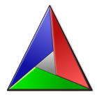



Tool of the trade
Dependency management
- Git submodules
- CMake (FetchPackage)
- Package managers (Conan, VCPkg)
CI/CD
- Docker (build/test environment)
- Github Actions
Good practice & sanity check
- Test Framework (Catch2, Criterion, Google tests, etc.)
- Linters/formatter (clang-tidy, etc.)
Documentation
- Dia, StarUML, Lucid Chart
- Doxygen, ReadTheDoc.io, Spinx, etc.

Slide 27
Questions ?
The bootstrap is all about software architecture.
Have fun on your project !

