Slide 1
CFD Modelling of a Structured Monolithic Reactor for Biodiesel Production
PRELIMINARY QUALIFICATION
Heterogeneous transesterification in a catalytic washcoat channel — model development, verification and regime analysis
CANDIDATE
ADVISORS
Gabriel Hernandez Rozo
Prof. Dr. Raphael Soeiro Suppino
Prof. Dr. Dirceu Noriler
School of Chemical Engineering · UNICAMP · November 2026
Notes:
Apresentação de andamento. A pesquisa está em curso: o modelo CFD está construído e verificado; os dados experimentais ainda não chegaram.

Slide 2
Why a monolithic reactor for biodiesel
1
Heterogeneous catalysis
Solid catalyst removes the soap formation and washing steps that burden homogeneous alkaline routes.
MODELLED CONFIGURATION
Channel
400 CPSI · Dh = 1.1 mm
2
Structured channels
Straight parallel channels give an ordered flow field and a negligible pressure drop.
Length
50 mm
Temperature
120 °C · 8 bar
3
Thin catalytic washcoat
Feed
triolein + methanol, 6:1 molar
Catalyst is coated on the channel wall — reaction becomes a surface process.
Catalyst
ZnAl₂O₄ washcoat, 20 µm
Flow
laminar, Re = 0.16
4
Open question
Monoliths are designed to defeat mass-transfer limits. Does this system actually have one?
Notes:
O monólito é escolhido para vencer limitação de transferência de massa. A pergunta no item 4 é a que este trabalho responde.

Slide 3
Objectives
PRIMARY OBJECTIVE
Build and verify a CFD model of heterogeneous transesterification in a monolith channel, and use it to identify the controlling regime
Hydrodynamics
Surface reaction
Verification
Validate the laminar velocity field against the analytical Poiseuille solution.
Implement the Allain (2015) kinetics as a wall species-flux boundary condition.
Check every link of the numerical chain against independent hand calculation.
Regime analysis
Design insight
Calibration
Determine whether kinetics or transport limits conversion.
Quantify what would be needed to reach a useful conversion.
Prepare the model to receive laboratory data.
Notes:
Os quatro primeiros objetivos estão cumpridos. Os dois últimos dependem dos dados de laboratório.

Slide 4
Model construction
Geometry · mesh · physics · kinetics

Slide 5
Numerical model
GEOMETRY
MESH
PHYSICS
Representative channel, pseudo-2D
50 × 1.1 mm, symmetry on side faces
Built parametrically in build123d
286 440 cells, trimmed + prism layers
10 prism layers on the catalytic wall
First cell 1.43 µm
Single-phase multicomponent liquid
Six species: TG, DG, MG, FAME, GL, MeOH
Laminar, segregated solver
KINETIC MODEL — Allain et al. (2015), Chem. Eng. J. 283:833
Three reversible second-order steps on a solid ZnAl₂O₄ catalyst
TG + MeOH ⇌ DG + FAME
DG + MeOH ⇌ MG + FAME
MG + MeOH ⇌ GL + FAME
rᵢ = kᵢ(T)·[ C_A·C_MeOH − (1/Kᵢ)·C_B·C_FAME ]
kᵢ(T) = kᵢ⁰ · exp(−Eaᵢ/RT)
Wall basis: r_wall = r_vol × ρ_washcoat × δ_washcoat
Notes:
Escolhemos o modelo clássico de 2ª ordem de Allain em vez do Eley-Rideal: ele ajusta melhor (LS 0,022 vs 0,044) com menos parâmetros.

Slide 6
Implementation as a wall boundary condition
The published kinetics are expressed per mass of catalyst; Star-CCM+ requires a flux per unit wall area. Sixteen chained field functions perform the conversion.
Cᵢ
kᵢ(T)
rᵢ,vol
rᵢ,wall
Jᵢ
→
→
→
→
concentrations
from ρ and Yᵢ
Arrhenius
rate constants
volumetric rate
mol/kg_cat·s
× ρ·δ washcoat
mol/m²·s
species flux
kg/m²·s
STOICHIOMETRIC WALL FLUXES
WASHCOAT CONVERSION FACTOR
TG = −0.8854 · r₁
DG = +0.6210 · (r₁ − r₂)
MG = +0.3570 · (r₂ − r₃)
MeOH = −0.0320 · (r₁ + r₂ + r₃)
FAME = +0.2970 · (r₁ + r₂ + r₃)
GL = +0.0920 · r₃
ρ_washcoat × δ_washcoat
= 1180 kg/m³ × 20 µm
= 0.0236 kg_cat / m²_wall
The result is strictly linear in this factor — it is also the least certain input in the model.
Notes:
A conversão de base — massa de catalisador para área de parede — é o elo que mais depende de dado experimental.

Slide 7
Verification and results
Hydrodynamics · reaction chain · mesh independence · regime

Slide 8
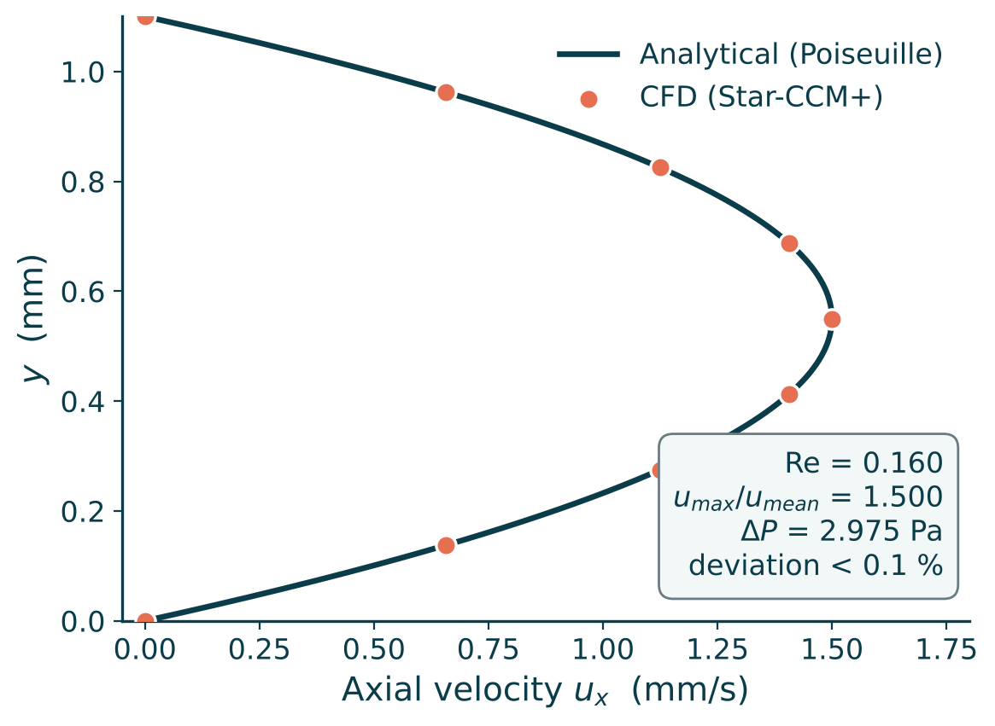
Phase 1 — hydrodynamics verified
The laminar field is reproduced exactly
Before enabling any chemistry, the cold-flow solution was checked against the closed-form Poiseuille result. Agreement is within 0.1 %.
Reynolds number
0.160
Stokes regime
u_max / u_mean
1.500
exact
Pressure drop
2.975 Pa
vs 8 bar operating
Entry length
8.8 µm
0.02 % of channel
Outlet velocity profile at x = L, against the analytical plane-channel solution
Notes:
Fase 1 valida a malha e o solver antes de introduzir qualquer química.

Slide 9
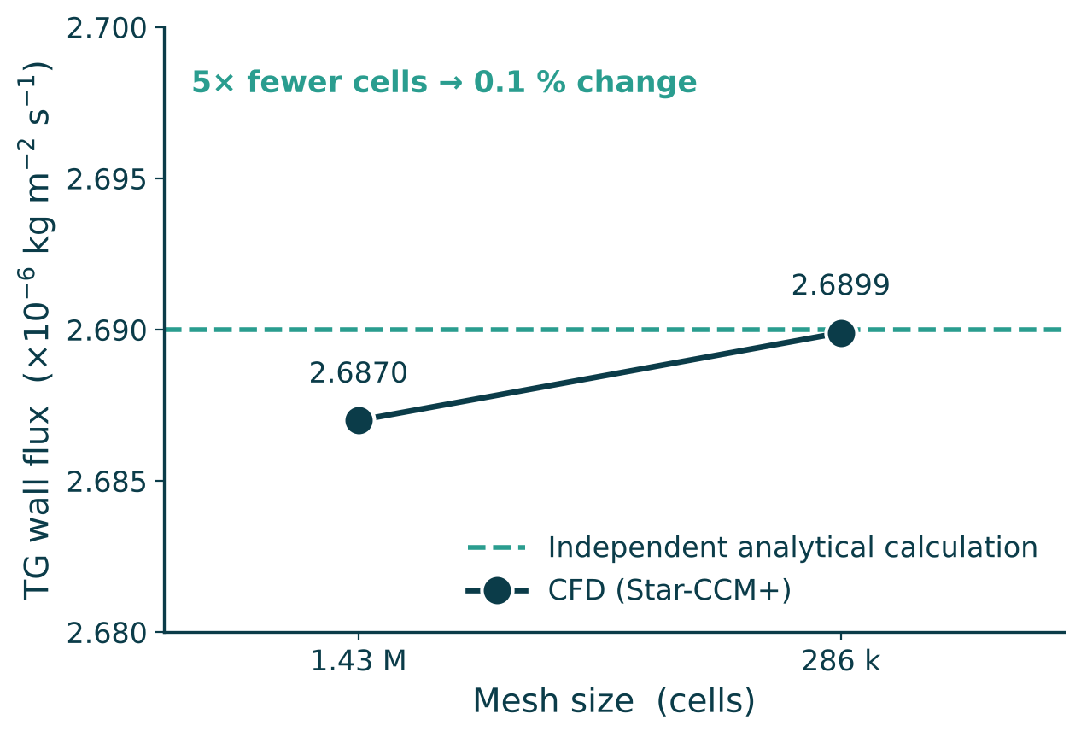
Phase 2 — every link verified against hand calculation
The wall flux computed by the solver was compared with the same quantity derived by hand from the published rate constants. This became the standard test of the project.
0.2 %
0.1 %
1.0000000
Flux agreement
Mesh independence
Mass closure
solver vs independent
analytical calculation
1.43 M → 286 k cells,
same wall flux
sum of the six outlet
mass fractions
WHY THIS MATTERED
The first converged-looking solution disagreed with hand calculation by a factor of 2338. That discrepancy exposed a diverging species solution whose results looked physically plausible — large radial gradients, a sharp boundary layer — but were numerical artefacts.
Notes:
Esta é a contribuição metodológica central: um teste independente que separa resultado de artefato.

Slide 10
What the verification caught
Issue | Detected by | Resolution
Inlet composition gave a 3.77:1 molar ratio, not the specified 6:1 | Stoichiometric check of the mass fractions | Corrected to Y_TG = 0.8218 / Y_MeOH = 0.1782
Species equations diverging — residuals reaching 10⁸ | TG consumed did not match products formed (45× gap) | Non-negative concentration clamps; flow frozen after convergence; transient marching
Boundary-layer thickness reported as 22 µm | Comparison with the Lévêque solution | 220 µm — an order of magnitude larger
Regime reported as mass-transfer limited | Damköhler number evaluation | Kinetically controlled, Da ≈ 0.003
A plausible-looking CFD result is not evidence. Four of the six findings originally reported were artefacts of a solution that had converged in appearance only. All were caught by one independent calculation.
Notes:
Reportar os erros encontrados é parte do resultado — mostra que o trabalho tem controle de qualidade, não sorte.

Slide 11
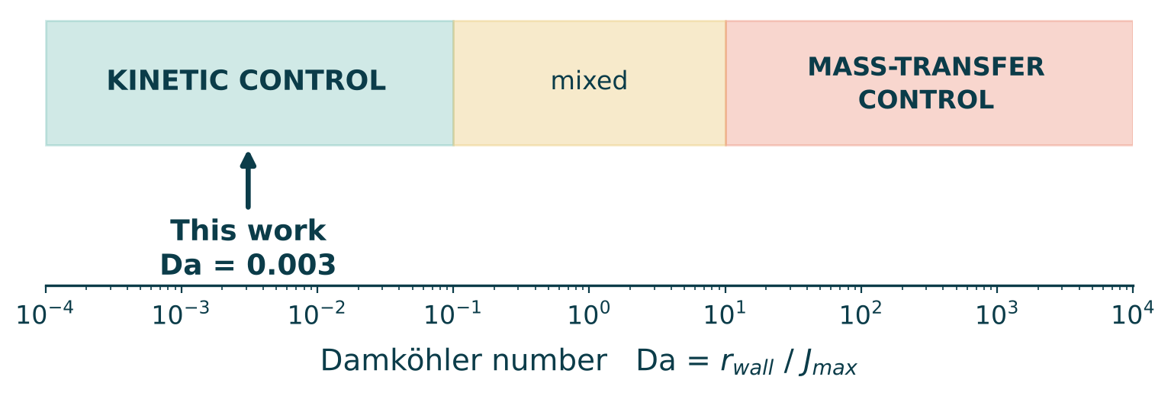
The controlling regime is kinetic, not transport
Da = r_wall / J_max = 3.04×10⁻⁶ / 9.85×10⁻⁴ = 0.003
A HIGH SCHMIDT NUMBER IS NOT A LIMITATION
The catalytic wall receives roughly 300 times more triglyceride than it can consume. Surface concentration is essentially the bulk value.
Sc ≈ 59 000 means the concentration boundary layer is thin — not that transport is the bottleneck. The Damköhler number decides that. Conflating the two produced the error in the earlier analysis.
Notes:
Distinção conceitual central do trabalho: Schmidt alto diz que a camada é fina; Damköhler diz quem limita.

Slide 12
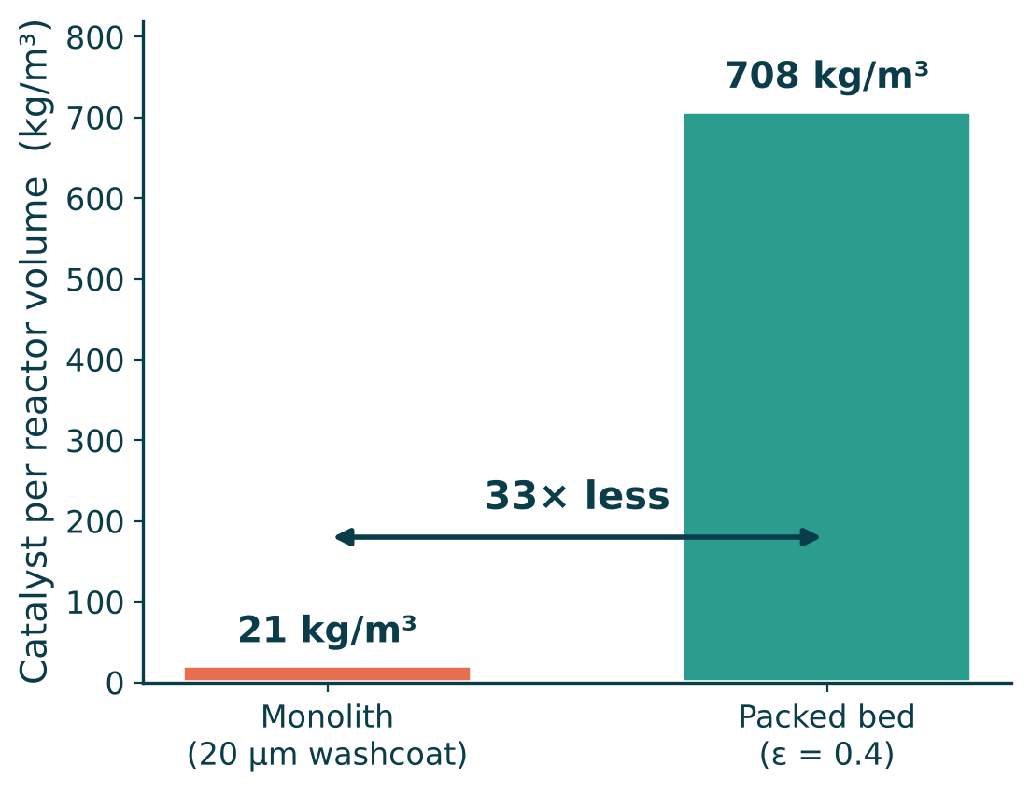
Predicted conversion and why it is so low
X = r₁ · W / F_TG — three multiplying factors
0.017 %
1
Slow kinetics at 120 °C
k₁ is 16.5× smaller than at 185 °C; 120 °C is below the source's range.
TG conversion per pass
2
Low catalyst inventory
120 °C · 50 mm · 6:1 · 1 mm/s
A 20 µm washcoat gives 21 kg/m³ — 33× less than a packed bed.
3
Short contact time
τ = L/u = 50 s in a single pass.
DESIGN IMPLICATION
A monolith exists to overcome mass-transfer limitation — straight channels, negligible pressure drop, a thin boundary layer. With Da ≈ 0.003 transport is not the bottleneck, so none of that is being used, while the geometry's one real cost is paid in full.
The geometry is optimised for a regime this system is not in.
Notes:
Não é um resultado negativo: é uma conclusão de engenharia quantificada, que só a simulação entrega antes do experimento.

Slide 13
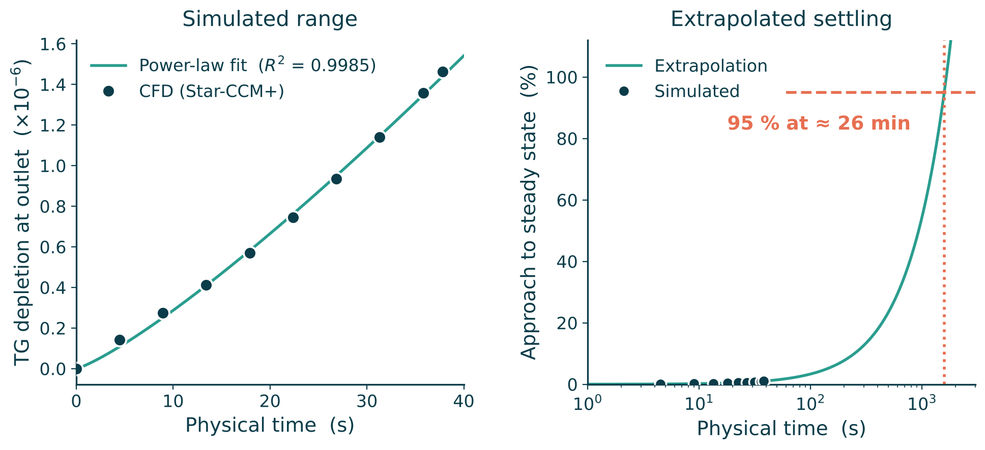
A practical finding for the experimental campaign
≈ 30 min
to reach steady state
Despite a residence time of only 50 s — about 32 residence times.
Samples drawn earlier will understate the conversion.
Outlet depletion of TG during start-up, and its extrapolation to steady state
WHY SO SLOW
Triglyceride is depleted exactly where the velocity vanishes, and its diffusivity (1.3×10⁻¹⁰ m²/s) is far too low to carry it into the fast-moving core. Fluid 10 µm from the wall needs 926 s to traverse the channel; at 5 µm, 1840 s. The controlling time scale is near-wall transit, not the mean residence time.
Notes:
Recomendação concreta para os alunos de IC: curva de partida com amostras em 5, 10, 20, 30 e 45 min. Valida o transiente e evita dados fora de regime.

Slide 14
The open question
Firth (2014), University of Bath
This model, ZnAl₂O₄ kinetics
> 90 %
0.017 %
conversion in a monolith at 120 °C with an SrO washcoat
conversion per pass at the same nominal temperature
Nearly four orders of magnitude apart — three candidate explanations
Catalyst activity
Recirculation
Catalyst loading
SrO is a strong base; the ZnAl₂O₄ study required 140–220 °C, while Firth operated at 120 °C.
If the charge passes the monolith repeatedly over hours, a minute per-pass conversion is consistent with 90 % accumulated.
The real washcoat may hold considerably more catalyst than the 20 µm assumed here.
If recirculation is the answer, the structure becomes elegant: CFD supplies the per-pass conversion, a batch balance supplies the hours-long curve.
Notes:
Esta pergunta só apareceu porque a simulação funciona e dá um número. É a pergunta certa para levar aos orientadores.

Slide 15
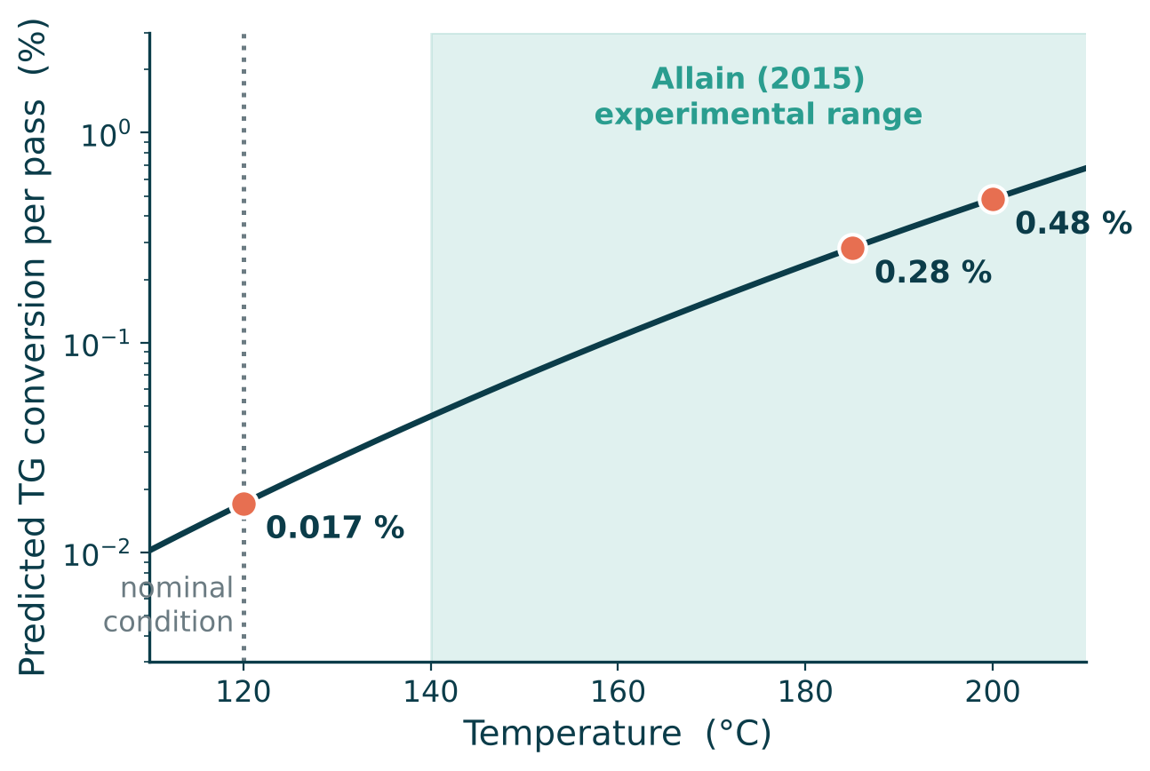
Ready for calibration
Because Da ≪ 1, the reactor is differential and conversion scales linearly
X_TG ∝ k(T) · ρ · δ · L / u
Any new parameter set can therefore be evaluated before running CFD — the simulation then confirms a few points rather than sweeping the whole space.
DATA STILL REQUIRED, BY IMPACT
Catalyst and kinetic source
10–1000×
Single pass or recirculation
10–100×
Washcoat loading
linear
Predicted conversion against temperature, from the validated reference point
Flow rate and bed length
linear
Fluid properties ρ, µ, D
negligible
Because the regime is kinetic, fluid properties barely move the answer — the characterisation effort belongs on the first three rows.
Notes:
A lei de escala é o que torna a calibração barata: prevê-se antes, confirma-se depois.

Slide 16
Work plan
Model construction
Complete
Geometry, mesh, kinetics implementation
Verification
Complete
Independent checks, mesh independence, regime analysis
Laboratory data
In progress
Kinetics and conversion from the undergraduate team
Calibration
Next
Fit the model to measured conditions and compare
Parametric study
Planned
Temperature, residence time, molar ratio, washcoat
Dissertation
Planned
Writing and defence
Notes:
O modelo está pronto e verificado. O caminho crítico agora é o dado experimental.

Slide 17
Summary
1
A verified CFD model
Hydrodynamics within 0.1 % of the analytical solution; reaction chain within 0.2 % of independent calculation; mesh independence demonstrated.
2
The regime is kinetic
Da ≈ 0.003. The catalytic wall receives about 300× more reactant than it consumes — transport is not the bottleneck.
3
Conversion is set by catalyst inventory
A 20 µm washcoat holds 33× less catalyst per reactor volume than a packed bed; the monolith's advantage is not being used.
4
An operational prediction
Steady state takes roughly 30 minutes, not the 50 s residence time — relevant to how the experiment is sampled.
5
A question for the advisors
Four orders of magnitude separate this model from Firth (2014). Catalyst identity and recirculation would resolve it.

Slide 18
Thank you
Questions and suggestions are welcome
Gabriel Hernandez Rozo · ghrozo97@gmail.com
Advisors: Prof. Dr. Raphael Soeiro Suppino · Prof. Dr. Dirceu Noriler

Slide 19
References
Allain, F. et al. (2015)
Estimation of kinetic parameters and diffusion coefficients for the transesterification of triolein with methanol on a solid ZnAl₂O₄ catalyst. Chem. Eng. J. 283:833–845.
Kinetic model and diffusion coefficients used throughout
Firth, B. (2014)
Biodiesel Production in Fixed-Bed Monolithic Reactors. PhD thesis, University of Bath.
Geometry, operating conditions and the > 90 % benchmark
Noureddini, H.; Zhu, D. (1997)
Kinetics of transesterification of soybean oil. JAOCS 74:1457–1463.
Mechanistic foundation of the stepwise scheme
Ezzati, R. et al. (2021)
Kinetics models of transesterification reaction for biodiesel production. Renew. Energy 168:280–296.
Comparative framework for rate models
Omranpour, S.; Larimi, A. (2024)
Modeling and simulation of biodiesel synthesis in fixed bed and packed bed membrane reactors. Sci. Rep. 14:10153.
CFD benchmark for heterogeneous biodiesel reactors

