Slide 1

NumPy: Tips & Tricks
Gabriel Cabrera & Lucas Charpentier

Slide 2
Lists
Advantages:
Dynamic size
Irregular Shapes Allowed
Built Into Python
Multiple Types Allowed
Disadvantages:
Slow
No Vector Operations

Slide 3
NumPy Arrays
Advantages:
Speed comparable to low-level languages
Vector & Matrix Operations
Fancy Indexing
Disadvantages:
Steep Learning Curve
Fixed Array Size
Only Regular Shaped Arrays
Imported

Slide 4
Review of the Basics [0]
Declaring an array:
import numpy as np
arr = np.array(object = [1,2,3,4,5], dtype = np.int64)
Generally:
np.array(object, dtype)
list, tuple, or array
element type (optional)

Slide 5
Review of the Basics [1]
Extracting an element by index:
import numpy as np
arr = np.array(object = [1,2,3,4,5])
arr_element = arr[2]
Extracting multiple elements by a list of indices:
import numpy as np
arr = np.array(object = [1,2,3,4,5])
arr_elements = arr[[0,2,3]]
array with elements: [1,3,4]

Slide 6
Review of the Basics [2]
Slice objects represent sequences of indices with constant step size:
start, stop, step = 0, 5, 1
s = slice(start, stop, step)
Can be used implicitly or explicitly when calling array indices:
import numpy as np
arr = np.array([1,2,3,4,5])
s = slice(1, 4, 1)
arr_element = arr[s] # explicit
arr_element = arr[1:4:1] # implicit equivalent

Slide 7
Review of the Basics [3]
2-D Array Example:
import numpy as np
mat = np.array([[1,2,3,4,5],[6,7,8,9,10]])
Description | Matrix Element | Matrix Row | Matrix Sub-Row | Matrix Column
Input | mat[1,3] | mat[0] | mat[1,1:4] | mat[:,2]
Output | 9 | [1 2 3 4 5] | [7 8 9] | [3 8]

Slide 8
Review of the Basics [4]
Element-Wise Mathematical Operations:
import numpy as np
arr_1 = np.array([1,2,3,4,5])
arr_2 = np.array([5,4,3,2,1])
arr_sum = arr_1 + arr_2 # [6 6 6 6 6]
arr_difference = arr_1 - arr_2 # [-4 -2 0 2 4]
arr_product = arr_1 * arr_2 # [5 8 9 8 5]
arr_quotient = arr_1 / arr_2 # [0.2 0.5 1. 2. 5. ]
arr_exponent = arr_1 ** arr_2 # [ 1 16 27 16 5]

Slide 9
Review of the Basics [5]
Reshaping Arrays:
import numpy as np
arr = np.array([1,2,3,4,5,6])
arr_reshaped = np.reshape(arr, (2,3)) # [[1 2 3]
# [4 5 6]]

Slide 10
Review of the Basics [6]
Concatenation:
import numpy as np
arr_1 = np.array([1,2,3])
arr_2 = np.array([4,5,6])
arr_concat = np.concatenate([arr_1, arr_2]) # [1 2 3 4 5 6]
arr_hstack = np.hstack([arr_1, arr_2]) # [1 2 3 4 5 6]
arr_vstack = np.vstack([arr_1, arr_2]) # [[1 2 3]
# [4 5 6]]

Slide 11
Array Datatypes
NumPy type | C type | Description
np.int8 | int8_t | Byte (-128 to 127)
np.int16 | int16_t | Integer (-32768 to 32767)
np.int32 | int32_t | Integer (-2147483648 to 2147483647)
np.int64 | int64_t | Integer (-9223372036854775808 to 9223372036854775807)
np.uint8 | uint8_t | Unsigned integer (0 to 255)
np.uint16 | uint16_t | Unsigned integer (0 to 65535)
np.uint32 | uint32_t | Unsigned integer (0 to 4294967295)
np.uint64 | uint64_t | Unsigned integer (0 to 18446744073709551615)
np.intp | intptr_t | Integer used for indexing, typically the same as ssize_t
np.uintp | uintptr_t | Integer large enough to hold a pointer
np.float32 | float
np.float64 / np.float_ | double | Note that this matches the precision of the builtin python float.
np.complex64 | float complex | Complex number, represented by two 32-bit floats (real and imaginary components)
np.complex128 / np.complex_ | double complex | Note that this matches the precision of the builtin python complex.
Selecting a dtype can be very important in some cases.
On the left, we have listed some of the available datatypes.
Source: https://docs.scipy.org/doc/numpy/user/basics.types.html

Slide 12
Linear Algebra [0]
Vector Operations:
import numpy as np
arr_1 = np.array([1,2,3,4,5])
arr_2 = np.array([5,4,3,2,1])
arr_dot = np.dot(arr_1, arr_2) # 35
arr_inner = np.inner(arr_1, arr_2) # 35
# [[ 5 4 3 2 1]
# [10 8 6 4 2]
arr_outer = np.outer(arr_1, arr_2) # [15 12 9 6 3]
# [20 16 12 8 4]
# [25 20 15 10 5]]

Slide 13
Linear Algebra [1]
Matrix Operations Part I:
import numpy as np
arr_1 = np.array([[1,2],[3,4]])
arr_2 = np.array([[5,6],[7,8]])
arr_inner = np.inner(arr_1, arr_2) # [[17 23]
# [39 53]]
# [[ 5 6 7 8]
arr_outer = np.outer(arr_1, arr_2) # [10 12 14 16]
# [15 18 21 24]
# [20 24 28 32]]

Slide 14
Linear Algebra [2]
Matrix Operations Part II:
import numpy.linalg as linalg
import numpy as np
arr = np.array([[1,2,3],[4,5,6],[7,8,9]])
eigvals, eigvecs = linalg.eig(arr) # For square arrays
eigvals = linalg.eigvals(arr) # For general arrays

Slide 15
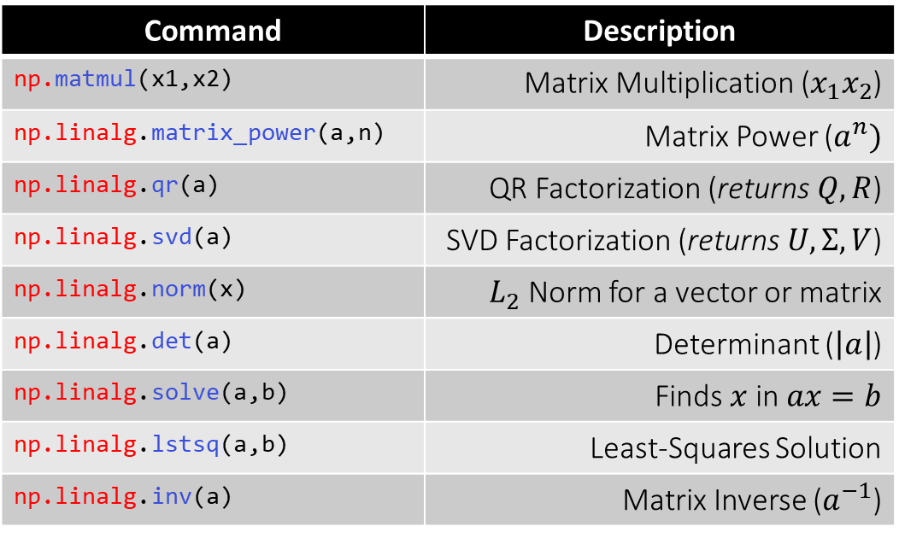
Linear Algebra [3]
Matrix Operations Part III – Some useful commands
Command | Description
np.matmul(x1,x2) | Matrix Multiplication ($x_{1}x_{2}$)
np.linalg.matrix_power(a,n) | Matrix Power ($a^{n})$
np.linalg.qr(a) | QR Factorization (returns $Q, R$)
np.linalg.svd(a) | SVD Factorization (returns $U, Σ, V$)
np.linalg.norm(x) | $L_{2}$ Norm for a vector or matrix
np.linalg.det(a) | Determinant ($\left|a\right|$)
np.linalg.solve(a,b) | Finds $x$ in $ax=b$
np.linalg.lstsq(a,b) | Least-Squares Solution
np.linalg.inv(a) | Matrix Inverse ($a^{−1}$)

Slide 16
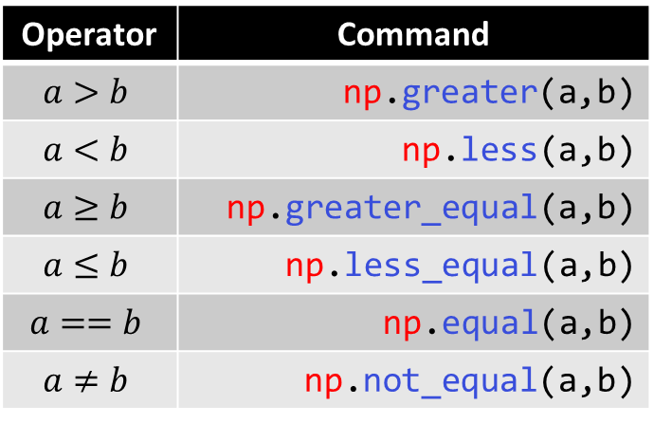
Logic [0]
Element-Wise Comparators
Element-Wise Boolean Operators
Operator | Command
$$a>b$$ | np.greater(a,b)
$$a<b$$ | np.less(a,b)
$$a≥b$$ | np.greater_equal(a,b)
$$a≤b$$ | np.less_equal(a,b)
$$a==b$$ | np.equal(a,b)
$$a≠b$$ | np.not_equal(a,b)
Operator | Command
not a | np.logical_not(a,b)
a and b | np.logical_and(a,b)
a or b | np.logical_or(a,b)
a xor b | np.logical_xor(a,b)

Slide 17
Logic [1]
Checking array equivalence:
Using np.array_equal(a,b) returns True if a and b have the same shape and elements
Using np.array_equiv(a,b) returns True if a and b are broadcastable
Broadcasting:
“Subject to certain constraints, the smaller array is “broadcast” across the larger array so that they have compatible shapes.”
Source – https://docs.scipy.org/doc/numpy-1.13.0/user/basics.broadcasting.html

Slide 18
Statistics
Some useful commands:
Command | Description
np.mean(a) | Mean
np.std(a) | Standard Deviation
np.var(a) | Variance
np.nanmean(a) | Mean of Finite Elements
np.nanstd(a) | Standard Deviation of Finite Elements
np.nanvar(a) | Variance of Finite Elements

Slide 19
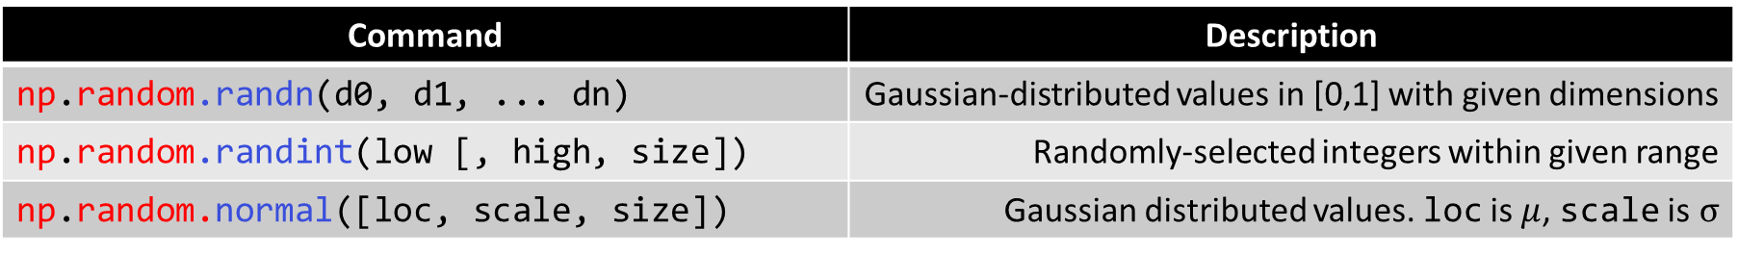
Random Number Generation
Some useful commands:
Command | Description
np.random.randn(d0, d1, ... dn) | Gaussian-distributed values in [0,1] with given dimensions
np.random.randint(low [, high, size]) | Randomly-selected integers within given range
np.random.normal([loc, scale, size]) | Gaussian distributed values. loc is $μ$, scale is$σ$

Slide 20
Other Useful Commands [0]
Array Generators:
Command | Description
np.linspace(start, stop, num=50) | Set of num equidistant elements from start to stop
np.arange([start,] stop, [step]) | Equidistant values from start to stop with given step
np.zeros(shape) | Array of zeros with dimensions given by shape
np.ones(shape) | Array of ones with dimensions given by shape
np.zeros_like(a) | Array of zeros with same shape as a
np.ones_like(a) | Array of ones with same shape as a

Slide 21
Other Useful Commands [1]
Meshgrid:
import numpy as np
vals = np.arange(0,4,1)
X,Y = np.meshgrid(vals, vals)
Values of X and Y:
X: [[0 1 2 3]
[0 1 2 3]
[0 1 2 3]
[0 1 2 3]]
Y: [[0 0 0 0]
[1 1 1 1]
[2 2 2 2]
[3 3 3 3]]

