Slide 1
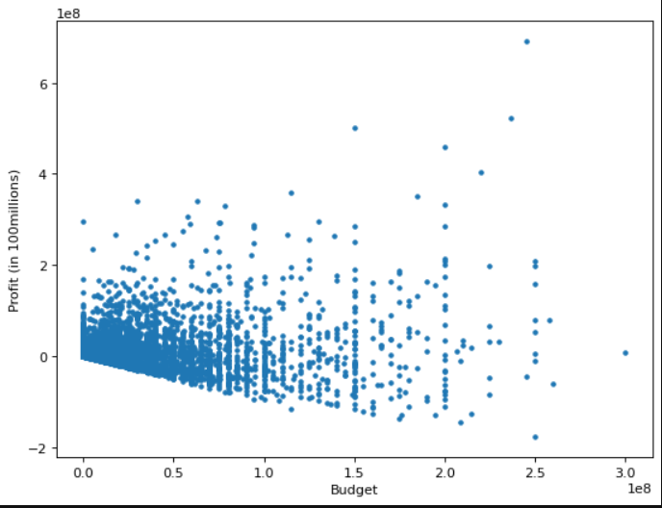
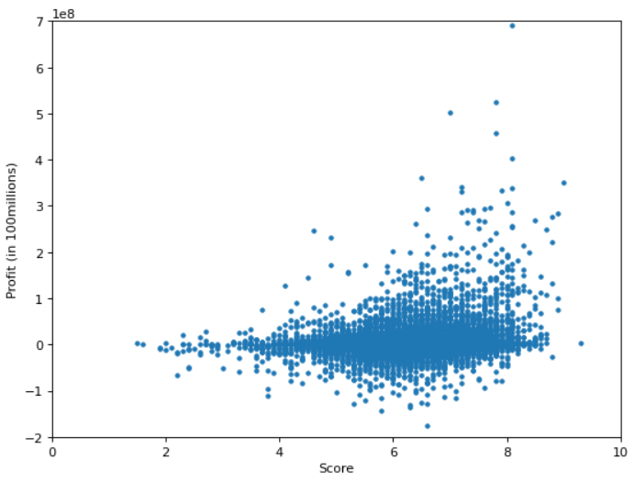
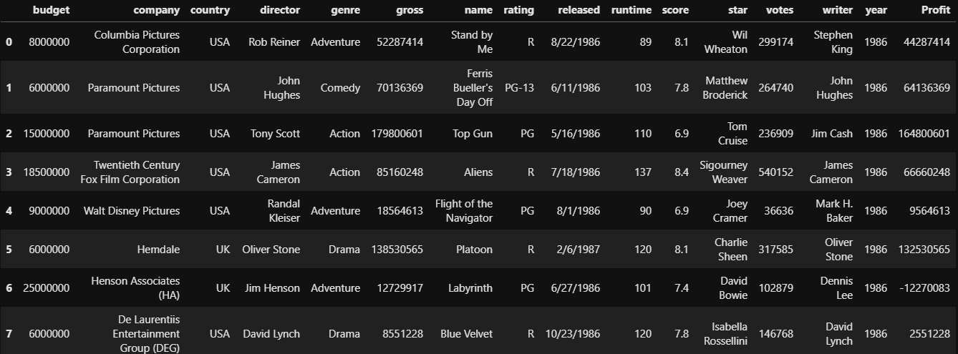
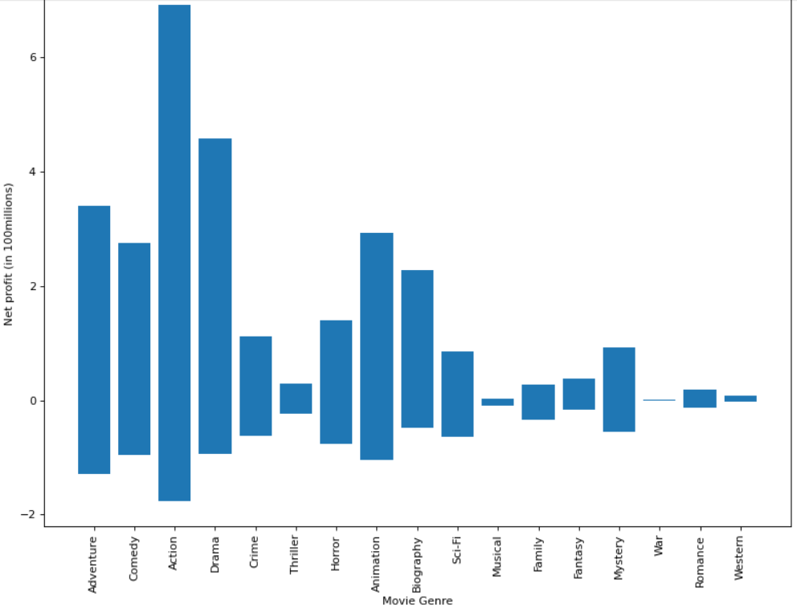
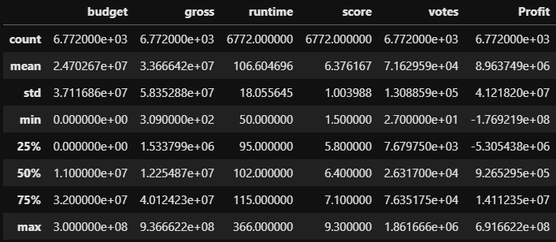
Machine Learning – Movie Success Prediction
Gabriel Solomon Holland
The goal of this was to see if I can predict how profitable a movie would be based on the score it received and the budget, essentially, can you buy a profitable movie?
Initial Graphs show little correlation between budget and profit, score and profit, and genre and profit. (See to the right).
Linear Regression only scored a 51% accuracy with predicting profit based on budget
Had a bias of 5.7 million.
Overall not bad, considering how ambiguous the correlations were, 50% isn’t good but for what we were using, not bad.
Clustering could only manage to split it into 2 clusters no matter what I did, clustering couldn’t handle this dataset and got me nowhere.
Clustering was not only unable to properly cluster the data, it was unable to make any predictions
A Tree classifier worked best. It was able to predict profit with 65% accuracy using score and budget yet when feeding score and runtime into the same classifier it completely broke it.
Probably our best bet, 65% is ultimately not great and is in no way a reliable predictor but considering how impossible my project was, I think 65% is amazing.
An SVC classifier worked well on score and runtime with a shocking 80% accuracy, yet I believe this is due to an error because score and budget completely broke the SVC, winding up with a .2% accuracy with 950% precision.
SVC managed to, with 80% accuracy, predict the profit of a movie based on the score and the runtime. That is so weirdly out of place that I don’t think this is a reliable predictor. The fact that runtime has such a monumental effect on the classification just doesn’t seem possible. Most movies fall within the same 1.5-2 hour runtime mark and I don’t think it’s possible to, within 30 minutes, help determine how profitable a movie will be, especially when disregarding the original theory of this project.
Pipeline learning gave us an embarrassing 18% accuracy, and the larger the training set the lower the accuracy. Not remotely usable
Ensemble and Neural Nets refused to run in a reasonable time
running at 1% training set the Ensemble and NN were unable to run. I think both of these would get a 70% or above accuracy because ensemble would implement our 65% tree classifier and more, which surely would give us >70%. Neural Nets seem to solve every problem so I really wanted to see what it could do
Raw Data:
Cleaned Data Description
Realistically you cannot predict how profitable a movie will be. Movies follow very few trends on the financials of a movie versus how popular it will be. There are movies that make millions and movies that lose millions with similar budgets and scores. A tree classifier was able to get a 65% accuracy with predictions, which is impressive and probably the closest we’ll get to an answer. 65% isn’t good enough to make full predictions on but for a general range of movies it gives us an idea of where it will probably land. There are too many outliers in the data to make a good prediction.
Budget vs Profit
Score vs Profit
Used a spreadsheet of 6772 movies off Kaggle. Cleaned the data by removing non-numeric data such as the writer, star actor, director, etc. Using clustering, linear regression, pipeline, and ensemble learning I tried to predict the profit of a movie using the budget and score.
Genre vs Profit
Kaggle.com for datasets, Jupyter Lab for IDE, Sklearn from Python Libraries for machine learning tools.
Full Code Here:
https://github.com/GabrielSolomonHolland/GSH-Machine-Learning-Project

