Slide 1
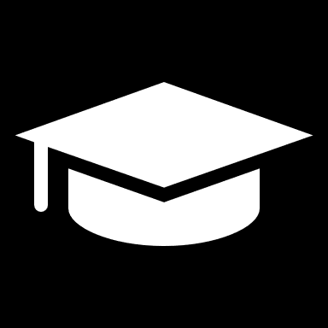
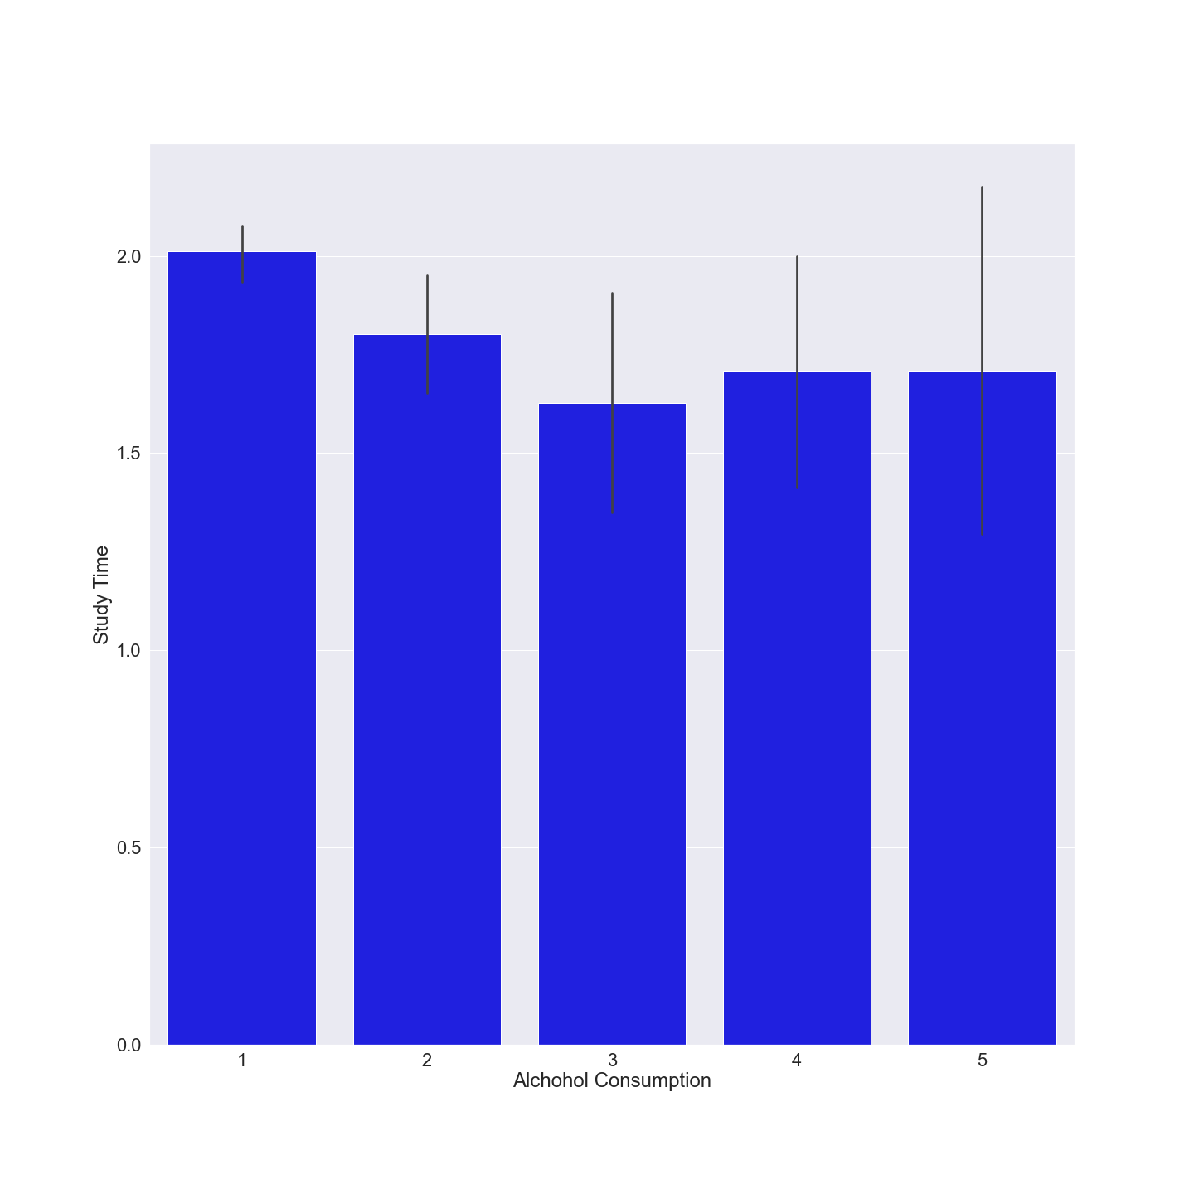
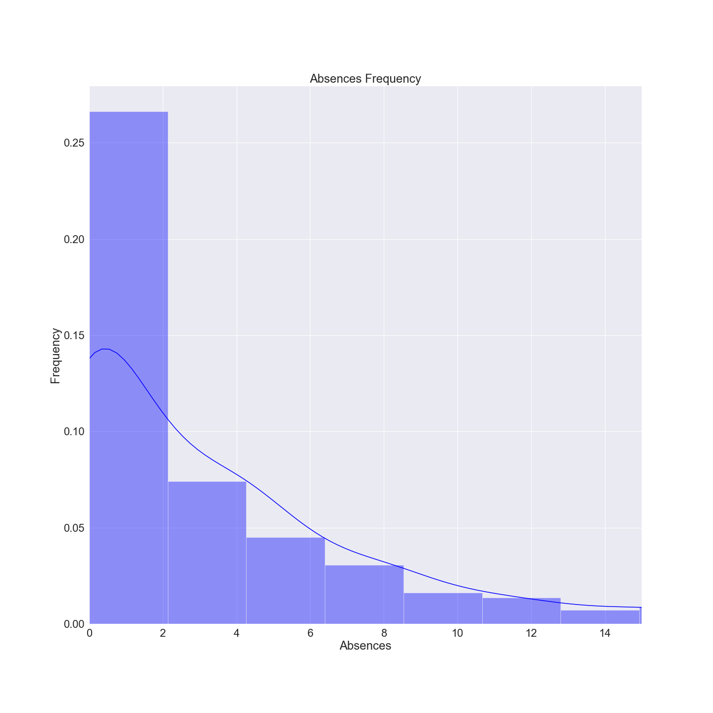
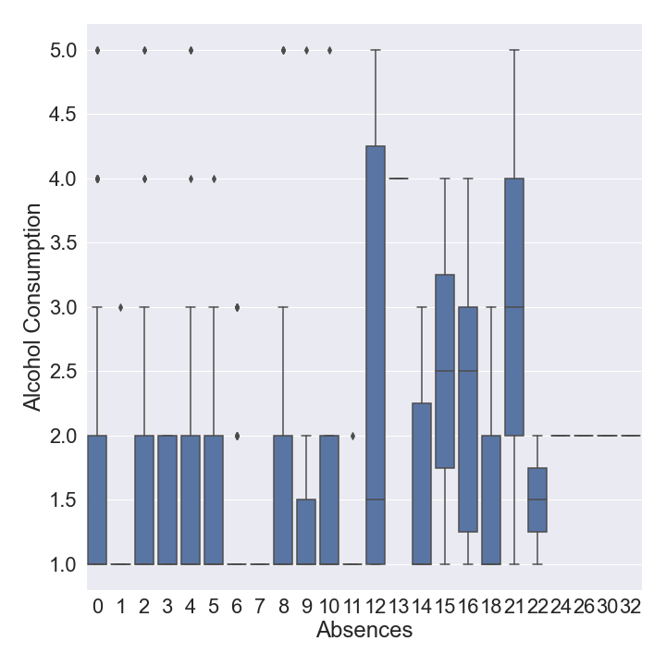
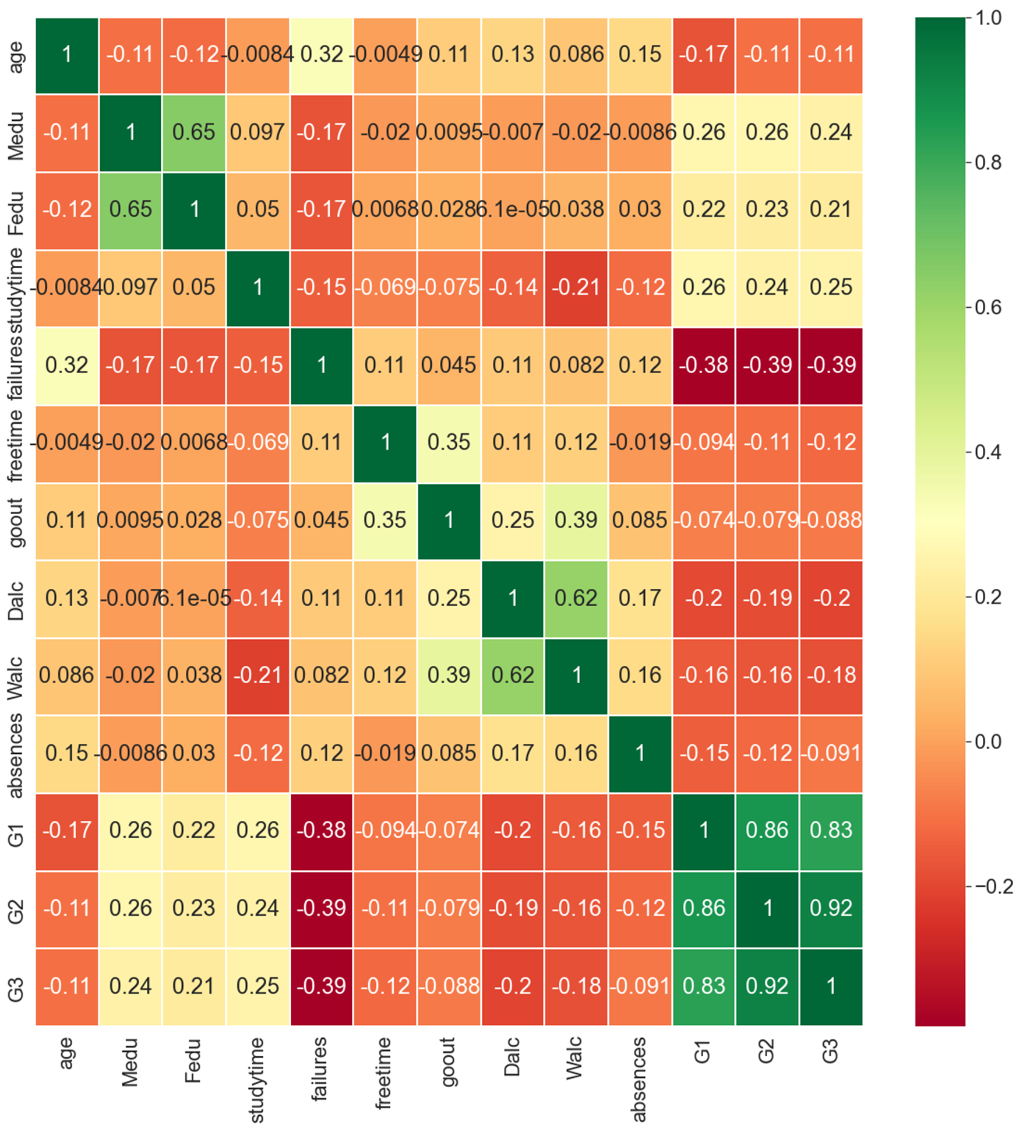
Alcohol Consumption and Absences Effect on Student Failures
Gabriel Solomon Holland
Nathan Eloe, NWMSU
Introduction
Results
Conclusion
Dataset was a collected at a High School in Portugal
Goal was to find potential causes of a student’s success or failure
Target features were alcohol consumption and absences
One foreseen issue: many of the features were self reported scales 1-5 which result in inconsistent data
Barely any trends/correlations in the dataset
Initial hypothesis disproven in absences vs alcohol consumption box plot, across higher levels of absences alcohol consumption becomes more diverse but not bigger.
Correlation matrix shows that there are no immediate correlations between failures and any features
Machine learning algorithms achieved an 85% accuracy in predicting failure regardless of features used. Upon further analysis the model guessed 0-2 failures every single time, which made up ~85% of the dataset. It guessed the statistically most likely answer every time.
I was unable to successfully predict a failure rate of students using this dataset.
Possible reason for failure: self reported data, certain numbers could be exaggerated or understated. The scale of numbers was not clear
Materials/Methods
Jupyter Notebook
Matplotlib Python Library
Seaborn Python Library
Scikit-Learn Python Library
Kaggle.com
Sources
Acknowledgements
Further Information
Scikit-Learn: https://scikit-learn.org/stable/
Seaborn: https://seaborn.pydata.org/
Matplotlib: https://matplotlib.org/
Kaggle: https://www.kaggle.com/uciml/student-alcohol-consumption
Special thanks to Nathan Eloe
https://github.com/GabrielSolomonHolland/data-science-final

