Slide 1
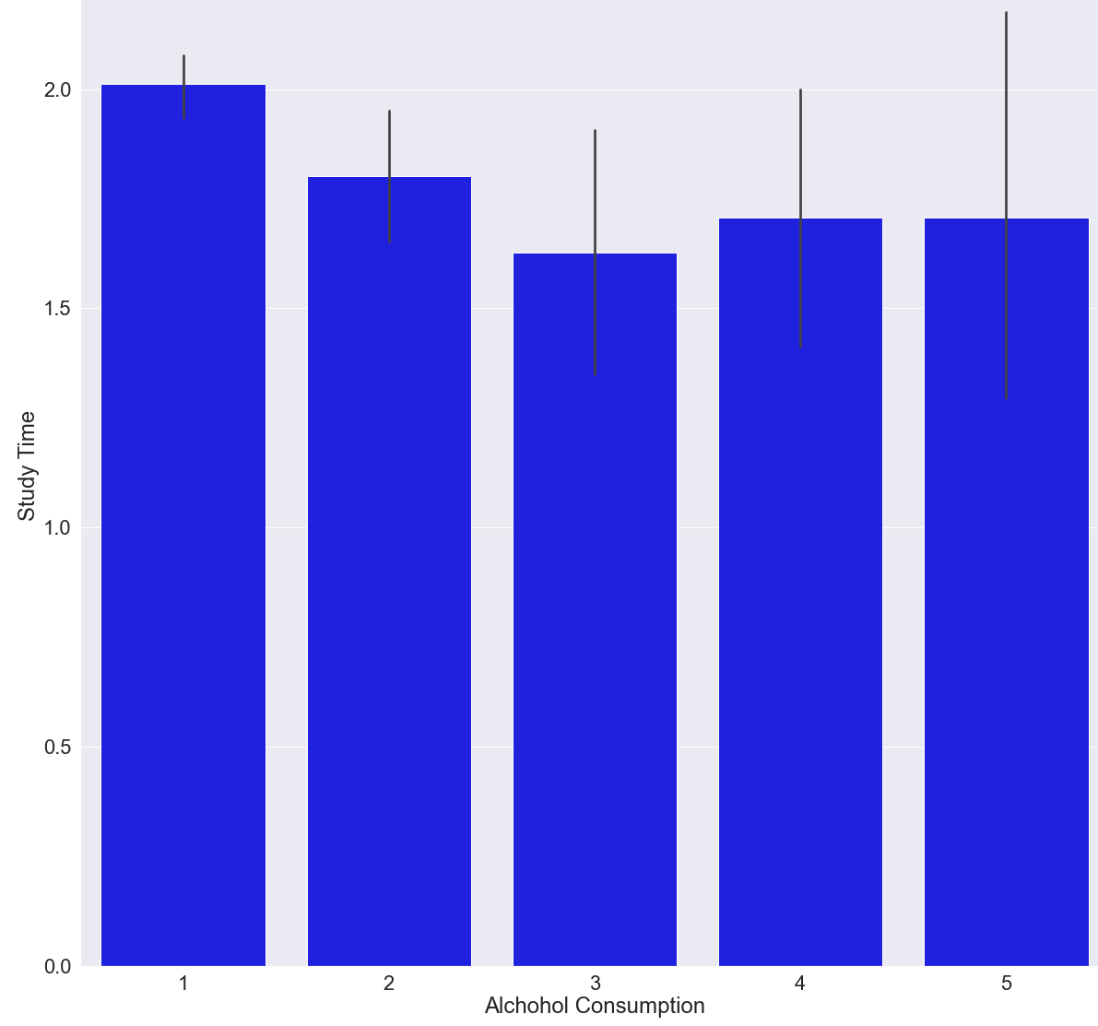
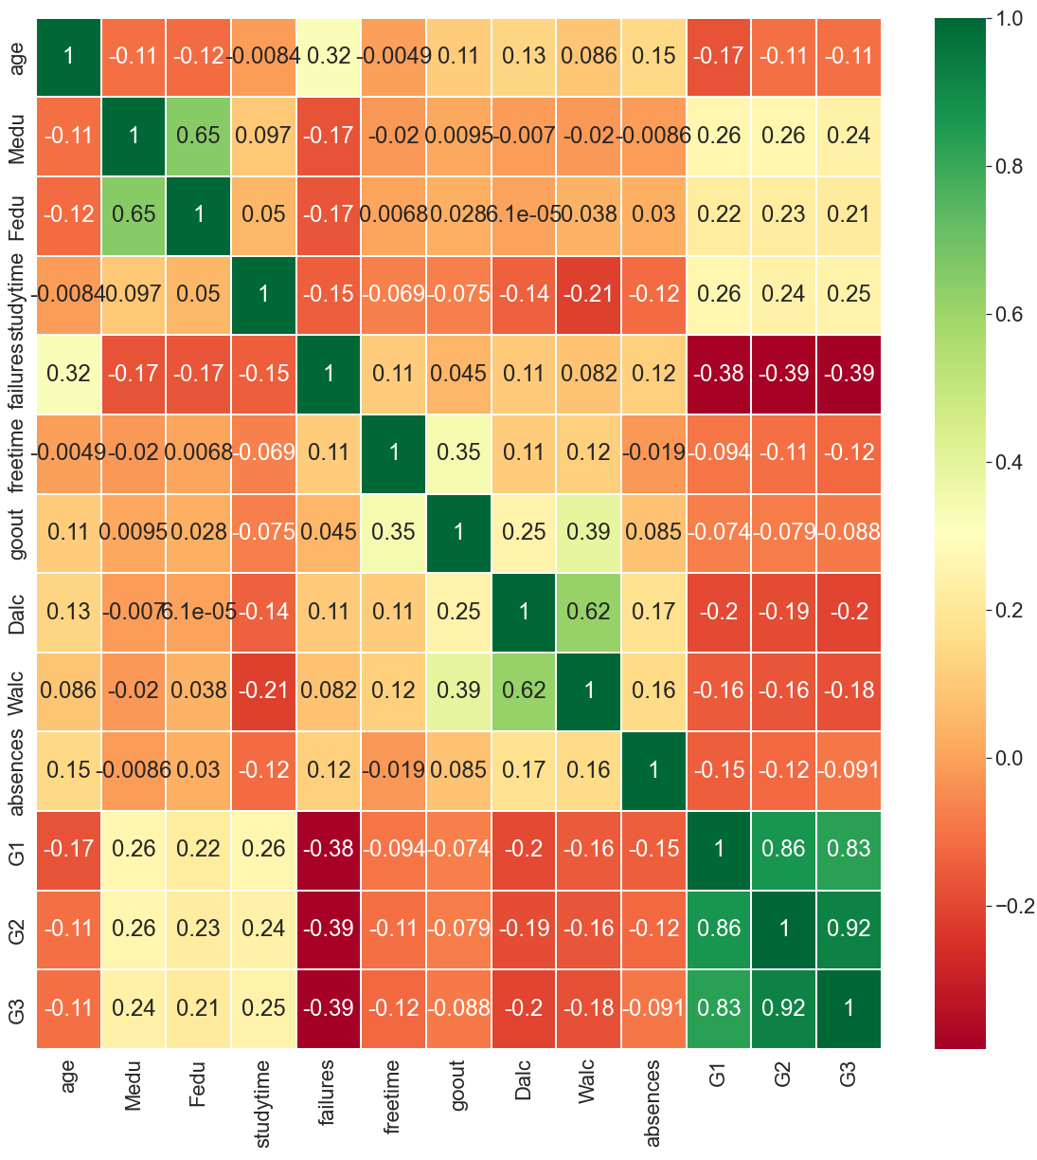
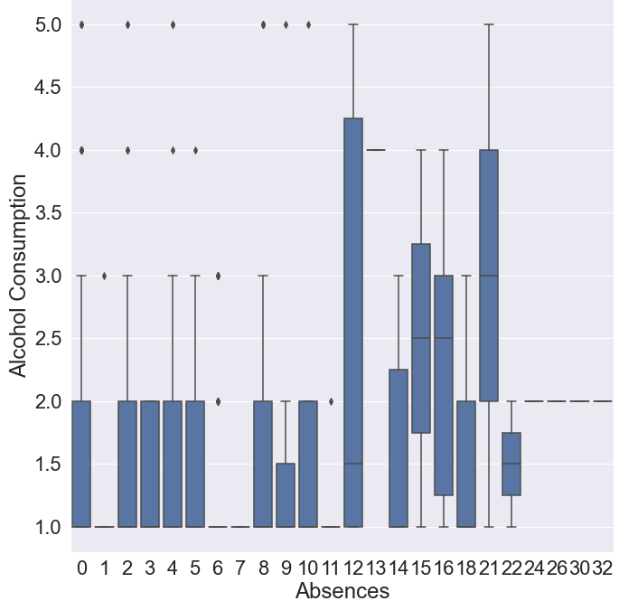
Alcohol Consumption and Absences Effect on Student Failures
Gabriel Solomon Holland
Dr. Nathan Eloe, Northwest Missouri State University
I acquired a dataset published from a Portuguese high school that acquired data regarding that student’s attendance, their trimester grades, how many classes they failed, and how much alcohol they consumed. It further cataloged personal information such as age, sex, parental education, and more. My goal is to see if, using alcohol consumption and absences, if I can predict if a student can fail. Many of these features are self reported scales 1-5, resulting in slightly inconsistent data which may explain my results.
Graphs
Left: Alcohol Consumption vs Study Time
Bot. Left: Absences vs Alcohol Consumption
Bot. Right: Correlation Matrix
This project surprised me in countless ways. I expected there to be distinct correlations between data. Things like alcohol consumption vs study time but as shown, the trend is barely noticeable. That was a common theme across my data: the seemingly obvious correlations simply don’t exist.
The principle of my hypothesis was disproven by the absences vs alcohol consumption box chart, showing that across higher levels of absences the levels of alcohol consumption becomes more diverse, but doesn’t get decisively bigger. The correlation matrix also proves that there is very little correlation amongst this data.
Looking at the correlations I decided to use a few machine learning algorithms to see if accounting for more features at a time would result in better predictions. The algorithms consistently scored with 85% accuracy for correctly identifying how often a student would fail using absences and alcohol consumption. Further imploring how they achieved such results I realized that they guessed 0-2 failed classes every single time, and 0-2 made up 85% of the dataset. They could not predict failures; they just guessed the most common answer every time. Their failure further confirmed my theory that this dataset cannot predict if a student will fail.
These lackluster results may be because many of the features were self reported. The alcohol consumption was collected by a survey to the students. Students exaggerating or understating certain results could explain the unreliability of my conclusions.
Jupyter Notebook
Matplotlib python library
Seaborn python library
Scikit-Learn python library
Seaborn and Matplotlib for graphs and charts, Scikit-learn for variety of machine learning algorithms. Jupyter notebooks are an environment to program in python
Scikit-Learn: https://scikit-learn.org/stable/
Seaborn: https://seaborn.pydata.org/
Matplotlib: https://matplotlib.org/
Special thanks to Dr. Eloe
https://github.com/GabrielSolomonHolland/data-science-final
All graphs and charts are available on github

